Slide 1
Sleep Stage Classification Using Deep Learning
(BIO3609) Biomedical Signal Processing
Team 9
ليان عمرو – رقية مختار – هيا غراب

Slide 2
Problem Statement
Sleep staging is important in diagnosing diseases that are linked to cardiovascular diseases and fatigue.
The standard method uses polysomnography that includes EEG, ECG, EOG, and EMG signals.
The problem is that it is expensive, uncomfortable, and not practical for long-term monitoring.
Deep learning models can be built to automate the classification process.

Slide 3
Project Idea
“Can we classify sleep stages using ECG signals only?”
ECG signals are easy to measure and can be made into wearable devices that could enable home monitoring.
It would classify the stages into 4 classes:
Wake
Light sleep (N1+N2)
Deep sleep (N3)
REM

Slide 4
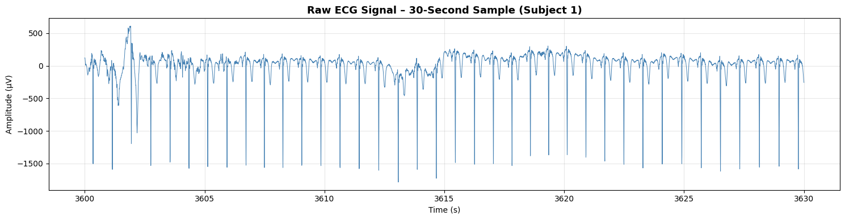
MESA Sleep Study Dataset
ECG sampled at 256 Hz.
Divided into signals (.edf) and annotations (.xml).
Signals split into 30-second epochs.
10 subjects are used (major limitation).

Slide 5
Pipeline Overview
Dataset Access & Loading
Signal Preprocessing
Multi-Scale Feature Extraction
Data Balancing
Hybrid Architecture
Advanced Optimization
Performance Evaluation

Slide 6
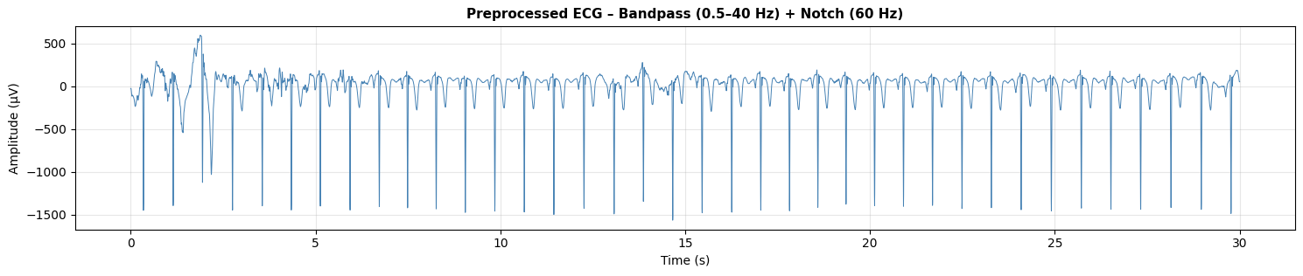
Signal Preprocessing
Bandpass filter (0.5-40 Hz) to remove baseline drift.
Notch filter (60 Hz) to remove powerline noise.
Normalization to standardize amplitudes.

Slide 7
Signal Segmentation
Signals are split into 30-second epochs (standard in sleep scoring).
Context window is 11 epochs (5 previous + current + 5 future).
Neighboring epochs are useful as sleep stages transition gradually.

Slide 8
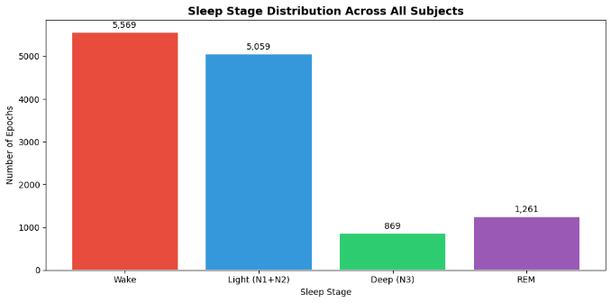
Data Splitting & Imbalance
Total epochs: 12,758
Train: 8561 Epochs
Val: 2,998 Epochs
Test: 1,199 Epochs
Subject-wise split:
Training: 7 subjects
Validation: 2 subjects
Testing: 1 subject

Slide 9
Model Architecture
Three-branch architecture:
1. Epoch CNN (Waveform features)
Effective for automatic feature extraction from raw physiological signals.
2. 2-layer Bidirectional LSTM
Learns transitions and uses previous and future context.
3. Attention mechanism
Focuses on informative epochs which reduces irrelevant temporal information.

Slide 10
HRV + ECG Fusion
The reason behind combining them:
Raw ECG: waveform morphology
HRV: physiological rhythm changes
Together: complementary information

Slide 11
Training
Configurations:
Loss : FocalLoss (gamma=2.0)
Optimizer : AdamW
Learning rate= 0.0003
Weight decay= 2e⁻⁴
Scheduler : CosineAnnealingWarmRestarts
Epochs : 30
Batch size : 8

Slide 12
Comparison
Old Version:
Used CrossEntropyLoss with label smoothing
Used constant learning rate
Standard random shuffling during training
Final Version:
Used Focal Loss for imbalance handling
Added WeightedRandomSampler
Used Cosine Annealing Warm Restarts scheduler
Expanded HRV context window to 5.5 minutes

Slide 13
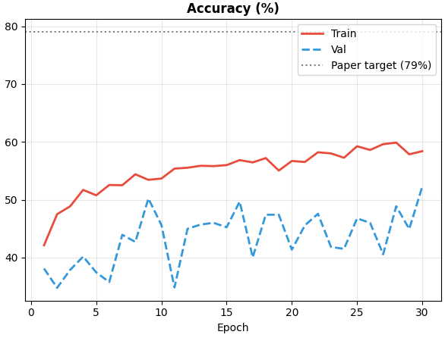
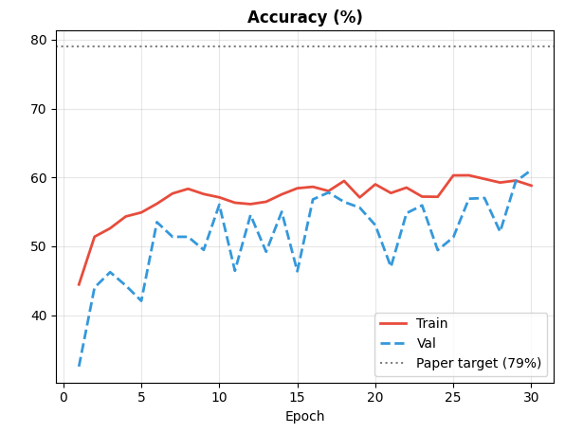
Results
Previous version
Final version
Notes:
Training improved steadily
Validation fluctuated
Gap indicates overfitting
Because only 10 subjects
imbalance
ECG variability

Slide 14
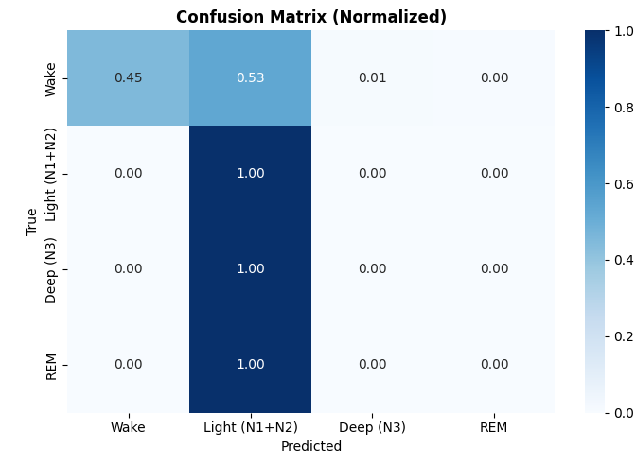
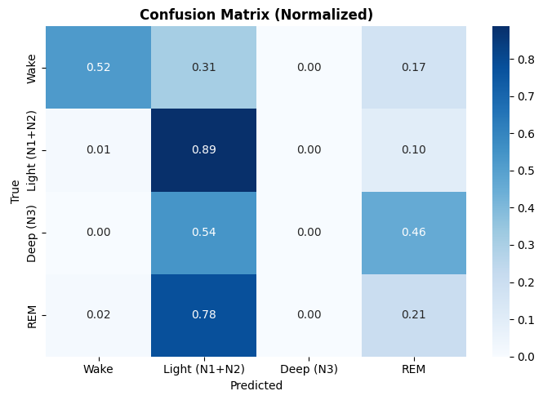
Results
Previous version
Final version
Notes:
Training improved steadily
Validation fluctuated
Gap indicates overfitting
Because only 10 subjects
imbalance
ECG variability

Slide 15
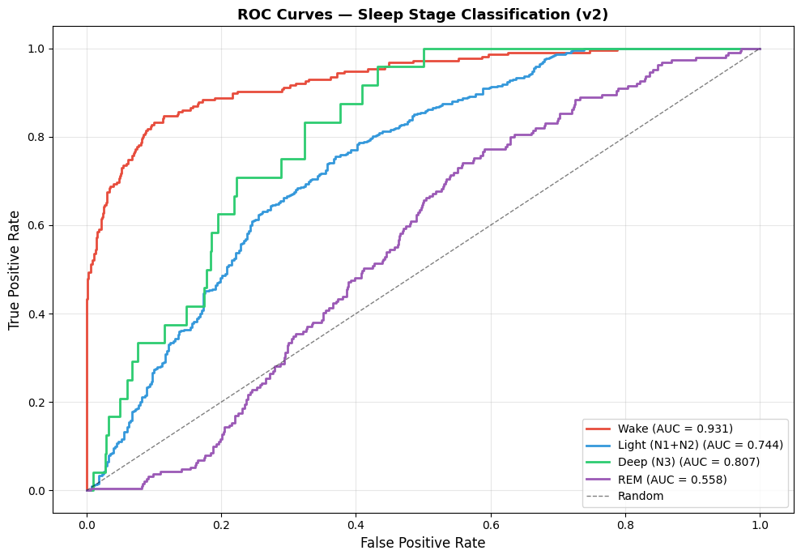
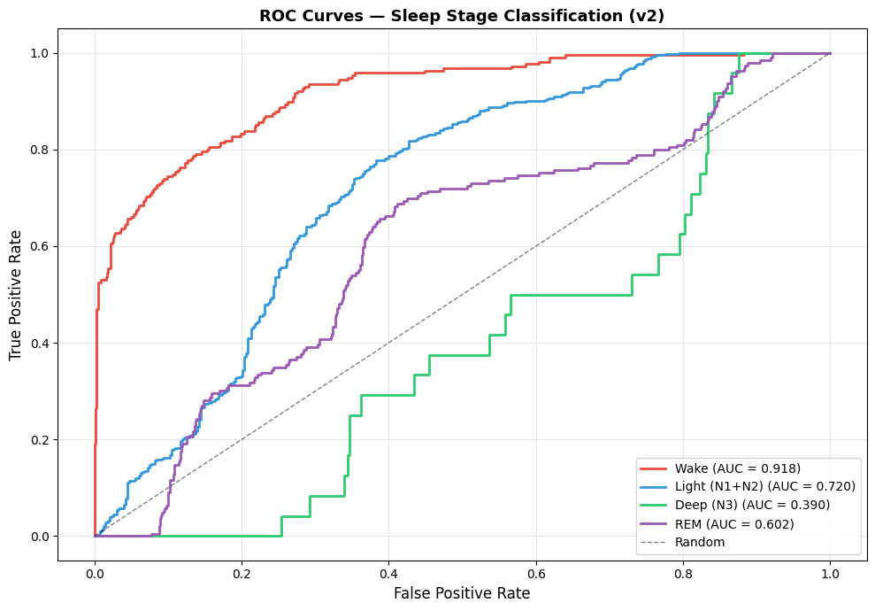
Results
Previous version
Final version
Notes:
Training improved steadily
Validation fluctuated
Gap indicates overfitting
Because only 10 subjects
imbalance
ECG variability

Slide 16
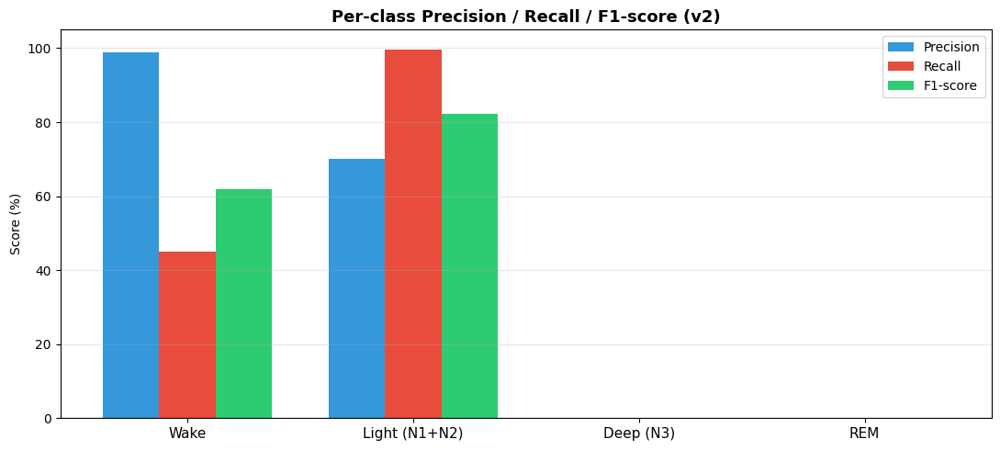
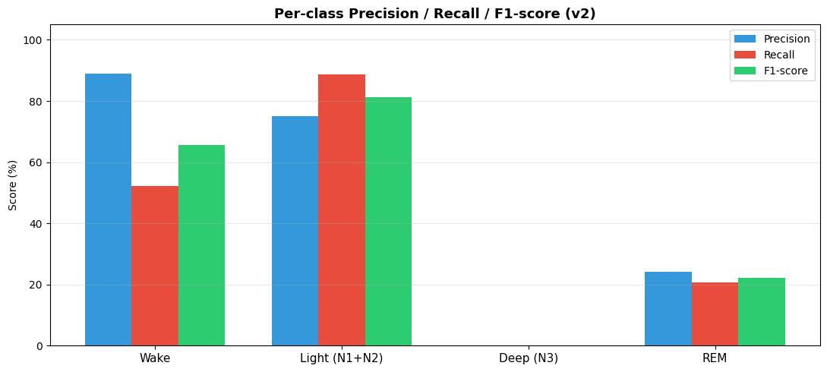
Results
Previous version
Final version
Notes:
Training improved steadily
Validation fluctuated
Gap indicates overfitting
Because only 10 subjects
imbalance
ECG variability

Slide 17
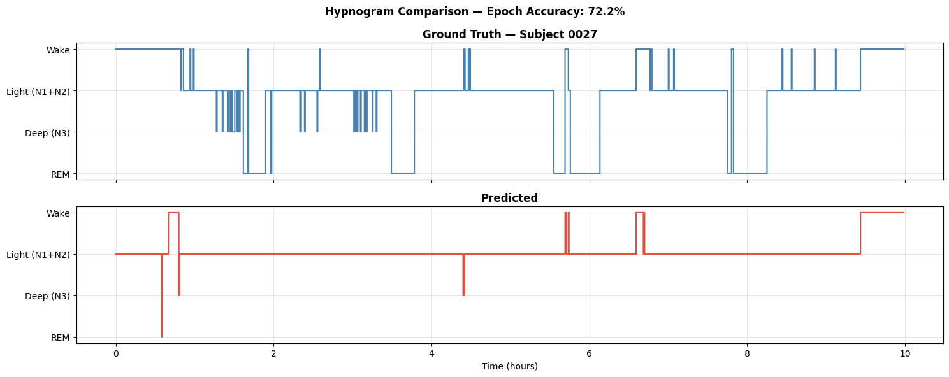
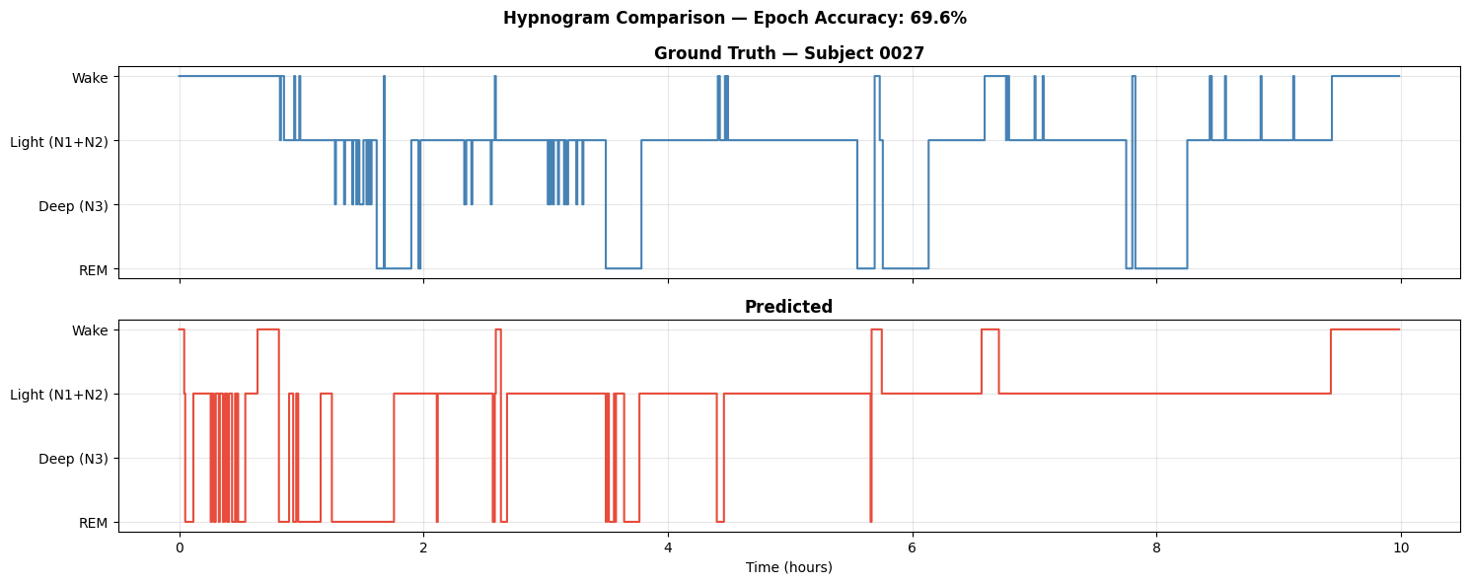
Results
Previous version
Final version
Notes:
Training improved steadily
Validation fluctuated
Gap indicates overfitting
Because only 10 subjects
imbalance
ECG variability

Slide 18
Challenges and Limitations
Small dataset
Severe class imbalance
Overfitting
Subject variability

Slide 19
Future improvements
More subjects
Better class balance
Multimodal signals
Better REM representation

Slide 20
Thank you :)

