Slide 1
Supacharge
The live tutors your family couldn't afford — now you can. "To the next level."
EdTech — high-school (FET phase) live tutoring · South Africa (Musina, Limpopo) · founded Supacharge operates under ROKCT INTELLIGENCE (PTY) LTD, registered 25 November 2025 (CIPC 2025/919921/07); source: CIPC Business Registration Certificate in Compliance/ROKCT/.
A product of ROKCT INTELLIGENCE (PTY) LTD
Supacharge · 1 / 12

Slide 2
The Problem
FET learners (2.9M in Grades 10–12) and their families cannot afford effective exam help: private tutoring costs R100–R250 per hour per subject, public-school classes average 30.8 learners per educator, and only 47.8% of 2024 matric candidates achieved a Bachelor pass. The cost is life-long: matric outcomes gate university entry and employment.
Supacharge · 2 / 12

Slide 3
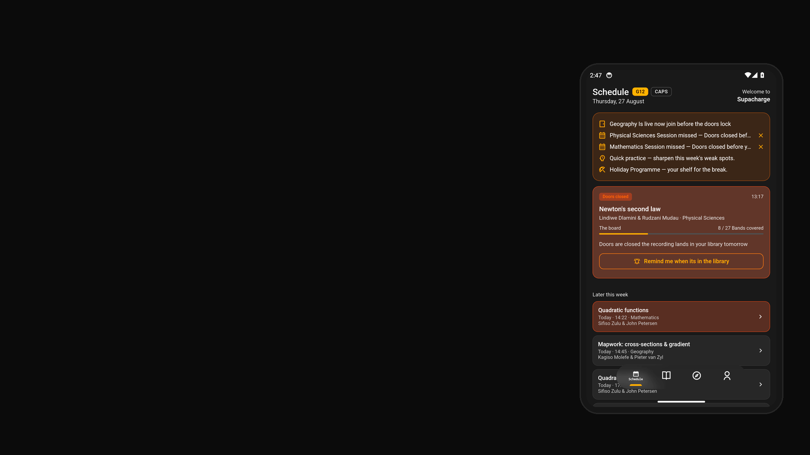
The Solution
Live, expert human teaching — every lesson taught by a subject expert plus a simplifier — across the complete CAPS and IEB FET curricula, at a subscription price one-to-one tutoring can never reach.
What ships
Supacharge app (Flutter, composed from modular SDKs) — schedule, live sessions, practice, leagues, progress; lesson factory (github.com/RokctAI/factory) — automated production of the 732-package CAPS + IEB catalogue; Manim pipeline — animated whiteboard scenes per lesson; multi-tenant backend (Python/Frappe) — accounts, billing, content delivery; per-grade assistant hosts — learner support between sessions.
Supacharge · 3 / 12

Slide 4
Market
Layer | Size | Share of the layer above
TAM — the whole category | R1.5bn | —
SAM — reachable with the current model | R1.5bn | 100.0% of TAM
SOM — realistic capture over 36 months | R125m | 8.3% of SAM
Why now
Structural, annual demand — every learner writes matric; record headline pass rates (87.3% in 2024) masking low Bachelor-pass and maths outcomes, which keeps parents seeking help; shrinking maths candidate numbers raising the stakes for maths support (2024 NSC results; ITWeb).
Supacharge · 4 / 12

Slide 5
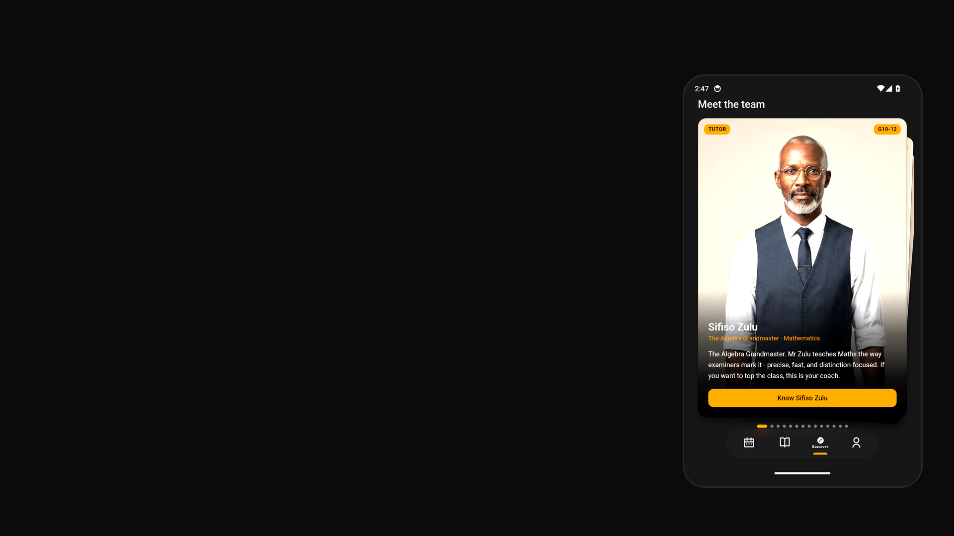
Business Model
Consumer subscriptions (current pricing implemented in billing: R299/month, R249/month with accountability partner — a flat R50 off, R2,990/year; Holiday Programme R449 one-off). Final structure: three-tier expansion agreed 23 Aug 2026 — One R199/month (single subject) / Standard R299/month / Ahead R599/month — final prices pending confirmation before launch.
Pricing
• Current pricing implemented in billing: R299/month; R249/month with an accountability partner (a flat R50 off); R2,990/year; Holiday Programme R449 one-off.
• Final tier structure: three-tier expansion agreed 23 Aug 2026 — One R199/month (single subject) / Standard R299/month / Ahead R599/month — final prices pending confirmation before launch.
Supacharge · 5 / 12

Slide 6
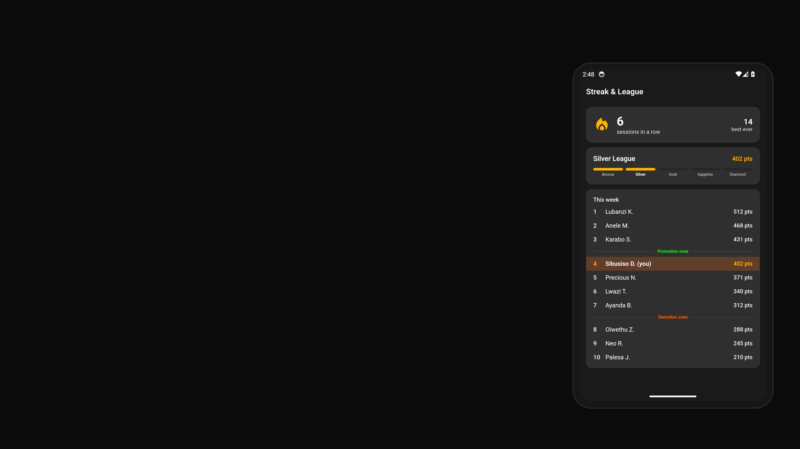
Traction
• Complete dual-curriculum catalogue built and published (732 lesson packages across CAPS and IEB, six subjects, Grades 10–12); working Flutter app with automated CI-captured product tour; multi-tenant backend live — all built by one founder.
Raised to date
None — bootstrapped by the founder to date; no external funding raised.
Supacharge · 6 / 12

Slide 7
Competition
Competitor | Positioning against them
Private tutors | live but one-to-one at R100–R250/hr — can't scale past one learner per hour.
Teach Me 2 | tutor-matching marketplace, per-hour 1-to-1 pricing.
Paper Video | recorded CAPS-aligned videos with past-paper practice — scales, but can't respond to a confused learner.
Matric Live | freemium app whose paid tier is an AI Q&A chat — not taught live lessons.
Supacharge | live scheduled group teaching, two-tutor format, full CAPS + IEB catalogue, subscription pricing.
Our advantage
The complete dual-curriculum catalogue (732 lesson packages, nine components each) plus the automated lesson factory that produced it, the two-tutor live format, and the capital efficiency of a platform built end to end by one founder.
Supacharge · 7 / 12

Slide 8
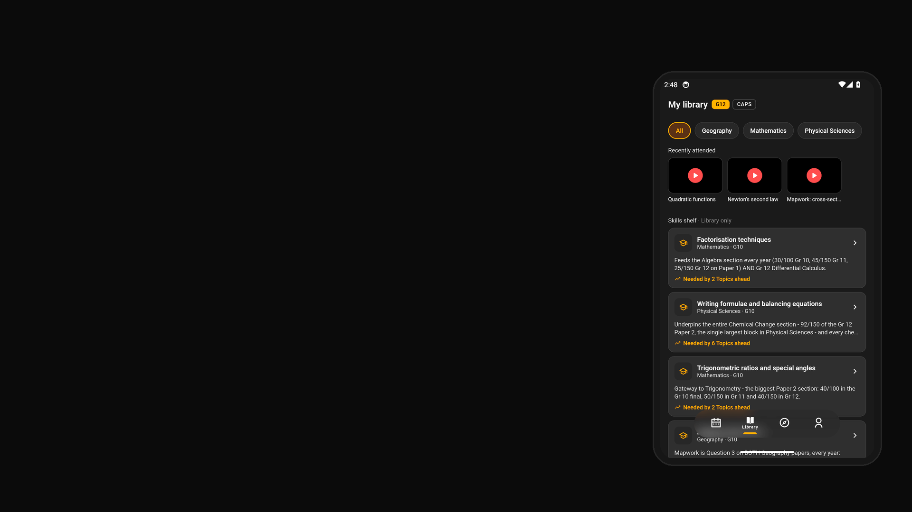
Go To Market
Google Play. Social channels fed by per-lesson promo reel clips — TikTok (organic short-form content) is the primary channel. In-person school visits. Word of mouth from the 100-student free pilot. All organic — no paid channels.
Supacharge · 8 / 12

Slide 9
Financials
Year | Revenue | YoY growth | Gross profit (at 80% target margin)
Year 1 | R14.4m | — | R11.52m
Year 2 | R43m | +199% | R34.4m
Year 3 | R129m | +200% | R103.2m
• CAC payback: 0.4 months
LTV not derivable yet — needs Average Revenue Per Customer, Gross Margin Target and Customer Churn Rate.
Runway not derivable yet — needs Cash On Hand and Monthly Operating Costs.
• Break-even: Because the bootstrapped cost base is minimal (infrastructure and AI API costs, no salaries), break-even is reached at a low subscriber count relative to the current 100-student pilot. It is tied to paid conversion at public launch — planned for January 2027, with a preferred earlier first paid revenue start in December 2026 via the Holiday Programme — rather than modelled to a specific figure or date.
All figures in ZAR (R).
Supacharge · 9 / 12

Slide 10
Team
• Rendani (Ray) Sinyage — Founder; owns product, engineering, content and operations.
• Headcount: 1 (solo founder)
Hiring next
• Planned first-team shape (agreed 24 Aug 2026), timed post-funding — the company is deliberately AI-first, so the first hires are non-engineering (AI tutors deliver the curriculum; AI agent sessions cover engineering).
• Two full-time hires: (1) platform operations owner (SRE/on-call) and (2) school partnerships lead (SA sales/BD).
• Around them: a remote pool of part-time South African teacher-raters scoring lessons per rubric, with one fractional lead moderator for catalogue sign-off; junior remote support/triage for the student-error stream (may start as part of ops); and fractional finance & compliance (POPIA/safeguarding).
• Salary costs not yet set.
Supacharge · 10 / 12

Slide 11
The Ask
R950,000 is being sought, preferred as equity-free grant or programme funding (no external capital raised to date — bootstrapped). Allocation across the founder's three stated priorities (indicative proposed split): ≈R450,000 AI capacity — tutoring API and compute to serve growth toward the 35,000-student first stop; ≈R300,000 marketing — launch campaigns on top of the current organic TikTok and in-person school-visits motion; ≈R200,000 office facilities. The funding carries the venture through paid public launch (January 2027; preferred earlier paid start December 2026 via the Holiday Programme).
Use of funds
• To date all capital deployed has been the founder's own, spent on infrastructure and AI API costs (no salaries); no external capital has been raised.
• New capital would be spent per the R950,000 funding ask's indicative split: ≈R450,000 AI capacity (tutoring API and compute), ≈R300,000 marketing (launch campaigns), ≈R200,000 office facilities — the founder's three stated priorities.
Supacharge · 11 / 12

Slide 12
Corporate Standing
• Registered legal name: ROKCT INTELLIGENCE (PTY) LTD
• CIPC number: 2025/919921/07
• Tax compliance: Pending — tax compliance status not verified — add Tax_Pin.pdf
• B-BBEE: no certificate on file; no level is claimed.
Intellectual property
The Supacharge brand; the 732-package original lesson catalogue and the automated lesson factory that produces it (published for inspection at github.com/RokctAI/factory); the Flutter app and multi-tenant backend software. Trademark registrations: none registered yet — the "ROKCT" trademark is filed with the CIPC and registration is pending; "Supacharge" has not yet been filed as a trademark.
Figures are management projections from questions.md — unaudited, and unverified where marked Pending.
Supacharge · 12 / 12

