Slide 1
Using Yelp Reviews for Predicting Users’ Ratings
Haoran Zhang, Keren Ye

Slide 2
Outline
Introduction
Methodology
Current Progress
Future Works

Slide 3
Introduction
Predict the ‘preference’ that a user would give to a business
Unlike the collaborative filtering approach that ’count’ on the co-occurrence
Utilize the abundant textual information from the Yelp reviews
Incorporate multiple features
An unified framework for predicting ratings

Slide 4
Introduction
Yelp dataset
77445 records of business
552339 records of unique users
2225213 records of reviews
Useful information
Average rating of a specific business
Average rating given by a specific user
Abundant textual information of reviews
How to combine these features

Slide 5
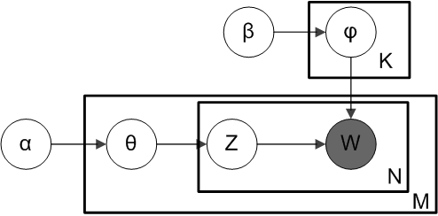
Methodology
Textual features
Tf-idf
Simple, Widely used
Problem of synonyms
measures the distance between ‘surface’ words
Topic Modeling
Solve the problem of synonyms
Capture the meaning (latent topic) of the document

Slide 6
Methodology
Topic model training on +/- corpus
+ corpus: 162894 records of 5 stars reviews
- corpus: 74451 records of 1 stars reviews
Example
User: The fries is tasty… -> +(Service: 0.5,…)
User’s topics are inferred from all the reviews given by him/her
Business: +(Tasty: 0.4,…); -(Service: 0.8,…)
Business’ topics are inferred from top reviews towards the business

Slide 7
Methodology
Pipeline
Train the topic model on the yelp reviews
+ corpus / - corpus
Infer topic distribution for a specific user based on his/her reviews
+/- topic distribution inferred from historical reviews
Infer topic distribution for a specific business based on top reviews towards it
Generate the dataset
Supervised learning process

Slide 8
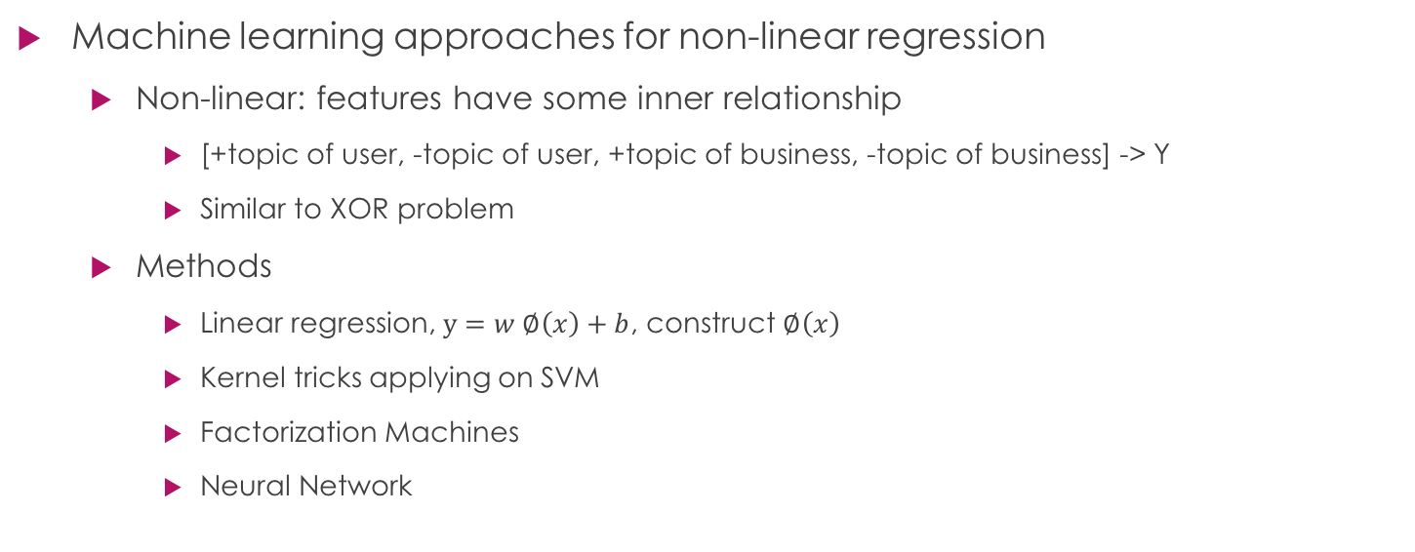
Methodology
Machine learning approaches for non-linear regression
Non-linear: features have some inner relationship
[+topic of user, -topic of user, +topic of business, -topic of business] -> Y
Similar to XOR problem
Methods
Linear regression, $y=w ∅\left(x\right)+b$, construct $∅\left(x\right)$
Kernel tricks applying on SVM
Factorization Machines
Neural Network

Slide 9
Methodology
Evaluation
Metrics
MSE, RMSE, R-SQUARED
10 – folds cross-validation

Slide 10
Current Progress
Preprocess
+/- topic model
inference of the +/- topic distribution
Baseline
Average rating given by user
Average rating towards business

Slide 11
Current Progress
+ Topics:
9 0.031*sushi + 0.026*roll + 0.026*buffet + 0.018*fish + 0.014*noodl + 0.013*rice + 0.013*shrimp + 0.012*crab + 0.011*dish + 0.011*spici
13 0.011*time + 0.011*work + 0.010*t + 0.009*servic + 0.008*get + 0.008*great + 0.008*need + 0.007*will + 0.007*call + 0.007*day
16 0.020*flavor + 0.019*cream + 0.018*ice + 0.018*chocol + 0.015*sweet + 0.012*cake + 0.010*tast + 0.008*dessert + 0.008*tea + 0.008*top
- Topics:
10 0.023*us + 0.021*order + 0.019*food + 0.019*wait + 0.018*tabl + 0.018*minut + 0.013*ask + 0.013*drink + 0.011*t + 0.011*time
11 0.022*us + 0.015*manag + 0.015*ask + 0.008*rude + 0.007*staff + 0.007*told + 0.006*experi + 0.006*employe + 0.006*one + 0.006*friend

Slide 12
Current Progress
 | MSE | RMSE | R-squared
Avg ratings by user | 1.1875 | 1.0897 | 0.2045
Avg ratings by business | 1.2788 | 1.1308 | 0.1434

Slide 13
Thanks
Q & A

