Slide 1
Fake News Detection using Machine Learning
Name : Rokeya Siddiqua
ID : 1813063042
Course : CSE445
Section : 01

Slide 2
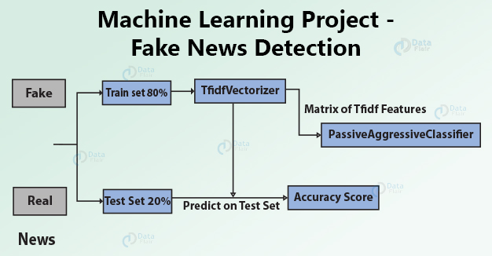
Project idea
Fake news spreads like a wildfire and this is a big issue in this era. We can learn how to distinguish fake news from a real one. We can use supervised learning to implement a model like this.

Slide 3
why interesting
There are a lot of news articles, where the news is false or cooked up. With so many advances in Natural Language Processing and machine learning, we can actually build an ml model which is able to detect if a piece of the news article is genuine or fake. Here we will be using artificial neural network models to verify the genuinity of the article.

Slide 4
Data source
data-flair
https://drive.google.com/file/d/1er9NJTLUA3qnRuyhfzuN0XUsoIC4a-_q/view

Slide 5
expectation
The main objective is to detect the fake news, which is a classic text classification problem with a straight forward proposition. It is needed to build a model that can differentiate between “Real” news and “Fake” news.

