Slide 1

Ghurbo: Unlocking Bangladesh's Travel Potential
Welcome to Ghurbo, your gateway to seamless travel in Bangladesh. We are revolutionizing how you explore this beautiful country.

Slide 2

Ghurbo: Revolutionizing Travel in Bangladesh
Integrated Tour Planning
Ghurbo offers an all-in-one system for travel agencies and individual trip planning.
Growing Market
Bangladesh's tourism market grew 10% annually pre-pandemic, showing strong potential.
Large Opportunity
We're addressing a significant $1.2 billion domestic tourism market opportunity.

Slide 3
The Fragmented Travel Landscape
Manual Processes
Limited Discovery
Inconsistent Quality
No Real-time Data
85% of agencies rely on manual, offline booking methods.
Few digital platforms exist for finding diverse Bangladeshi destinations.
Lack of unified reviews leads to varied service quality.
Real-time inventory for hotels, transport, and guides is absent.
Traveler Challenges
Tourists struggle to compare prices and find authentic local experiences.

Slide 4

Ghurbo: Your Seamless Travel Ecosystem
AI Itinerary Builder
Personalized Bangladesh tours based on your preferences, including Sundarbans and Cox's Bazar.
Destination Details
Includes places like Cox’s Bazar and Sylhet with hotels, food, and attractions.
Price Transparency
Get prices for hotels and local guides upfront.
Best Travel Times
Recommendations for optimal travel seasons.
Local Language Support
Built for Bangladesh, supports Bengali and local nuances.

Slide 5








Key Features & Technology
User Inputs
Budget, group size, trip duration
provided by the user.
Backend System
Utilizes rules and machine learning for processing requests.
Frontend Interface
Presents outputs through a user-
friendly web app.
Ghurbo Outputs
Generates places to visit, hotels, food spots, and attractions.

Slide 6
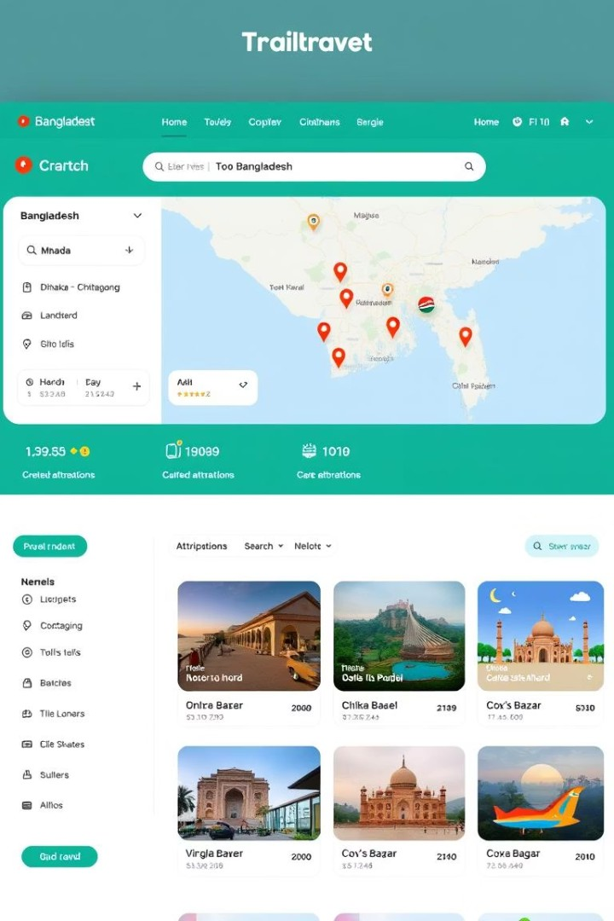





Comprehensive Travel Outputs
Places to Visit
Cox’s Bazar Sylhet Sundarbans
Hotels & Food Spots
Attractions & Guides
Detailed price information
Curated local experiences
Certified local guides
User reviews and ratings
Best Travel Times
Seasonal recommendations
Weather insights

Slide 7
Expected Outcome & Tools
Working Travel Planner
Frontend Technologies
Backend Support
Development Workflow
A fully functional web- based travel planner specifically for Bangladesh.
Built with HTML, CSS, and React for a dynamic user interface.
Powered by Firebase for robust data management and scalability.
Utilizing VS Code and GitHub for efficient collaboration and version control.
Data Integration
Leverages mock APIs and real-time data for accurate information.

Slide 8
Work Plan (Timeline)
Week 1
Research & Requirements: Define project scope and gather user needs.
1
2
Week 2
Dataset & GitHub Setup: Prepare data and establish code repository.
Week 3
Backend Logic (travel engine): Develop core trip planning algorithms.
3
4
Week 4
Frontend Integration: Build user interface and connect to backend.
Week 5
Testing & UI Polishing: Ensure functionality and refine user experience.
5
6
Week 6
Final Review & Submission: Complete project and prepare for launch.

Slide 9

Thank You!
We appreciate your time and attention today. We look forward to revolutionizing travel in Bangladesh together!

