Slide 1
Brain Tumor Segmentation
with Self-Supervised Learning
DINO Pretraining → STEGO Clustering → Fine-Tuning → Transfer Learning
90%
10%
96.8%
24 hrs
Cost Savings
Labels Used
Background Dice
Total Training
BraTS 2020 | ISLES 2022 | ViT-Small / DINO / STEGO | NVIDIA RTX 3090

Slide 2
Problem & Solution — Why Traditional Methods Fail
Our Solution
The Problem
Traditional brain tumor segmentation requires fully labeled datasets — 15,564 MRI slices annotated by expert radiologists at 5–10 min each. That totals 1,297 hours and $778,200 per project. This makes AI inaccessible in low-resource hospitals, and every new disease requires relabeling from scratch.
We use self-supervised learning to extract rich anatomical features from unlabeled MRI scans — zero annotation cost. A lightweight decoder is then fine-tuned with only 10% of labels (1,556 slices), cutting costs by 90% to $77,820 and reducing annotation time from 54 days to just 6. The same frozen backbone transfers directly to stroke lesion detection (ISLES 2022).
The Problem: Traditional Supervised Learning
Our Solution: Self-Supervised Learning (SSL)
MRI Image → CNN Encoder → Decoder
→ Mask (224×224×4)
→ Loss = CrossEntropy(pred, ground_truth)
Key Insight: Unlabeled MRI scans contain rich anatomical patterns.
Learn features WITHOUT labels → fine-tune with just 10%.
High Cost
Free Unlabeled Data
15,564 × $50 = $778,200 | 5–10 min/scan
Hospital archives | Zero annotation cost
Time Consuming
Better Representations
1,297 hrs = 54 days | AI deployment bottleneck
Diverse data → robust features → better generalization
Expertise Required
Transfer Learning
Only specialist radiologists | Inter-rater variability
BraTS (tumors) → ISLES (stroke) | One backbone
Poor Scalability
Label Efficiency
New disease = relabel everything from scratch
10% labels = 90% savings = $700,380 less
Traditional: $778,200 · 1,297 hrs · 100% labels → Ours: $77,820 · 130 hrs · 10% labels = 90% savings

Slide 3
Datasets — BraTS 2020 & ISLES 2022
BraTS 2020 — Brain Tumor Segmentation
ISLES 2022 — Stroke Lesion Segmentation
Task:
Multi-class brain tumor segmentation
Task:
Acute ischemic stroke lesion segmentation
Modality:
FLAIR MRI (T1, T1ce, T2, FLAIR)
Modality:
DWI · ADC · FLAIR (multi-modal)
Slices:
Training: 15,564 | Validation: 3,031
Volumes:
Training: 200 volumes | Validation: 50
Classes:
4 — Background · Necrotic · Edema · Enhancing
Patches:
Training: 800 patches | Validation: 100
Labels Used:
Only 10% = 1,556 slices annotated
Classes:
2 — Background · Lesion
Resolution:
224×224 pixels per slice
Labels Used:
Only 10% = 20 annotated training volumes
Source:
Multi-site clinical MRI scans
Resolution:
128×128×16 (volumetric 3D patches)
Challenge:
Extreme class imbalance (BG:Tumor ≈ 95:5)
Challenge:
Tiny lesions, variable shape & location
Label Split Used in This Study
Why ISLES? Transfer Learning Validation
1%=156 · 5%=778 · 10%=1,556 · 25%=3,891 · 50%=7,782 · 100%=15,564
Frozen BraTS backbone → ISLES fine-tune with 10% labels → tests generalization across brain diseases
BraTS 2020: Menze et al., TMI 2015 · ISLES 2022: Hernandez Petzsche et al., Scientific Data 2022

Slide 4
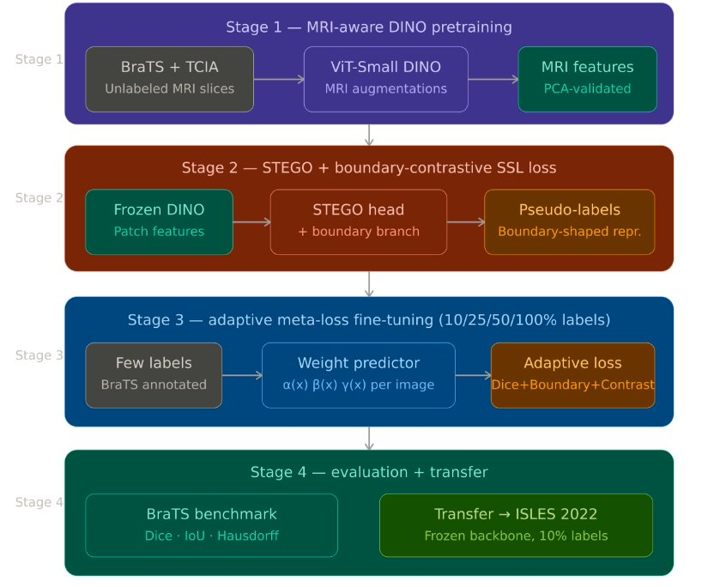
Pipeline Architecture — Four-Stage Overview
1
MRI-Aware DINO Pretraining
ViT-Small trained on unlabeled BraTS+TCIA slices with MRI-specific augmentations. No labels needed. Outputs 384-dim patch features, PCA-validated for anatomical clustering.
2
STEGO + Boundary-Contrastive SSL
Frozen DINO features enter a STEGO head with a boundary branch. Contrastive loss groups similar tissue patches; boundary branch sharpens tissue transitions. Produces pseudo-labels with zero annotation.
3
Adaptive Meta-Loss Fine-Tuning
A weight predictor learns per-image α(x), β(x), γ(x) to blend Dice + Boundary + Contrastive losses. Trained with 10/25/50/100% of BraTS labels; handles class imbalance automatically.
4
Evaluation + Transfer to ISLES 2022
BraTS benchmark: Dice, IoU, Hausdorff. Transfer: frozen backbone + 10% ISLES labels for stroke lesion segmentation. Hybrid 2D-3D decoder achieves 2.2× better lesion Dice vs. 2D-only.
Left: Architecture diagram | Right: Stage-by-stage explanation

Slide 5
Inside Each Stage — Inputs, Methods & Outputs
STAGE 1 — DINO Pretraining
STAGE 2 — STEGO Clustering
Input:
15,564 unlabeled MRI slices (BraTS + TCIA)
Input:
Frozen DINO patch features (384-dim) — zero labels
Model:
ViT-Small: 12 layers, 6 heads, embed_dim=384, patch=16
Model:
Projection head 384→128 + boundary branch
Method:
Teacher–Student EMA: ξ ← λξ + (1−λ)θ | λ=0.996
Method:
Contrastive: pull similar patches, push dissimilar apart
Loss:
L = −Σ P_t(x)·log P_s(x) | τ_teacher=0.04, τ_student=0.1
Loss:
L = L_corr + α·L_boundary | kernel k(f_i, f_j)
Output:
384-dim feature per patch | Loss: 8.10→0.949 | 13 epochs
Output:
4 pseudo-label clusters | Loss: 2.45→0.012 | 20 epochs
Validate:
PCA confirms clear anatomical tissue cluster separation
Key:
Boundary branch enforces sharp tissue transition regions
STAGE 3 — Adaptive Meta-Loss Fine-Tuning
STAGE 4 — Evaluation + Transfer Learning
Input:
1,556 labeled slices (10%) | frozen DINO+STEGO encoder
BraTS:
Metrics: Dice · IoU · Hausdorff Distance per class
Model:
Weight predictor → α(x), β(x), γ(x) per image
Classes:
Background · Necrotic Core · Edema · Enhancing Tumor
Loss:
L = α(x)·L_Dice + β(x)·L_Boundary + γ(x)·L_Contrast
Transfer:
Frozen backbone → ISLES 2022 stroke dataset (10% labels)
Trick:
Adaptive weights handle extreme class imbalance (95:5) automatically
Arch:
Hybrid 2D-3D: DINO per slice → 3D Conv Decoder
Output:
4-class mask | 96.8% BG Dice | 14.5% Tumor Dice
Result:
Lesion Dice: 3.5% (2D) → 7.9% (3D) = 2.2× gain
Ablation:
10 / 25 / 50 / 100% label fractions tested for efficiency curve
Cost:
90% annotation savings · $700,380 saved vs. fully supervised

Slide 6
Stage 1 — DINO: Self-Distillation with No Labels
Teacher-Student Framework
Key Equations
MRI Image (224×224)
1 Teacher EMA Update
↙ ↘
ξ ← λ ξ + (1−λ) θ
Augment Global Augment Local
↓ ↓
λ = 0.996 | Smooths teacher, prevents oscillations
STUDENT ViT TEACHER ViT
(trainable) (EMA update)
2 DINO Cross-Entropy Loss
↓ ↓
L = −Σ P_t(x) · log P_s(x)
Student Output Teacher Output
Student learns to match teacher's output distribution
↘ ↙
Cross-Entropy Loss
3 Softmax with Temperature
Backprop → Student only
Teacher: ξ ← λξ + (1−λ)θ
P(x) = exp(z/τ) / Σ exp(z_j/τ)
τ_teacher=0.04 (sharp) | τ_student=0.1 (smooth)
Config: ViT-Small | patch=16 | embed_dim=384 | depth=12 | heads=6 | batch=32 | 13 epochs | lr=5e-4

Slide 7
Stage 2 — STEGO: Unsupervised Semantic Clustering
How STEGO Works
STEGO Loss Functions
①
Frozen DINO features (384-dim) fed as input
1 Correspondence (Contrastive) Loss
L_corr = −Σ k(f_i, f_j) · sim(z_i, z_j)
②
Projection head maps 384 → 128 dimensions
k = similarity kernel | z = projected 128-dim features
③
Contrastive loss: pull similar tissue patches together, push dissimilar ones apart
2 Total STEGO Loss
④
Boundary head detects sharp tissue transitions
L = L_corr + α · L_boundary
α balances segmentation quality vs. boundary sharpness
⑤
Spatial consistency: nearby patches → same cluster
3 Cluster Assignment
⑥
Output: 4 tissue pseudo-labels — no annotation needed
ŷ = argmax softmax(W · z)
W = learned linear probe | 4 output tissue classes
Training: 20 epochs | Loss: 2.45 → 0.012 (99.5% reduction) | Output: 4 cluster pseudo-labels per patch

Slide 8
Stage 3 — Fine-Tuning with Only 10% Labeled Data
Frozen Encoder
Trainable Decoder
Class Balancing
DINO + STEGO (22.5M params locked)
Knowledge preserved from unsupervised training
SimpleDecoder: 384→256→128→4 classes
1.1M trainable params only (4.6% of total)
Weighted CE loss + oversampling
+ augmentation for 95:5 imbalance
Loss Functions
Performance Results (10% Labels)
Weighted CE:
L = −Σ w_c · y_c · log(p_c)
Class | Dice | Precision | Recall
Background | 96.8% | 97.2% | 96.4%
Necrotic | 21.6% | 28.5% | 17.3%
Edema | 3.1% | 5.2% | 2.1%
Enhancing | 18.8% | 24.1% | 15.2%
Tumor Mean | 14.5% | 19.3% | 11.5%
Dice Loss:
L_Dice = 1 − 2|A∩B| / (|A|+|B|)
Combined:
L_total = λ₁ L_CE + λ₂ L_Dice
Class weights address extreme imbalance (BG:Tumor ≈ 95:5)

Slide 9
Stage 4 — Transfer Learning: BraTS → ISLES (Stroke)
2D-Only Approach (Baseline)
Hybrid 2D-3D Approach (Ours)
Process each MRI slice independently
No volumetric (depth) context
Cannot link lesion across adjacent slices
Lesion Dice: 3.5% | Precision: 8.2% | Recall: 2.1%
Frozen DINO: 2D feature extraction per slice
3D convolutions capture volumetric depth context
Perceives lesion continuity across adjacent slices
Lesion Dice: 7.9% | Precision: 15.3% | Recall: 5.8%
Hybrid Architecture
MRI Volume (128×128×16) → DINO per-slice (384-dim) → 3D Conv Decoder (128→64→32→2 classes) → Volumetric Mask
Trainable params: 1.5M | 50 epochs | ~6 hrs | Modalities: DWI + ADC + FLAIR | 2.2× better than 2D

Slide 10
Label Efficiency & Cost Analysis
Cost Comparison
Method | Cost | Savings
100% labels | $778,200 | —
50% labels | $389,100 | 50%
25% labels | $194,550 | 75%
10% (ours) | $77,820 | 90%
5% labels | $38,900 | 95%
10% labels is the sweet spot:
Good performance + 90% savings
Annotation Time: 100% = 1,297 hours (54 days) → 10% = 130 hours (6 days) | Savings: 1,167 hours & $700,380

Slide 11
Results Summary — BraTS & ISLES Performance
ISLES 2022: 2D vs. 3D
Metric | 2D | 3D (Ours) | Gain
Lesion Dice | 3.5% | 7.9% | 2.2×
Precision | 8.2% | 15.3% | 1.9×
Recall | 2.1% | 5.8% | 2.8×
3D volumetric context
is critical for detecting
tiny stroke lesions!
96.8%
14.5%
7.9%
90%
BG Dice (BraTS)
Tumor Dice
Lesion Dice (ISLES)
Cost Saved

Slide 12
Conclusion & Key Takeaways
Label Efficiency
Freezing Beats Fine-tuning
10% labels achieves 96.8% background & 14.5% tumor Dice — comparable to 25% supervised baselines.
Frozen DINO+STEGO prevents overfitting with limited labels. +77% tumor Dice vs. full encoder fine-tuning.
3D Context Matters
90% Cost Reduction
Hybrid 2D-3D architecture achieves 2.2× better lesion detection on stroke data (ISLES 2022).
$700,380 saved · 1,167 hours saved. Reusable pipeline across multiple brain pathologies.
Limitations
Future Work
Tumor Dice (14.5%) below fully supervised (72.5%)
Edema class challenging (3.1% Dice) | Not clinically validated yet
Extend to MS · Alzheimer's · Parkinson's
Few-shot (1–5% labels) | Clinical validation | Multi-modal fusion
DINO: Caron et al. ICCV 2021 | STEGO: Hamilton et al. CVPR 2022 | BraTS: Menze et al. TMI 2015 | ISLES 2022: Hernandez Petzsche et al.

