Slide 1

INFO 4652-5652
Artificial Intelligence
https://refreshscience.com

Slide 2
Agenda
01
Introduction to AI
Artificial intelligence is nothing but a computer program. Using artificial intelligence machines learns from the surrounding and thinks on their own.
02
What is AI
Artificial intelligence is a branch of computer science that aims to create intelligent machines.
03
Examples of AI
Artificial intelligence is all around as playing an active role in our daily lives.
04
Applications with AI
AI and robotics are Powerful combination for automatic tasks. Robots perform their task with the help of humans through machine language which is a part of Artificial intelligence.

Slide 3
Introduction to artificial intelligence

Slide 4

Artificial
Intelligence
Introduction to AI
Artificial intelligence is nothing but a computer program. Using artificial intelligence machines learns from the surrounding and thinks on their own. It is not like writing a program and getting an output.
When it does a work repeatedly, it finds an easier way to complete the work in lesser time. We can say that artificial intelligence are software programs that resembles humans in learning and solving problems.

Slide 5
ARTIFICIAL
INTELLIGENCE
What is AI
Artificial intelligence is a branch of computer science that aims to create intelligent machines.
Artificial intelligence is based on studying human behaviour such as how human brain thinks, how humans learn, how humans solve an issue, how they take decisions and so on. This machine can also be called as expert systems.

Slide 6
Components of Intelligence
Learning
Problem Solving
Using Languages
Reasoning
Perception

Slide 7
Examples of Artificial Intelligence
Smart Assistant
Manufacturing Robots
Social Media Monitoring
Automated Financial Investing
Proactive Health care Managements

Slide 8
AI Examples in Real life:
Google’s AI Powered Prediction
By using location data from smart phones traffic at any place and at any time can be found out .
Ride Sharing Apps
Apps like UBER uses AI technique to find out the wait time of the cab after booking, price for the ride etc.
Banking/Finance
Banks offers a ability to deposit checks through smart phones by using AI means. This helps to eliminate the customer to physically present in the branch and deposit the cheque.
Social Networking Sites
Social sites like Facebook uses AI technique in personalising one’s news feed, Displaying ads relevant to their interest and so on.

Slide 9

Robots & Applications with AI
Assembly
Packaging
It is used in complex manufacturing sectors like aerospace.
It helps to reduce the cost, make accurate packing and do the packing quicker.
Customer Service
Open Source Robotics
They are employed in customer services in retail stores and in hotels.
In open source, users can feed the robots with the data of specific task required.

Slide 10
Difference b/w AI and ML
Artificial Intelligence
Machine Language
In Artificial Intelligence we are able to carry out tasks that are smart. This includes fields such as image processing, neural networks etc.
Machine language is a application of AI where data are fed and machine learn by themselves. We can say machine language is the subset of AI.
ML is specific and it deals about classification, clustering, prediction etc. but both provides high accuracy.

Slide 11
Advantages of AI
High precision, accuracy, speed.
Low error compared to humans.
They can work in tasks that are dangerous to humans.
CONTENTS
TITLE
They can work 24*7.
They can be employed in repetitive and boring kind of jobs.
They are used in day to day applications.

Slide 12
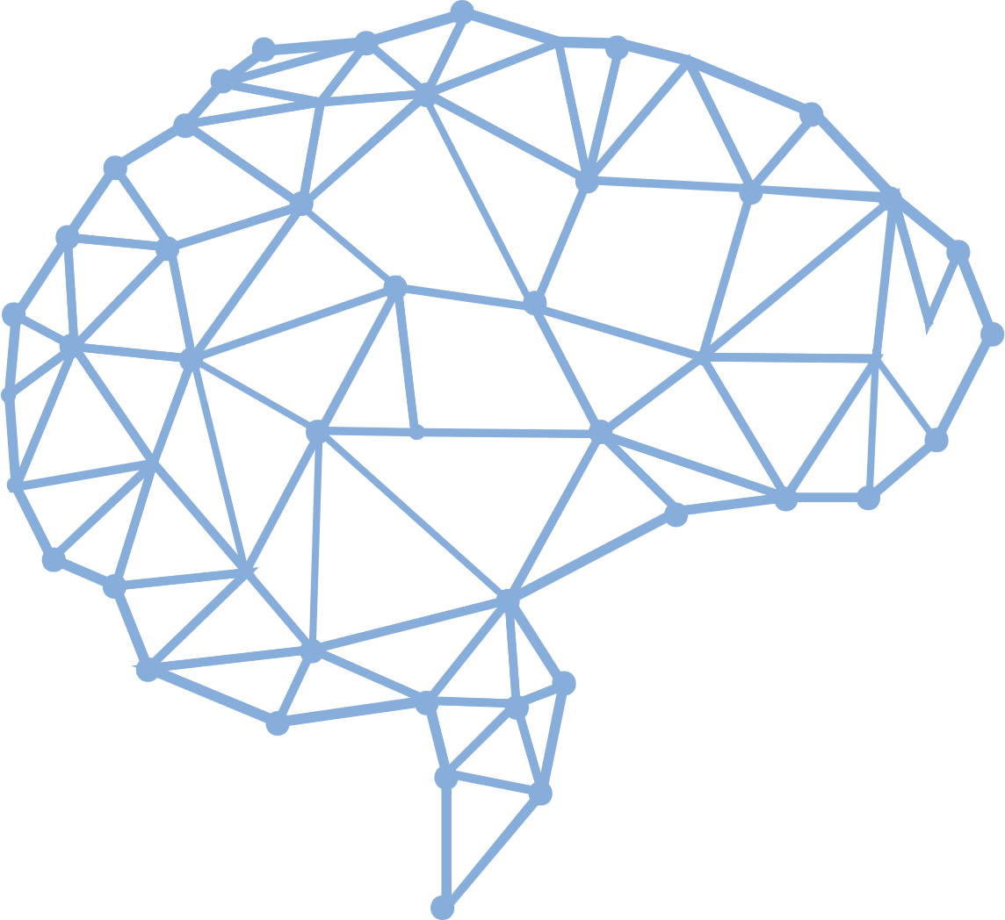
Disadvantages of AI
Since they are replacing humans in many fields there is a chance of huge unemployment.
Cost of creation is very high.
If any error occurs it is very difficult to rectify it.

