Slide 1
FINAL PRESENTATION
QuizRush
Web
API
Live
Real-time quiz hosting and gameplay across web, Android, ASP.NET Core, SignalR, and SQL Server.
Blazor Server
ASP.NET Core
SignalR
Mobile
Data
Tests
.NET MAUI
SQL Server
xUnit
Team 01 | OICAR 2026
Roko Pejo Bozic · Matej Pilic · Pavlo Nerekov · Maksym Moroz · Goran Junior Skoric

Slide 2
Project at a glance
QuizRush is a real-time quiz platform designed to be self-hostable and runnable on owned infrastructure. Hosts create live sessions, and players join instantly from web or Android using a PIN.
6-char
2
1
Real-time
Virtual
Session PIN
Clients
Shared backend
SignalR hub
Gambling points
For hosts
For players
For evaluators
Create quizzes, launch sessions, control game pace, reveal answers, and review results.
Join without friction, answer timed questions, gamble score, and see leaderboards live.
Clear full-stack implementation with REST API, SignalR, database, testing, and privacy notes.
QuizRush | OICAR Final Presentation

Slide 3
Problem and opportunity
Closed quiz ecosystems
Fragmented experience
Developer flexibility gap
Existing tools are easy to use, but they limit ownership, deployment control, customization, and integration options.
Some open alternatives focus on web only or mobile only, which creates separate experiences for the same game.
Rigid scoring rules and limited API access make it hard to build custom education, corporate training, or event workflows.
QuizRush addresses this gap with one real-time backend, browser + Android participation, and configurable game mechanics.
QuizRush | OICAR Final Presentation

Slide 4
Planned vs delivered
Requirement
Final delivery
ASP.NET Core backend
Delivered: ASP.NET Core 8 API
Real-time hub
Delivered: SignalR GameHub
Web application
Delivered: Blazor Server app
Android app
Delivered: .NET MAUI Android target
Relational database
Delivered: SQL Server + EF Core migrations
Gambling mechanic
Delivered: virtual point-risk flow
Testing
Delivered: xUnit + integration checks
Key message: the final project moved from planned technology choices to a concrete implementation stack.
QuizRush | OICAR Final Presentation

Slide 5
Key use-cases
Host signs in
Builds quiz
Creates session
Shares PIN
Controls game
HOST
PLAY
USER
Use-case 1: Host runs a live quiz
Use-case 2: Player joins and competes
Use-case 3: Registered user manages profile and stats
Actor: Registered host
Actor: Guest or registered player
Actor: Registered user
Player enters PIN
Joins hub
Gambles score
Answers live
Views rank
Goal: Create/select a quiz, launch a session, control rounds, and finish with ranked results.
Goal: Join by PIN, answer timed questions, optionally gamble score, and view live ranking.
Goal: Update profile/password and review personal quiz history and statistics.
Outcome: shareable PIN + controlled live session.
Outcome: fast onboarding + live engagement.
Outcome: persistent ownership beyond one game.
User signs in
Updates profile
Changes password
Reviews stats
These three use-cases map directly to the host, player, and registered-account stakeholder groups required for assessment.
QuizRush | OICAR Final Presentation

Slide 6
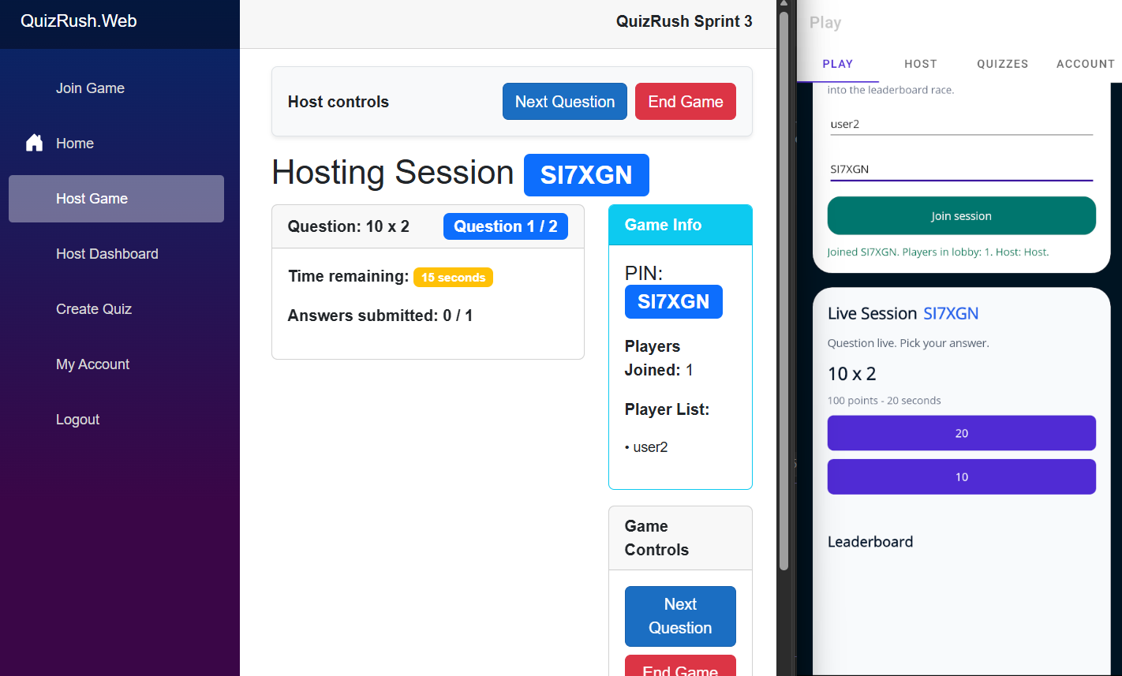
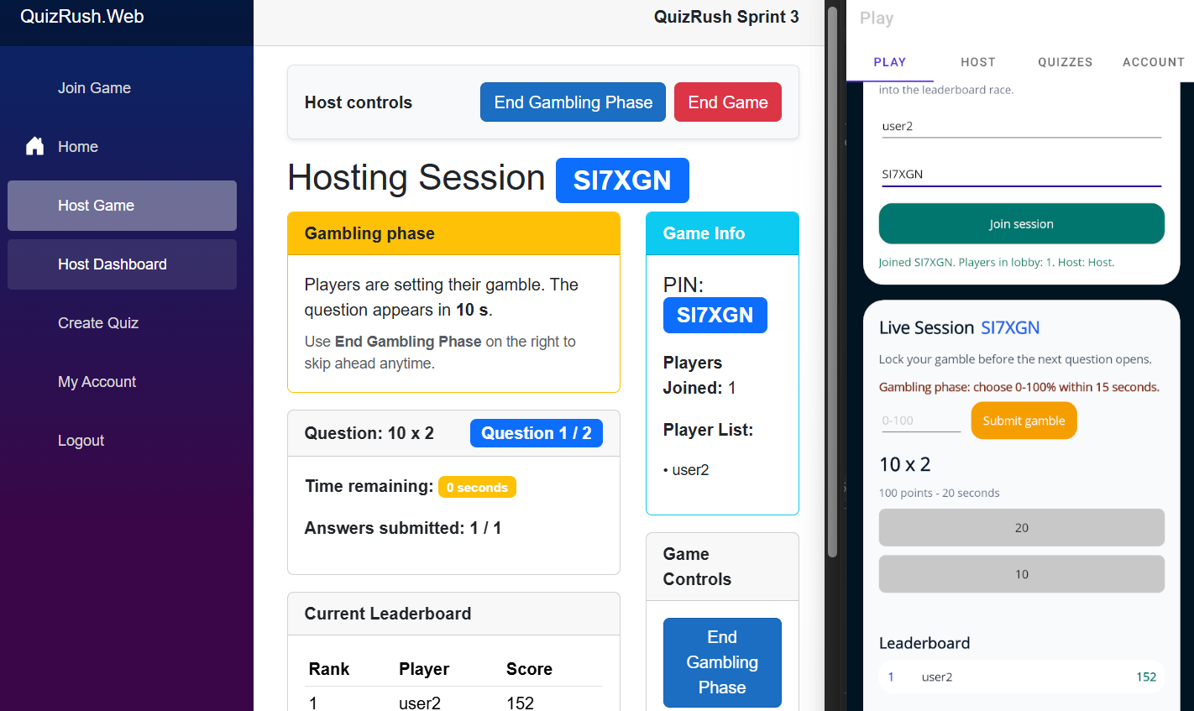
Gameplay and Hosting
QuizRush | OICAR Final Presentation

Slide 7
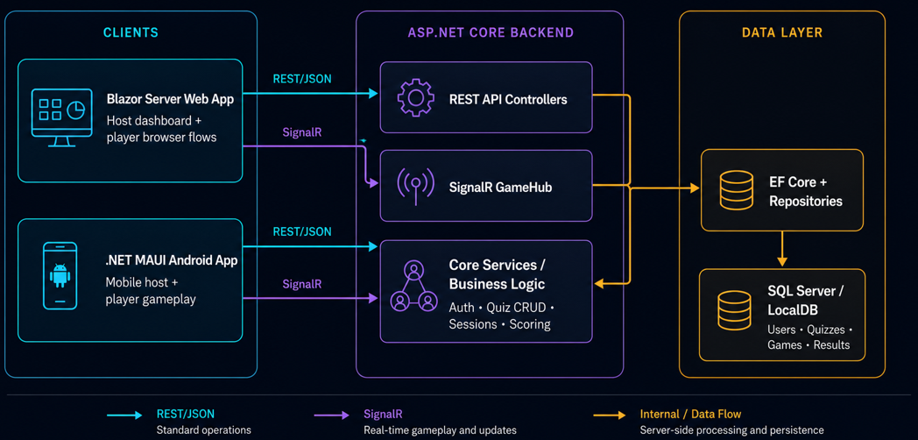
High-level architecture
QuizRush | OICAR Final Presentation

Slide 8
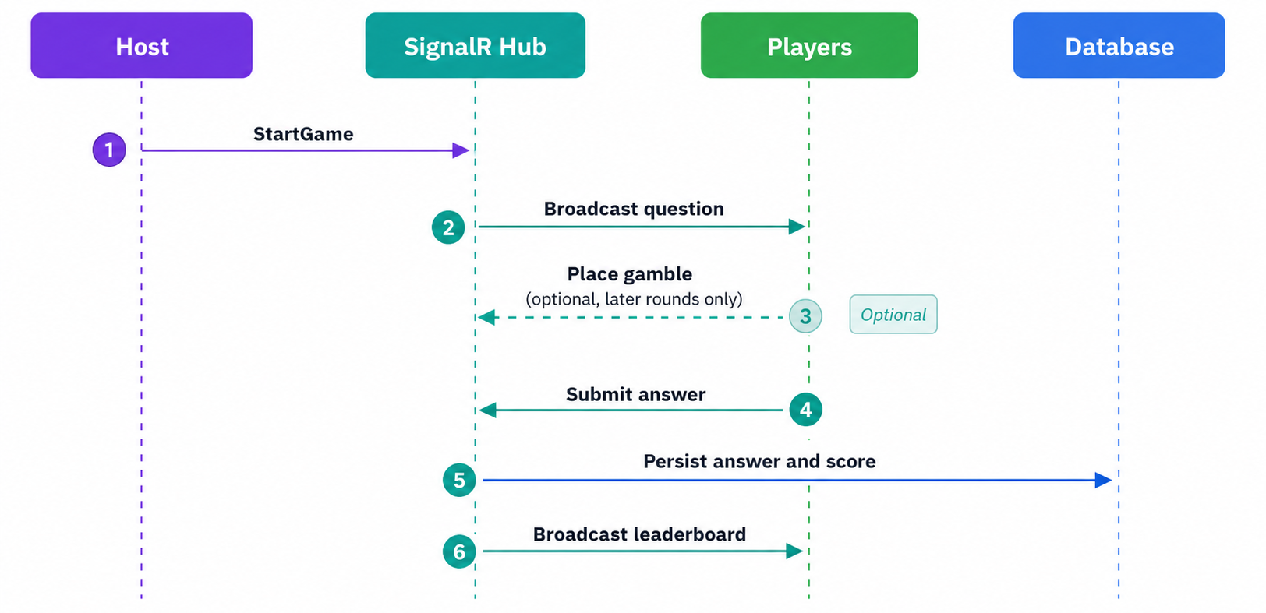
Real-time gameplay sequence
Gambling is an optional pre-question step in later rounds; question broadcast, answer submission, scoring, and leaderboard refresh are synchronized through the hub.
Why it matters
The host controls the timeline, but players receive question and leaderboard updates at the same time instead of polling the server.
QuizRush | OICAR Final Presentation

Slide 9
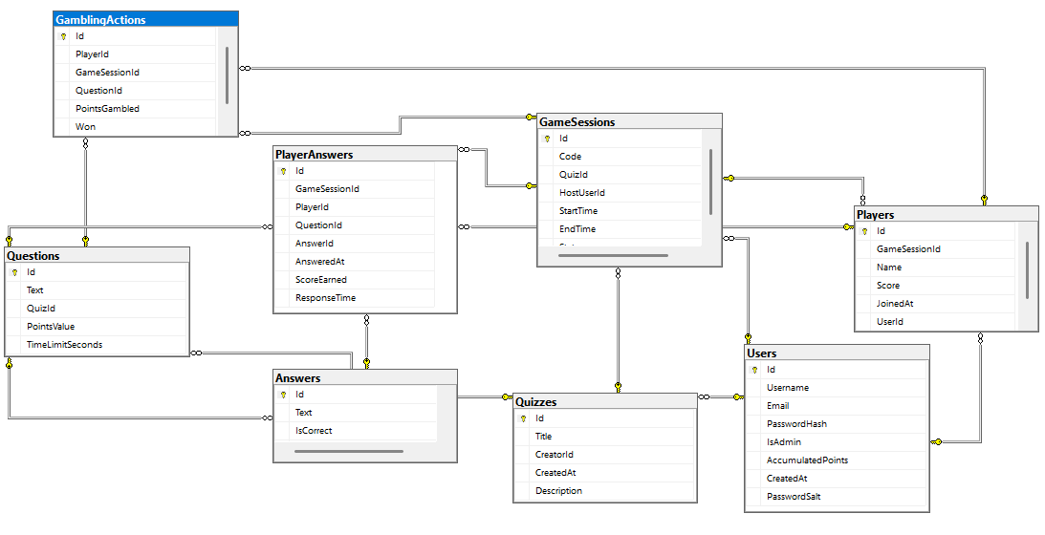
Database overview
Content data (quizzes/questions/answers) is separated from runtime data (sessions/players/answers/gambles), which keeps reusable quiz content distinct from live-game history.
QuizRush | OICAR Final Presentation

Slide 10
Unique feature: score gambling
How it works
Example with base points
Before a question, a player chooses a percentage of their current virtual score to risk. The system converts that percentage into a stake. A correct answer adds normal question points plus the stake bonus; a wrong answer loses the stake. Decisions lock before answering.
Why it helps
500
200
Adds strategy and risk-reward tension beyond ordinary speed-based scoring.
Current score
40% selected risk
Correct answer
+100 question points
+200 stake bonus
Wrong answer
stake is lost
800
300
Final score
Final score
Example assumes a 100-point question: 500 + 100 + 200 = 800.
QuizRush | OICAR Final Presentation

Slide 11
API and SignalR contracts
REST endpoints
Hub methods
Server events
POST /api/auth/register
POST /api/auth/login
GET/POST/PUT/DELETE /api/quiz
POST /api/gamesession
GET /api/gamesession/{code}
GET /api/gamesession/{id}/results
GET /api/user/profile
PUT /api/user/change-password
GET /api/user/stats
HostGame, RejoinGame
StartGame, NextQuestion
EndGamblingPhase, EndGame
JoinGame
PlaceGamble
SubmitAnswer
Question display
Gambling countdown
Answer reveal
Leaderboard refresh
Host notices
Final game results
QuizRush | OICAR Final Presentation

Slide 12
Security and privacy controls
Authentication
Password safety
Personal data
JWT bearer tokens protect owner-only features. Public gameplay remains lightweight through PIN-based joining.
Passwords are hashed and salted with PBKDF2. The database stores hashes rather than plaintext passwords.
Registered users store email, username, profile changes, and history. Guest players only need a display name for a session.
QuizRush | OICAR Final Presentation

Slide 13
Testing and verification
Unit
API startup
Hub connectivity
Manual
Setup
Auth-protected
Services
WebAppFactory
SignalR
Web + mobile
DB setup
flows
Automated tests
Manual flows
Verification focus
xUnit tests cover service logic, score calculation, gambling behavior, and game session creation. Integration checks confirm API startup and SignalR hub connectivity.
Host creates a quiz, launches a session, player joins by PIN, optional gambling opens in later rounds, answer is submitted, and leaderboard updates.
The most important risk area is multiplayer synchronization, so end-to-end web/mobile testing remains essential.
QuizRush | OICAR Final Presentation

Slide 14
Challenges and lessons learned
Real-time state
Cross-client behavior
Security trade-offs
Scope control
Clear session states were needed to avoid conflicting submissions and inconsistent leaderboards.
Web and mobile consume the same API, which simplifies backend logic but requires careful client configuration.
Guest joining must stay simple while registered user actions remain protected by JWT and ownership checks.
Push notifications and extra social features were kept as stretch goals to protect core delivery.
QuizRush | OICAR Final Presentation

Slide 15
Future improvements
iOS support
Cloud deployment
AI quiz generation
Advanced analytics
These improvements build on the Competitive Analysis opportunities: integration, gamification, analytics, customization, and self-hosting.
QuizRush | OICAR Final Presentation

Slide 16
Conclusion
QuizRush delivers a credible full-stack real-time quiz platform.
Delivered product
Technical value
Project value
Web app, Android app, REST API, SignalR GameHub, SQL Server schema, authentication, statistics, and virtual gambling.
Layered architecture, reusable backend, EF Core persistence, test coverage, Swagger, and clear install steps.
Flexible platform designed to be self-hostable for education, corporate training, events, and custom gamified experiences.
Questions?
QuizRush | OICAR Final Presentation

