Slide 1
DBMS CAPSTONE PROJECT
Athenaeum
A Library Management System built on MySQL
› What — a normalized relational database with a live web front-end
› How — MySQL · Node/Express · vanilla HTML/CSS/JS, in a 3-tier design
› Where — deployed live on Vercel (app) + Aiven (database)
athenaeum-roky-pauls-projects.vercel.app

Slide 2
AGENDA
How this talk is organised
PART 1
PART 2
PART 3
PART 4
What is it
How we did it
What we built
Walkthrough
The problem, the goal, and why a library is the perfect model.
Architecture, the data model, and normalization to 3NF.
The database, the logic inside it, the live app & deployment.
The build, step by step — design → database → app → ship.
Athenaeum · Library Management System
2

Slide 3
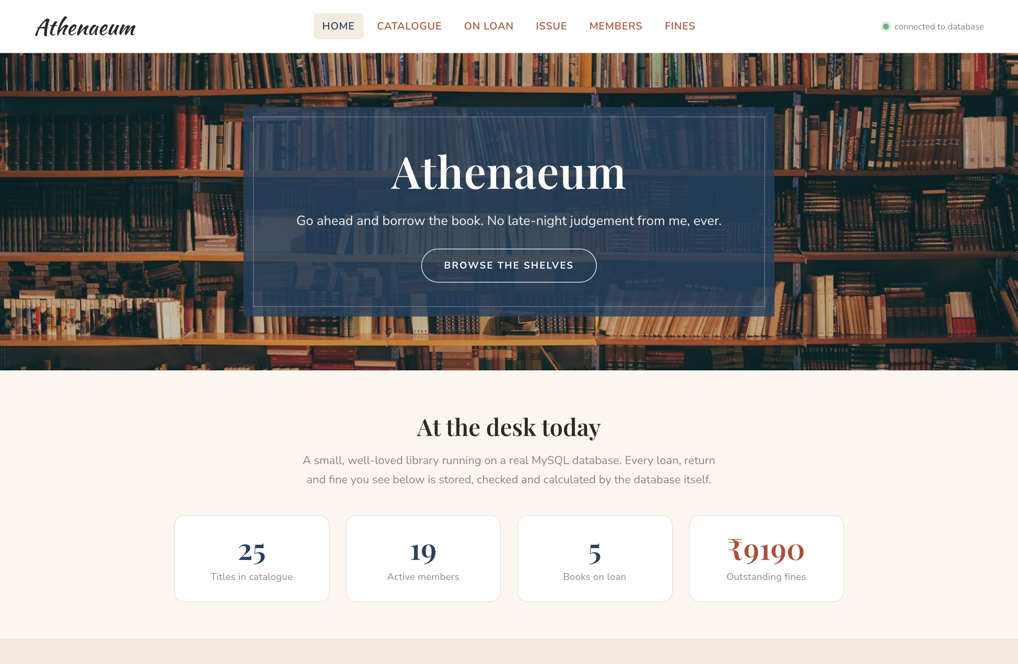
PART 1 WHAT IS IT
A working library, run by a database
Athenaeum manages the everyday work of a library — and every action is stored, checked and calculated by the MySQL database itself.
— Catalogue books, authors, publishers & categories
— Track each physical copy and its availability
— Issue & return books (borrow–return transactions)
— Charge late fines automatically
— Register members & reserve titles
The live home page — bookshelf hero + today's figures
Athenaeum · Library Management System
3

Slide 4
PART 1 WHY A LIBRARY
It exercises every relationship type
One domain that naturally needs 1:M, M:N, recursive and 1:1 links:
1 : M
M : N
self
1 : 1
One-to-Many
Many-to-Many
Recursive
One-to-One
A publisher has many books; a book has many copies.
A book has many authors; an author writes many books.
A category can be a sub-category of another.
Each loan has at most one fine.
Athenaeum · Library Management System
4

Slide 5
PART 2 HOW WE DID IT
System architecture (3-tier)
A browser cannot reach MySQL directly — a server sits in between.
PRESENTATION
APPLICATION
DATA
Browser HTML · CSS · JS
Express API (Node.js)
MySQL (library_db)
renders dashboard, tables & forms
calls views & stored procedures
tables, views, triggers, procedures
Hosted as: application on Vercel · database on Aiven.
Athenaeum · Library Management System
5

Slide 6
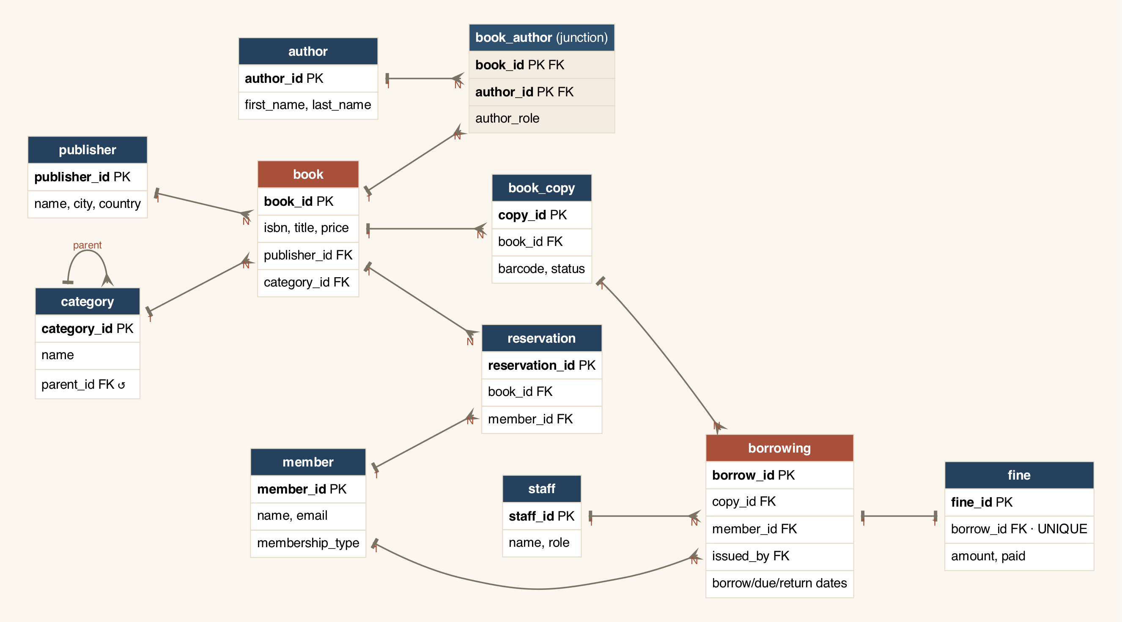
PART 2 HOW WE DID IT
From ER diagram to 11 tables
The entity–relationship design — each box is an entity that becomes one table:
11 tables
— 5 catalogue
— 1 inventory (copies)
— 2 people
— 3 activity
Lines show cardinality — the fork (crow's foot) marks the 'many' side.
Athenaeum · Library Management System
6

Slide 7
PART 2 HOW WE DID IT
The data model — 11 entities
Tables, grouped by purpose
Key relationships
— Catalogue: publisher, category, author, book, book_author
— Inventory: book_copy (each physical item + status)
— People: member, staff
— Activity: borrowing, fine, reservation
— publisher → book (1:M)
— book ↔ author via book_author (M:N)
— book → book_copy (1:M)
— category → category (recursive)
— borrowing → fine (1:1)
— member → borrowing (1:M)
Athenaeum · Library Management System
7

Slide 8
PART 2 HOW WE DID IT
Normalization to 3NF
Each fact stored once — removing redundancy and anomalies.
1NF
2NF
3NF
Atomic values
No partial dependency
No transitive dependency
Multi-valued authors & copies moved to their own tables.
Non-key columns depend on the whole composite key.
Publisher / category details split into their own tables.
Athenaeum · Library Management System
8

Slide 9
PART 3 WHAT WE BUILT
The database layer
Schema
sql/01_schema.sql
11 tables · all constraints · indexes · ALTER demo
Sample data
sql/02_data.sql
~200 meaningful rows (over the 100 minimum)
Views
sql/03_views.sql
catalogue, availability, active loans, fines
Queries
sql/04_queries.sql
joins · subqueries · aggregates · GROUP BY / HAVING
Procedures
sql/05_procedures.sql
3 triggers · 3 procedures · 1 function · transactions
Athenaeum · Library Management System
9

Slide 10
PART 3 WHAT WE BUILT
Logic inside the database
Rules live in MySQL, so data stays correct however it is accessed.
Triggers
Procedures & transactions
— Block issuing a copy that is not Available
— Auto-mark a copy 'Borrowed' when issued
— Auto-free the copy + add a fine on late return
— sp_issue_book / sp_return_book / sp_pay_member_fines
— fn_member_balance() — outstanding dues
— Wrapped in transactions with ROLLBACK (ACID)
Athenaeum · Library Management System
10

Slide 11
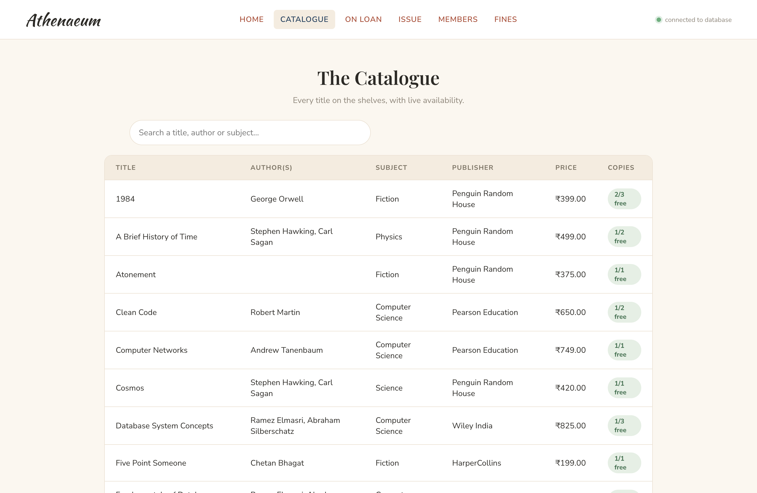
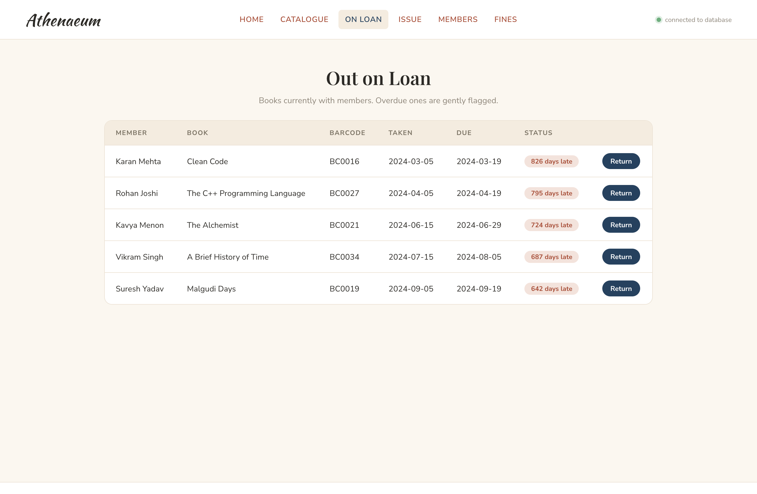
PART 3 WHAT WE BUILT
The live application
On Loan — overdue flagged, one-click return
Catalogue — search + live availability
Athenaeum · Library Management System
11

Slide 12
PART 3 WHAT WE BUILT
Hosting it online
Database → Aiven
Free cloud MySQL; imported sql/init.sql (schema + data + views + procedures).
App → Vercel
Imported the GitHub repo; static front-end + serverless API.
Wiring
Set MYSQL_URL & DB_SSL environment variables, then redeployed.
Result
A public URL — full front-end ↔ backend ↔ live database.
Athenaeum · Library Management System
12

Slide 13
PART 4 WALKTHROUGH
Step 1–4 · Plan & Design
1
Understand the problem
List what a library does; turn the nouns into entities (tables).
2
Map relationships
Decide 1:M, M:N, recursive and 1:1 links between entities.
3
Draw the ER diagram
Blueprint all 11 entities before writing any SQL.
4
Keys & normalization
Surrogate primary keys; design straight to 3NF.
Athenaeum · Library Management System
13

Slide 14
PART 4 WALKTHROUGH
Step 5–9 · Build the Database
5
Create tables
CREATE TABLE with PK, FK, UNIQUE, CHECK, ENUM + indexes.
6
Insert sample data
~200 rows; a mix of returned, active & overdue loans.
7
Create views
Reusable queries for catalogue, availability, loans, fines.
8
Advanced queries
Joins, subqueries, aggregates, GROUP BY / HAVING.
9
Triggers & procedures
Move integrity + workflows into the DB, in transactions.
Athenaeum · Library Management System
14

Slide 15
PART 4 WALKTHROUGH
Step 10–13 · Build & Ship
10
Backend API
Express endpoints that read views and call stored procedures.
11
Frontend UI
Vanilla HTML/CSS/JS — responsive, handmade-style design.
12
Connect with fetch()
JSON over REST; database errors surfaced to the user.
13
Deploy online
Database on Aiven, app on Vercel, wired via env vars.
Athenaeum · Library Management System
15

Slide 16
SUMMARY
Deliverables & technology
Deliverables
Technology
— Relational schema (3NF) + data dictionary
— SQL: schema, data, views, queries, procedures
— ~200-record sample dataset
— Working web app (frontend + API)
— Report & step-by-step walkthrough (PDF)
— This presentation
— Database: MySQL 8 (InnoDB)
— Backend: Node.js + Express
— Frontend: HTML, CSS, JavaScript
— Hosting: Vercel + Aiven
— Source: GitHub
Athenaeum · Library Management System
16

Slide 17
Thank you
Athenaeum — Library Management System
Live demo: athenaeum-roky-pauls-projects.vercel.app
Happy to walk through the schema, the SQL, and a live demo.

