Slide 1

Weather Trend Forecasting
Analysis and forecast modeling for the Global Weather Repository
By : Rola Elabd
PM Accelerator Data Science Assessment 2026
By making industry-leading tools and education available to individuals from all backgrounds, we level the playing field for future PM leaders. This is the PM Accelerator motto, as we grant aspiring and experienced PMs what they need most – Access. We introduce you to industry leaders, surround you with the right PM ecosystem, and discover the new world of AI product management skills.

Slide 2
Problem & Objective
From historical weather observations to a next-day temperature forecast
The goal is to forecast the temperature at the next observation, approximately 24 hours later, for the same location.
Historical
observations
Temporal
feature engineering
Multiple
forecasting models
Final
ensemble
Next-day
temperature
Evaluation is time-based so that future observations are kept separate from training data.
Rola Elabd | Weather Trend Forecasting
2

Slide 3
Dataset Overview Go To Data
A global weather dataset spanning more than two years
Dataset at a glance
Observation period
168,591
observations
16 May 2024 → 1 October 2026
41
features
Features Overview
Features vary from Weather Variables, Air Quality Variables, Astronomical variables,Time variables, and Location variables.
268
locations
191
countries after cleaning
Forecasting setup
For each location, the target is the temperature at the next observation, approximately 24 hours later.
Evaluation uses chronological train / validation / test splits.
Rola Elabd | Weather Trend Forecasting
3

Slide 4
Exploratory Data Analysis
Displaying Just important Plots and Insights

Slide 5
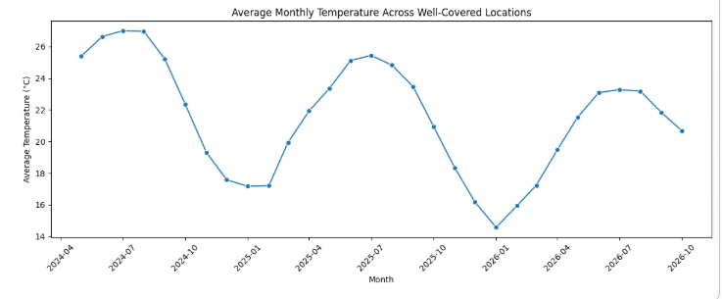
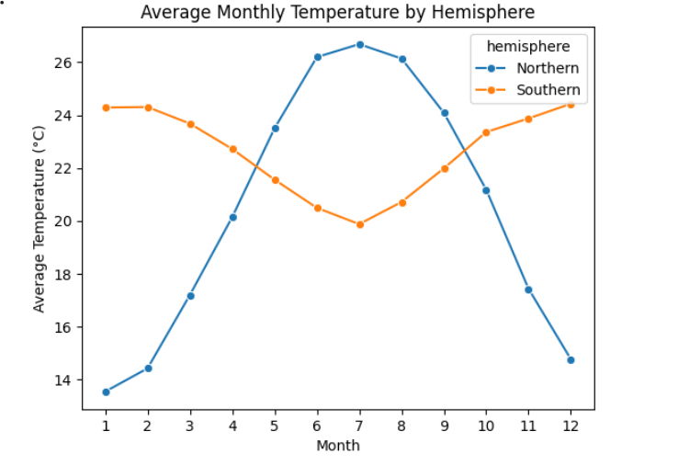
Temperature Patterns
Question: How does temperature vary over time, and how does the pattern differ between hemispheres?
Takeaway: Temperature follows a clear seasonal cycle. Northern locations peak around June–August, while Southern locations peak around December–February, so global averages can hide important geographic differences.
Rola Elabd | Weather Trend Forecasting
4

Slide 6
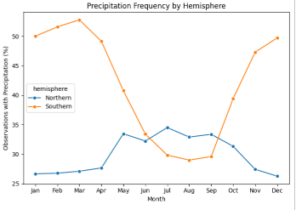
Precipitation Patterns
Question: Does precipitation show seasonal patterns, and do those patterns differ geographically?
What stands out?
67%
of observations have no precipitation
28.94
precipitation skewness
0.13 mm
mean precipitation
74.52 mm
maximum observed precipitation
Takeaway: Precipitation is recorded at the observation level rather than as a daily total.
Overall precipitation frequency changes modestly, but the hemisphere comparison reveals clearer seasonal differences. The strong right skew also means extreme rainfall values need to be interpreted carefully by using median instead of mean.
Rola Elabd | Weather Trend Forecasting
5

Slide 7
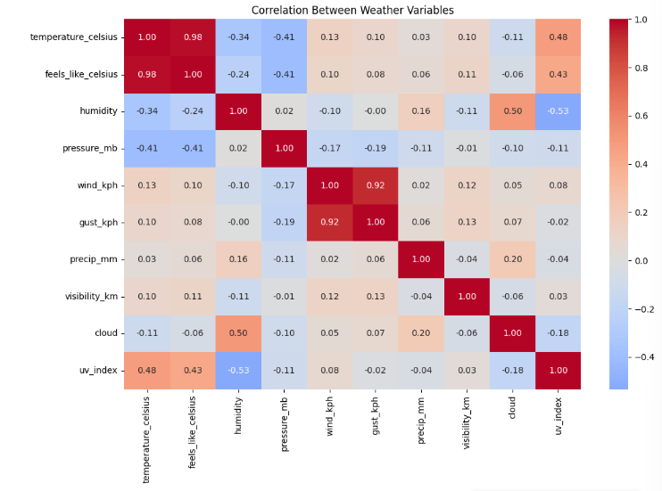
Weather Variable Relationships
Question: Which weather variables have the strongest relationships with temperature?
Key relationships
r ≈ 0.98
Temperature and feels-like temperature are almost perfectly aligned.(won’t use feels like in modeling)
r ≈ 0.92
Wind speed and gust speed are strongly related.(use one of them in modeling to avoid multicollinearity)
r ≈ 0.48
Temperature has a moderate positive relationship with UV index.
r ≈ −0.53
Humidity has a moderate negative relationship with UV index.
Takeaway: Had an overview of what features would benefit the modeling stage and what would need removing
Rola Elabd | Weather Trend Forecasting
6

Slide 8
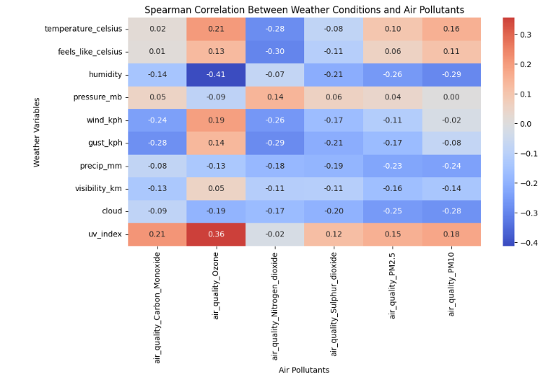
Air Quality & Environmental Impact
Question: How are air pollutants associated with weather conditions, and do these patterns vary seasonally?
Why Spearman?
Several pollutant and precipitation variables are strongly skewed. Spearman measures monotonic relationships without assuming a linear relationship.
What the analysis shows (other plots can be found in the notebook)
Ozone
positively associated with UV (ρ ≈ 0.36) and negatively associated with humidity (ρ ≈ −0.41).
Particulates
PM2.5 and PM10 show negative associations with precipitation and several weather variables.
Seasonality
PM2.5, PM10 and ozone follow different seasonal cycles across the two hemispheres.
Precipitation
Observations with precipitation generally show lower particulate concentrations.
These are associations, not evidence of causation.
Even though they do not have much of a relation with temperature but will be used in the modeling experiments
Rola Elabd | Weather Trend Forecasting
7

Slide 9
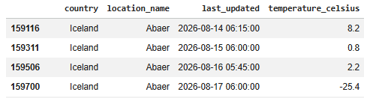
Anomaly Detection & Data Quality
Question: Which extreme observations are genuine weather events, and which indicate data-quality problems?
IQR screening was only a first-pass check
Date-specific temperature anomaly
Extreme values were investigated rather than removed automatically. This was important because unusual weather and pollution measurements can still be valid.
17 August 2026
76 observations showed isolated temperature jumps greater than 10°C relative to both neighboring observations.
Examples required investigation
Temperature
79.3°C in Suva was inconsistent with surrounding observations → treated as a data-entry error.
Wind / gust
Five implausibly high readings were inconsistent with surrounding weather → removed.
Pressure
Two invalid readings (3000 and 3006 mb) → removed.
The same pattern appeared across many unrelated locations on the same date, indicating a likely corrupted batch rather than normal weather variation.
PM10
Two negative PM10 values → removed.
Correction
Only the identified temperature values were interpolated from the surrounding local pattern. The rest of each affected row was preserved.
Precipitation
Highly skewed, but extreme rainy observations were supported by other conditions → retained.
Rola Elabd | Weather Trend Forecasting
8

Slide 10
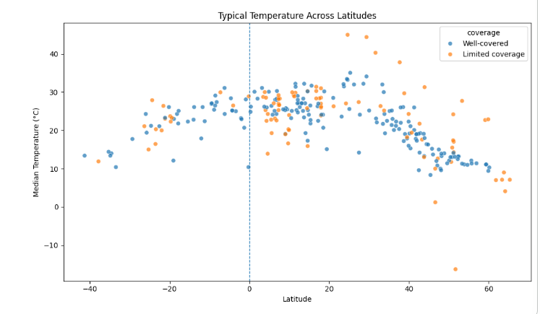
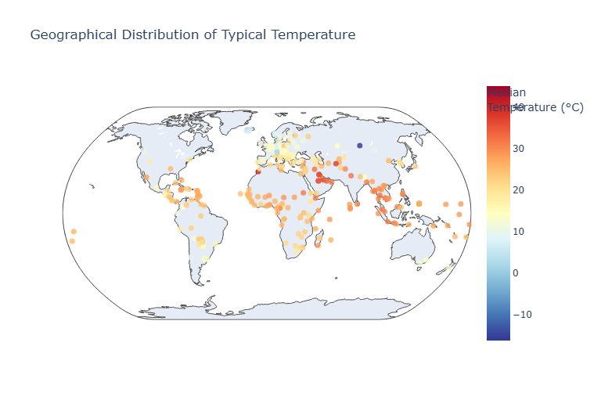
Spatial & Geographical Patterns
Question: How does typical temperature vary geographically across the sampled locations?
What was found
Typical temperature generally decreases farther from the equator, while warmer locations cluster in tropical and subtropical regions.
Locations at similar latitudes can still differ substantially, so latitude alone does not explain all geographic variation.
Coverage matters: 149 of 191 standardized country labels have only one sampled location, so country-level averages are not nationally representative.
Rola Elabd | Weather Trend Forecasting
9

Slide 11
Feature Engineering & Modeling

Slide 12
Forecasting Setup & Feature Engineering
Target : Next-day temperature prediction without leaking future information and providing sufficient history data
Forecasting design
Final feature groups
Current weather
temperature, humidity, pressure, wind, cloud, UV, precipitation
Key checks
Target
Next observation
= 24 hours later
98.75%
of gaps were between 20 and 28 hours
Recent history
lag_1, lag_2, lag_3, lag_7, temp_change_1d, temp_mean_3d
Time window
0.93%
missing lag_1 values retained
22–26 hours
accepted
Seasonality
cyclical day-of-year features
Geography
latitude, longitude, country, Location
No leakage
Evaluation
Features were created only from information available at forecast time.
Chronological
train / val / test
Air Quality
These Features were tested but their feature importance score were nearly zero so they were not included
Takeaway: The setup treats this as a real forecasting problem, not a random row-level prediction task.
Rola Elabd | Weather Trend Forecasting
10

Slide 13
Modeling Approach
Each model was approached differently, some can handle missing values and others needed imputation, some others could handle features as is without scaling and other needed scaling and encoding to ensure good prediction results
Persistence
CatBoost
Hist Gradient Boosting
Ridge
XGBoost
Ensemble
baseline
was tested with basic features then basic features + one lag feature then all features with multiple day lag
linear comparison needed preprocessing
Needed preprocessing
Why these models?
Model selection rule
Persistence
tests whether models can beat a simple “tomorrow ≈ today” assumption.
Validation performance was used to choose hyperparameters, feature sets, and ensemble weights.
Tree models
capture nonlinear relationships without requiring heavy scaling.
Ridge
provides a regularized linear benchmark with imputation, scaling, and one-hot encoding.
The test set was used only for final evaluation.
Ensemble
tests whether CatBoost and Ridge make complementary errors.
Rola Elabd | Weather Trend Forecasting
11

Slide 14
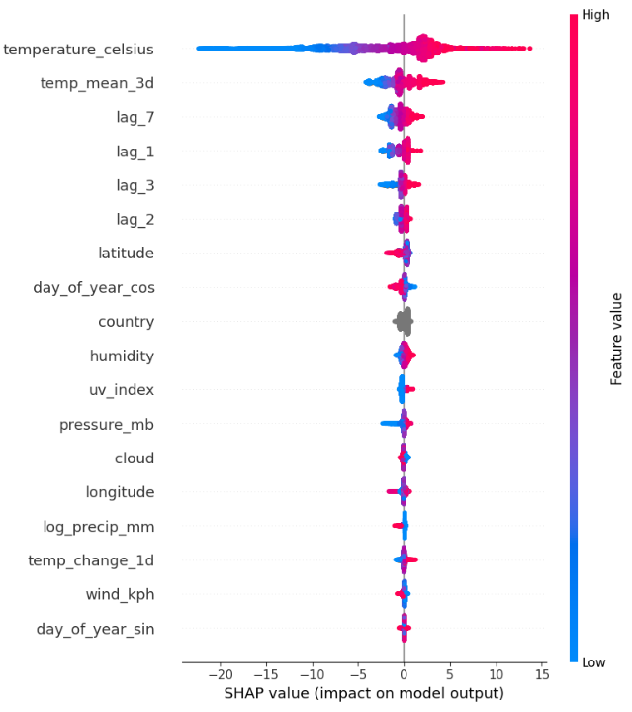
Feature Importance & SHAP
What the model learned
Current temperature dominates
The model relies most on today’s temperature.
Recent history matters
The 3-day mean and lag features add important temporal context.
Geography and seasonality remain useful
Latitude and day-of-year help adjust for location and seasonal effects.
Weather variables are secondary
Pressure, humidity, wind, cloud and precipitation add smaller corrections.
Rola Elabd | Weather Trend Forecasting
12

Slide 15
Model Comparison & Final Ensemble
Question: Did the final ensemble improve forecasting accuracy?
Model | Test MAE | Test RMSE | Test R²
CatBoost + Ridge Ensemble | 1.350 | 1.934 | 0.9229
Final CatBoost | 1.360 | 1.942 | 0.9223
Initial CatBoost | 1.414 | 2.008 | 0.9169
XGBoost | 1.417 | 2.011 | 0.9167
HistGradientBoosting | 1.419 | 2.017 | 0.9162
Ridge | 1.428 | 2.035 | 0.9147
Persistence | 1.445 | 2.126 | 0.9069
Final predictor
CatBoost
70%
weighted average
Ridge
30%
Final Ensemble Test
MAE 1.350 | RMSE 1.934
Takeaway: The ensemble produced the best final test error, but the gain over Final CatBoost was small.
Rola Elabd | Weather Trend Forecasting
13

Slide 16
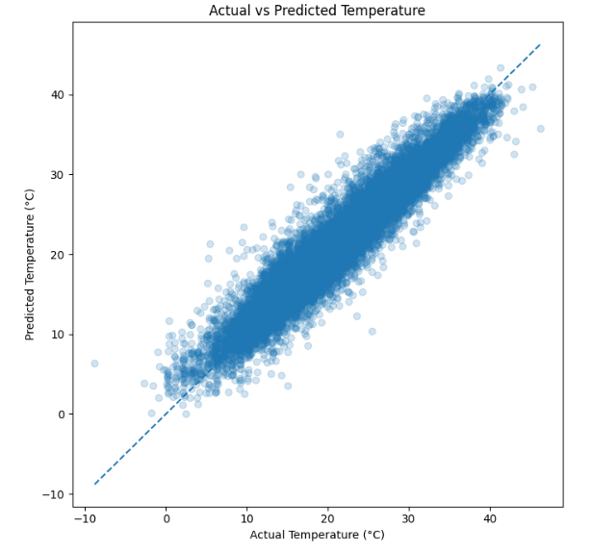
Error Analysis: Overall Fit
Question: How closely do the final ensemble predictions follow the actual temperatures?
What the test set shows
Test R²
0.9229
Mean residual
−0.13°C
Median residual
−0.04°C
Interpretation
Predictions track the diagonal closely, so the model captures most of the overall temperature variation. Residuals are centered near zero, indicating little overall systematic bias. The spread is wider at the lower and higher ends of the temperature range.
Rola Elabd | Weather Trend Forecasting
14

Slide 17
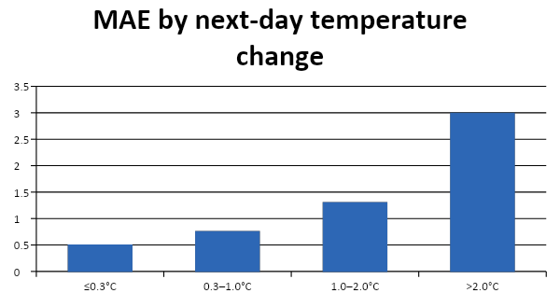
Error Analysis: Where the Model Struggles
Question: Which conditions lead to the largest next-day forecast errors?
Direction of temperature change
Direction | Obs. | MAE | Mean residual
Cooling | 11,642 | 1.53 | −1.41°C
Little/no change | 1,165 | 0.49 | −0.06°C
Warming | 12,193 | 1.26 | +1.08°C
Effect of missing recent history
lag_1 available
MAE 1.34
lag_1 missing
MAE 2.06
Main limitation
The ensemble is strongest when temperature stays fairly stable. It tends to dampen larger changes: cooling is overpredicted, while warming is underpredicted. Missing recent temperature history also increases error.
Rola Elabd | Weather Trend Forecasting
15

Slide 18
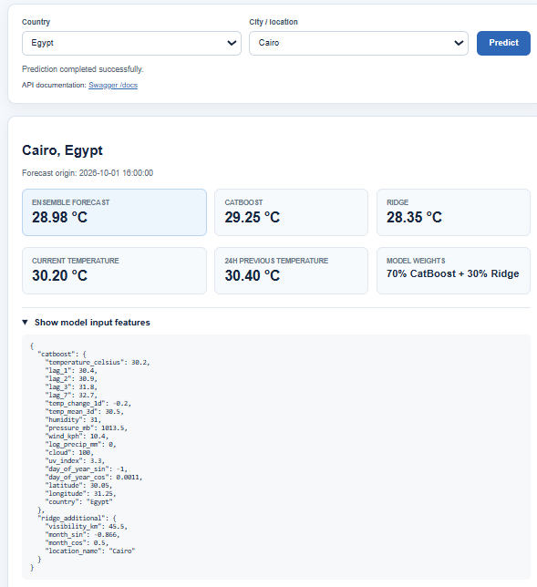
Deployment Demo
Live prediction pipeline
Input
Weather API
Feature prep
Saved models
Forecast
city + country
current + recent
weather history
lags, rolling mean,
seasonal features
CatBoost + Ridge
next-day
temperature
FastAPI interface
GET /predict accepts city and country, then returns feature values and the ensemble forecast.
Note: the demo uses live Open-Meteo inputs, while the model was trained on the Kaggle dataset, so it demonstrates deployment flow rather than separately validated production performance.
Rola Elabd | Weather Trend Forecasting
16

Slide 19
Thank You

