Slide 1
DISCUSSION SECTION
WEEK 2
EXPRESSIONS, CONDITIONALS, LOOPS, & C++ PROGRAM STRUCTURE

Slide 2
C vs. C++
C++, also known as “C with Classes,” is an extension of C with object-oriented programming support
You can write C code in your C++ program; C++ cannot be written in C programs
C has approx. 32 keywords, C++ has 95 keywords
• You don’t need to memorize them; you will get familiar with them as you write more C++ code
You will be working in C++ in future classes; probably C as well

Slide 3
Refresher…
C++ is a strictly typed language
• You must explicitly declare the type of a variable (or function) when creating it
All C++ programs must have a main function.
ALWAYS!
• By C++ Standards, the main function cannot be called within a program.
All statements in C++ must end with a semicolon
C++ is not whitespace sensitive, but is case sensitive

Slide 4
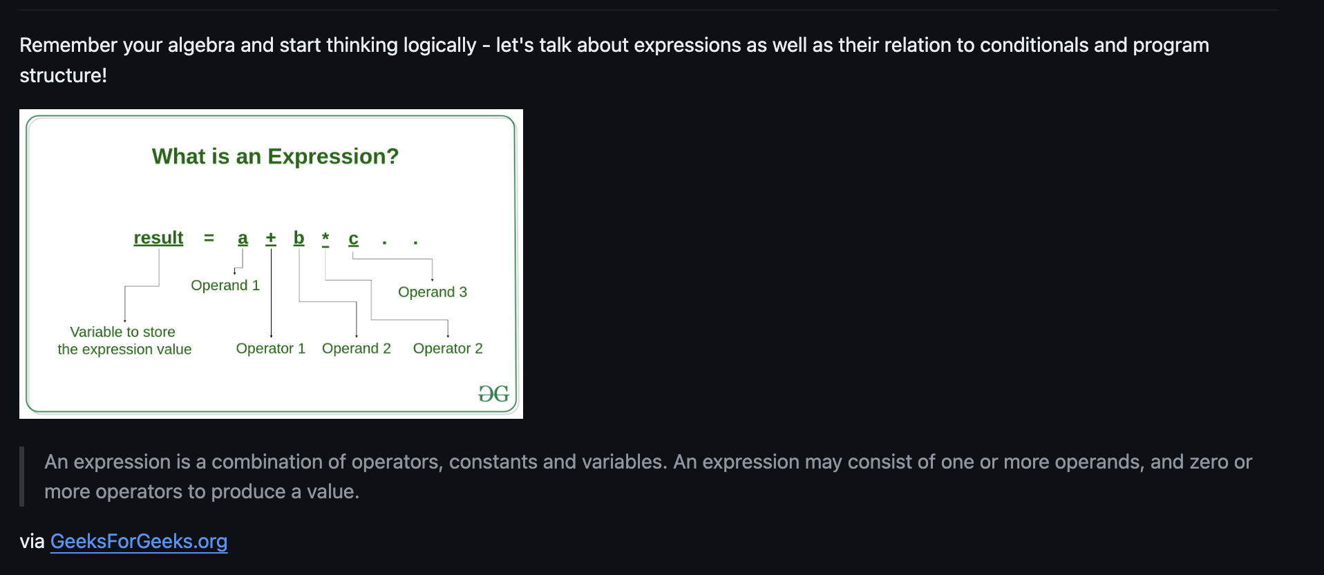

Slide 5
Using Boolean Expressions for Conditionals
Knowing that expressions can come in a variety of different forms, let’s think about how we can utilize them for conditional statements. So, let’s take a look at Boolean expressions.
First, what is a Boolean expression? A Boolean expression is a specific kind of expression whose value when evaluated results in true or false (sometimes 1 or 0, respectively).

Slide 6
Using Boolean Expressions for Conditionals
Knowing that expressions can come in a variety of different forms, let’s think about how we can utilize them for conditional statements. So, let’s take a look at Boolean expressions.
First, what is a Boolean expression? A Boolean expression is a specific kind of expression whose value when evaluated results in true or false (sometimes 1 or 0, respectively).

Slide 7
For example, the code snippet below assigns a Boolean variable in C++ to true or false depending on whether or not the value of x is greater than or equal to 25.
bool myBooleanExpression = (x >= 25);

Slide 8
Another example: the code snippet below assigns a Boolean variable in C++ to true or false depending on whether or not the value of x is equal to the square root of y.
bool myBooleanExpression = (x == sqrt(y));
Note: == is an equality operator that is used to compare right side with left side. Returns true/false.
= (single equal sign) is an assignment operator used to assign values to variables.
Understand when to use either!

Slide 9
What would be the value of our Boolean variables?
int x = 25;
int y = 62;
1. bool variable1 = (x > 0);
2. bool variable2 = (y % 2 == 0);
**Remember that % gets the remainder after an integer division
3. bool variable3 = (x == y);
4. bool variable4 = (x % 10 != 0);

Slide 10
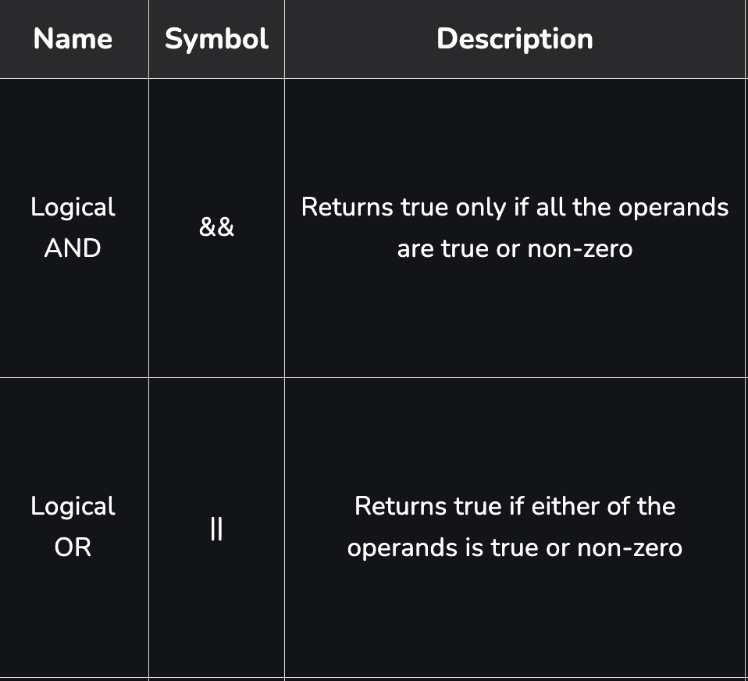
Compound Boolean Expressions
We can certainly combine two or more individual Boolean expressions into a single compound expression, using logical operators!
But first, we must understand
the Truth table.

Slide 11
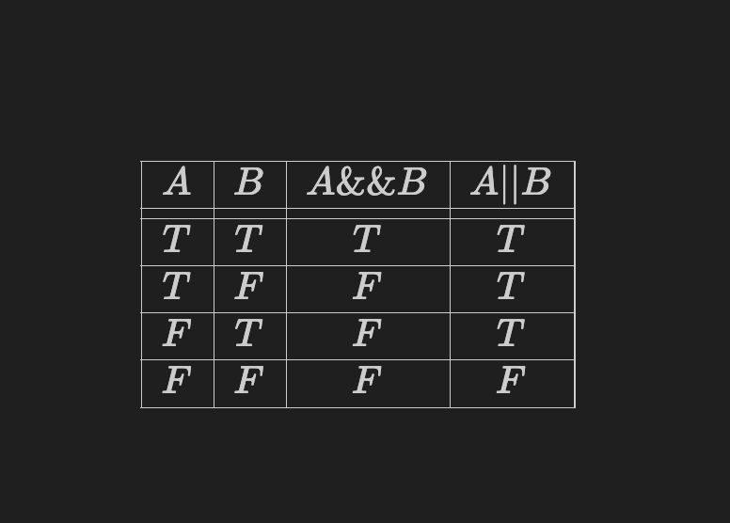
Examples:
bool myExpression = (x >= minVal && x <= maxVal && y >= minVal && y <= maxVal);
bool myExpression = (x > 0 && y < 10) || (z == 5 && w != 0);

Slide 12
Exercise 1 (5 minutes):
Consider a scenario where a company offers discounts based on the following criteria:
If the purchase amount is greater than $100 and the customer is at least 50 years old, they get a discount.
If the purchase amount is between $50 and $100 (inclusive) and the customer is less than 50 years old, they get a discount.
Write a Boolean expression that evaluates to true if a customer is eligible for discount based on the given criteria; and evaluates to false otherwise.
***You can use two variables of your choosing for age and purchase amount.

Slide 13
Answer
bool discountEligible = (amt > 100 && age >= 50) || (amt >= 50 && amt <= 100 && age < 50);
Notes:
bool discountEligible = (amt > 100 && age >= 50) || (amt >= 50 && amt <= 100 && age < 50);

Slide 14
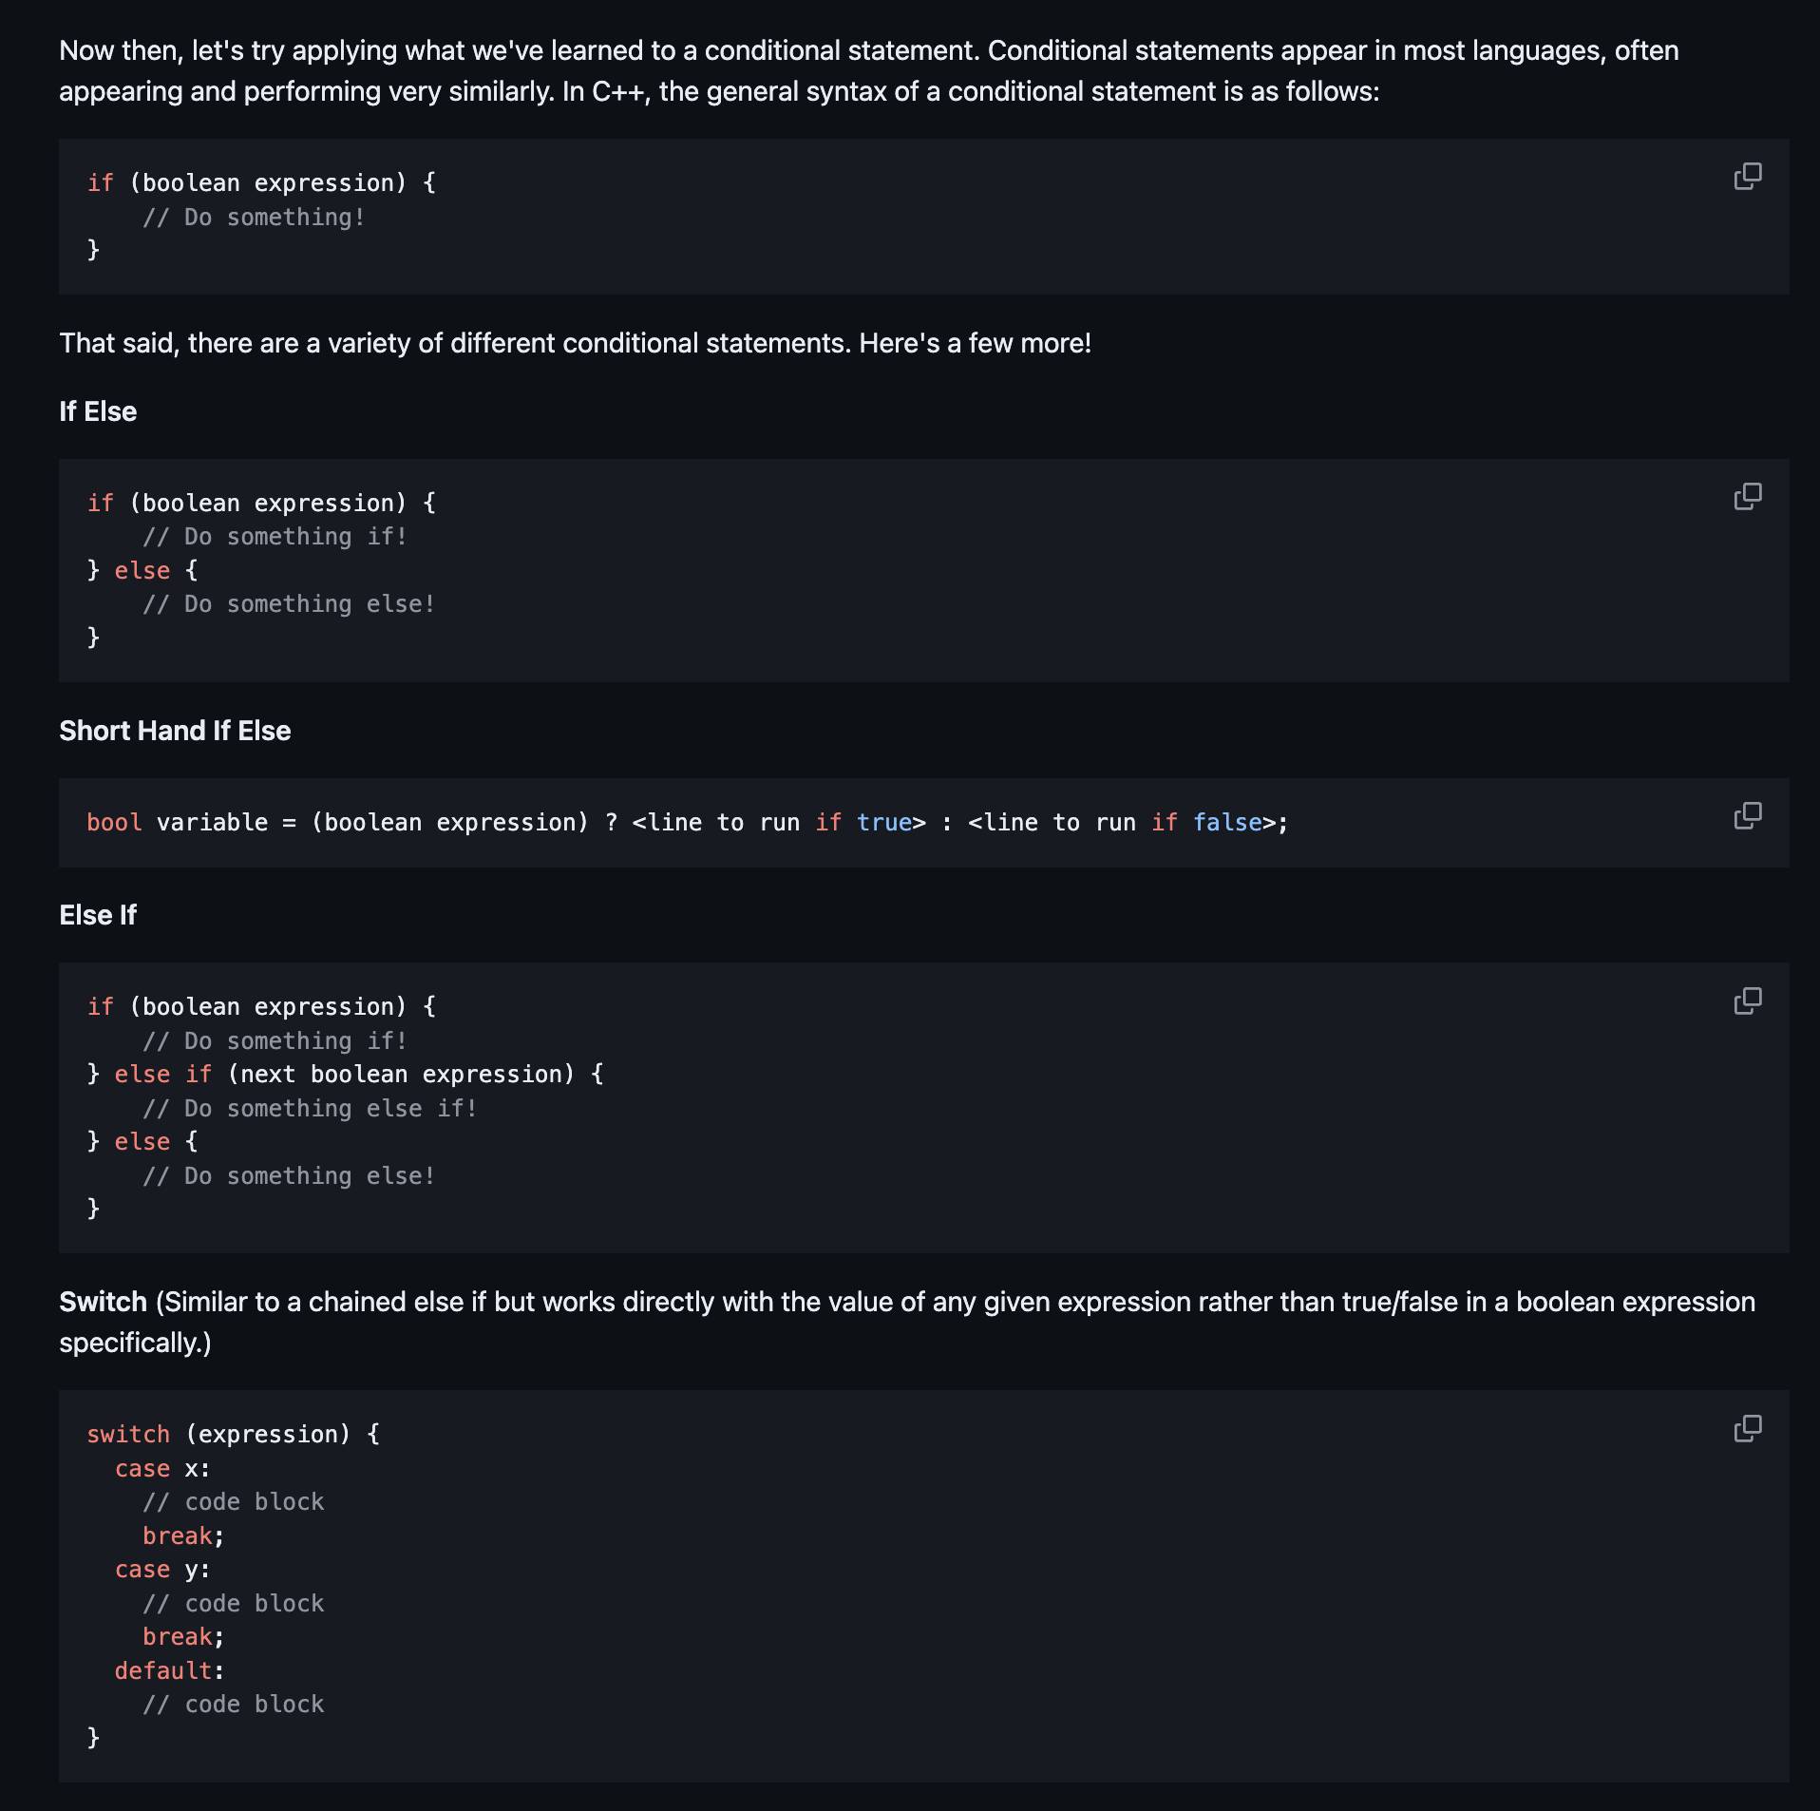

Slide 15
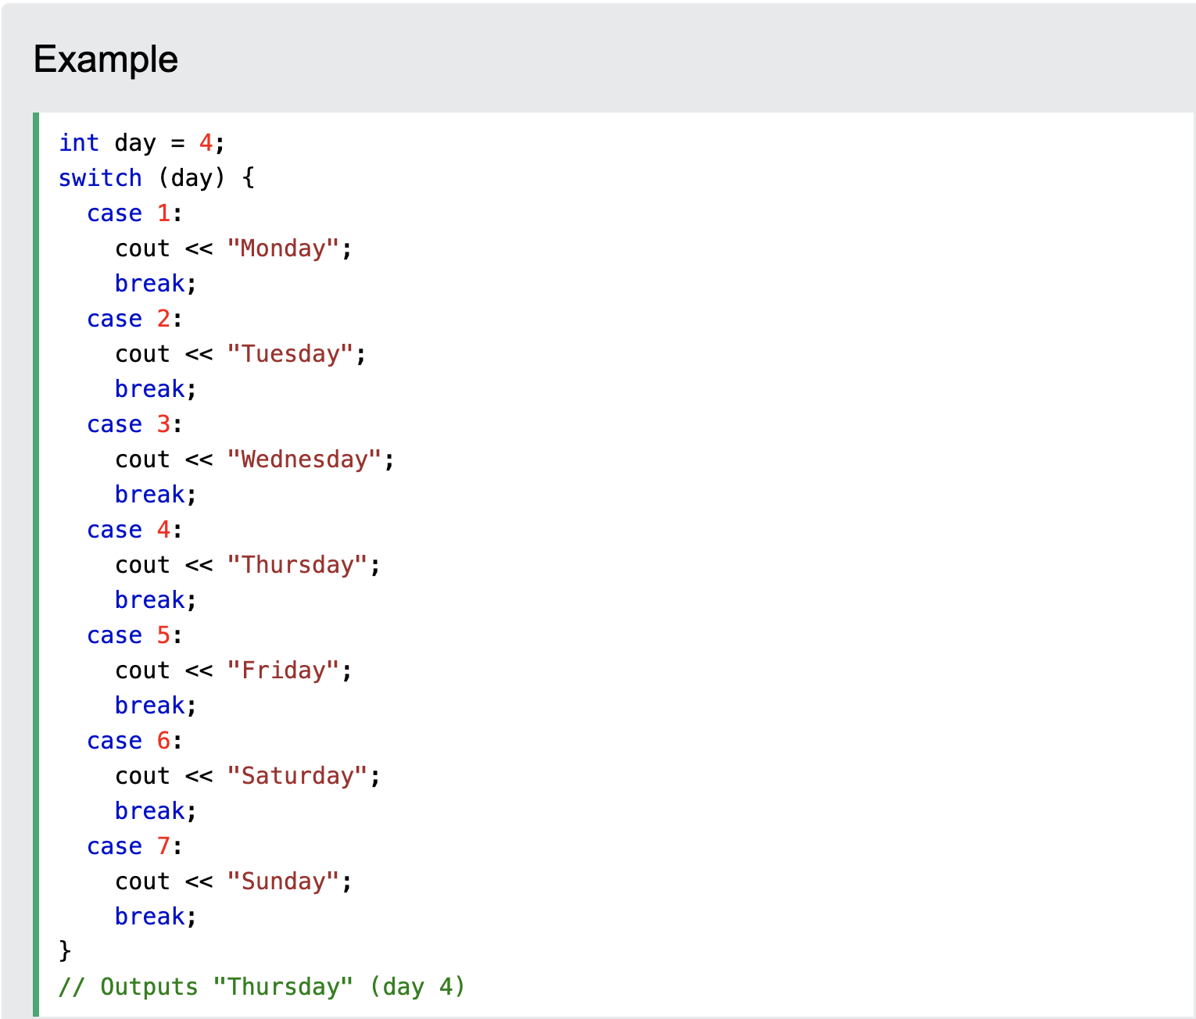
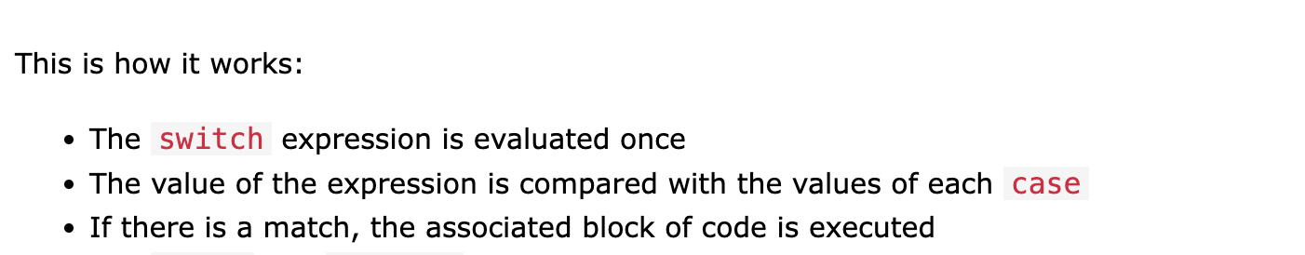
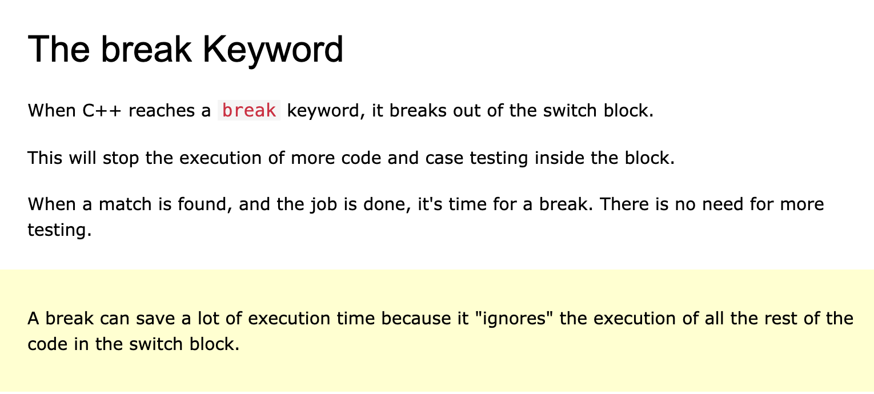
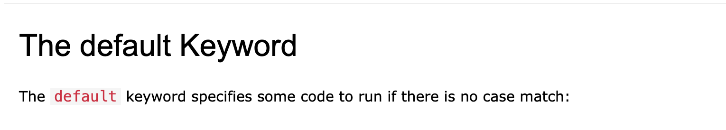
Notes:
bool discountEligible = (amt > 100 && age >= 50) || (amt >= 50 && amt <= 100 && age < 50);

Slide 16
Exercise 2 (10 minutes):
1. Convert the switch statement on the previous slide to conditional statements (using if, else if, & else).
2. Write a program that takes in an integer between 1 and 12 (inclusive), and prints out the month corresponding to that number. Use a switch statement.
• Print “Invalid month” if the integer input is not between 1 and 12. (Hint: this is the default case!)

Slide 17
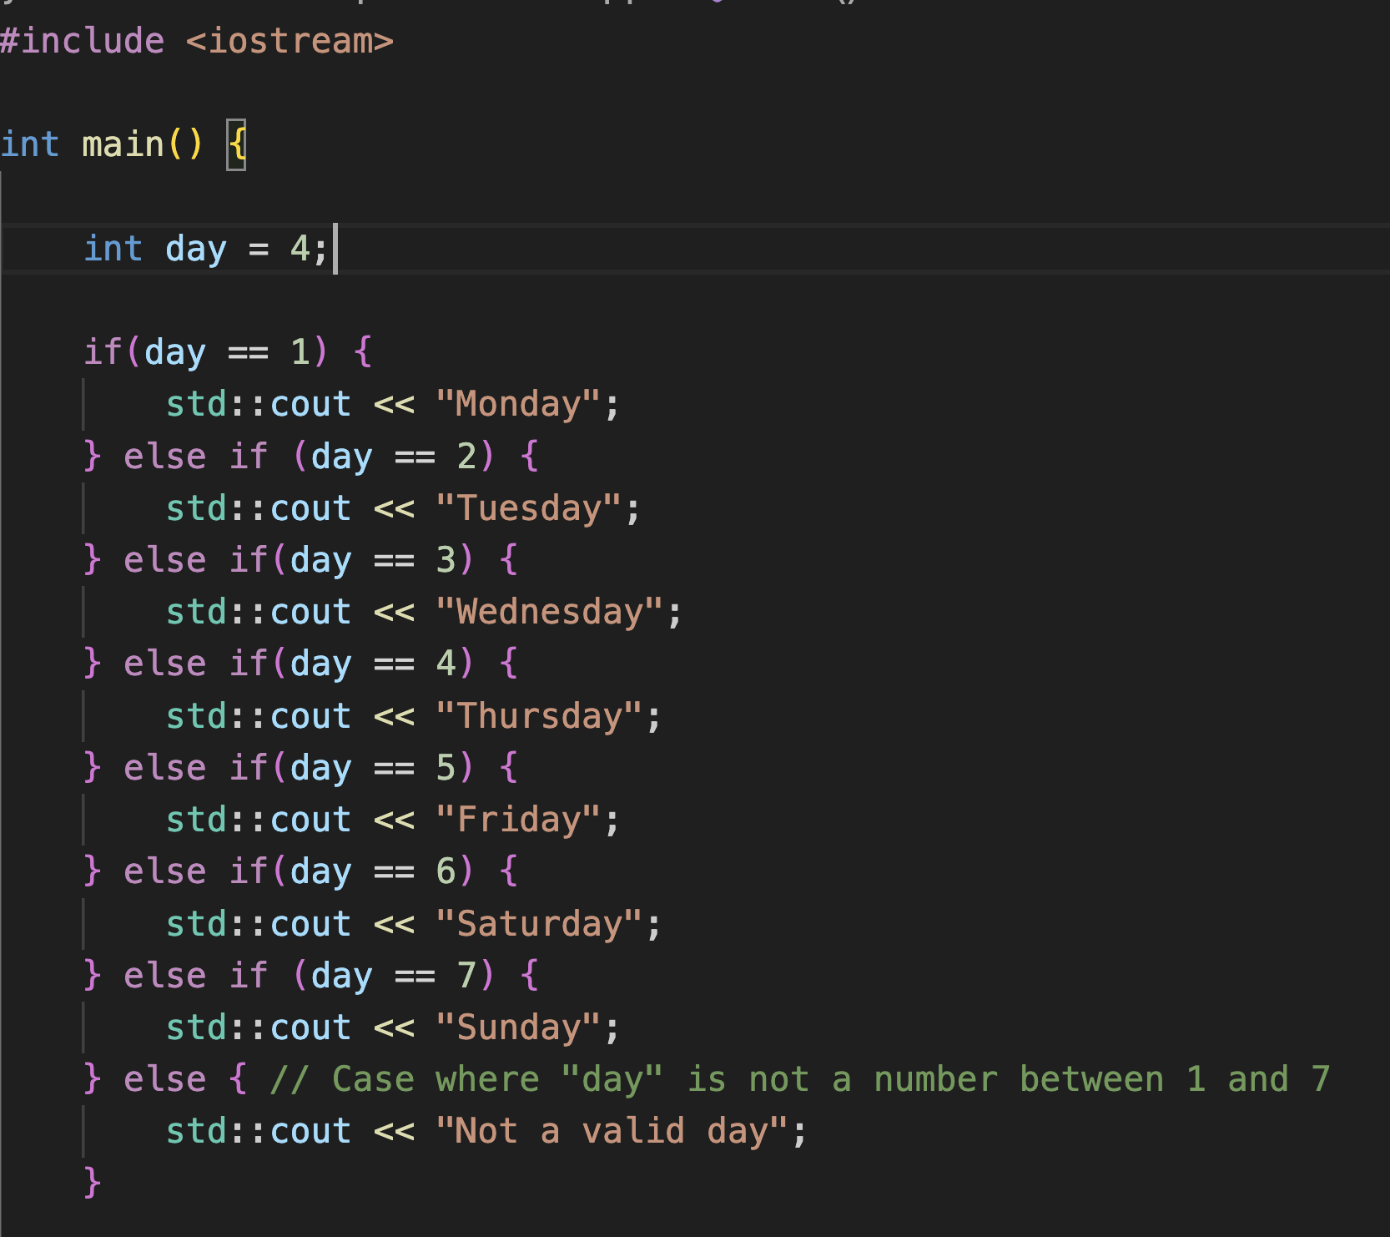

Slide 18
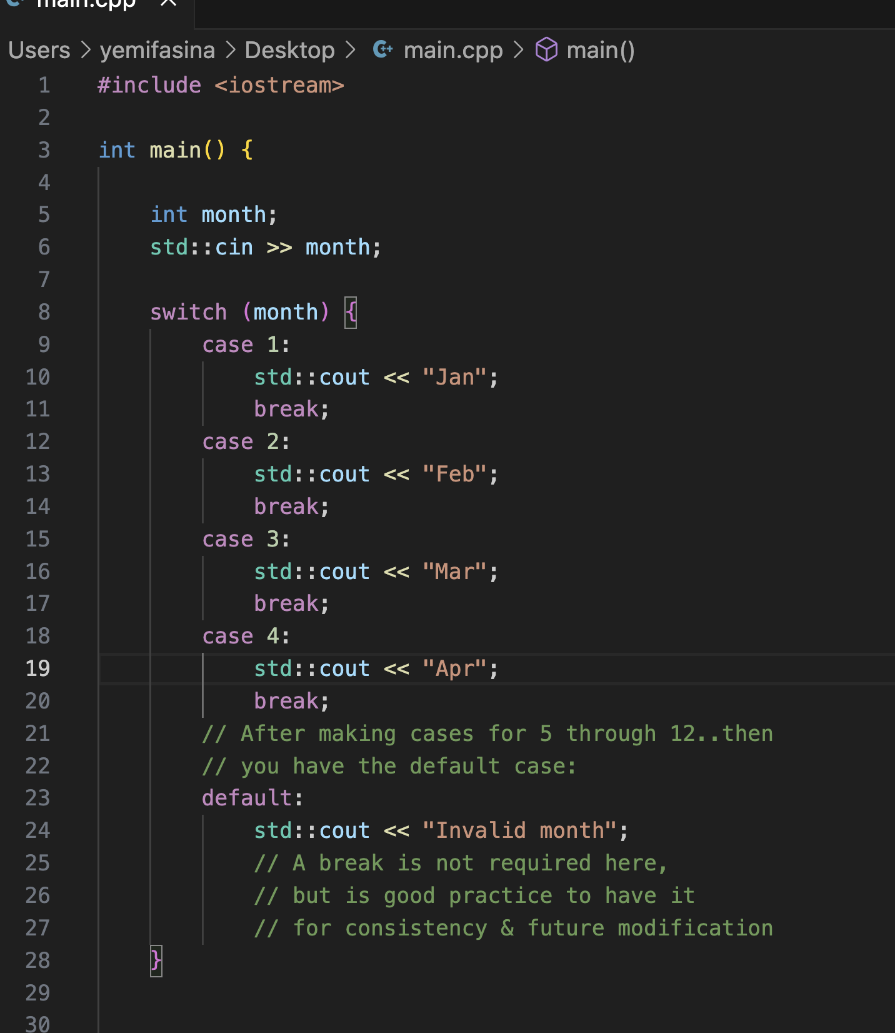

Slide 19
Loops..
for(init; boolean expression; update) {
// some code to be executed
}
• init is usually the declaration of a variable to control the loop
• boolean exp. is the condition for executing the code block
• update modifies the variable in init

Slide 20
Range-based For Loop (or For-each loop)
for(type variableName : rangeExpression) {
// some code
}
Example:
for(char letter : "Programming") {
std::cout << letter;
}
• Note: You may get a warning message using the range-based loop if your version of C++ is prior to C++11. In that case, you can add a c++11 flag to your compilation as in:
g++ -std=c++11 main.cpp -o main
….or better still, don’t use range-based loop at all

Slide 21
Nested Loop
is a loop within a loop
Example Scenario:
Suppose you’re a teacher in a classroom with 3 rows of desks, and each row has 7 students. You want to say “Hello” to every student in each row.
for(int numberOfRows = 1; numberOfRows <= 3; numberOfRows++ ) {
for(int numStudentsPerRow = 1; numStudentsPerRow <= 7; numStudentsPerRow++) {
std::cout << "Hello" << std::endl;
}
}
• In this case, we are able to visit all students in a row (inner loop), before moving on to another row (outer loop).

Slide 22
Exercise 3 (15 minutes)
Write a program to print a 2x3 grid of numbers starting from 1.
Expected Output:
1 2 3
4 5 6

Slide 23
Answer
#include <iostream>
int main() {
int number = 1;
for (int rows = 1; rows <= 2; rows++) { // 2 rows so outer loop runs twice
for (int cols = 1; cols <= 3; cols++) { // 3 numbers per row
std::cout << number << " ";
number++;
}
std::cout << std::endl; // Move to the next line after each row has printed
}
return 0;
}
Output:
1 2 3
4 5 6

