Slide 1
DISCUSSION SECTION
WEEK 1
COMMAND LINE INTERFACE
(CLI)

Slide 2
Command Line Interface…
- is a text-based interface where you can input commands that interact with a computer’s operating system (OS).
- is different on various operating systems
* MacOS: Mac Terminal
* Windows: Windows PowerShell or Command Prompt
* Linux: Linux Bash Shell
* Microsoft Azure: Azure CLI Bash

Slide 3
A few CLI applications…
1. Configuration of your IP address
2. Send and receive emails
3. Package Management
* to install, update and remove software packages
4. Text Processing
* to search within files (like Command + F)

Slide 4
The Standard
- Majority of developers & companies use Linux or MacOS. So, get used to Bash!
- Linux/MacOS is more comfortable; programming tools are easier to use with both e.g., Node.js with NVM
- Commands are much simpler to write in a Linux/MacOS terminal as supposed to, for
example, a Windows PowerShell
wc -l filename vs. (Get-Content filename | Measure-Object -Line).Lines

Slide 5
Some Background about Linux File Systems
- The Linux file system can be viewed as a tree like structure.
- The system is made of directories (folders), subdirectories and files.
- ~ is the home directory. For the purpose of this class, all work will be done in the path ~/

Slide 6
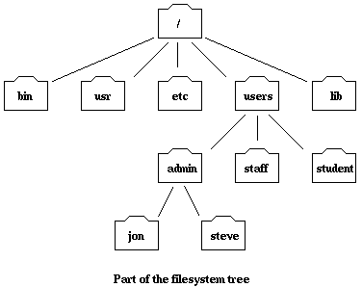
File System Overview
Current working directory
Denoted by “.”

Slide 7
File System Overview
“Parent directory”
Denoted by “..”

Slide 8
A few Shell Commands…
• pwd*
• cd*
• man
• ls*
• mkdir*
• rm*
• rmdir*
• mv*
• touch*
• cp
• cat
• echo*
• grep *Frequently used in CSC 211

Slide 9
pwd
Prints the current working directory
cd
Change Directory – change the current working directory to a specific Folder

Slide 10
mkdir
Create new folder(s), if they do not already exist
touch
Create new file(s)

Slide 11
rm
Remove files (delete/unlink)
rmdir
Remove/delete folder; this command will only work if the folder is empty
rm –r folderName to delete non-empty folders. Warning: this is irreversible!

Slide 12
mv
Move or rename files or directories
echo
Display message on screen, writes each given String to standard output, with a space between each, and a newline after the last one

Slide 13
clear
Clear the entire terminal window
open
Used to launch files, folders (multiple too), URLs, applications, and others..

Slide 14
cat
Concatenate and print (display) the content of files
nano
Opens a file in the nano text editor. If the file does not exist, nano will create it for you.

Slide 15
Exercise 1 (10 minutes)
Provide a sequence of commands to:
Navigate to your Desktop directory
Create a folder named Exercise-1 and navigate to that folder
Create a file named bashIntro.txt and add the text “I am learning bash!” to the file (Hint: use nano!)
Make two copies of bashIntro.txt, named copy1.txt and copy2.txt
Delete copy2.txt; Rename copy1.txt to bashCopy.txt
Display the contents of bashCopy.txt
Delete the Exercise-1 folder

Slide 16
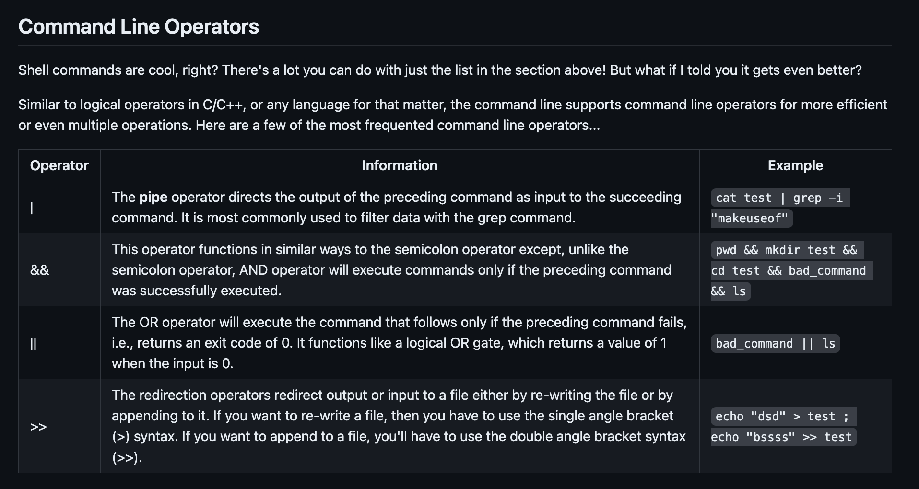

Slide 17
Exercise 2 (10 minutes)
DO IT ALL AT ONCE WITH COMMAND LINE OPERATORS!
Navigate to your Desktop directory
Create a folder named Exercise-1 and navigate to that folder
Create a file named bashIntro.txt and add the text “I am learning bash\!” to the file (Hint: use redirection operator!)
Make two copies of bashIntro.txt, named copy1.txt and copy2.txt
Delete copy2.txt; Rename copy1.txt to bashCopy.txt
Display the contents of bashCopy.txt
Delete the Exercise-1 folder
Notes:
cd Desktop && mkdir Exercise-1 && cd Exercise-1 && echo "I am learning bash\!" > bashIntro.txt && cp bashIntro.txt copy1.txt && cp bashIntro.txt copy2.txt && rm copy2.txt && mv copy1.txt bashCopy.txt && cat bashCopy.txt && cd .. && rm -r Exercise-1
In bash, the exclamation mark (!) has a special meaning related to history expansion, where it is used to refer to previous commands in the command history. When you include an exclamation mark inside double quotes, bash tries to interpret it as a history expansion, which can lead to unexpected behavior or errors.
To safely include an exclamation mark in a string without triggering history expansion, you have a few options:
Use single quotes: Single quotes prevent history expansion and other special character interpretations.
Disable history expansion temporarily: You can disable history expansion for the current session using set +H. Do this before running the echo command
Escape the exclamation mark: You can escape the exclamation mark with a backslash (\).

Slide 18
Now you should be able to compile and run your C++ code at once!
g++ main.cpp -o main && ./main

