Slide 1
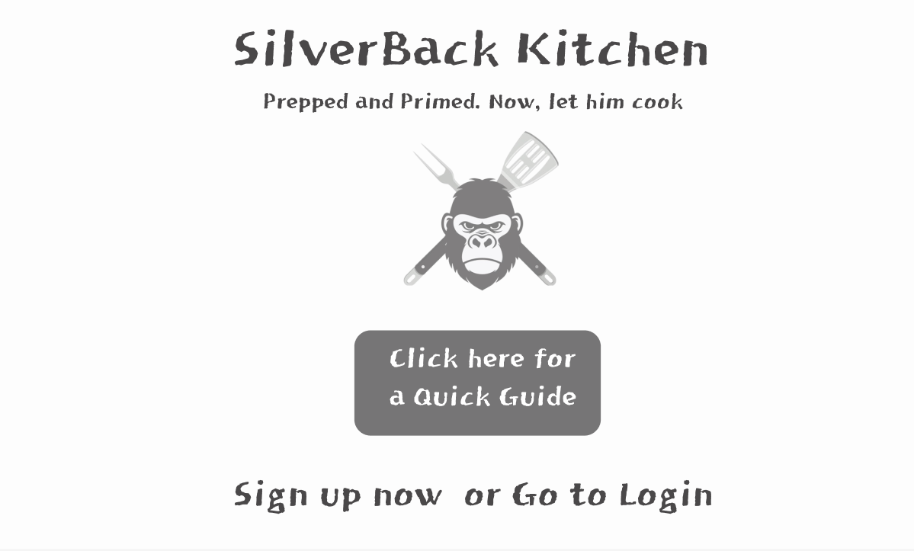
View: Landing Page -> if user searches for SilverBack Kitchen, Route Name: https://silverbackkitchen.com

Slide 2
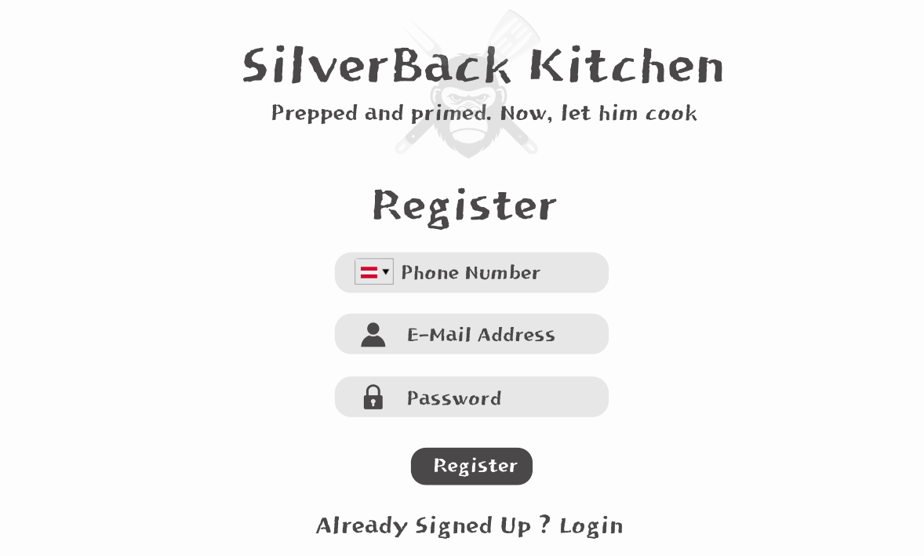
View: Register Page, Route Name: https://silverbackkitchen.com/register

Slide 3
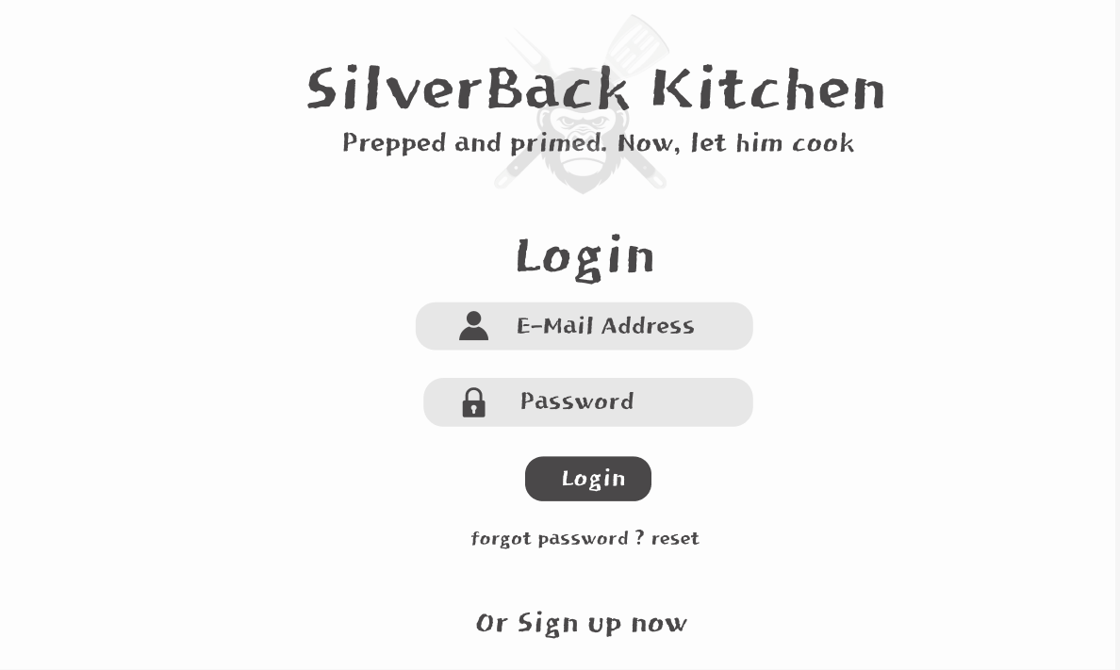
View: Login Page, Route Name: https://silverbackkitchen.com/login

Slide 4
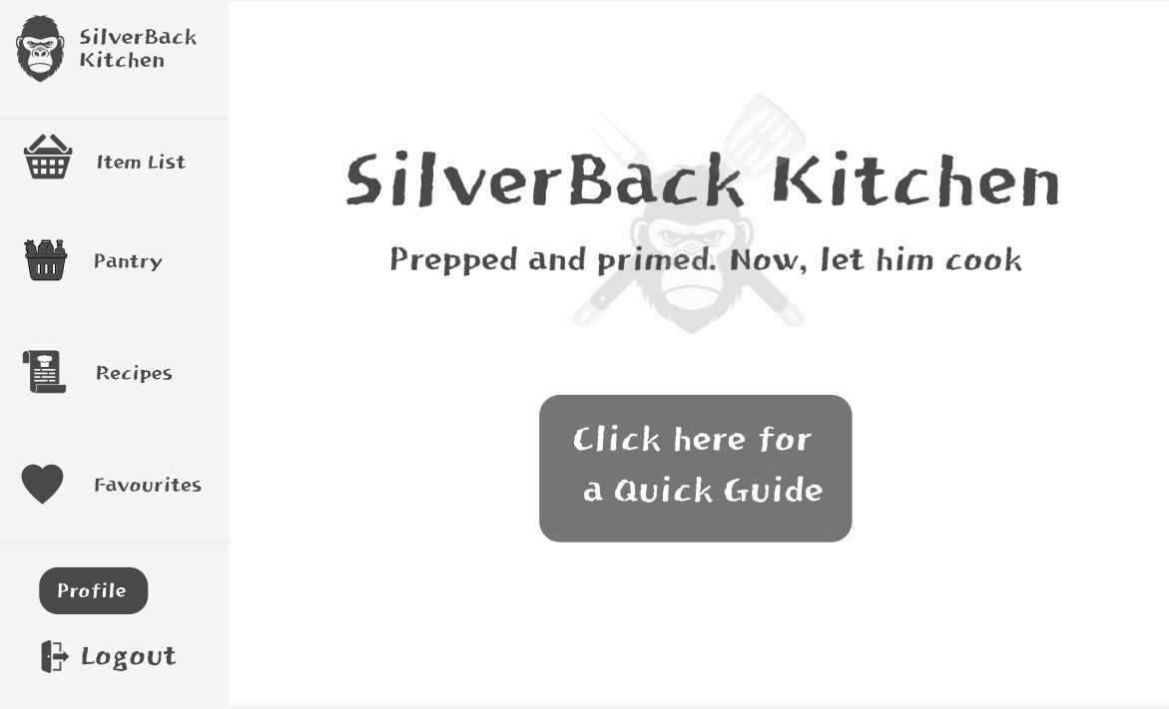
View: Dashboard Page if user registers or logs in or clicks the „back to home“ button, Route Name: https://silverbackkitchen.com/dashboard

Slide 5
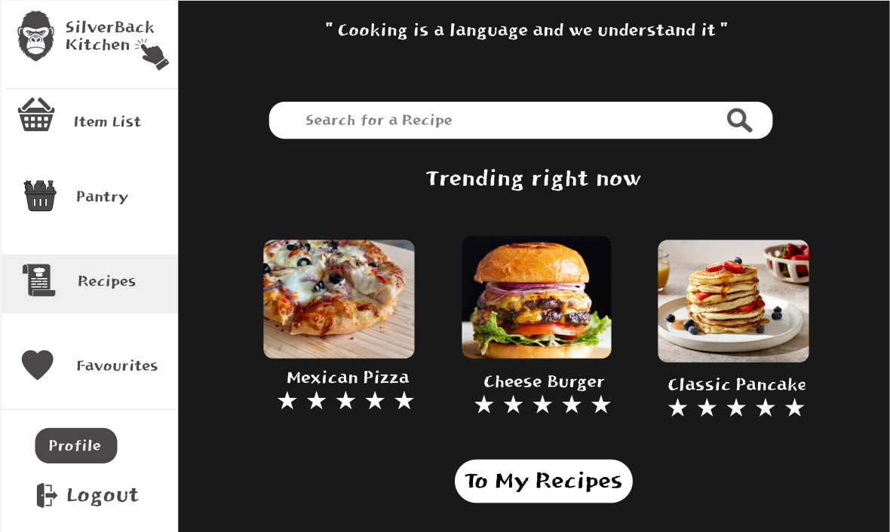
View: Online Recipes Section, Route Name: https://silverbackkitchen.com/dashboard/recipes

Slide 6
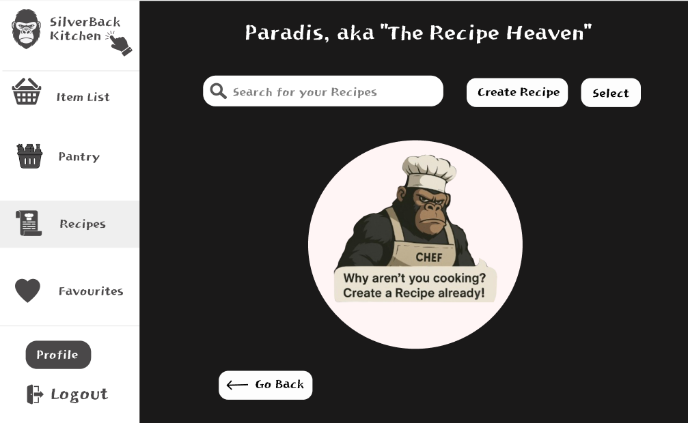
View: My Recipes Section, Route Name: https://silverbackkitchen.com/dashboard/recipes/my-recipes Here it‘s the view if user has not created any recipes yet

Slide 7
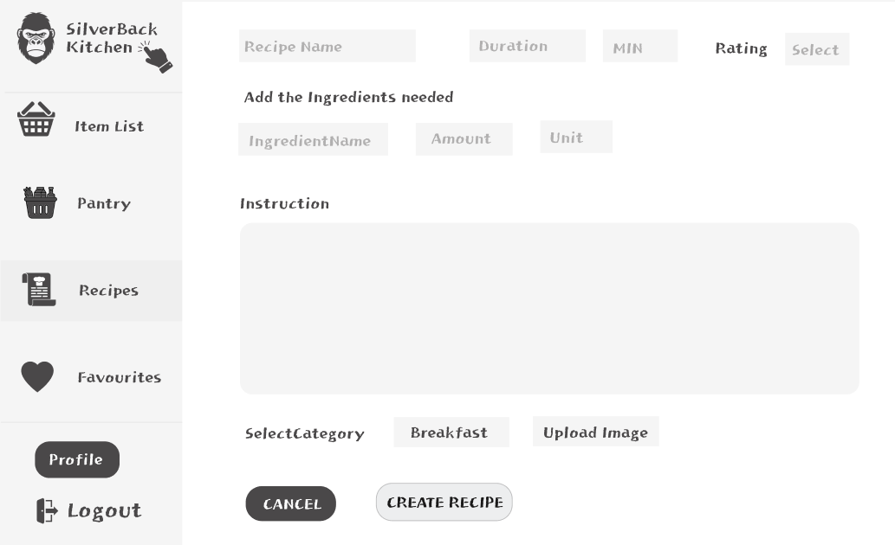
View: My Recipes Section, Here it‘s the view if user clicks on create recipe button Route Name: https://silverbackkitchen.com/dashboard/recipes/my-recipes/create-recipe

Slide 8
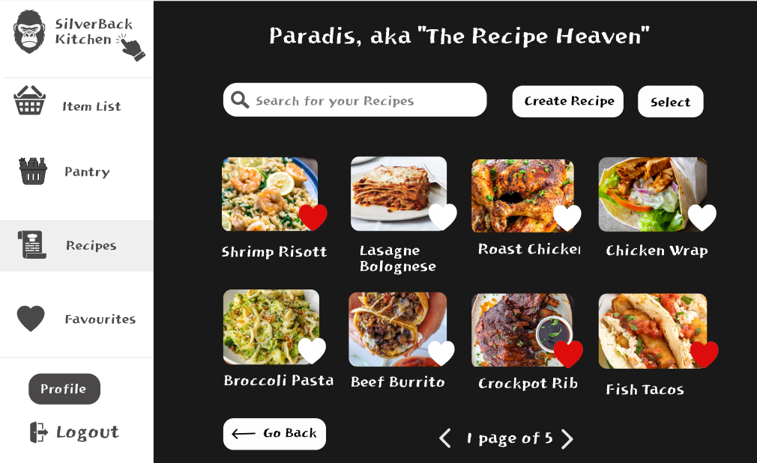
View: My Recipes Section, Route Name: https://silverbackkitchen.com/dashboard/recipes/my-recipes Here it‘s the view if user has created some recipes

Slide 9
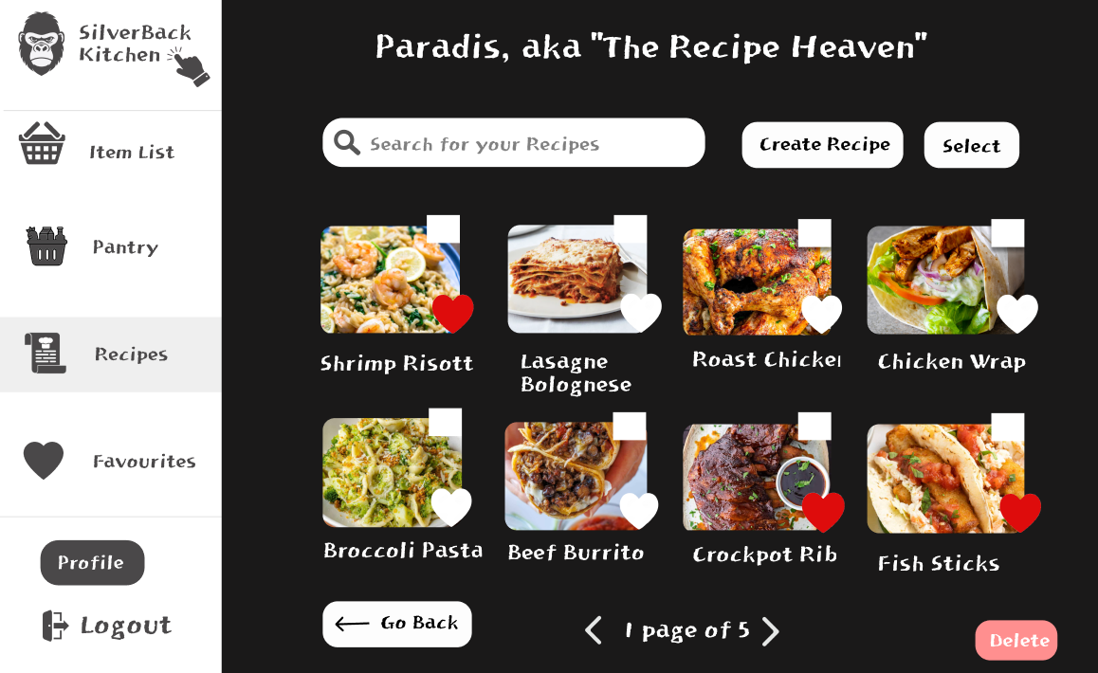
View: My Recipes Section, Route Name: https://silverbackkitchen.com/dashboard/recipes/my-recipes Here it‘s the view if user has clicked the select button (delete button still disabled)

Slide 10
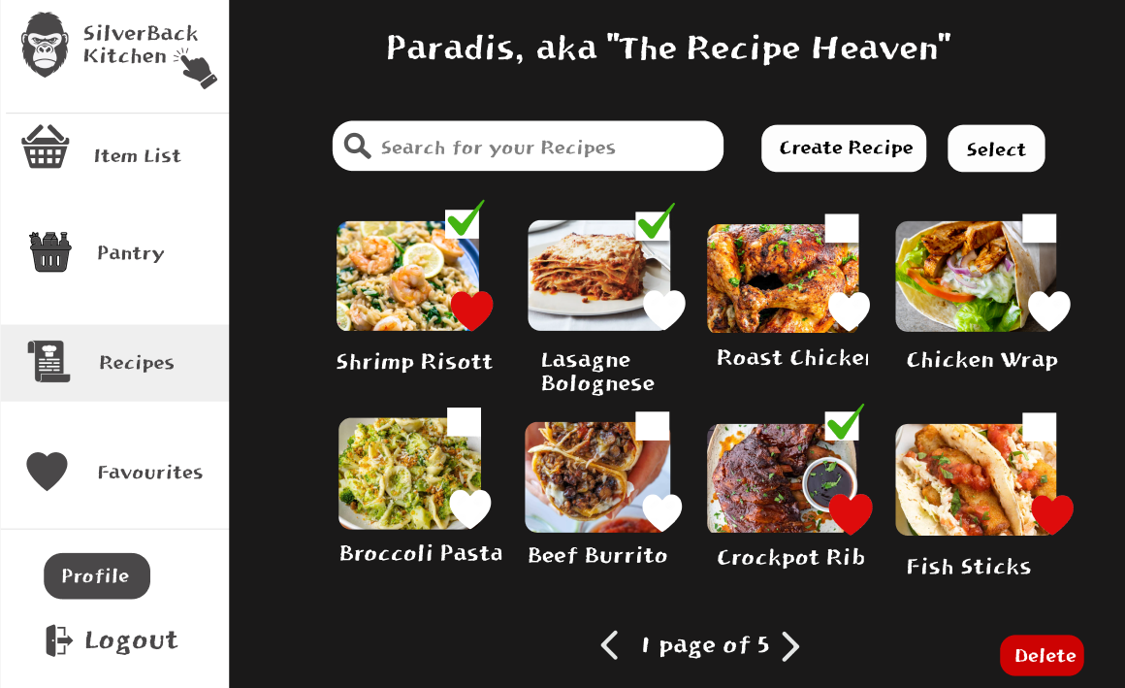
View: My Recipes Section, Route Name: https://silverbackkitchen.com/dashboard/recipes/my-recipes Here it‘s the view if user has clicked the select button, then selected some recipes, delete button now enabled

