Slide 1
Introduction to mdtsObject
First steps to use mdts Objects
Roland Ritt
06.08.2018
Internal Presentation

Slide 2
Overview
What is the mdts-Object?
A ‘container’ for time series data (multi-dimensional-time-series), as emanate from systems the CoA is analysing
What is the benefit of mdts-Objects?
Delivers functionality often used
Common code base (GitLab)
Should be improved from everybody
Where do I find the mdts-Toolbox
Web-Url: https://gitlab.ia.unileoben.ac.at/tsdev/mdtstoolbox
Git-Link: git@gitlab.ia.unileoben.ac.at:tsdev/mdtstoolbox.git
I want to know more:
Read the documentation – mdtstoolbox/Documentation/mdtsToolboxDocu.pdf
Ask me

Slide 3
Preliminaries
Installed Git
GitLab account
ssh-key added to your GitLab account
Download all necessary toolboxes (Web-Urls)
Mdtstoolbox : https://gitlab.ia.unileoben.ac.at/tsdev/mdtstoolbox
IAToolboxes/figureManager: https://gitlab.ia.unileoben.ac.at/toolboxes/figureManager
IAToolboxes/DOPbox: https://gitlab.ia.unileoben.ac.at/toolboxes/DOPbox
IAToolboxes/general: https://gitlab.ia.unileoben.ac.at/toolboxes/general
IAToolboxes/graphics: https://gitlab.ia.unileoben.ac.at/toolboxes/graphics
Add Toolboxes to path

Slide 4
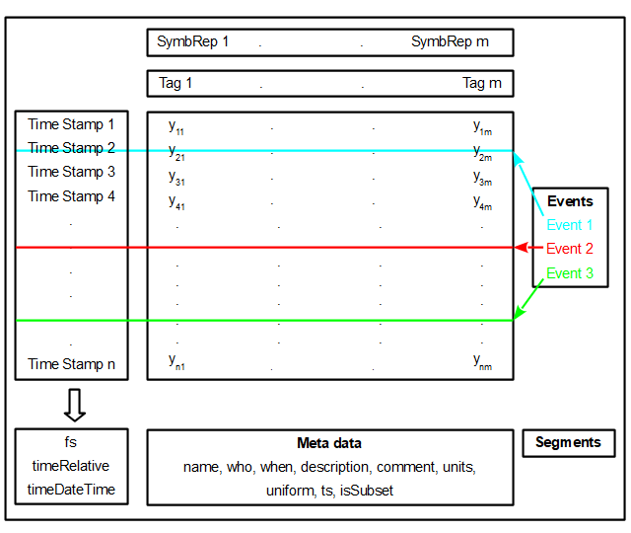
Basic Structure (1)

Slide 5
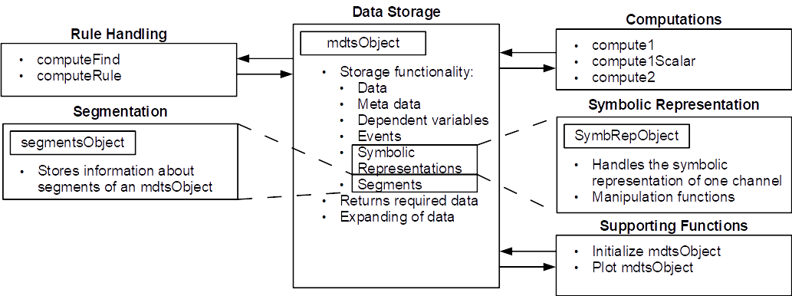
Basic Structure (2)

Slide 6
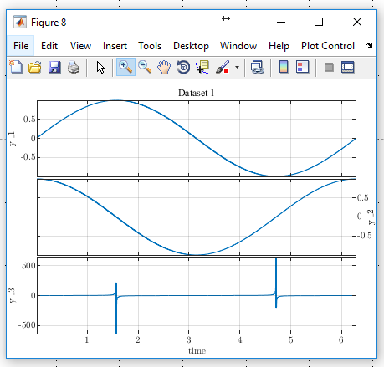
Initialize mdtsObject – numeric x-values
%% Initialize mdtsObject - numeric values
n=1000;
%generate dataset
x = linspace(0,2*pi,n)';
y1 = sin(x);
y2 = cos(x);
y3 = tan(x);
D = [y1,y2, y3]; %concatenate data to matrix
tags = {'y_1', 'y_2', 'y_3'} %define the tag names (channel names)
name = 'Dataset 1';
% initialize mdtsObject
mymdtsObject = mdtsObject(x,D, tags, 'name', name);
plotmdtsObject(mymdtsObject); % plot the object

Slide 7
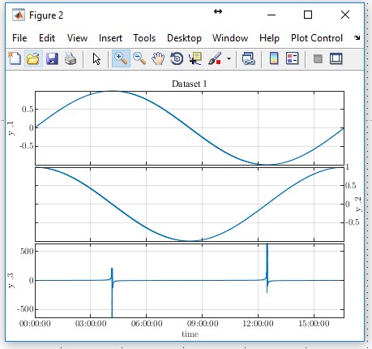
Initialize mdtsObject – Durations
%% Initialize mdtsObject - Durations
n=1000;
%generate dataset
x = minutes(1).*(1:n)';
xy = linspace(0,2*pi,n)';
y1 = sin(xy);
y2 = cos(xy);
y3 = tan(xy);
D = [y1,y2, y3]; %concatenate data to matrix
tags = {'y_1', 'y_2', 'y_3'} %define the tag names (channel names)
name = 'Dataset 1';
% initialize mdtsObject
mymdtsObject = mdtsObject(x,D, tags, 'name', name);
plotmdtsObject(mymdtsObject); % plot the object

Slide 8
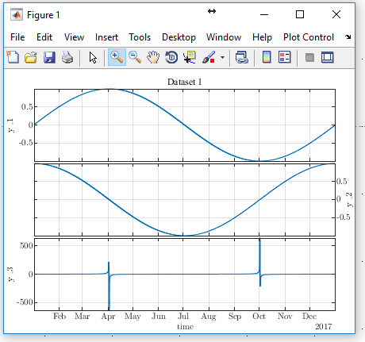
Initialize mdtsObject – absolute datetime x-values
%% Initialize mdtsObject
n=1000;
%generate dataset
x = linspace(datetime(2017,1,1), datetime(2018,1,1),n)'; %datetime - xvalues
xy = linspace(0,2*pi,n)';
y1 = sin(xy);
y2 = cos(xy);
y3 = tan(xy);
D = [y1,y2, y3]; %concatenate data to matrix
tags = {'y_1', 'y_2', 'y_3'} %define the tag names (channel names)
mymdtsObject = mdtsObject(x,D, tags); % initialize mdtsObject
plotmdtsObject(mymdtsObject); % plot the object

Slide 9
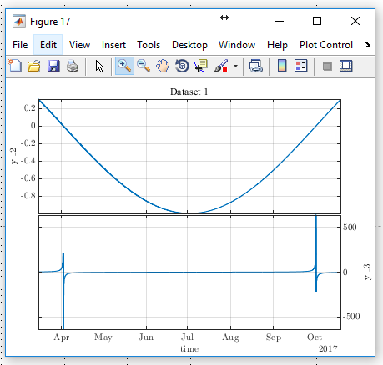
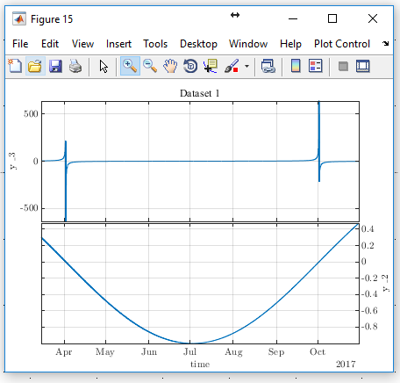
Extract a subset from mdtsObject – return mdtsObject
Direct Indexing
Maybe use Subfunctions of mdtsObject
getInveralIndices
getTagIndices
%slice
timeInds = (200:800);
tagInds = [2,3];
mymdtsObjectSnippet = mymdtsObject(timeInds,tagInds);
%plot
plotmdtsObject(mymdtsObjectSnippet); % plot the object
Using functions
%slice
timeSnippet = [datetime(2017,3,15), datetime(2017,10,31)];
tagsSnippet = {'y_3', 'y_2'};
mymdtsObjectSnippet = mymdtsObject.getData(tagsSnippet, timeSnippet);
%plot
plotmdtsObject(mymdtsObjectSnippet); % plot the object

Slide 10
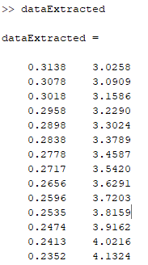
Extract data from mdtsObject – return data-Matrix
Direct Indexing of ‘data’
Maybe use Subfunctions of mdtsObject
getInveralIndices
getTagIndices
%slice
timeInds = (200:800);
tagInds = [2,3];
dataExtracted = mymdtsObject.data(timeInds,tagInds);
Using functions
%slice
timeSnippet = [datetime(2017,3,15), datetime(2017,10,31)];
tagsSnippet = {'y_3', 'y_2'};
mymdtsObjectSnippet = mymdtsObject.getRawData(tagsSnippet, timeSnippet);

Slide 11
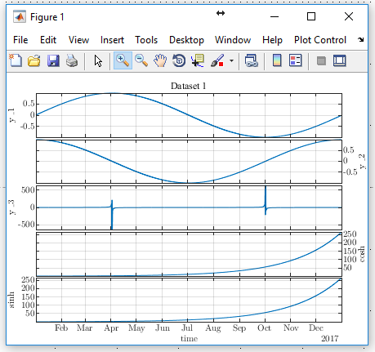
Add data to mdtsObject – ‘expandDataSet(data,tags)
%add data to mdtsObject
y_cosh = cosh(xy);
y_sinh = sinh(xy);
data_expand = [y_cosh, y_sinh];
tags_expand = {'cosh', 'sinh'};
mymdtsObject.expandDataSet(data_expand, tags_expand);
plotmdtsObject(mymdtsObject);

Slide 12
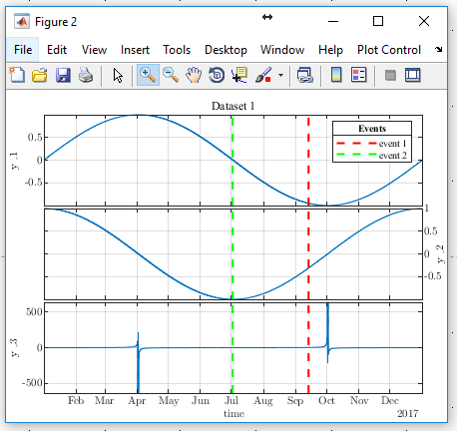
Add event to mdtsObject – ‘addEvent(eventID, timep,duration)’
event1time = x(700);
event1ID = 'event 1';
event1duration = seconds(5);
event2time = x(500);
event2ID = 'event 2';
event2duration = seconds(3);
mymdtsObject.addEvent(event1ID,event1time,event1duration);
mymdtsObject.addEvent(event2ID,event2time,event2duration);
plotmdtsObject(mymdtsObject);
Only accepts timepoints from x-axis?? Maybe allow every timepoint

Slide 13
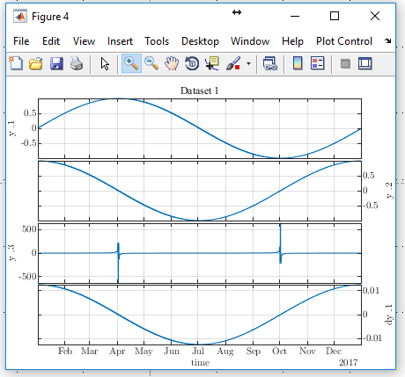
Perform calculations – compute1(matrix,input)
Performs a calculation on one data-vector (one channel) x
matrix: matrix to perform local computation
Input: either a vector of data or a struct
Inputstruct.tag: string containing the tagname of channel in mdtsObject to apply the computation on
Inputstruct.object: the mdtsObject to apply the computation
Matrix computation
L (compact)
Convolutional approach
[B,dB] = dop(ls);
DMat = dB*B';
input1.tag = 'y_1';
input1.object= mymdtsObject;
dy_1 = compute1(DMat, input1);
mymdtsObject.expandDataSet(dy_1, 'dy_1');
plotmdtsObject(mymdtsObject);
Kernel
Signal
Operated signal

Slide 14
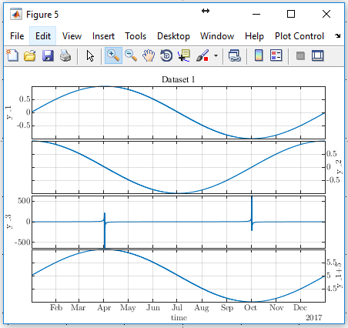
Perform calculations – compute1Scalar(operator,scalar,input)
Performs elementwise operations with the given scalar:
operator: +, - , / , * , @funHandle
input: vector or struct containing tag and object
Struct.tag = ‘tag’
Struct.object = ‘mymdtsObject’
Scalar: a scalar value
input1.tag = 'y_1';
input1.object= mymdtsObject;
operator = '+';
scalarVal = 5;
y_15 = compute1Scalar(operator, scalarVal,input1);
mymdtsObject.expandDataSet(y_15, 'y_1+5');
plotmdtsObject(mymdtsObject);

Slide 15
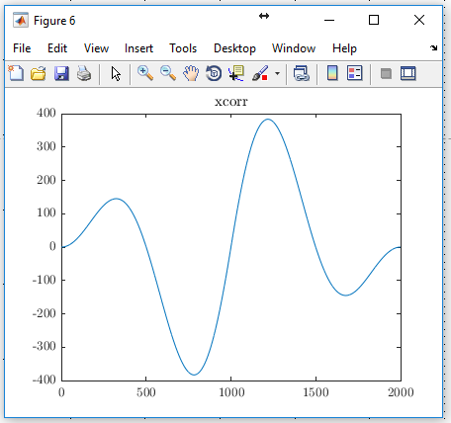
Perform Calculations – compute2(operator, input1, input2)
Performs operations on two input vectors/signals
operator: *, /, +, -, dot, outer, xcorr, @funHandle
Input1/2: vector or struct containing tag and object
Struct.tag = ‘tag’;
Struct.object = ‘mymdtsObject’;
input1.tag = 'y_1';
input1.object= mymdtsObject;
input2.tag = 'y_2';
input2.object= mymdtsObject;
operator = 'xcorr';
xcorry_12 = compute2(operator, input1, input2);
figureGen;
plot(xcorry_12);
title('xcorr');

Slide 16
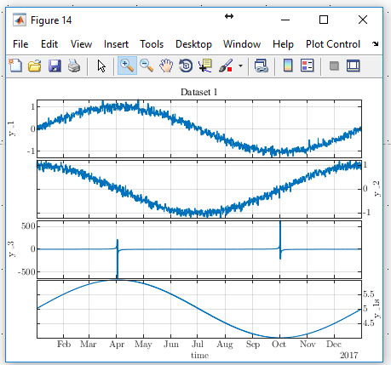
Perform Calculations – smoothAsConv(input, varargin)
Performs local smoothing on given input using convolutional approach in combination with dop-Box
Input vector or struct containing tag and object
Varargin: key-value pairs – ls, noBfs
It is assumed, that the x-axis is evenly spaced
input1.tag = 'y_1';
input1.object= mymdtsObject;
y1s = smoothAsConv(input1, 'ls', 11, 'noBfs', 3);
mymdtsObject.expandDataSet(y_15, 'y_1s');
plotmdtsObject(mymdtsObject);

Slide 17
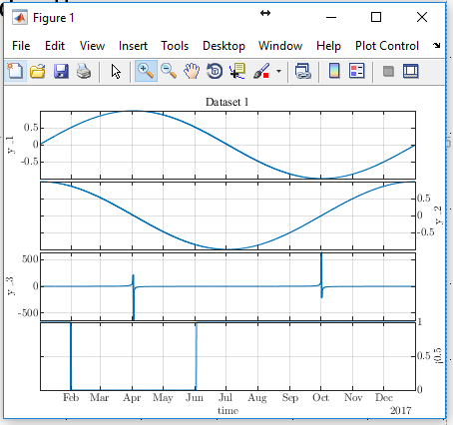
Perform Calculations – computeFind(operator, input, value)
Finds values in the input which meet the given criteria and value
Operator: >, <, ==, ~=, >=, <=
Input: vector or struct containing tag and object
Value: a scalar to which the input should be compared with
input1.tag = 'y_1';
input1.object= mymdtsObject;
valueComp = 0.5;
ruleRes = computeFind('<', input1, valueComp);
mymdtsObject.expandDataSet(ruleRes, '<0.5');
plotmdtsObject(mymdtsObject);

Slide 18
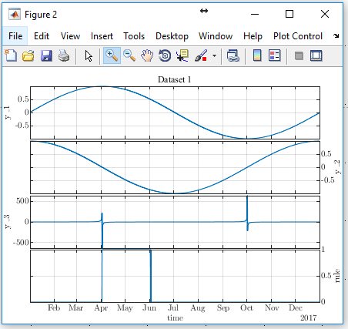
Perform Calculations – computeRule(operator, arr1, arr2)
Used to perform logical operations on two logical arrays
Operator: &, |
Arr1/2: logical arrays for which the computation should be performed
input1.tag = 'y_1';
input1.object= mymdtsObject;
input2.tag = 'y_2';
input2.object=mymdtsObject;
valueComp1 = 0.5;
valueComp2 = 0;
findRes1 = computeFind('>', input1, valueComp1);
findRes2 = computeFind('<', input2, valueComp2);
ruleOperator = '&';
ruleRes = computeRule(ruleOperator, findRes1, findRes2);
mymdtsObject.expandDataSet(ruleRes, 'rule');
plotmdtsObject(mymdtsObject);

Slide 19
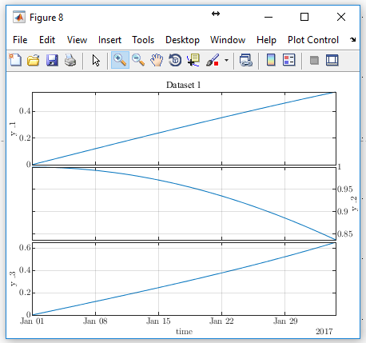
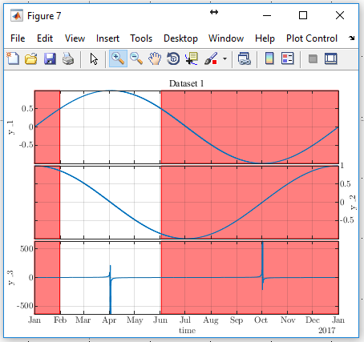
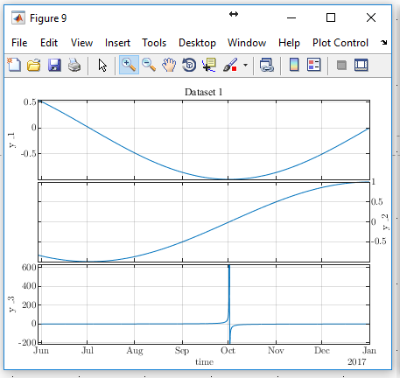
Segments (under development)
Goal: define segments as own objects – can be used to extract data from timeseries objects
input1.tag = 'y_1';
input1.object= mymdtsObject;
valueComp1 = 0.5;
findRes1 = computeFind('<', input1, valueComp1);
nRow = length(mymdtsObject.time);
mySeg1 = segmentsObject(nRow);
segTag = 'segment1';
mySeg1 =mySeg1.addSegmentVector(segTag, findRes1);
mymdtsObject.addSegments(mySeg1);
plotSegments(mymdtsObject, segTag);
segsMdtsObjects = extractSegments(mymdtsObject, segTag);
for i=1:length(segsMdtsObjects)
plotmdtsObject(segsMdtsObjects{i});
end

Slide 20
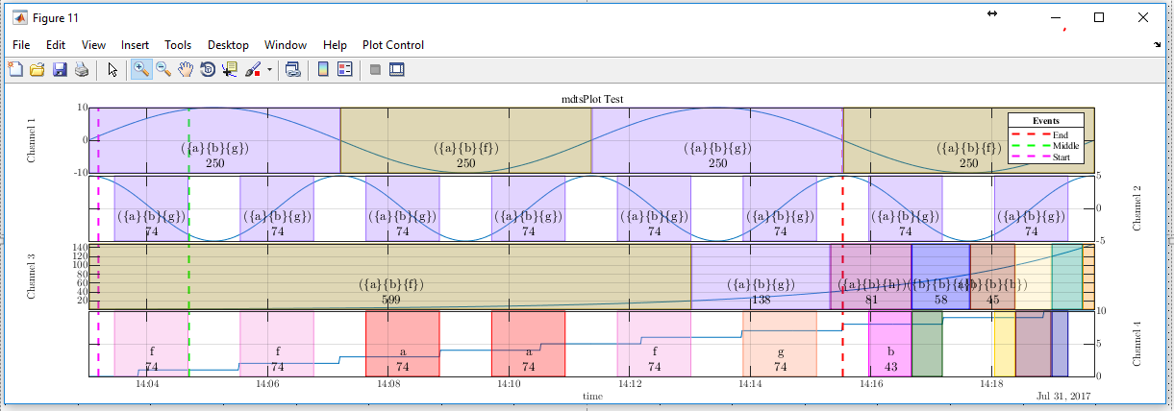
Symbolic Analyisis

