Slide 1

Nonlinear Profiles
with R

Slide 2

Section 10.1
Introduction

Slide 3
10.1 Introduction
How to treat data whose relation between the predictive and response variables is Nonlinear.

Slide 4
Section 10.2
Nonlinear Profiles Basics

Slide 5
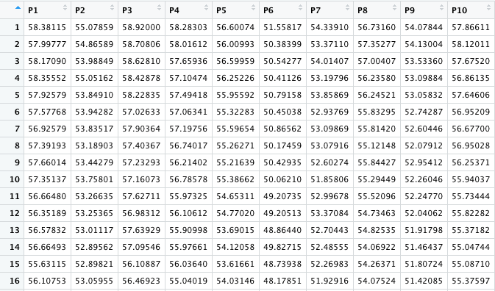
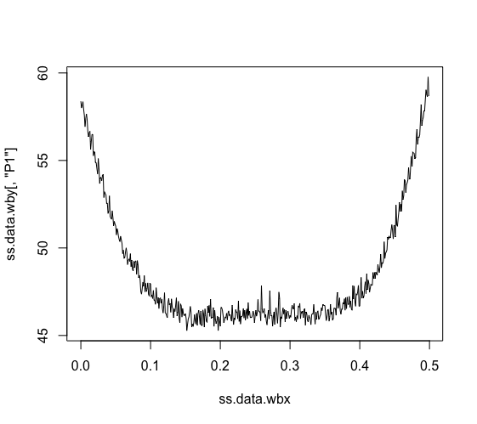
10.2 Example 10.1 Engineered woodboards

Slide 6
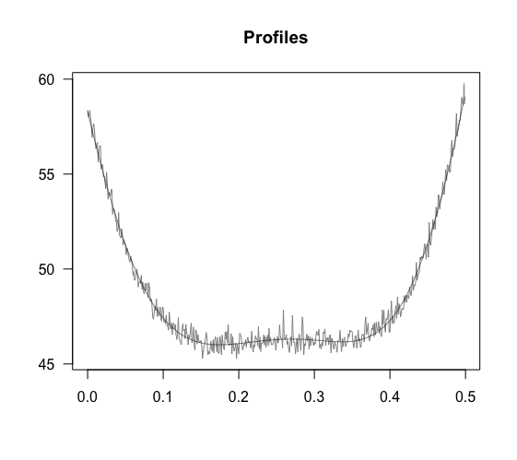
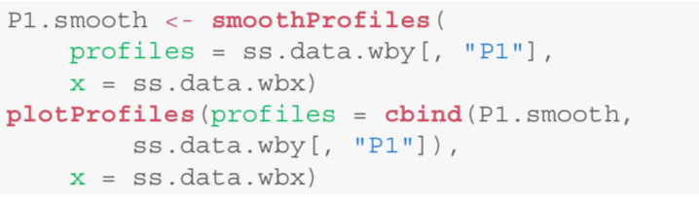
10.2 Example 10.1 Engineered woodboards
smoothProfiles
  Accepts as first input argument a matrix.
  Second input : Vector
  Output : Matrix
  SVM model inside.
  From package ” e1071 ”

Slide 7
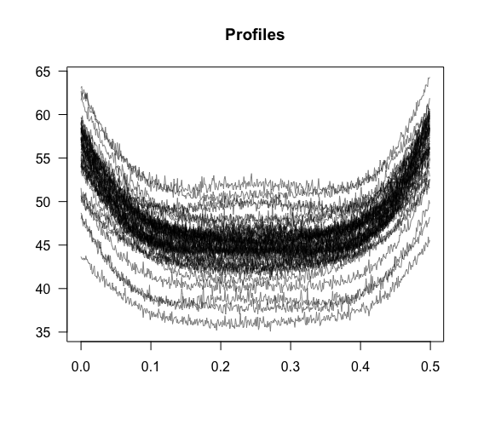

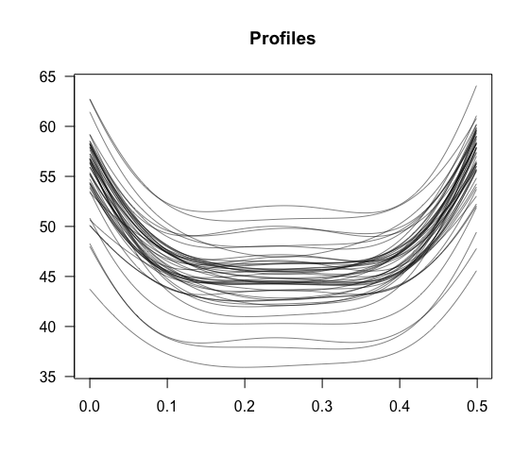

10.2 Example 10.1 Engineered woodboards
Always check that the smoothing procedure is working well.
Plot jointly the profile itself and its smoothed version.
Check if the smoothing procedure is working similarly or not.
Fail: use the original set of profiles without smoothing.
Change the default SVM parameters in the smoothProfiles.

Slide 8
Section 10.3
Phase I & Phase II Analysis

Slide 9
10.3 Phase I & Phase II
Phase I
  Test the stability of the process, in order to model the in-control process performance.
Phase II
  Monitor the process.

Slide 10
10.3 Example – Phase I Analysis
Two subset
First | Second
P1 – P35 | P36 – P50
First seven 4-h shifts | Remaining 4-h shifts
Seek for a baseline subset of in-control profiles.

Slide 11
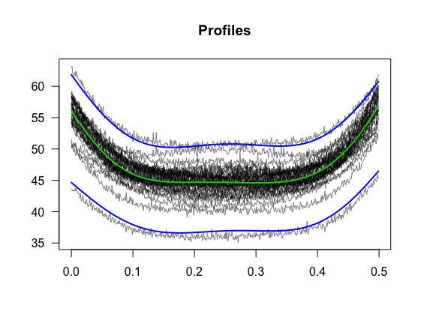
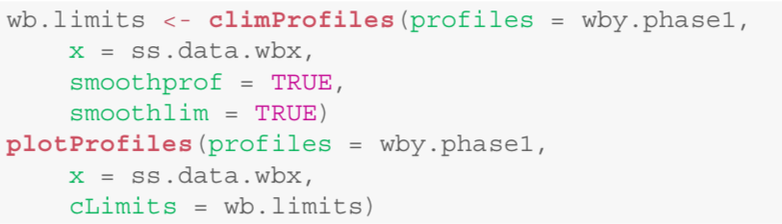
10.3 Example – Phase I Analysis

Slide 12
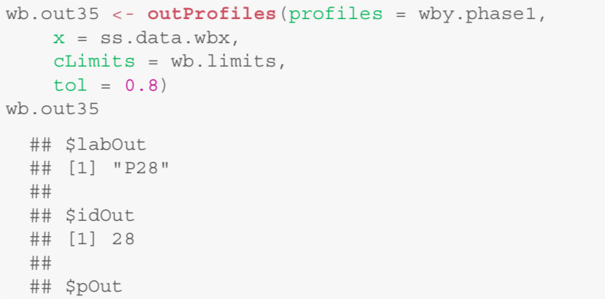
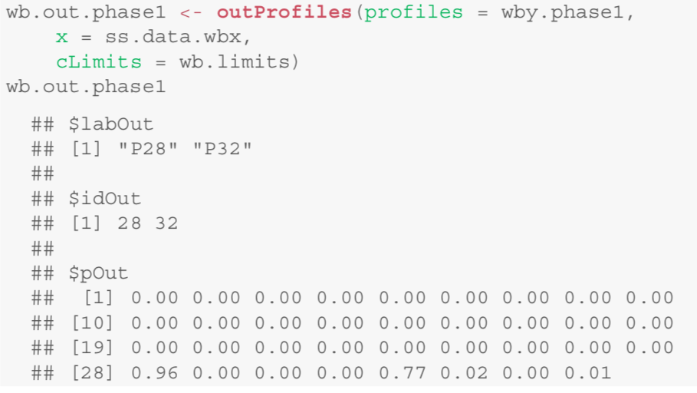
10.3 Example – Phase I Analysis
Out when p > 0.8

Slide 13
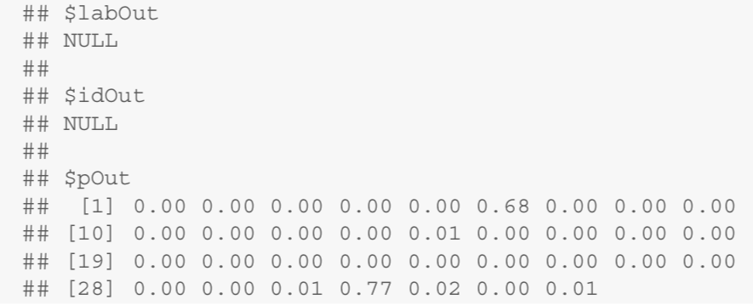
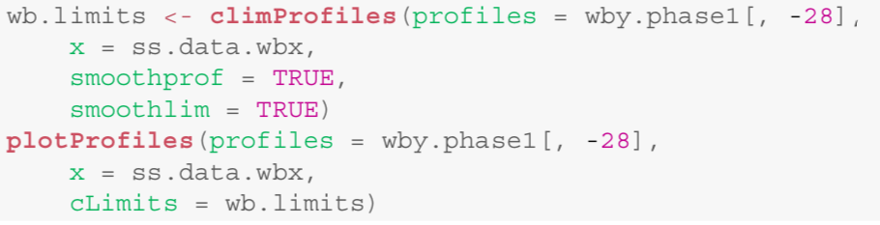
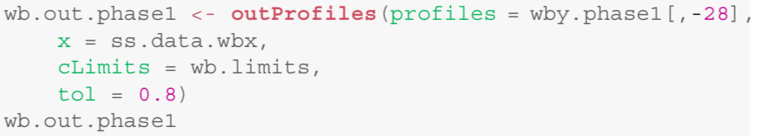
10.3 Example Phase I Analysis – Remove P28
It is clear that now the process seems to be in control.
Confidence bands and the baseline profiles have been determined.

Slide 14
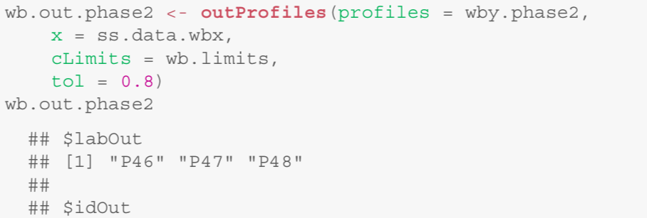
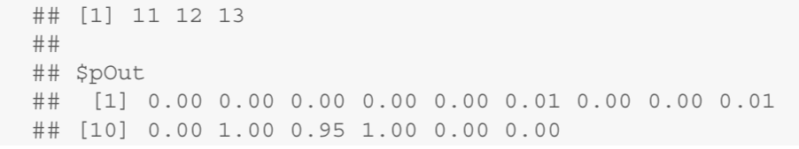
10.3 Phase II

Slide 15
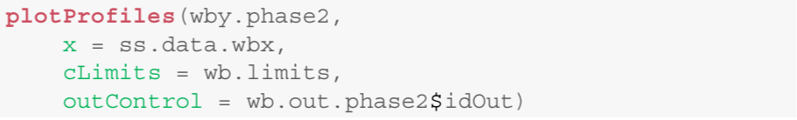
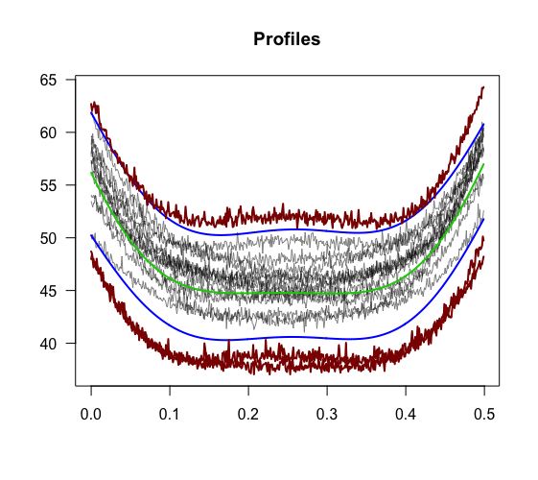
10.3 Phase II

Slide 16
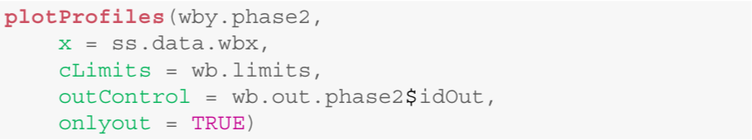
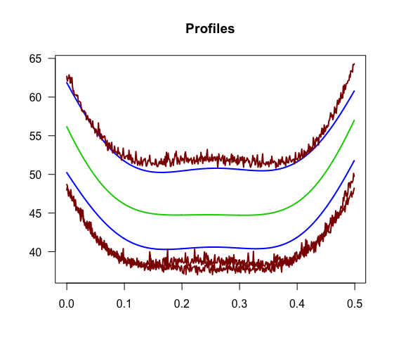
10.3 Phase II

Slide 17
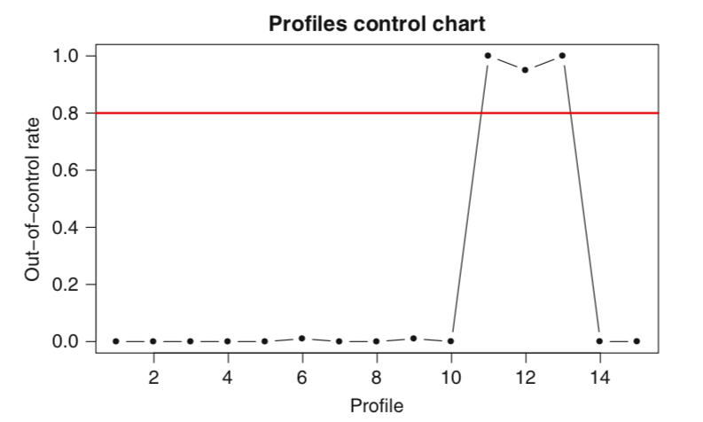
10.3 Phase II

Slide 18


