Slide 1

Quality Specifications and
Process Capability Analysis with R

Slide 2

Section 8.1
Introduction

Slide 3
8.1 Introduction
Purpose
  Provide some guidelines and resources to establish such specifications.
  How to measure and analyze the capability of a process to fulfill them.
Notice
  Making clear the difference between Specification Limits and Control Limits.
Specification Limits | Control Limits
Voice of the Customer (VoC) | Control Limits Voice of the process (VoP)
Notes:
The idea is to fix some specification limits, Upper and/or Lower (USL and LSL respectively), and compare them with the natural limits of
the process.

Slide 4
Section 8.2
Tolerance Limits and Specifications Design

Slide 5
8.2.1 The Voice of the Customer
The Voice of the Customer (VoC)
  Specification Limit
  Upper Specification Limit (USL) & Lower Specification Limit (LSL)
Three categories
  Smaller- the- better : USL
  Larger- the- better : LSL
  Nominal- is- best : USL & LSL

Slide 6
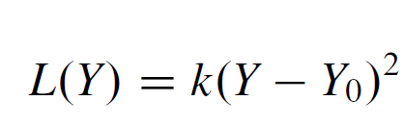
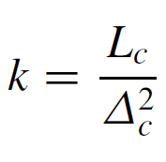
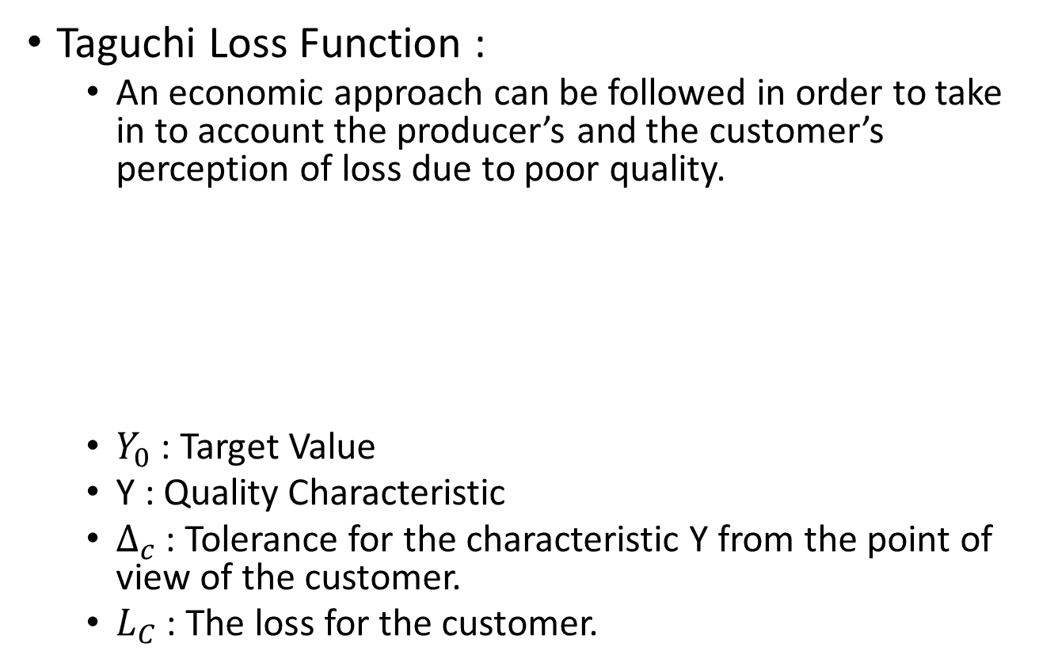
8.2.2 Process Tolerance
Taguchi Loss Function :
  An economic approach can be followed in order to take in to account the producer’s and the customer’s perception of loss due to poor quality.
  $Y_{0}$ : Target Value
  Y : Quality Characteristic
  $Δ_{c}$ : Tolerance for the characteristic Y from the point of view of the customer.
  $L_{C}$ : The loss for the customer.

Slide 7
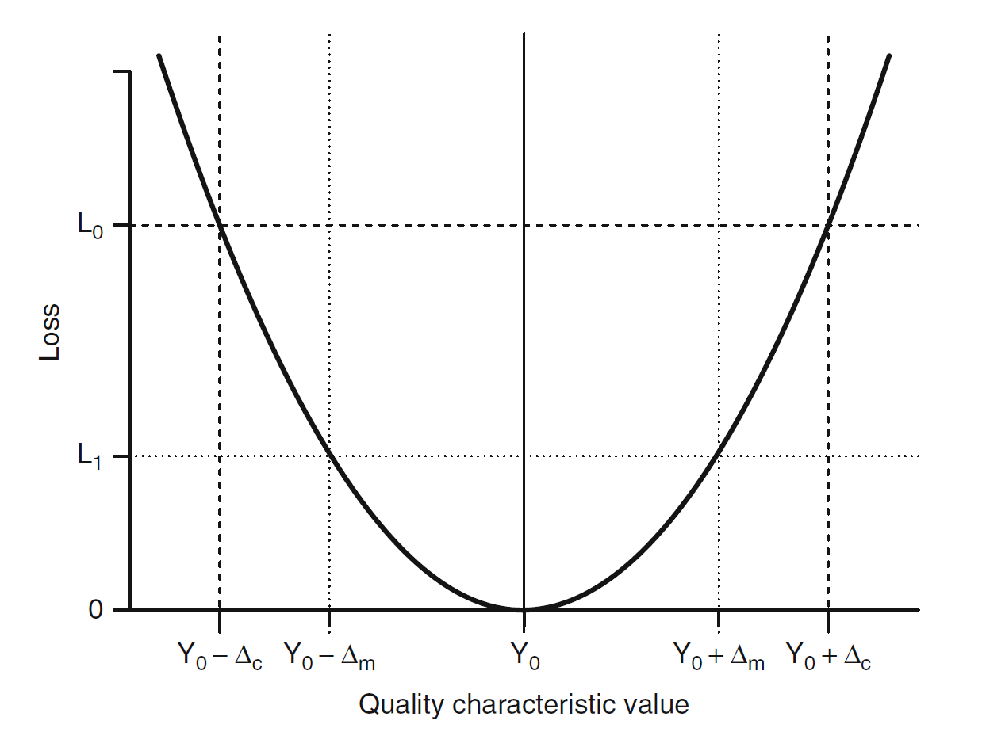
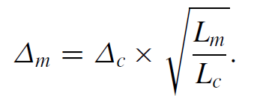
Process Tolerance
The cost of poor quality is usually higher for the customer than for the producer.
The manufacturing specification limit
is lower than the customer specification limit.

Slide 8
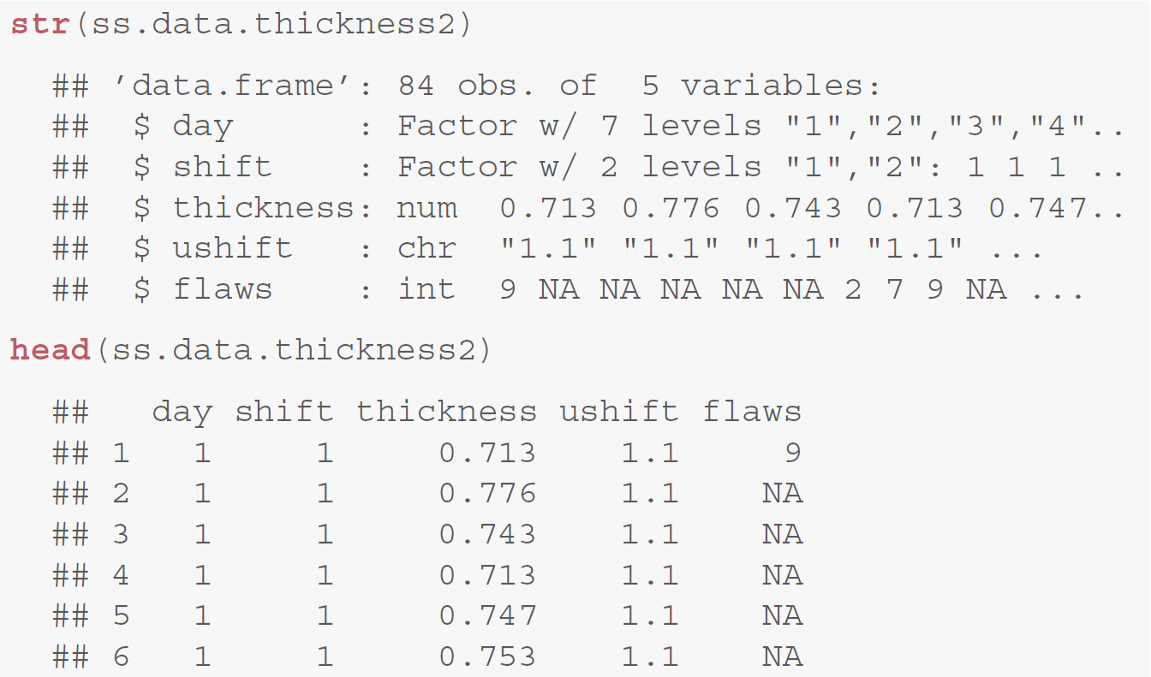
Example 8.1 Metal plates thickness
Package : SixSigma
Data : ss.data.thickness2

Slide 9
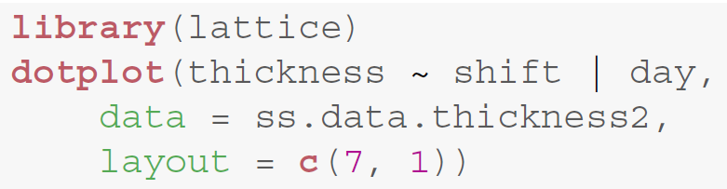
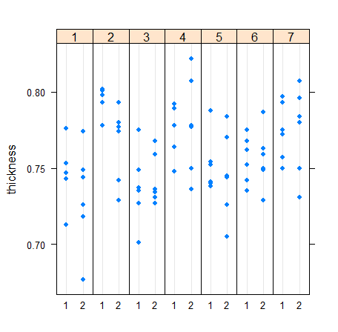
Visualization of all the data
Layout :
one panel for each day and in this way we sequentially display the whole week in one row.

Slide 10
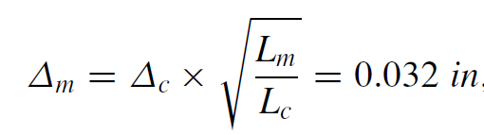
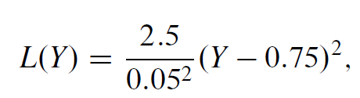
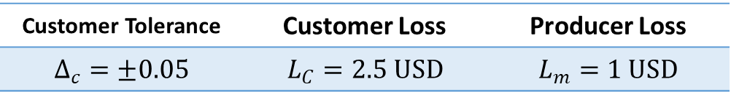

Example for Manufacturing Secification Limits
Assume :
Calculation :
Manufacturing specification limits :
$$0.75±0.032$$
Customer Tolerance | Customer Loss | Producer Loss
$$Δ_{c}=±0.05$$ | $$L_{C}=2.5 USD$$ | $$L_{m}=1 USD$$
Manufacturing tolerance | Loss Function

Slide 11
Section 8.3
Capability Analysis

Slide 12
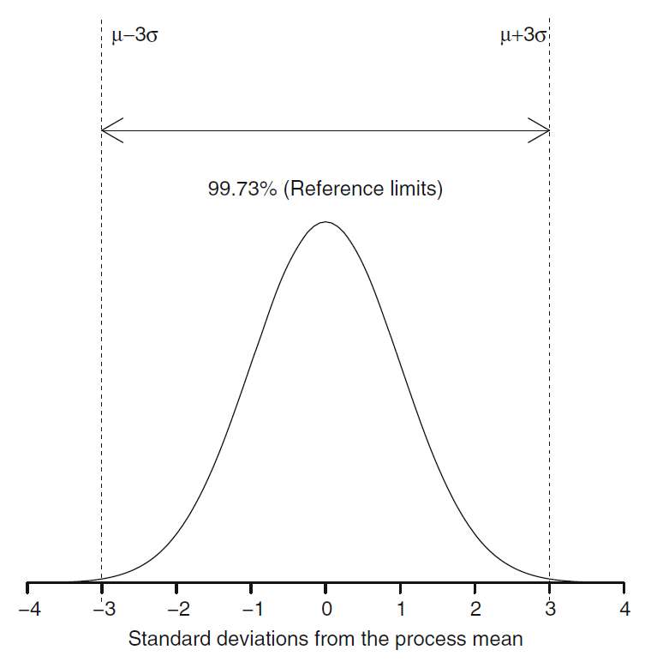
8.3.1 The Voice of the Process
Normally distributed process

Slide 13
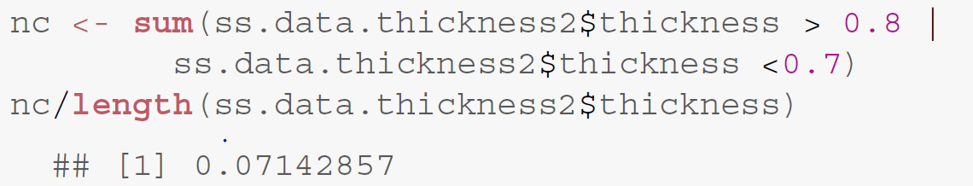
Process yield
If the sample is representative of the population, then we can estimate the yield of the process through the sample proportion of correct items.
The yield of the sample : 78/84 = 92.86%
The proportion of defects in the sample : 7.14%.

Slide 14
Long-term performance of a process
Identify the probability distribution of the data.
Estimate its parameters.
The proportion of defects : the process exceeds the specification limits.

Slide 15
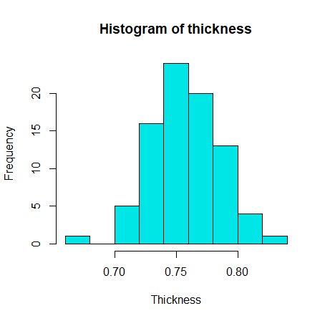
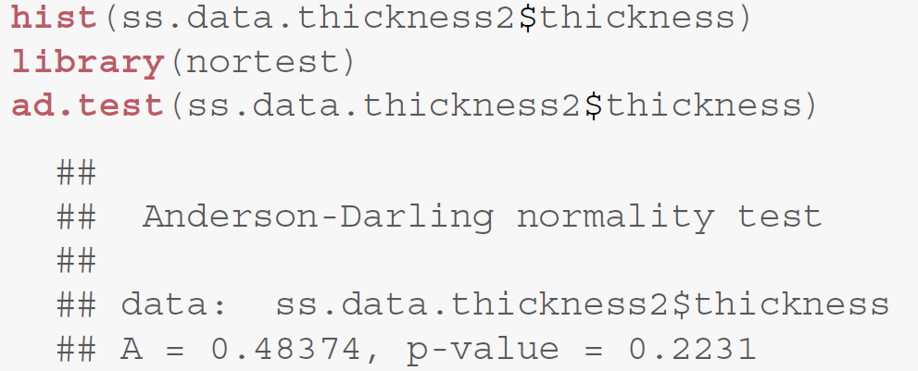
Proportion of defects – Normally distributed
Test for Normally distributed
Cannot reject the normality hypothesis

Slide 16
Proportion of defects – Normally distributed
Estimate the parameters
Thick.mu | Thick.sigma
0.7585238 | 0.02789588

Slide 17
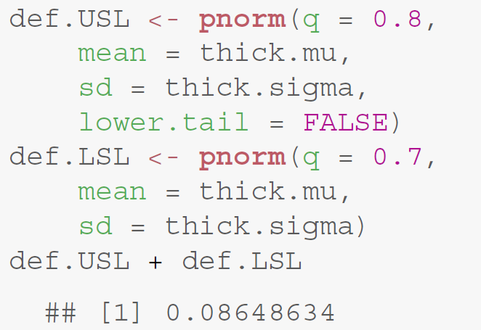
Proportion of defects – Normally distributed
Proportion of defects

Slide 18
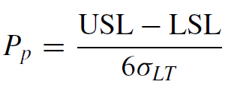
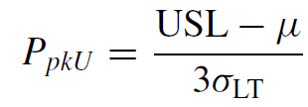
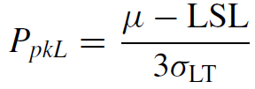


8.3.2 Process Performance Indices
Non-normal characteristics
Estimation methods : slightly different
Logic : the same
The process is centered in the target | The process is not centered in the target
Process performance index : The lower the index, the greater the proportion of non-conforming items. | Process performance index : Better the performance of the process.
$$σ_{LT} :long−term (LT) variation$$
Notes:
我們會希望 製程是根據常態分佈去執行的
所以這裡先記算Pp 用specification limits 去計算而得
接著計算 PpkU PpkL 然後比較最小的與Ｐp的差異
如果相同則代表 長期來說 製程錯誤率會是訂定的alpha％
但如果不同 indice >1代表較為嚴格 indice<代表較不嚴格 可能使得其無法滿足customer tolerance

Slide 19

Process Performance Indices
If $P_{P}≠P_{Pk}$
The process is not centered at the specification tolerance.
The process might need to be adjusted.

Slide 20
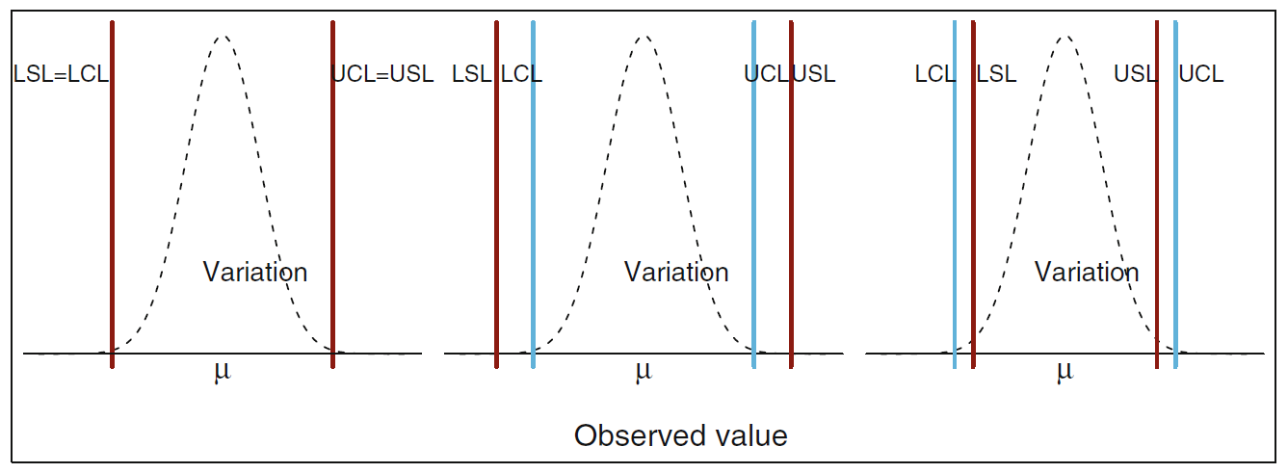
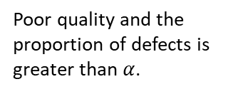

Specification limits vs. reference limits.
Performance indices = 1
Performance indices > 1
Performance indices < 1
Get approximately $α×100\%$ defects in the long term.
The process is “capable” of fulfilling the specifications
Poor quality and the proportion of defects is greater than $α$.

Slide 21
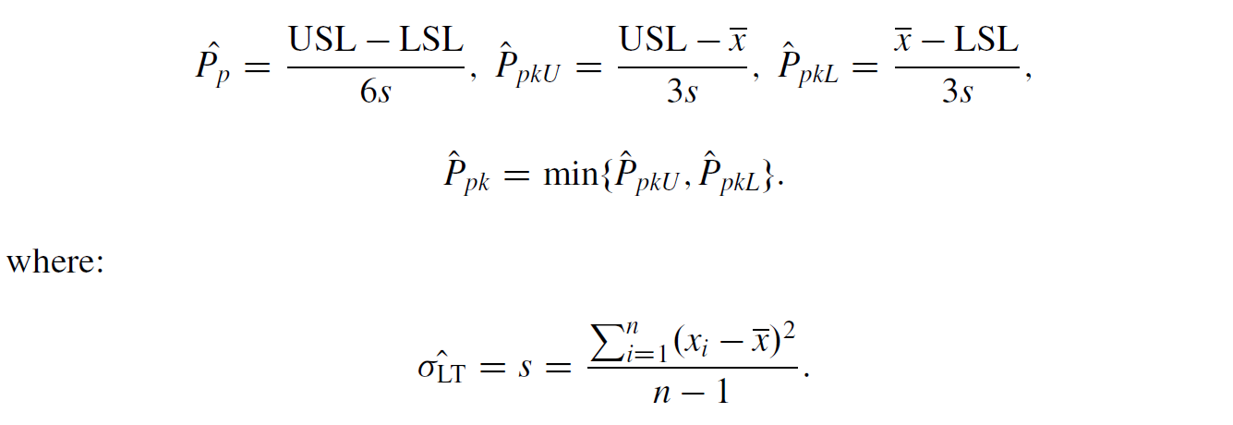
Process Performance Indices - Samples

Slide 22
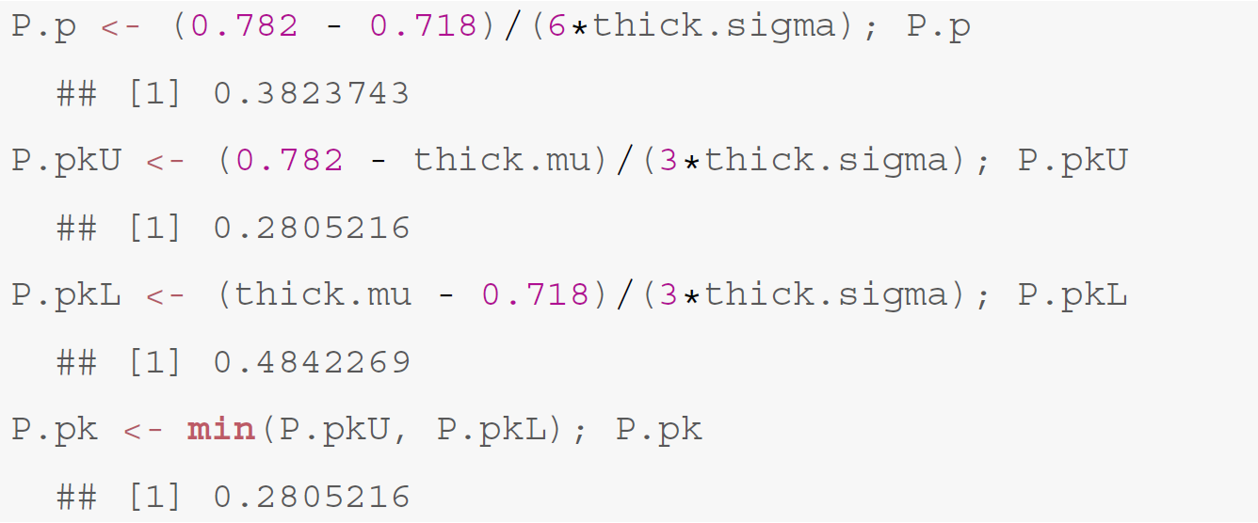

Process performance.
Producer’s specification limits : $0.75±0.032$
USL = 0.782 ; LSL = 0.718

Slide 23
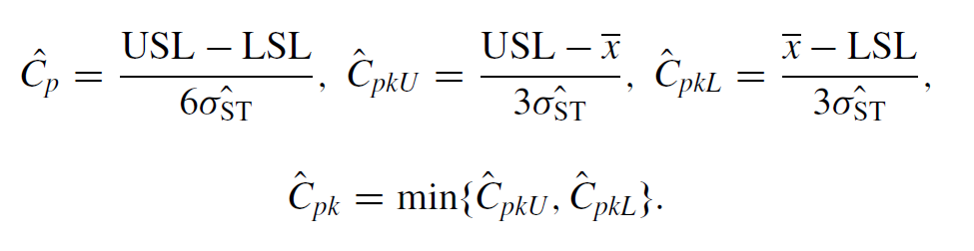
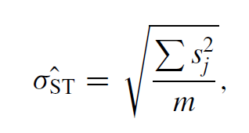
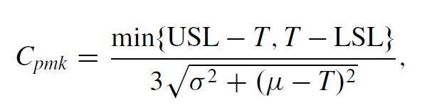
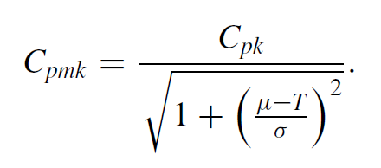
8.3.3 Capability Indices
Performance indices measure long-term (LT) variability.
Once the process is in control, capability indices can be obtained.
Taguchi index :

Slide 24
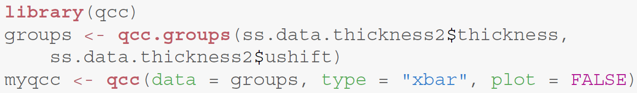
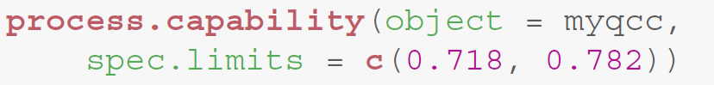
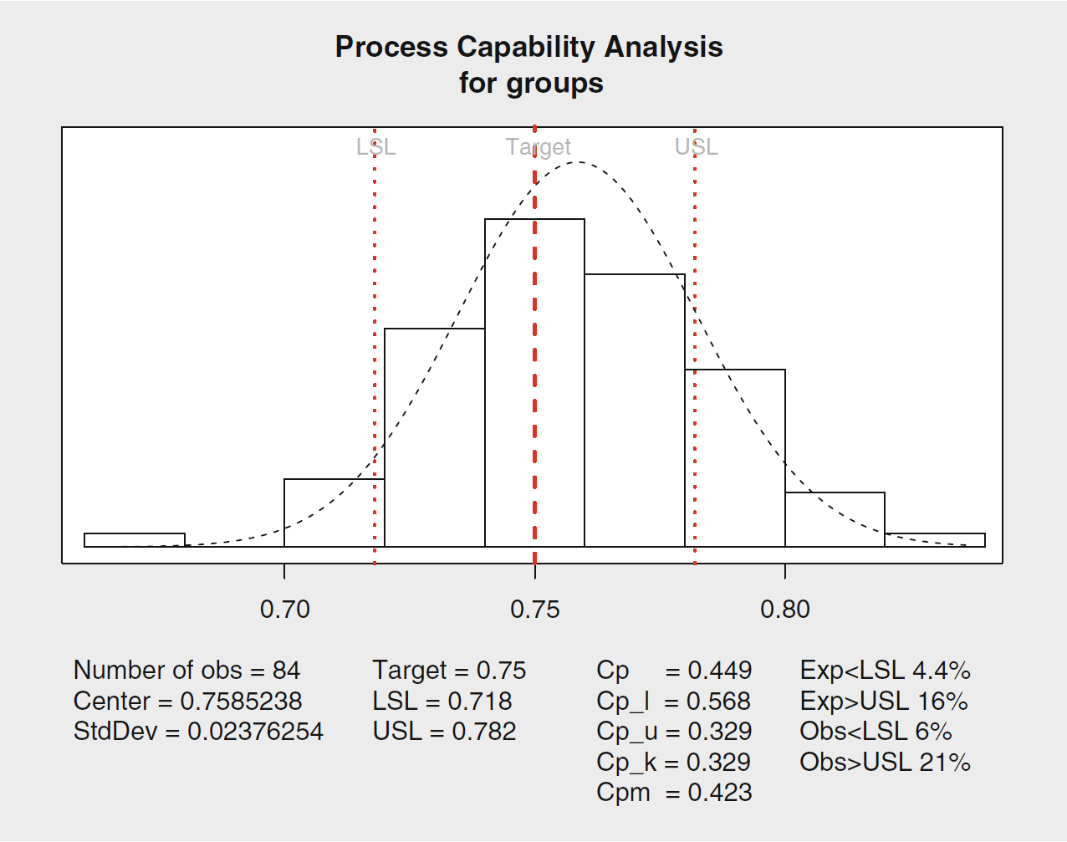
Example 8.5 Capability indices.
Obs > USL =
sum(ss.data.thickness2$thickness > 0.782) / length(ss.data.thickness2$thickness)
Obs < LSL =
sum(ss.data.thickness2$thickness < 0.718) / length(ss.data.thickness2$thickness)

Slide 25


