Slide 1

Furry Friends
Joint us and Share Your Love for Furry Friends with The World

Slide 2
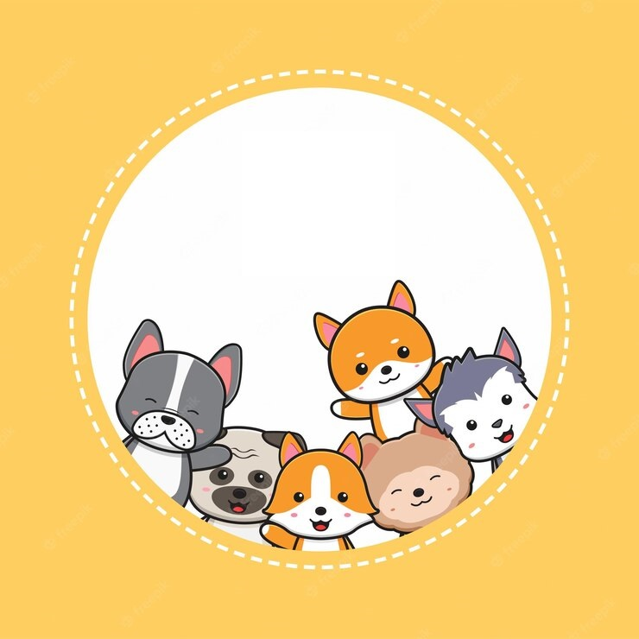
y

