Slide 1

Regression solutions in Real Estate
Project developed by:
Leonor Drummond
Jose Roldan
Pratik
Huang Mihn

Slide 2
Project Goals
Insight from 10000 properties
Defining a good regression model
Predicting house prices

Slide 3
Table Content
Data cleaning
Data preprocessing
Defining the best regression type
What we could achieve
Recommendations
Conclusions

Slide 4
Data Cleaning
Used the previous pre-cleaned data set;
Focus on adapting data set for machine leaning;
Keeping the house features that are better for perditions;
Removing the ones that don’t fit good this purpose;

Slide 5
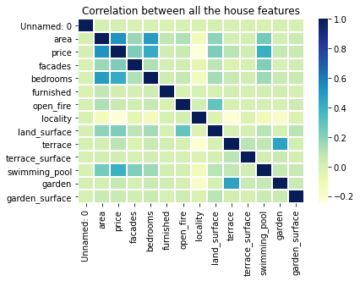
Data Cleaning
frequency

Slide 6
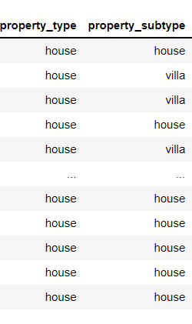
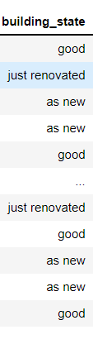
Data preprocessing
Removing redundancy such as subtype property;
Data engineering;
Standardization.

Slide 7
GRAPHIC WITH RELATION BETWEEN STATE OF BUILDING???
Includ different things in the data set from before

Slide 8
Defining the best regression type
Choosing between linear or polynomial regression;
Not all is regressive;
Evaluating modeling scores;
Understanding low model scores.

Slide 9
What we could achieve
Model chosen;
Scores from the model;
Visualizations;
Features considered.

Slide 10
Recommendations
Study different models for machine learning;
Look for other solutions that can include houses location;
Keep in mind

Slide 11
Conclusions
Not all data is possible to adapt to linear regression
One hot enconding does not makes sense with linear reression
Thank you for your trust and attention.

