Slide 1

Regression solutions in Real Estate
Project developed by:
Leonor Drummond
Jose Roldan
Pratik
Huang Mihn

Slide 2
Project Goals
Insight from 10000 properties
Defining a good regression model
Predicting house prices
Notes:
Sort of an introduction, to then show the content.
“This project comes from this client…. With the aim to….. In sequence of…..”

Slide 3
Table Content
Data cleaning
Data preprocessing
Defining the best regression type
What we could achieve
Recommendations
Conclusions

Slide 4
Data Cleaning
Used the previous pre-cleaned data set;
Focus on adapting data set for machine leaning;
Keeping the house features that are better for perditions;
Removing the ones that don’t fit good this purpose;
Notes:
- Why is data cleaning important?
-Used the previous pre-cleaned data set: where this data comes from; how it was cleaned and how good??
-Focus on adapting data set for machine leaning: no categorical; highly correlated data ----→ discussed in the next slide with correlation map
- Keeping the house features that are better for perditions: ----→ discussed in the next slide with correlation map
- Removing the ones that don’t fit good this purpose: outliers

Slide 5
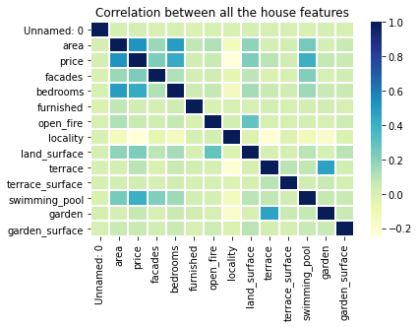
Data Cleaning
frequency
Notes:
What features are highly correlated;
Why not including swimming pool;

Slide 6
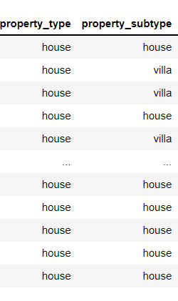
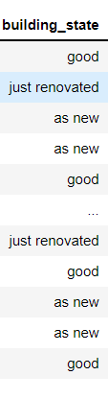
Data preprocessing
Removing redundancy such as subtype property;
Data engineering;
Standardization;
One Hot encoding is depreciated in
linear regression.
Notes:
Why is data pre processing important?
Why remove redundancy
What king of data engineering we did and why
Why standardize the data
Why not hot enconding other feature?

Slide 7
GRAPHIC WITH RELATION BETWEEN STATE OF BUILDING???

Slide 8
Defining the best regression type
Choosing between linear or polynomial regression;
Not all data is regressive;
Evaluating modeling scores;
Our features: bedrooms and area.
Notes:
Choosing between linear or polynomial regression: why?
Not all data is regressive: Why?
Evaluating modeling scores: why? What values we got ------→ add a print screen?
Our features: bedrooms and area ----→ discussed in the next slide with ploting

Slide 9
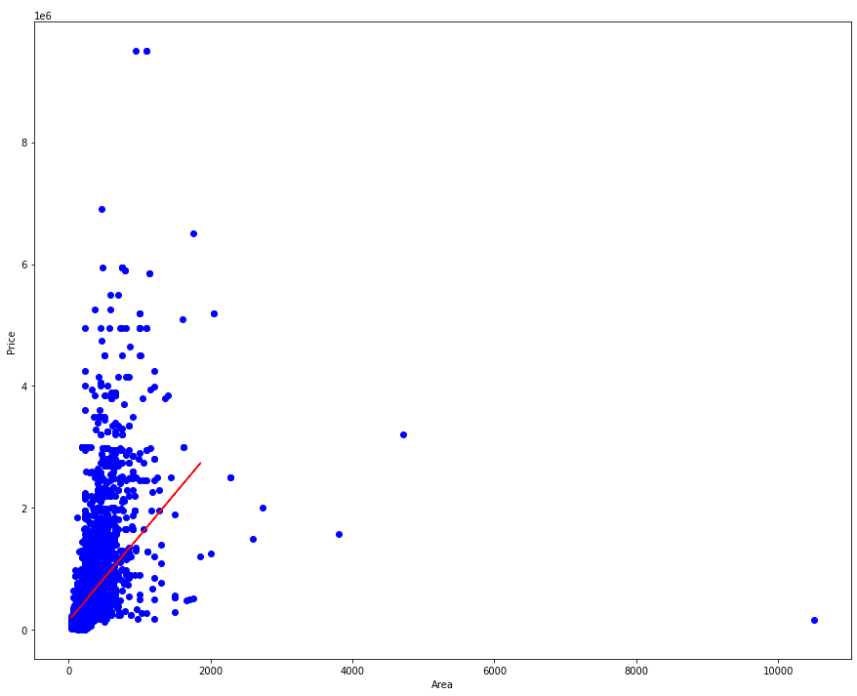
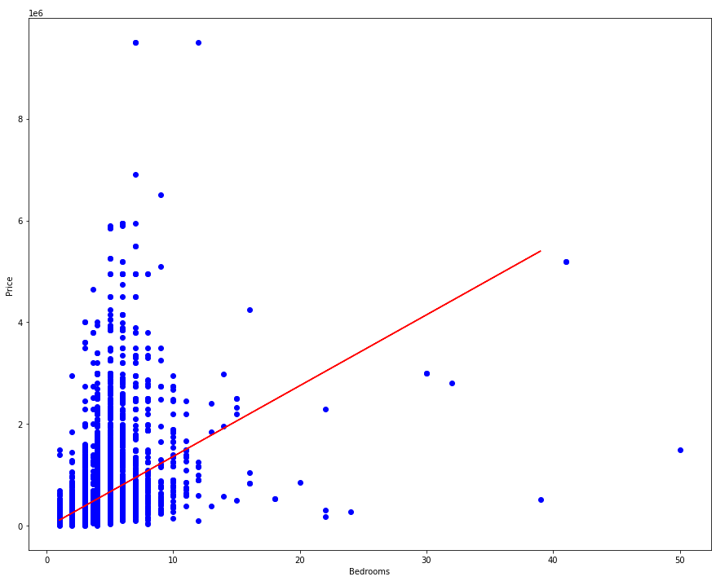
Defining the best regression type

Slide 10
What we could achieve
Model chosen;
Scores from the model;
Visualizations;
Features considered.
Notes:
Model chosen: which?
Scores from the model;
Visualizations;
Features considered.

Slide 11
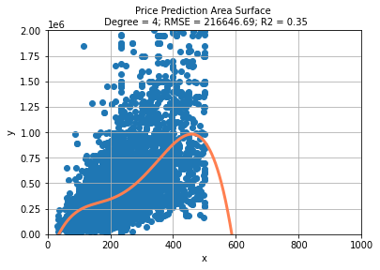
What we could achieve

Slide 12
Recommendations
Further studying different models for machine learning;
Look for other solutions that can include house location;
Keep in mind

Slide 13
Conclusions
Not all data is possible to adapt to linear regression
One hot enconding does not makes sense with linear reression
Thank you for your trust and attention.

