Slide 1
Planetarium-Programm
z.B. Guide 9.0
MoonPanoramaMaker
TCP/IP
FireCapture
(Zur Kamerasteuerung)
COM
COM
ASCOM-Hub
z.B. POTH
COM
Teleskop-Treiber (ASCOM)
z.B. Celestron NexRemote

Slide 2





Aquatorialer Nordpol
$$α_{S}−α_{M}$$
$$90°− δ_{S}$$
$$90°− δ_{M}$$
$$P_{S}$$
Mond
Sonne
$$E$$

Slide 3




$$r_{E}$$
Erde
Sonne
$$E$$
$$d_{M}$$
$$r_{M}$$
Mond

Slide 4











$$y$$
$$R_{a}$$
$$R_{a}$$
$$R_{o}^{v}$$
$$H$$
$$W$$
$$R_{o}^{h}$$
$$Ra$$
$$x$$
$$RM$$
$$R_{a}$$

Slide 5






$$dδ$$
$$x$$
$$P_{N}$$
$$dα$$
$$N$$
$$y$$

Slide 6
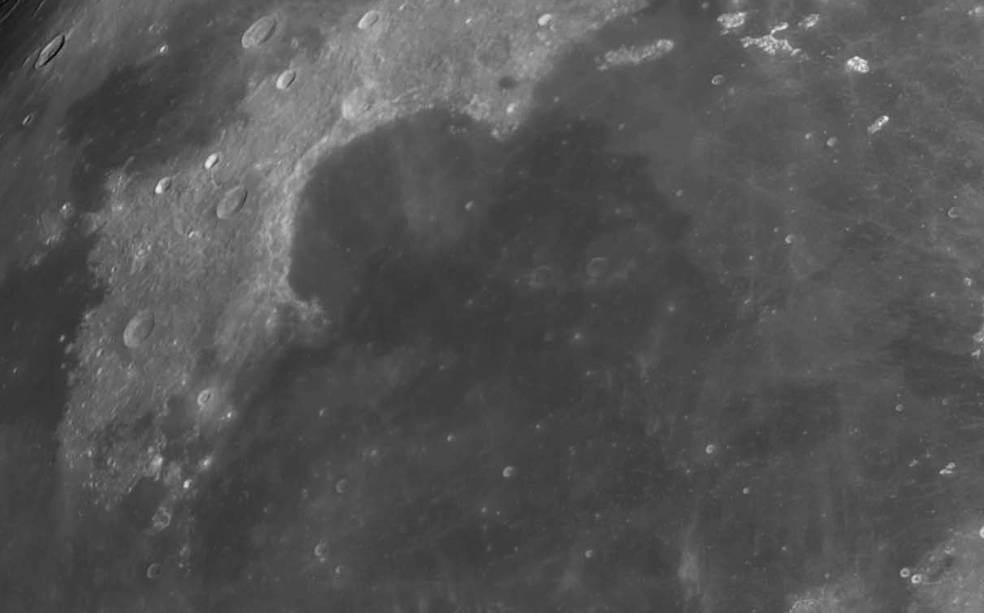




$$(x_{2}, y_{2})$$
$$d_{A}$$
$$(x_{1}, y_{1})$$
$$b$$

Slide 7
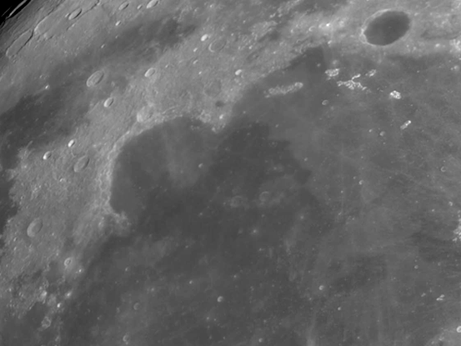




$$(x_{2}, y_{2})$$
$$d_{A}$$
$$(x_{1}, y_{1})$$
$$b$$

Slide 8




