Slide 1
Planetarium program
e.g. Guide 9.0
MoonPanoramaMaker
TCP/IP
FireCapture
(for camera control)
COM
COM
ASCOM hub
e.g. POTH
COM
Telescope driver (ASCOM)
e.g. Celestron NexRemote

Slide 2
Windows 7 / 8 / 10
Planetarium program
e.g. Guide 9.0
MoonPanoramaMaker
TCP/IP
MoonPanoramaMaker
plugin for FireCapture
Port 9820
FireCapture
camera control program
COM
COM
Either direct connection
or through a hub
ASCOM hub
e.g. POTH
COM
COM
ASCOM telescope driver

Slide 3
Linux
Planetarium program
e.g. KStars / Ekos
MoonPanoramaMaker
TCP/IP
MoonPanoramaMaker
plugin for FireCapture
Port 9820
FireCapture
camera control program
TCP/IP
Port 7624
Start in
Web browser
INDI Server
TCP/IP
Port 7624
INDI Web Manager
Unix pipe
INDI telescope driver

Slide 4
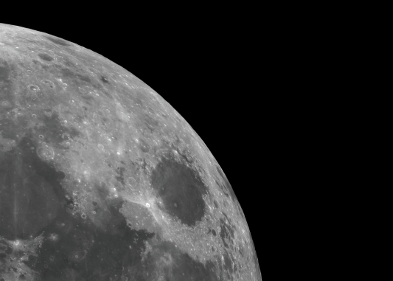
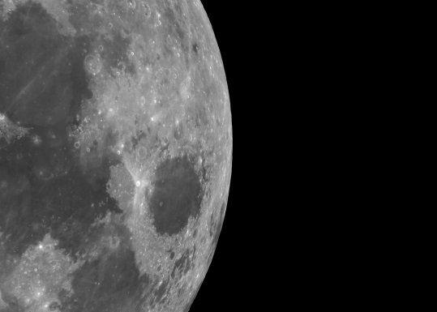
wrong
OK

Slide 5





Equatorial North Pole
$$α_{S}−α_{M}$$
$$90°− δ_{S}$$
$$90°− δ_{M}$$
$$P_{S}$$
Moon
Sun
$$E$$

Slide 6




$$r_{E}$$
Earth
Sun
$$E$$
$$d_{M}$$
$$r_{M}$$
Moon

Slide 7











$$y$$
$$R_{a}$$
$$R_{a}$$
$$R_{o}^{v}$$
$$H$$
$$W$$
$$R_{o}^{h}$$
$$Ra$$
$$x$$
$$RM$$
$$R_{a}$$

Slide 8






$$dδ$$
$$x$$
$$P_{N}$$
$$dα$$
$$N$$
$$y$$

Slide 9
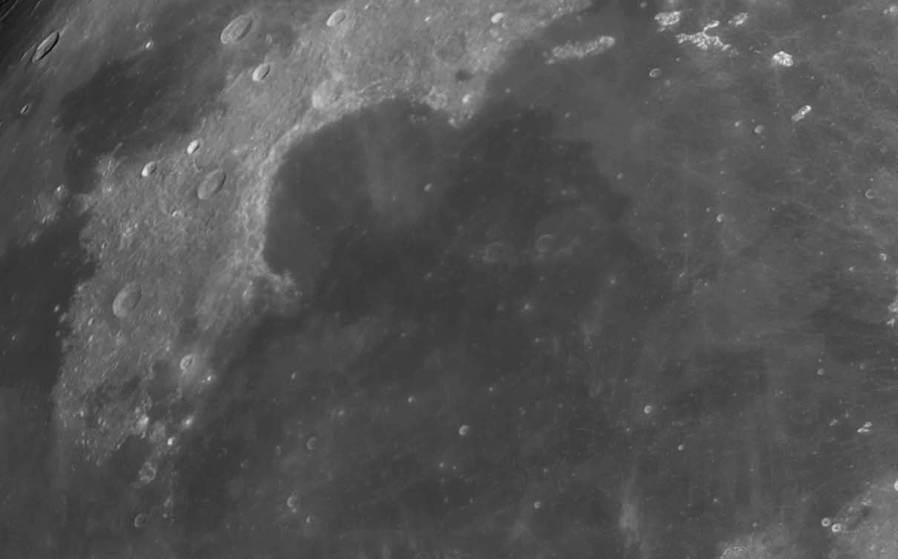




$$(x_{2}, y_{2})$$
$$d_{A}$$
$$(x_{1}, y_{1})$$
$$b$$

Slide 10
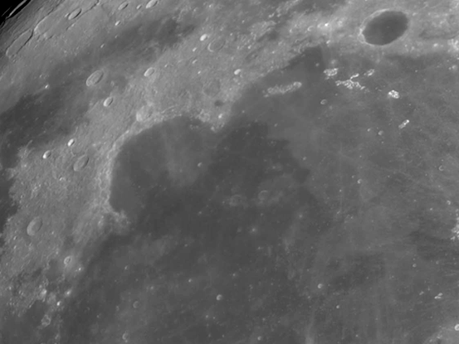




$$(x_{2}, y_{2})$$
$$d_{A}$$
$$(x_{1}, y_{1})$$
$$b$$

Slide 11




