Slide 2
P S S

Slide 3
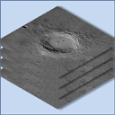
P S S

