Slide 1

Data report on Coding survey
Part 1

Slide 2



OUTLINE
Executive Summary
Introduction
Methodology
Results
Visualization – Charts
Dashboard
Discussion
Findings & Implications
Conclusion
Appendix

Slide 3
EXECUTIVE SUMMARY
Talent Landscape The developer community is young (25–34), highly educated, and concentrated in regions like the US, Germany, and India. Full-stack and back-end roles dominate the market.
Technology Trends Python, JavaScript, SQL, and TypeScript are the most widely used and admired programming languages. PostgreSQL leads as the most desired database, highlighting a shift toward open-source and cloud-ready tools. React and Node.js remain the most sought-after web frameworks.
AI Integration is Widespread Over 29,000 developers use AI tools for coding, debugging, and documentation — signaling a transformation in how software is built and maintained.
Compensation & Industry Outlook Salaries concentrate around $100K, with Fintech, Internet Services, and Banking generating the highest compensation volumes.
Strategic Takeaway To stay competitive, organizations must:
Invest in in-demand technologies (e.g., Python, PostgreSQL, React)
Adopt AI-assisted workflows
Modernize legacy systems
Engage global talent with flexible, future-facing tech stacks

Slide 4
INTRODUCTION - Project Overview
Goal: Extract, clean, analyze, and visualize data to uncover insights from the Stack Overflow Developer Survey and job-related APIs
Focus Areas:
Real-world data collection using APIs and web scraping
Data cleaning and wrangling for analysis readiness
Exploratory Data Analysis (EDA) to identify patterns and trends
Visual storytelling through charts, dashboards, and final presentation
Tools & Technologies:
Python (pandas, requests, BeautifulSoup, matplotlib, seaborn)
IBM Cognos Analytics for dashboarding
Microsoft PowerPoint for presenting final findings

Slide 5
INTRODUCTION - Objectives
Data Acquisition:
Understand and apply HTTP requests
Retrieve structured data via GitHub APIs
Perform web scraping to gather HTML-based data
Data Processing & Exploration:
Clean and normalize datasets (remove duplicates, handle missing values)
Analyze distributions, detect outliers, and explore feature relationships
Communication & Visualization:
Create clear, insightful charts and dashboards
Present findings effectively using best practices in data storytelling

Slide 6
METHODOLOGY - Data Collection and Preparation
Collected Data via APIs & Web Scraping
Analyzed HTTP requests to interact with the GitHub REST API
Retrieved and paginated job postings using the GitHub Jobs API
Performed web scraping: downloaded pages, extracted links, images, and HTML table data
Cleaned & Structured Data (Data Wrangling)
Identified and removed duplicate entries
Handled missing values using imputation strategies
Normalized key numerical columns for accurate comparisons
Used Python (pandas, requests, BeautifulSoup) for all data processing steps

Slide 7
METHODOLOGY - Analysis, Visualization & Reporting
Conducted Exploratory Data Analysis (EDA)
Analyzed distributions, correlations, and outliers using plots and statistics
Created summary visualizations: histograms, box plots, scatter plots, heatmaps
Visualized Trends and Relationships
Compared categories with pie, bar, stacked, and line charts
Analyzed technology preferences, job satisfaction, and compensation patterns
Built Dashboards and Presented Findings
Created dashboards with IBM Cognos / Looker Studio (current & future tech usage, demographics)
Summarized insights in a structured PowerPoint presentation using data storytelling best practices

Slide 8
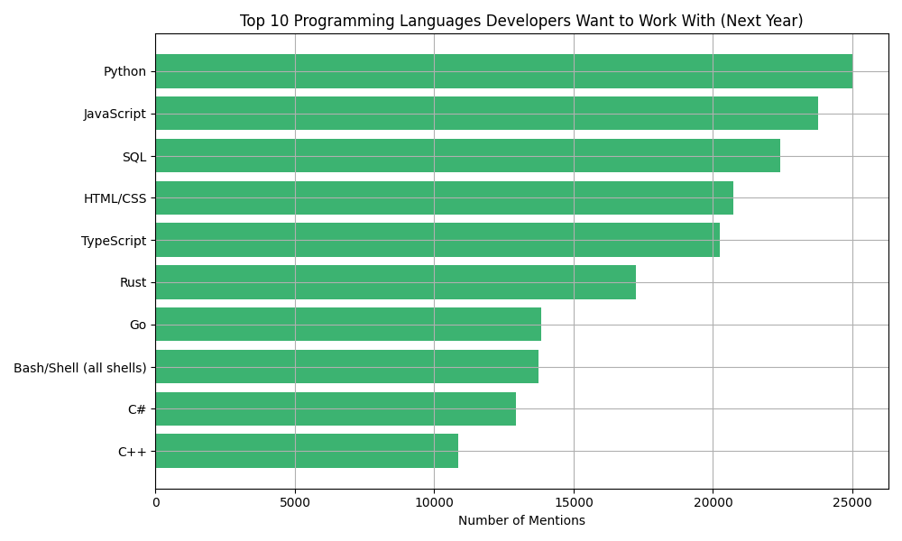
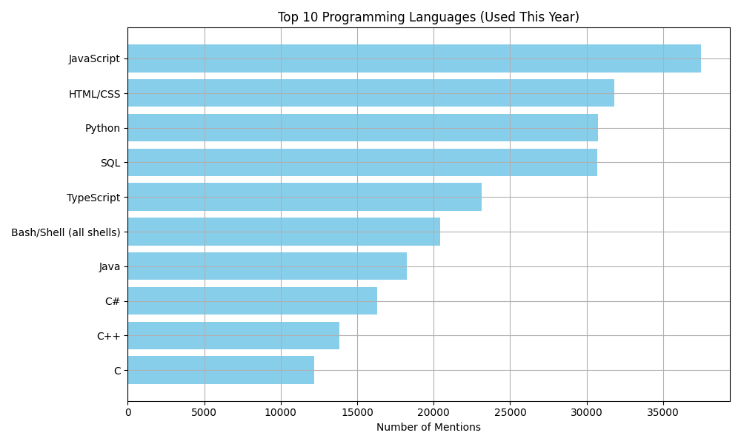
PROGRAMMING LANGUAGE TRENDS
Current Year
Next Year
<Bar chart of top 10 programming languages for the current year goes here.>
< Bar chart of top 10 programming languages for the next year goes here.>

Slide 9
PROGRAMMING LANGUAGE TRENDS - FINDINGS & IMPLICATIONS
Findings
Python is the most desired language, overtaking JavaScript.While JavaScript is the most used, Python leads in interest for future use, indicating a strong shift in developer preference.
Rust and Go are rising stars.Despite not appearing in the current top 10 used languages, Rust and Go rank 6th and 7th in the “want to work with” list — showing emerging developer enthusiasm.
Traditional languages like Java and C are losing appeal.Java and C are used frequently (7th and 10th), but neither appears in the top 10 most wanted list, suggesting waning interest among developers.
Implications
Organizations should invest more in Python and TypeScript.These languages are both popular now and in future demand — ensuring a healthy talent pipeline and long-term viability.
Tech stacks should consider adopting Rust or Go for new projects.Since many developers want to work with these languages, offering projects in them could attract top talent and modernize systems.
Legacy systems in Java or C may face future staffing challenges.As fewer developers express interest in these languages, maintaining systems built on them could become increasingly difficult and costly.

Slide 10
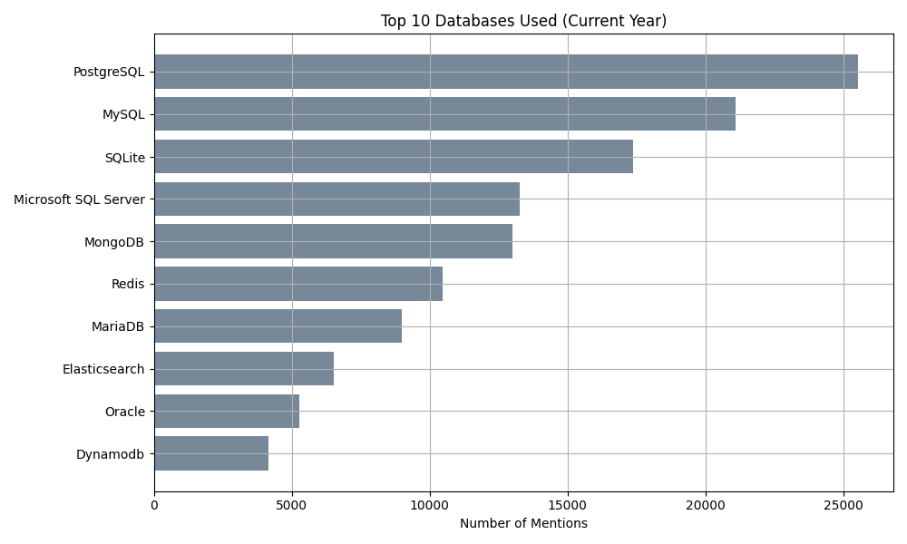
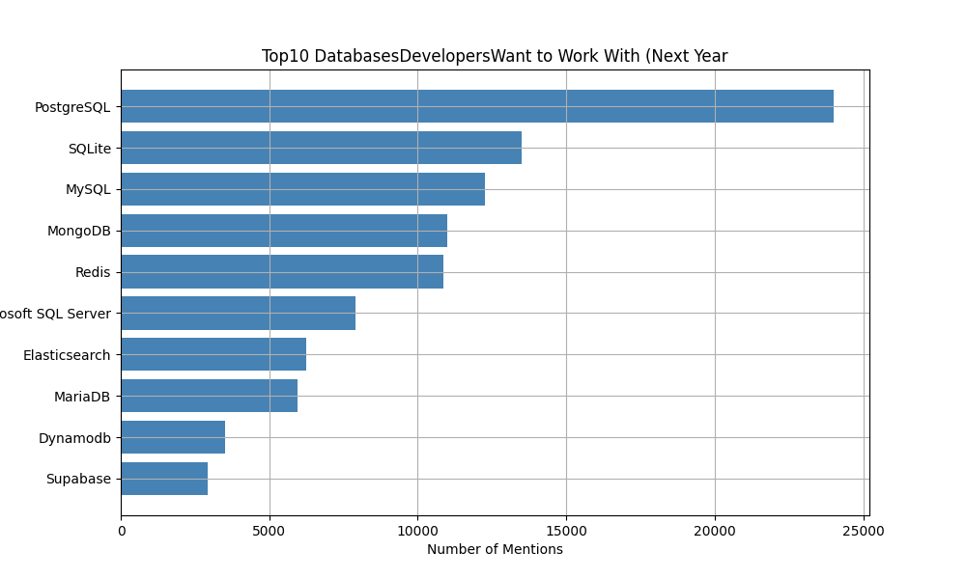
DATABASE TRENDS

Slide 11
DATABASE TRENDS - FINDINGS & IMPLICATIONS
Findings
PostgreSQL is the dominant and most desired database.It ranks #1 both in current usage and future interest — showing its continued momentum as the preferred open-source RDBMS.
Modern, developer-friendly databases like Supabase are gaining traction.While not in the current top 10, Supabase appears in the top 10 wanted list — signaling rising popularity in serverless and Jamstack ecosystems.
Traditional enterprise databases like Oracle and Microsoft SQL Server are declining in appeal.While still widely used (e.g., Oracle #9 in usage), they rank lower or are absent in developer preference for future use.
Implications
PostgreSQL should be a strategic default for new projects.Its strong community support and wide adoption ensure both talent availability and ecosystem stability.
Tech teams should explore integrating newer tools like Supabase.These tools align with modern developer workflows (e.g., serverless, real-time apps) and may help attract talent looking to work with cutting-edge stacks.
Organizations relying heavily on legacy systems (like Oracle) should plan for modernization or risk future hiring and maintenance challenges, as developer interest continues to decline.

Slide 12

DASHBOARD
<Please present your dashboard in the following slides.>

Slide 13
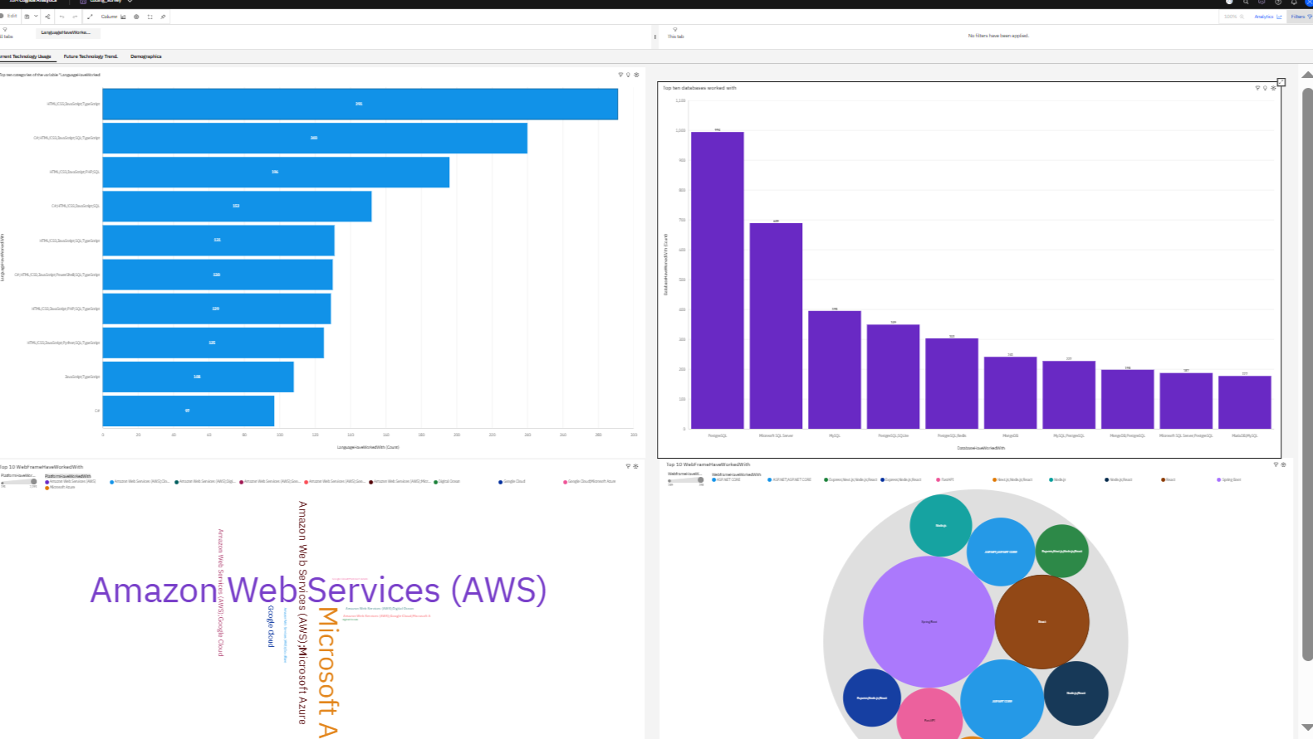
DASHBOARD TAB 1

Slide 14
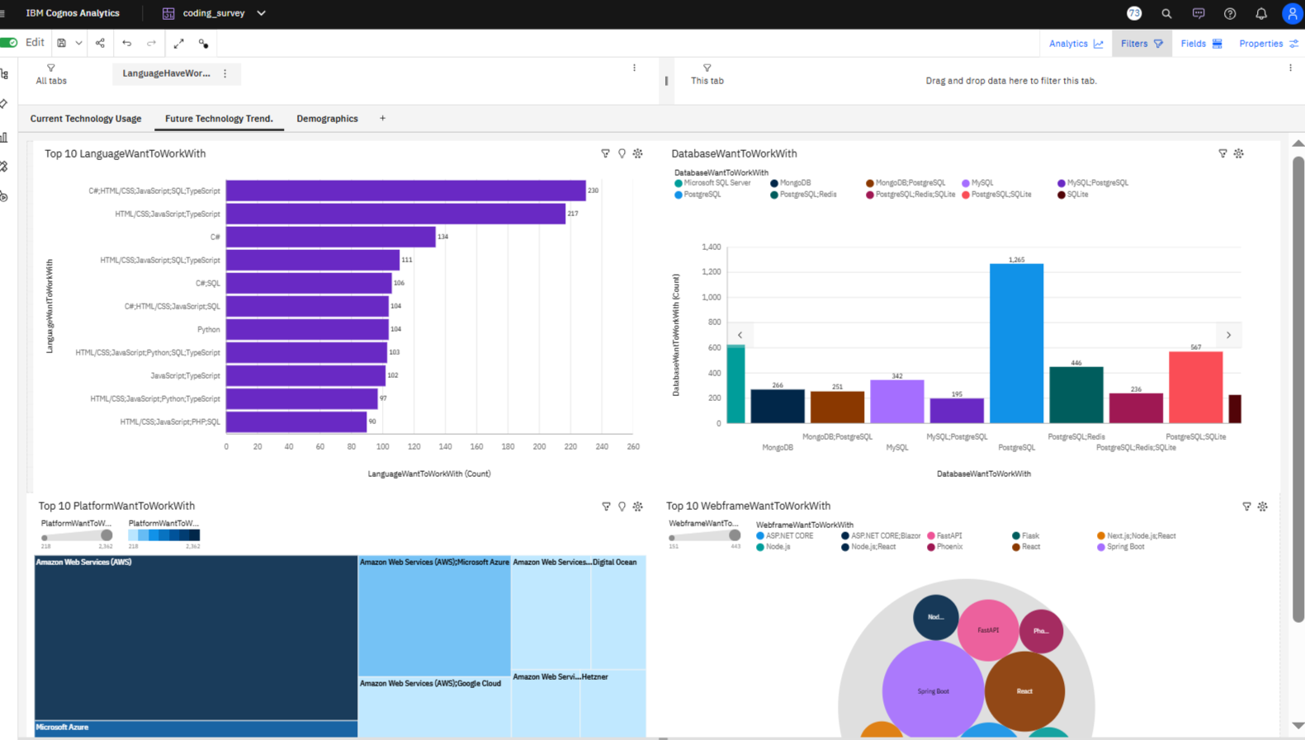
DASHBOARD TAB 2

Slide 15
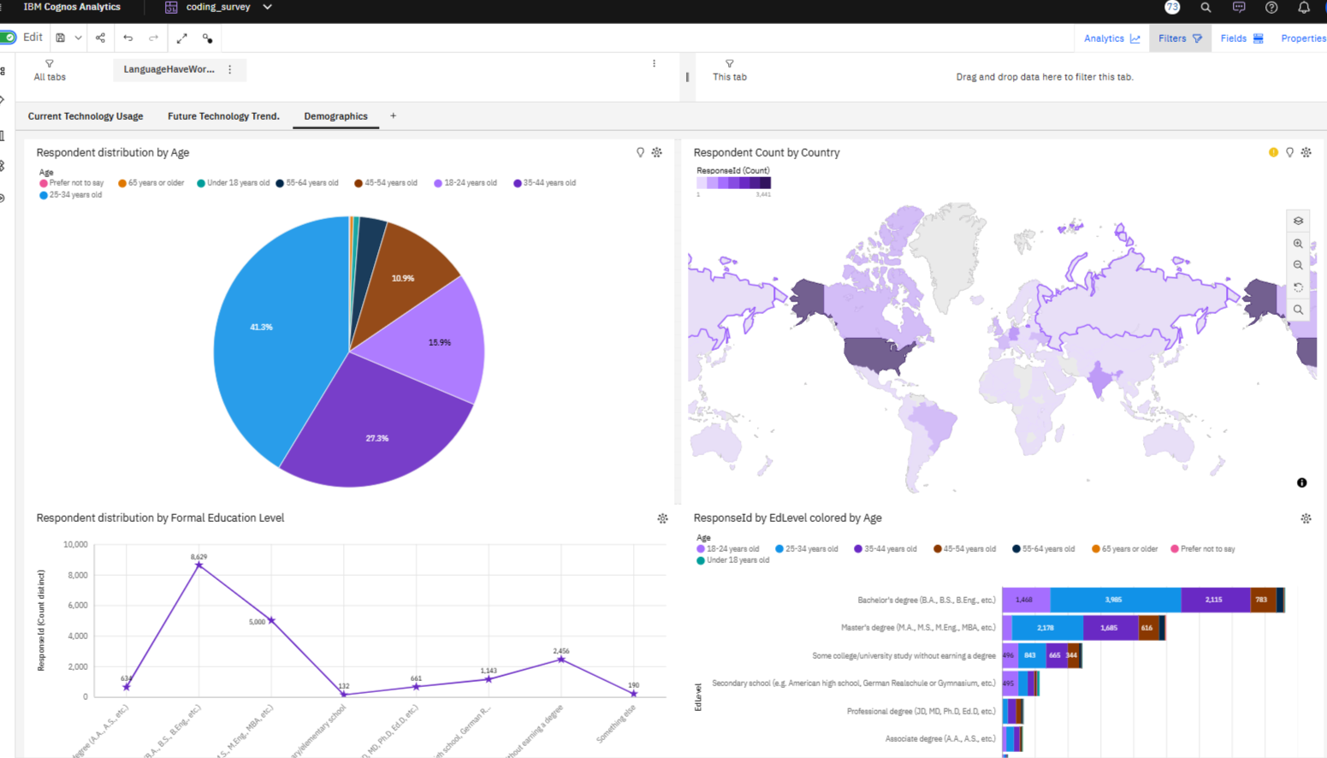
DASHBOARD TAB 3

Slide 16
DISCUSSION - Programming Language Trends – Usage vs. Satisfaction
Most Used Languages
JavaScript, HTML/CSS, Python, SQL, and TypeScript top the usage charts
These languages also lead in admiration, showing alignment between use and developer preference
Satisfaction Outliers
Groovy, Solidity, Zephyr, and Dart show highest average satisfaction
Despite lower adoption, these niche languages may offer high developer enjoyment in specific contexts
Low Satisfaction
Languages like Julia, Fortran, and R score lowest on satisfaction
May indicate limited use cases, outdated tooling, or learning curve issues
Balanced Stars
TypeScript and Python combine high usage, high admiration, and good satisfaction — ideal for modern development stacks

Slide 17
DISCUSSION - Strategic Insights Recommendations
Let me know if you’
Growth Languages: Python, TypeScript, Rust, Go
Python leads in future interest despite being only 3rd in current use
Rust and Go show rising appeal — attractive for developers, good fit for new projects
Declining Developer Interest
Java and C: still widely used, but missing from top “wanted” languages
Indicates potential long-term resourcing and maintenance challenges
Strategic Recommendations
Invest in Python & TypeScript: combine broad adoption with strong developer interest
Adopt Rust or Go for greenfield projects: attract talent and future-proof systems
Reassess reliance on legacy tech (Java, C): plan transitions or upskilling
AI Tools Influence Usage
Widespread use of AI tools (e.g., for writing, debugging, documentation)
may increase adoption of languages with better tool support like Python and JavaScript

Slide 18
DISCUSSION - Key Insights – Top Databases Among Developers
PostgreSQL Leads in Popularity
Most used and most wanted database
Valued for reliability, advanced features, and open-source support
Preferred in modern, cloud-native, and analytics applications
Relational Databases Remain Core Technologies
MySQL: Widely used in web dev (e.g., LAMP stack)
SQLite: Popular for mobile and embedded systems
SQL Server & Oracle: Still entrenched in enterprise environments
Rise of NoSQL Options
MongoDB: Flexible, JSON-based, great for web apps
Redis: Specialized in high-speed caching and real-time systems

Slide 19
DISCUSSION - Key Insights – Top Databases Among Developers
Growth in Cloud-Native & Scalable Solutions
Elasticsearch: Favored for search, logging, observability
DynamoDB: Gaining traction via AWS ecosystem
Oracle Losing Developer Interest
Present in usage, absent in "most wanted"
Perceived as outdated, expensive, or overly complex
Open-Source Momentum
Clear shift toward community-driven and cloud-friendly tools
PostgreSQL, MongoDB, and Redis benefit from Docker/K8s support
Strategic Recommendation
Align with technologies that combine strong developer interest and modern deployment compatibility

Slide 20
OVERALL FINDINGS
Demographics
Majority of respondents aged 25–34, followed by 35–44
Top countries: USA, Germany, India, UK, Ukraine
Most common roles: Full-stack and Back-end developers
Education: Majority hold Bachelor’s or Master’s degrees
Most Used Tools & Technologies
JavaScript, HTML/CSS, and Python top the usage charts
PostgreSQL is the most wanted database, surpassing MySQL and MongoDB
Web frameworks in demand: React, Node.js, Next.js
AI Integration is Widespread
Developers heavily use AI tools for writing code, searching, and debugging
Over 29,000 use AI tools for coding tasks alone
Compensation Patterns
Common salaries cluster around $100,000
Highest compensation sums in Fintech, Internet/Telecom, and Banking industries
Operating System Preferences
Windows leads for professional use, followed by macOS and Ubuntu
WSL adoption is strong, showing cross-platform development growth

Slide 21
OVERALL IMPLICATIONS for developers and organizations
Let me know if you
Invest in In-Demand Skills
Focus on Python, TypeScript, and PostgreSQL for long-term career and project viability
Master popular frameworks like React and Node.js to stay competitive
Align with Industry Trends
Fintech, Internet Services, and Healthcare offer the highest earning potential
Consider industry context when planning career moves or tech offerings
Embrace AI Coding Tools
With widespread adoption, AI tools are reshaping developer workflows
Upskilling in AI-assisted development is now essential
Rethink Legacy Systems
Languages like Java and C show declining interest despite heavy usage
Organizations should plan transitions to modern, desirable stacks (e.g., Rust, Go)
Support Developer Diversity
Large cohorts of students and junior developers entering the field
Opportunities for mentoring, inclusive hiring, and early-career support

Slide 22
CONCLUSION
Modern stacks win developer mindshare: PostgreSQL, Python, TypeScript, and React lead both in current use and future interest — ideal technologies for long-term investment.
Developer satisfaction matters: Languages like Groovy, Dart, and Go score high in satisfaction, suggesting emerging opportunities beyond traditional stacks.
AI tools are mainstream: AI is now a core part of the developer workflow — especially for writing, debugging, and searching, reshaping productivity expectations.
Industry and compensation alignment: Fintech, Internet Services, and Banking offer top compensation — key for talent retention and career planning.
A diverse, global talent pool: Young, highly educated developers from the US, Germany, and India dominate — companies should tailor outreach, tools, and culture accordingly.
Strategic imperative: Embrace modern, open-source, and AI-enhanced tools to attract talent, future-proof systems, and align with evolving developer expectations.

Slide 23

APPENDIX
Include any relevant additional charts, or tables that you may have created during the analysis phase.

Slide 24
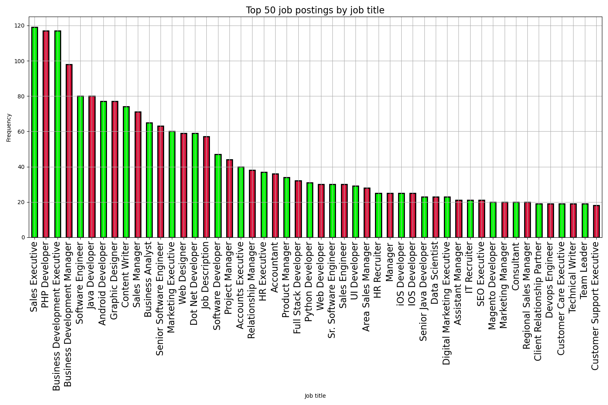
JOB POSTINGS

Slide 25
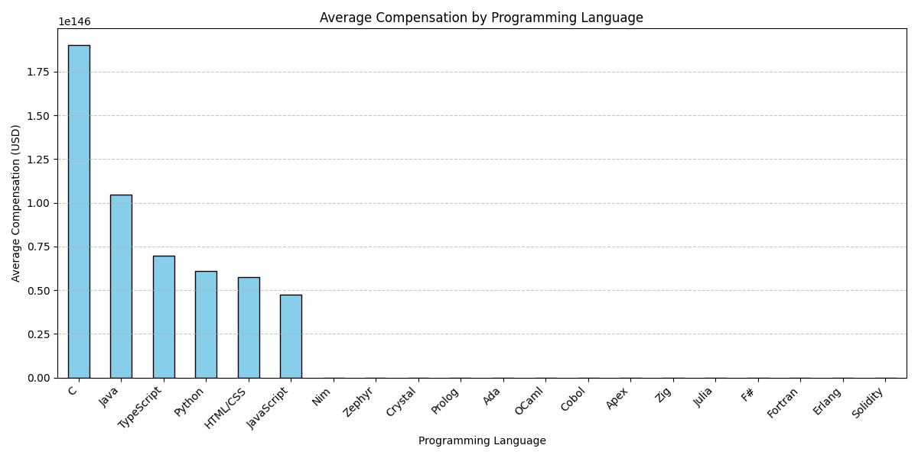
POPULAR LANGUAGES
In Module 1 you have collected the job postings data using web scraping in a file named “popular-languages.csv”. Present that data using a bar chart here. Order the bar chart in the descending order of salary.

