Slide 1
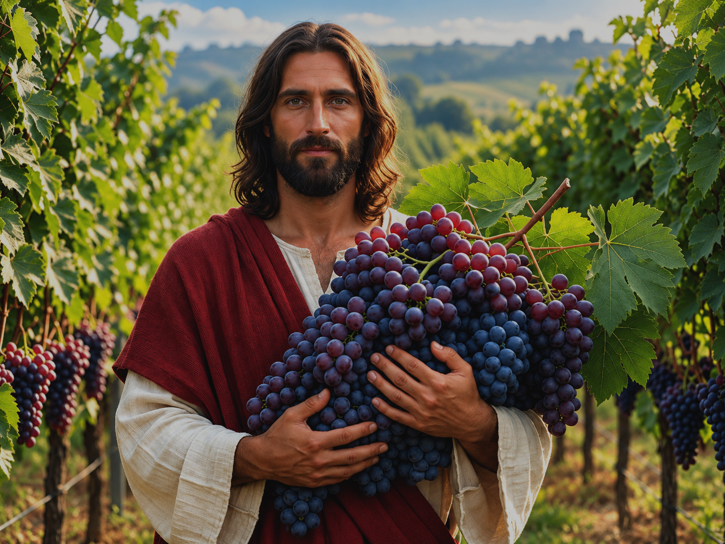

25th Sunday in Ordinary Time

Slide 2

Welcome
Please observe silence in the Church
Remain reverent, especially during the Consecration and receiving of
Holy Communion.
Cellphones are to be switched off
Use bathrooms before or after Mass
Parents with little ones please
use the baby chapel (crying room)

Slide 4
Entrance
THE CHURCH’S ONE FOUNDATION
IS JESUS CHRIST HER LORD
SHE IS HIS NEW CREATION
BY WATER AND THE WORD

Slide 5
FROM HEAVEN HE CAME
AND SOUGHT HER
TO BE HIS HOLY BRIDE
WITH HIS OWN BLOOD HE BOUGHT HER
AND FOR HER LIFE HE DIED

Slide 6

O HAPPY ONES AND HOLY
LORD, GIVE US GRACE THAT WE
LIKE THEM, THE MEEK AND LOWLY
ON HIGH MAY DWELL WITH THEE

Slide 8
Confessio
I CONFESS TO ALMIGHTY GOD
AND TO YOU MY BROTHERS AND SISTERS
THAT I HAVE GREATLY SINNED
IN MY THOUGHTS AND IN MY WORDS
IN WHAT I HAVE DONE
AND IN WHAT I HAVE FAILED TO DO

Slide 9
THROUGH MY FAULT, THOROUGH MY FAULT
THROUGH MY MOST GRIEVOUS FAULT
THEREFORE I ASK BLESSED
MARY EVER-VIRGIN
ALL THE ANGELS AND SAINTS
AND YOU, MY BROTHERS AND SISTERS
TO PRAY FOR ME TO THE LORD OUR GOD

Slide 11
Kyrie Eleison
KYRIE ELEISON
KYRIE ELEISON
CHRISTE ELEISON
CHRISTE ELEISON
KYRIE ELEISON
KYRIE ELEISON
Mass of Renew
Curtis Stephan

Slide 13
Gloria
GLORY TO GOD IN THE HEIGHEST
AND ON EARTH
PEACE TO PEOPLE OF GOOD WILL
WE PRAISE YOU, WE BLESS YOU
WE ADORE YOU
WE GLORIFY YOU

Slide 14
WE GIVE YOU THANKS
FOR YOUR GREAT GLORY
LORD GOD HEAVENLY KING
OH GOD ALMIGHTY FATHER
LORD JESUS CHRIST,
ONLY BEGOTTEN SON
LORD GOD, LAMB OF GOD
SON OF THE FATHER

Slide 15
YOU TAKE AWAY THE SINS OF THE WORLD
HAVE MERCY ON US
YOU TAKE AWAY THE SINS OF THE WORLD
RECEIVE OUR PRAYER
YOU ARE SEATED AT THE RIGHT HAND
OF THE FATHER
HAVE MERCY
HAVE MERCY ON US

Slide 16
FOR YOU ALONE ARE THE HOLY ONE
YOU ALONE ARE THE LORD
YOU ALONE ARE THE MOST HIGH
JESUS CHRIST
WITH THE HOLY SPIRIT
IN THE GLORY OF GOD THE FATHER
AMEN, AMEN
Mass of Renew
Curtis Stephan

Slide 18
Response
THE LORD IS CLOSE
TO THOSE
WHO CALL HIM

Slide 20
Credo
I BELIEVE IN ONE GOD
THE FATHER THE ALMIGHTY
MAKER OF HEAVEN AND EARTH
OF ALL THINGS VISIBLE AND INVISIBLE
I BELIEVE IN ONE LORD JESUS CHRIST
THE ONLY BEGOTTEN SON OF GOD
BORN OF THE FATHER BEFORE ALL AGES

Slide 21
GOD FROM GOD
LIGHT FROM LIGHT
TRUE GOD FROM TRUE GOD
BEGOTTEN NOT MADE
CONSUBSTANTIAL WITH THE FATHER
THROUGH HIM ALL THINGS WERE MADE

Slide 22
FOR US MEN AND FOR OUR SALVATION
(Please bow)
HE CAME DOWN FROM HEAVEN
AND BY THE HOLY SPRIT
WAS INCARNATE OF THE VIRGIN MARY
AND BECAME MAN

Slide 23
FOR OUR SAKE HE WAS CRUCIFIED
UNDER PONTIUS PILATE
HE SUFFERED DEATH AND WAS BURIED
AND ROSE AGAIN THE THIRD DAY
IN ACCORDANCE WITH THE SCRIPTURES

Slide 24
HE ASCENDED INTO HEAVEN
AND IS SEATED AT THE RIGHT HAND
OF THE FATHER
HE WILL COME AGAIN IN GLORY
TO JUDGE THE LIVING AND THE DEAD
AND HIS KINGDOM WILL HAVE NO END

Slide 25
I BELIEVE IN THE HOLY SPIRIT
THE LORD, THE GIVER OF LIFE
WHO PROCEEDS FROM
THE FATHER AND THE SON
WHO WITH THE FATHER AND THE SON
IS ADORED AND GLORIFIED
WHO HAS SPOKEN THROUGH THE PROPHETS

Slide 26
I BELIEVE IN ONE, HOLY, CATHOLIC
AND APOSTOLIC CHURCH
I CONFESS ONE BAPTISM
FOR THE FORGIVENESS OF SINS
AND I LOOK FORWARD
TO THE RESURRECTION OF THE DEAD
AND THE LIFE OF THE WORLD TO COME
AMEN

Slide 28
Offertory
TAKE OUR BREAD, WE ASK YOU
TAKE OUR HEARTS, WE LOVE YOU
TAKE OUR LIVES
OH FATHER WE ARE YOURS
WE ARE YOURS

Slide 29
YOURS AS WE STAND
AT THE TABLE YOU SET
YOURS AS WE EAT THE BREAD
OUR HEARTS CANT FORGET
WE ARE THE SIGNS OF YOUR LIFE
WITH US YET
WE ARE YOURS, WE ARE YOURS

Slide 30
TAKE OUR BREAD, WE ASK YOU
TAKE OUR HEARTS, WE LOVE YOU
TAKE OUR LIVES
OH FATHER WE ARE YOURS
WE ARE YOURS

Slide 32
Offertory
TO BE THE BODY OF THE LORD
IN THIS WORLD
TO HAVE HIS SPIRIT COURSING
THROUGH MY SOUL
TO KNOW THE PASSION OF MY JESUS
IN HIS LOVE FOR EVERY MAN
TO SHOW HIS MERCY
IN THE SHADOWS OF THIS LAND

Slide 33
COME WALK WITH ME
COME SHARE MY LIFE
YOU MUST KNOW THE SHADOWS
IF YOU WOULD KNOW THE LIGHT

Slide 34
TO BE THE BODY OF THE LORD
IN THIS WORLD
TO HAVE HIS SPIRIT COURSING
THROUGH MY SOUL
TO KNOW THE PASSION OF MY JESUS
IN HIS LOVE FOR EVERY MAN
TO SHOW HIS MERCY
IN THE SHADOWS OF THIS LAND

Slide 36
Offertory
TO BE THE BODY OF THE LORD
IN THIS WORLD
TO HAVE HIS SPIRIT COURSING
THROUGH MY SOUL
TO KNOW THE PASSION OF MY JESUS
IN HIS LOVE FOR EVERY MAN
TO SHOW HIS MERCY
IN THE SHADOWS OF THIS LAND

Slide 37
COME WALK WITH ME
COME SHARE MY LIFE
YOU MUST KNOW THE SHADOWS
IF YOU WOULD KNOW THE LIGHT

Slide 38
TO BE THE BODY OF THE LORD
IN THIS WORLD
TO HAVE HIS SPIRIT COURSING
THROUGH MY SOUL
TO KNOW THE PASSION OF MY JESUS
IN HIS LOVE FOR EVERY MAN
TO SHOW HIS MERCY
IN THE SHADOWS OF THIS LAND

Slide 40
Sanctus
HOLY, HOLY, HOLY
LORD GOD OF HOSTS
HEAVEN AND EARTH
ARE FULL OF YOUR GLORY
HOSANNA IN THE HIGHEST

Slide 41
BLESSED IS HE WHO COMES
IN THE NAME OF THE LORD
HOSANNA IN THE HIGHEST
HOSANNA IN THE HIGHEST
Mass of Renew
Curtis Stephan

Slide 43
Mysterium Fideii
SAVE US SAVIOUR OF THE WORLD
FOR BY YOUR CROSS
AND RESURRECTION
YOU HAVE SET US FREE
YOU HAVE SET US FREE
Mass of Renew
Curtis Stephan

Slide 45
Agnus Dei
LAMB OF GOD
YOU TAKE AWAY
THE SINS OF THE WORLD
HAVE MERCY
HAVE MERCY ON US
(repeat)

Slide 46
LAMB OF GOD
YOU TAKE AWAY
THE SINS OF THE WORLD
GRANT US
GRANT US PEACE
Mass of Christ the Saviour
Dan Schutte

Slide 48
Communion
WHO COMPARES TO YOU
WHO SETS THE STARS IN THEIR PLACE
HE WHO CALMED THE RAGING SEAS
THAT CAME CRASHING OVER ME

Slide 49
YOU ARE MAGNIFICENT
ETERNALLY WONDERFUL
GLORIOUS JESUS
NO ONE EVER WILL COMPARE
TO YOU JESUS

Slide 50
YOU ARE MAGNIFICENT
ETERNALLY WONDERFUL
GLORIOUS JESUS
NO ONE EVER WILL COMPARE
TO YOU JESUS
Hillsong

Slide 52
Communion
WHO COMPARES TO YOU
WHO SETS THE STARS IN THEIR PLACE
HE WHO CALMED THE RAGING SEAS
THAT CAME CRASHING OVER ME

Slide 53
YOU ARE MAGNIFICENT
ETERNALLY WONDERFUL
GLORIOUS JESUS
NO ONE EVER WILL COMPARE
TO YOU JESUS

Slide 54
YOU ARE MAGNIFICENT
ETERNALLY WONDERFUL
GLORIOUS JESUS
NO ONE EVER WILL COMPARE
TO YOU JESUS
Hillsong

Slide 56

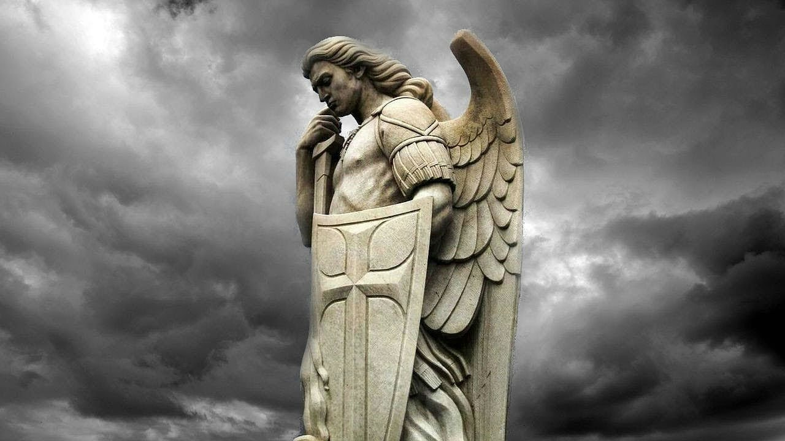
ST MICHAEL, THE ARCHANGEL
DEFEND US IN BATTLE
BE OUR DEFENCE AGAINT THE
WICKEDNESS AND SNARES OF THE DEVIL
MAY GOD REBUKE HIM,
WE HUMBLY PRAY

Slide 57
AND DO THOU,
OH PRINCE OF THE HEAVENLY HOST
BY THE POWER OF GOD
CAST INTO HELL
SATAN AND ALL THE OTHER EVIL SPIRITS
WHO PROWL AROUND THE WORLD
SEEKING THE RUIN OF SOULS
AMEN

Slide 59

GO THE MASS IS ENDED
CHILDREN OF THE LORD
TAKE HIS WORD TO OTHERS
AS YOU’VE HEARD IT SPOKEN TO YOU
GO THE MASS IS ENDED
GO AND TELL THE WORLD
THE LORD IS GOOD, THE LORD IS KIND
AND HE LOVES EVERYONE

Slide 60
GO THE MASS IS ENDED
TAKE HIS LOVE TO ALL
GLADDEN ALL WHO MEET YOU
FILL THEIR HEARTS WITH
HOPE AND COURAGE
GO THE MASS IS ENDED
FILL THE WORLD WITH LOVE
AND GIVE TO ALL WHAT YOU’VE RECEIVED
THE PEACE AND JOY OF CHRIST

Slide 61
GO THE MASS IS ENDED
STRENGTHENED IN THE LORD
LIGHTEN EVERY BURDEN
SPREAD THE JOY OF CHRIST AROUND YOU
GO THE MASS IS ENDED
TAKE HIS PEACE TO ALL
THIS DAY IS YOURS TO CHANGE THE WORLD
TO MAKE GOD KNOWN AND LOVED
Sr. Maria Lydia Pereira

