Slide 1
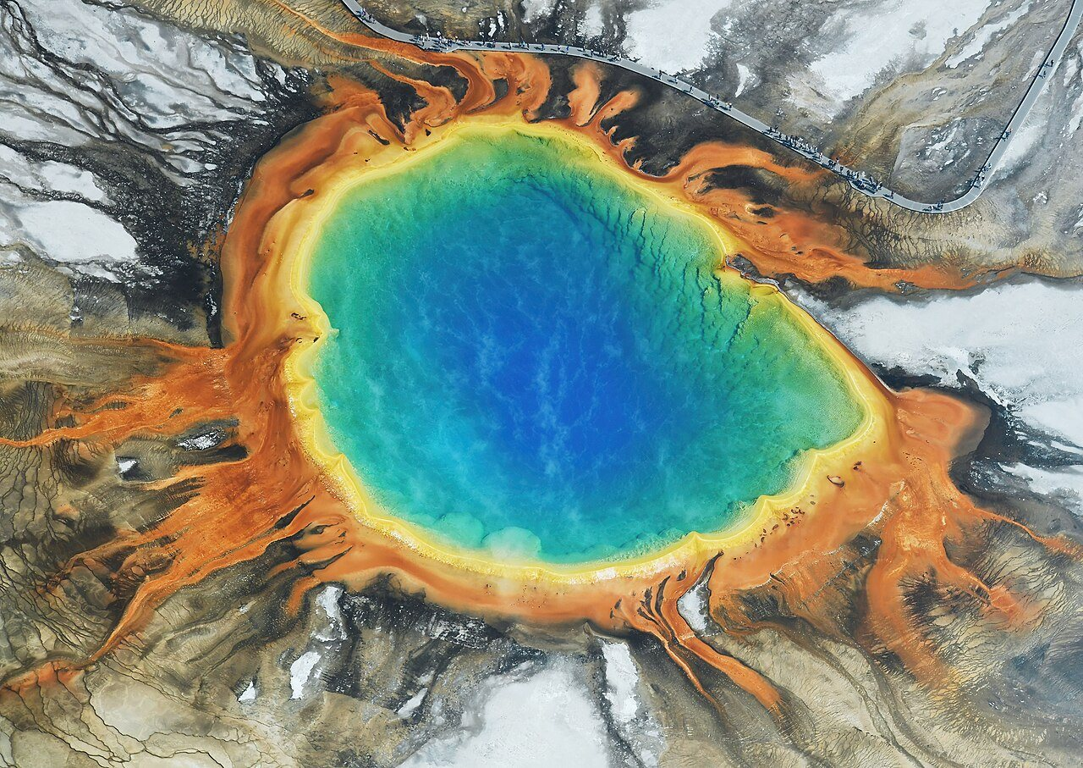
DATA ANALYSIS PROJECT
Biodiversity in National Parks
Conservation status of species across four national parks
Rolin
September 19

Slide 2
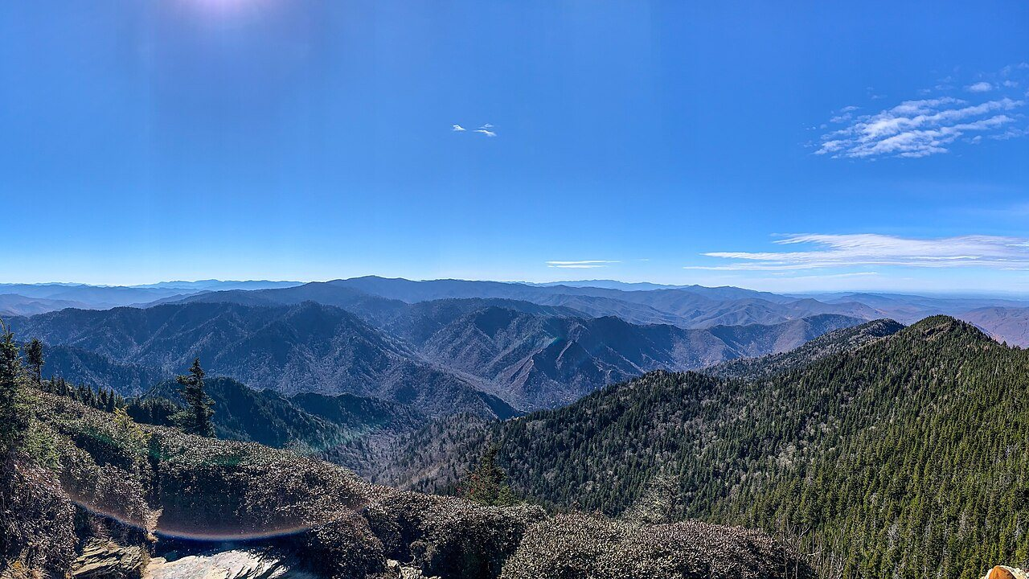
Why I Picked This Topic
• I have always liked anything related to nature, so when I got this national park dataset I was instantly interested.
• National parks are home to thousands of species, but not all of them are being tracked properly.
• The question I wanted to answer: which category of species is most often listed as protected?
• I hope the result can be a starting point for deciding where to focus monitoring.
Great Smoky Mountains
Rolin · September 19
2

Slide 3
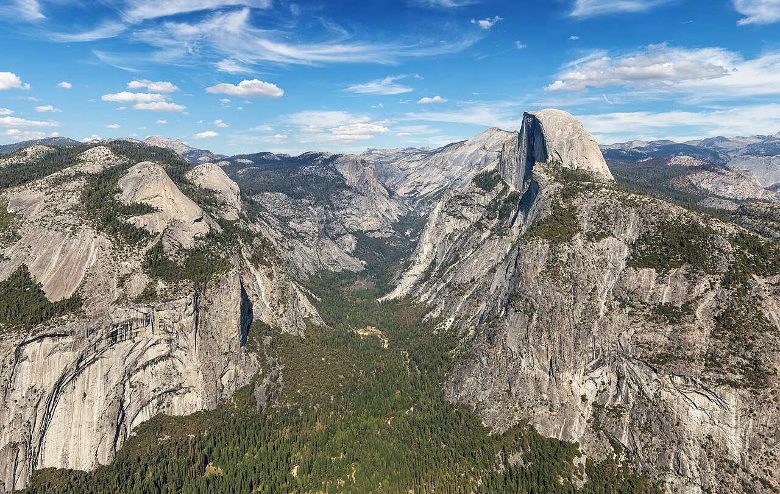
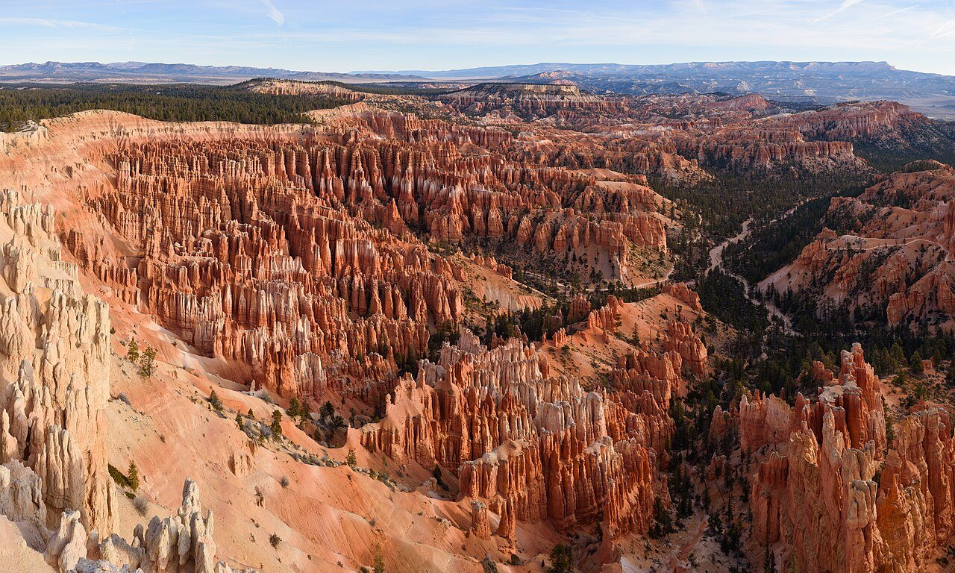
The Data I Used
• species_info.csv — 5,824 rows. It holds the category, scientific name, common names, and conservation status of each species.
• observations.csv — 23,296 rows. Sightings of each species over a 7-day period.
• The data comes from the National Park Service and is used here as project practice.
Yellowstone
Yosemite
Bryce Canyon
Great Smoky Mts.
Rolin · September 19
3

Slide 4
How I Worked On It
1. Opened the data and checked the row counts and column types.
2. Filled in the empty values in the conservation_status column to keep things tidy.
3. Calculated the proportion of protected species for each category.
4. Ran a chi-square test to see whether the difference was real or just chance.
5. Compared the total observations between parks.
6. Pulled everything together into a conclusion.
Rolin · September 19
4

Slide 5
Finding 1 — Conservation Status
Status | Count
No Intervention | 5,633
Species of Concern | 161
Endangered | 16
Threatened | 10
In Recovery | 4
191
species are listed as protected, only about 3.3% of the 5,824 species.
The largest group by far is not part of any conservation program at all.
Rolin · September 19
5

Slide 6
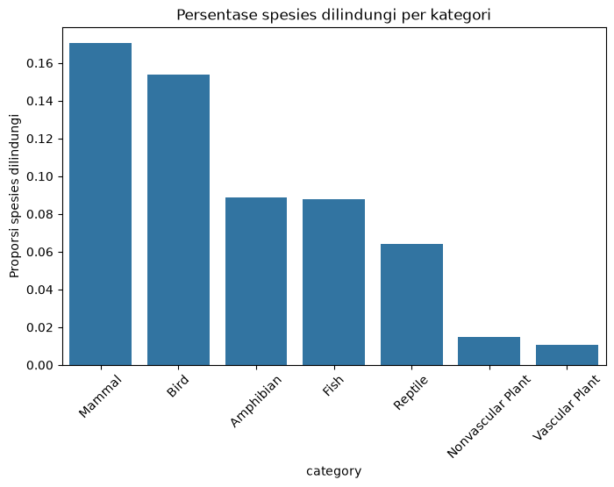
Finding 2 — Share of Protected Species
Mammals (17.0%) and birds (15.4%) come out on top.
Amphibians and fish sit around 9%.
Plants are at the bottom, only about 1%.
Animals seem to be hit faster by environmental change.
Rolin · September 19
6

Slide 7
Finding 3 — Chi-Square Test
chi2
• The p-value is far below 0.05.
• That means species category and conservation status are genuinely related.
• So the pattern I saw earlier is not just a coincidence.
628.58
p-value ≈ 2.46 × 10⁻¹¹⁷
Rolin · September 19
7

Slide 8
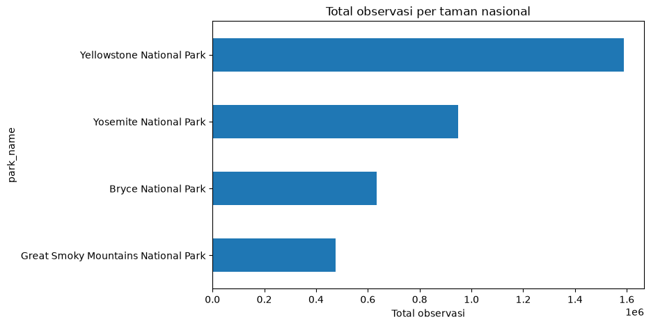
Finding 4 — Observations per Park
Yellowstone is highest, with 1,587,641 observations.
Followed by Yosemite (949,452) and Bryce Canyon (633,291).
Great Smoky Mountains is the lowest, at 474,863.
This may come down to park size and how much surveying is done.
Rolin · September 19
8

Slide 9
Conclusion
• Most species are not part of any conservation program; among those that are, Species of Concern is the most common status.
• Mammals and birds have the highest share of protected species, plants the lowest.
• The chi-square test shows a significant link between species category and conservation status (p < 0.05).
• Yellowstone recorded the highest total number of observations.
Yosemite National Park
Rolin · September 19
9

Slide 10
Recommendations
• Conservation efforts could be focused on mammals and birds.
• Monitoring should be increased in the parks with the fewest observations, such as Great Smoky Mountains.
• A period longer than 7 days would likely give a more stable pattern.
• Conservation status data should be refreshed regularly to stay accurate.
Bryce Canyon National Park
Rolin · September 19
10

Slide 11
Notes & Sources
• Data: National Park Service — Codecademy project dataset.
• Park photos: Wikimedia Commons (public domain / free licence).
• Built with Python (pandas, matplotlib, seaborn) in Jupyter Notebook.
• These slides were put together by me from the analysis in the notebook.
Rolin · September 19
11

Slide 12
Thank you
Rolin · September 19
Photo credit: Wikimedia Commons

