Slide 1
Little-Lemon-Workbook
File created on: 11/09/2024 7:59:48 GMT+3

Slide 3
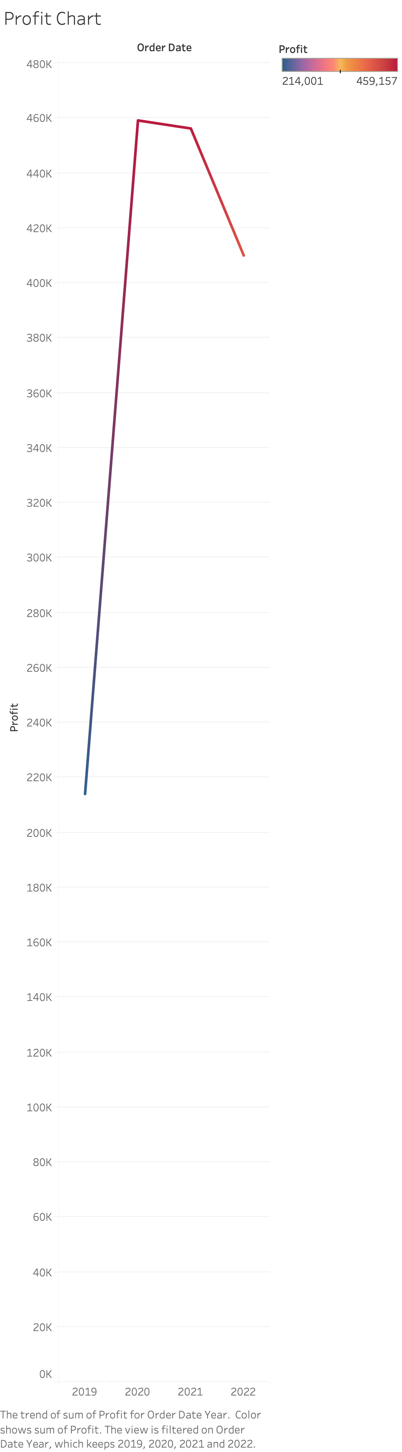

Slide 4
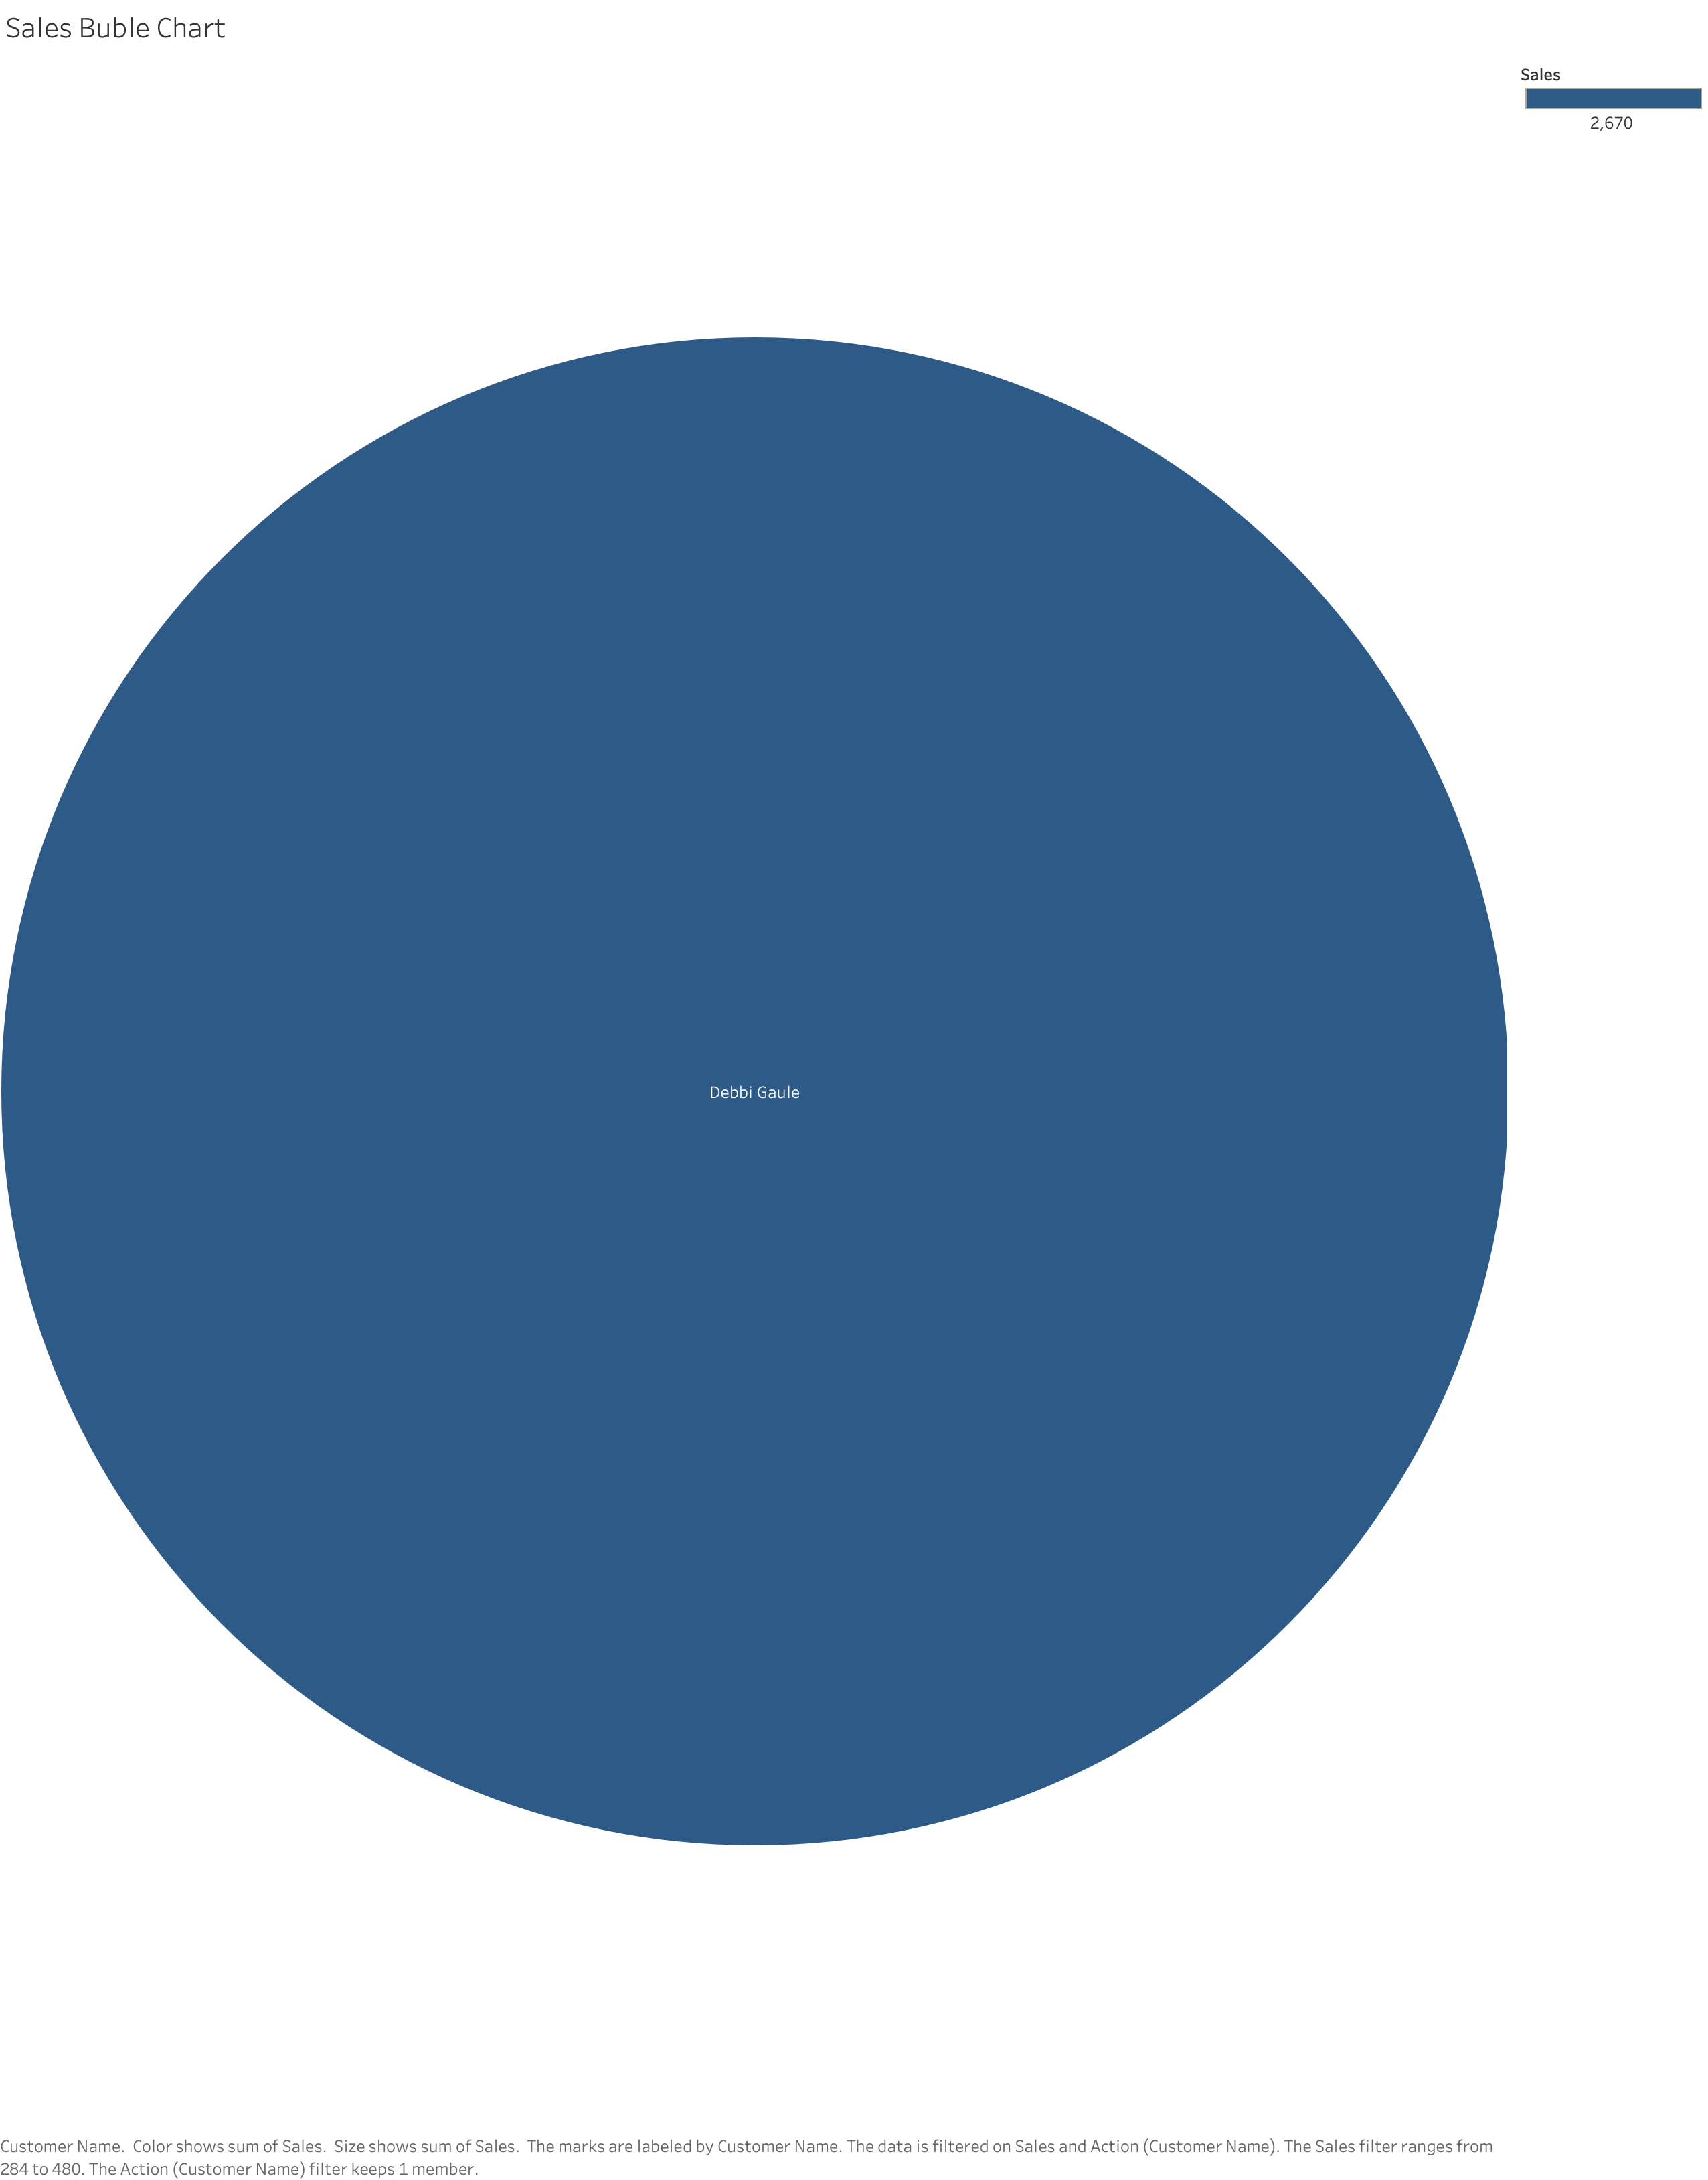

Slide 5
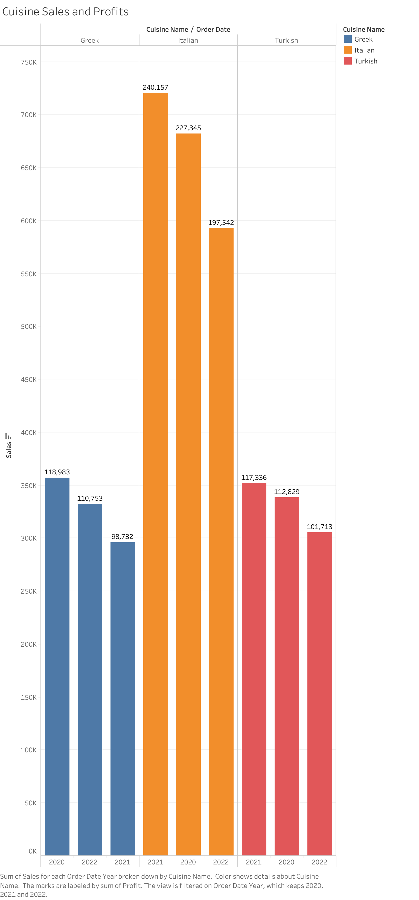

Slide 6
