Slide 1

Monte Carlo Method on GPUs
Topic 05
Roland Osterrieter

Slide 2
Agenda
Motivation
Monte Carlo Method
Nvidia CUDA
Program for π calculation
Running on ForHLR 2
Results
Conclusion
Sources

Slide 3
Motivation
Implement a monte carlo algorithmus for GPU
Run in a GPU cluster for huge problem sizes
Compare with a „standard“ cpu implementation

Slide 4
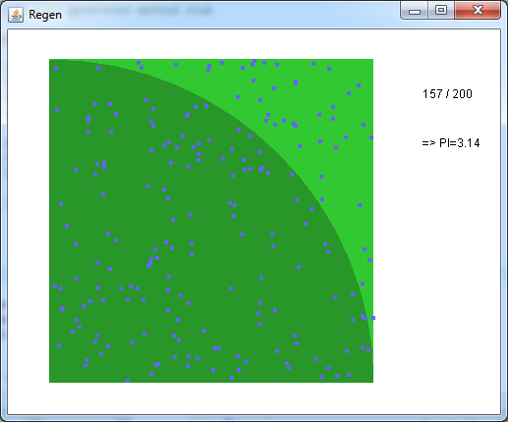

Monte Carlo Method
=> Use the law of large numbers
Huge sizes of random samples
Approximate a result
Famous problem: π calculation
„Raindrops in a grass circle“
$A_{C}=πr^{2} A_{S}=a^{2}={(2∗r)}^{2}$
$\frac{A_{c}}{A_{S}}=\frac{πr^{2}}{{(2∗r)}^{2}}= \frac{π}{4}$
$π= \frac{Drops in Circle}{Number Of Drops} ∗4$

Slide 5

Nvidia CUDA
Platform that enables general purpose calculations on GPUs
GPU is specialized for compute-intensive, highly parallel computation
Programming model:
Kernel code that gets executed on the device
Data transfer between host and device
Kernels run in blocks, which contain threads

Slide 6
Program for π calculation
Written in C, compiled with CUDA nvcc
Using curand library for calculating random numbers on the device
Kernel Procedure:
Blocks use shared memory to store the counters for their threads
All threads run a for-loop with the drop-calculation logic
One thread in each block aggregates the counters of all threads
Post Processing:
The aggregated counter of each block gets copied to the host
The host measures the execution time and calculates pi with the summed up counters

Slide 7
Program for π calculation
Drop-calculation loop
curandState_t curandom;
curand_init(clock64(), uniqId, 0, &curandom);
threadTotals[threadId] = 0;
for (Counter i = 0; i < ITERATIONS; i++)
{
float x = curand_uniform(&curandom) ;
float y = curand_uniform(&curandom) ;
float distanceToCenter = sqrt(x*x + y*y);
bool inCircle = distanceToCenter <= 1;
if (inCircle) {
threadTotals[threadId]+=1;
}
}

Slide 8

Running on ForHLR 2
Rendering-nodes with 48 cores (4xNvidia GeForce GTX980 Ti)
CUDA Toolkit version 9.0
Access a node with remote client
Running the kernel:
Threads per block: Set to warpsize (32)
Drop-calculation loop set to 10.000.000 iterations
Tested with different blockcounts to gather data
Total drops = Blockcount * 32 * 10.000.000

Slide 9
Sample Output
Run on node with 256 blocks
WARP SIZE: 32
BLOCKS: 256
ITERATIONS: 10000000
Init
Call Kernel
Aggregate Results
Finished calculating in 1.642886 seconds!
=> 64340018266 in Circle of
=> 81920000000 Points
=> PI = 3.14160245439453111871
[PI is = 3.14159265358979323846]
(1.6 Seconds)
Comparison:
Simple Java implementation
For-loop, no multithreading
Finished calculating in 2257.726 Seconds!
=> 64339653084 in Circle of
=> 81920000000 Points
=> PI = 3.1415846232421876
[PI is = 3.14159265358979323846]
(38 Minutes)

Slide 10
Results - Runtime

Slide 11

Results – π Accuracy
$$Margin=ABS\left(Calc. π − π\right)∗100000$$

Slide 12
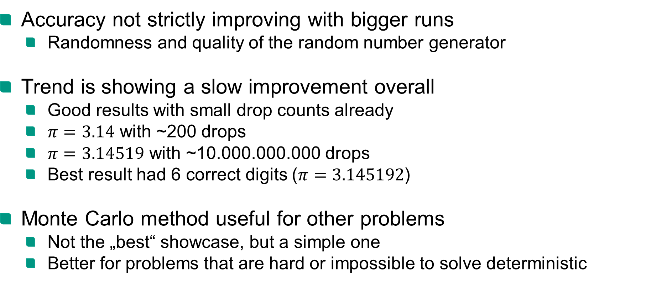
Conclusion
Accuracy not strictly improving with bigger runs
Randomness and quality of the random number generator
Trend is showing a slow improvement overall
Good results with small drop counts already
$π=3.14$ with ~200 drops
$π=3.14519$ with ~10.000.000.000 drops
Best result had 6 correct digits ($π=3.145192$)
Monte Carlo method useful for other problems
Not the „best“ showcase, but a simple one
Better for problems that are hard or impossible to solve deterministic

Slide 13
Sources
Source code:
https://github.com/Rolleander/gpuPi
CUDA logo:
https://nvidianews.nvidia.com/file?fid=544a60fef6091d588d000046
CUDA guide:
https://docs.nvidia.com/cuda/cuda-c-programming-guide/index.html#introduction
CUDA best practices for c:
http://developer.download.nvidia.com/compute/cuda/3_1/toolkit/docs/NVIDIA_CUDA_C_BestPracticesGuide_3.1.pdf
SCC ForHLR2 picture / website:
https://www.scc.kit.edu/dienste/forhlr2.php

Slide 14
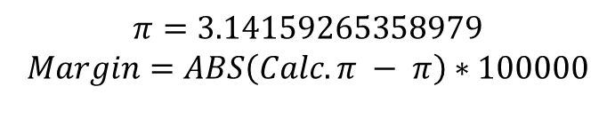
Sources – Results Table
blocks | points | time (s) | pi calc | pi margin
1 | 320000000 | 1.480765 | 3.14150791 | 8.47410898
8 | 2560000000 | 1.440004 | 3.141662 | 6.93448477
16 | 5120000000 | 1.507164 | 3.14163106 | 3.841047271
32 | 10240000000 | 1.445042 | 3.14158378 | 0.887351167
64 | 20480000000 | 1.500662 | 3.14158883 | 0.381862886
128 | 40960000000 | 1.561434 | 3.14157958 | 1.307751558
256 | 81920000000 | 1.642886 | 3.14160245 | 0.980080474
512 | 1.6384E+11 | 2.109586 | 3.14159618 | 0.352575591
1024 | 3.2768E+11 | 4.491677 | 3.1415918 | 0.085367524
2048 | 6.5536E+11 | 8.377587 | 3.14159365 | 0.099825347
4096 | 1.31072E+12 | 16.675217 | 3.14159129 | 0.136008394
8192 | 2.62144E+12 | 33.776812 | 3.14159424 | 0.158932555
16384 | 5.24288E+12 | 68.858016 | 3.14159352 | 0.086350081
32768 | 1.04858E+13 | 139.506641 | 3.14159233 | 0.032703492
65536 | 2.09715E+13 | 289.252594 | 3.14159335 | 0.069416564
131072 | 4.1943E+13 | 562.791313 | 3.14159338 | 0.073036311
262144 | 8.38861E+13 | 1124.12813 | 3.14159342 | 0.076787241
524288 | 1.67772E+14 | 2392.2615 | 3.14159305 | 0.039411588
1048576 | 3.35544E+14 | 4564.098 | 3.14159327 | 0.061338492
$$π=3.14159265358979$$
$$Margin=ABS\left(Calc. π − π\right)∗100000$$

