Slide 1
Predicting Movie Revenue
A Bayesian Approach
By: Greg Houston

Slide 2
Problem Description
Your client is a movie studio and they need to be able to predict movie revenue in order to greenlight the project and assign a budget to it. Most of the data is comprised of categorical variables. While the budget for the movie is known in the dataset it is often an unknown variable during the greenlighting process.

Slide 3
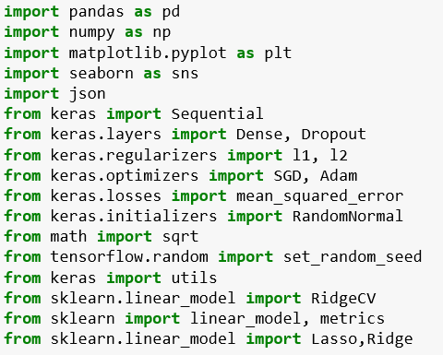
Python Packages & Libraries Used

Slide 4
Dataset Features
Title: string
Tagline: string
Revenue: int
Budget: int
Genres: string, JSON
Homepage: string
ID: int
Keywords: string, JSON
Original_language: string
Overview: string
Production_companies: string, JSON
Production_countries: string, JSON
Release_date runtime: int
Spoken_languages: string, JSON
Status: string

Slide 5
Columns To Drop
df7=df6.drop([ 'title', 'tagline', 'budget’, 'keywords’, 'overview’, 'status’,], axis=1)
Title: Extraneous
Tagline: Better suited for word vectorization (tokenization)
Budget: Requirements state that this is unknown
Overview: Better suited for word vectorization (tokenization)
Status: Extraneous

Slide 6
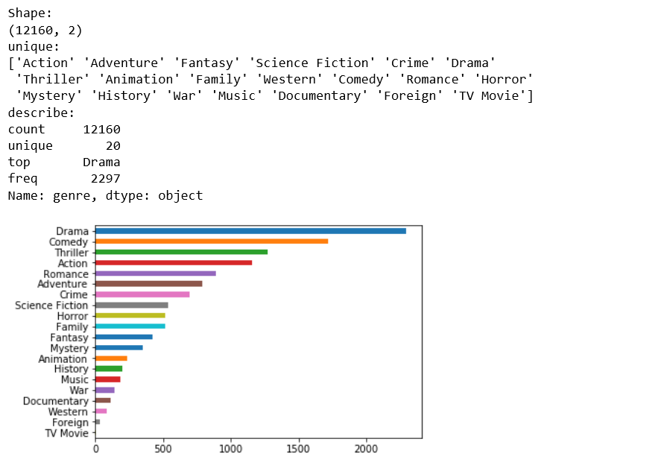
Descriptive Statistics Genres

Slide 7
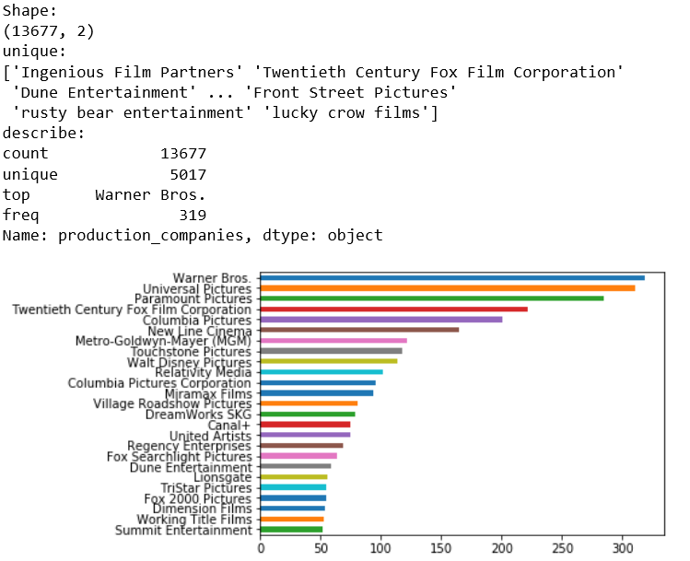
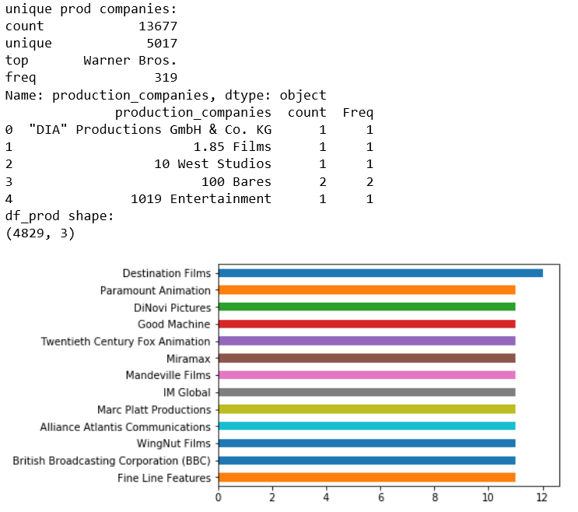
Production Companies (Head & Tail)

Slide 8
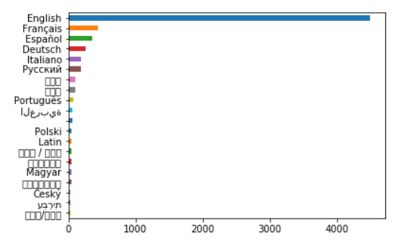
Spoken Language

Slide 9
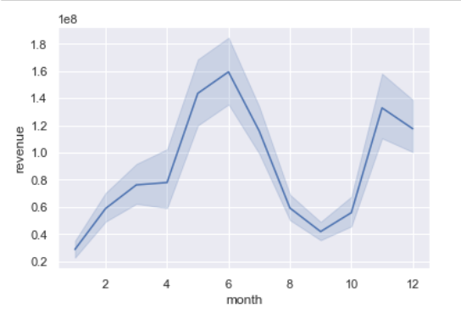
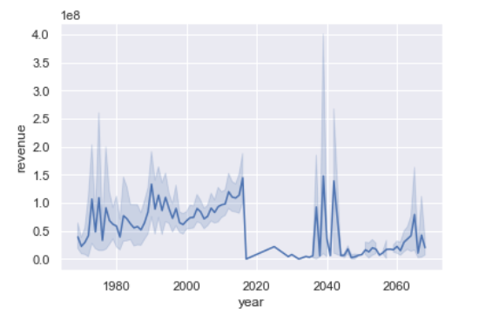
Release Date (Month & Year)

Slide 10
One-Hot-Encoding
Linear models need numeric values
Categories are represented in binary as a 1 or 0
Final categories represent N-1 variables
N-1 to prevent multicollinearity (One value predicted from the other)

Slide 11
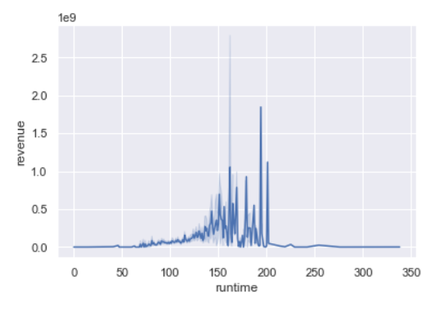
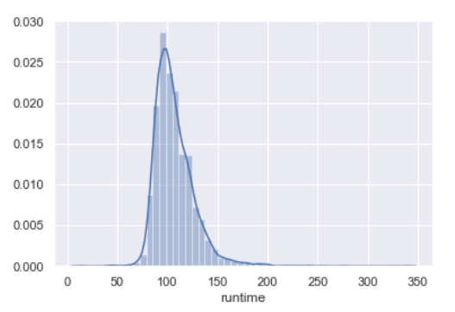
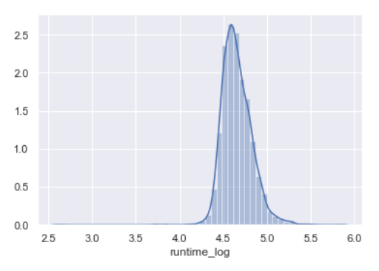
Transformations (Year, Runtime, Target/Revenue)

Slide 12
End Result of Features
Genres:
one-hot-encoded all
Production_companies:
Dropped if < 10 occurrences
Kept 188 out of 5017
Filled NA with most frequent
Spoken_language:
one-hot-encoded all
Filled NA with most frequent
Homepage:
One-hot-encoded all
No NA’s

Slide 13
End Result of Features
Original_language:
Only kept English
No NA’s
Revenue:
Log transformed
Dropped 0 revenue
Spoken_language:
one-hot-encoded all
Filled NA with most frequent
Homepage:
One-hot-encoded all
No NA’s

Slide 14
End Result of Features
Release Date:
Dropped one NA row
Converted to Month/Year
Transformed year
Runtime:
Log transformed
No NA’s
Production_Countries:
Kept all
No NA’s

Slide 15
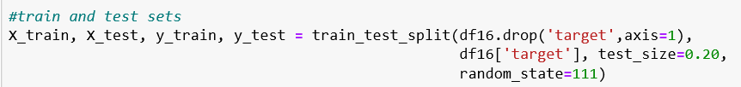
Testing and Training Sets
80% Training and 20% Testing
Also tried 70/30

Slide 16
Supervised Bayesian Models
Multi-Layer Perceptron (Neural Network: Keras & TensorFlow)
Ridge Regression
Lasso Regression

Slide 17
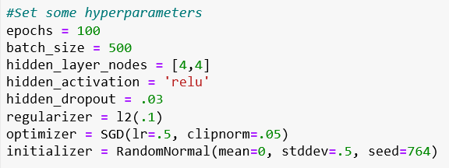
Multi-Layer Perceptron

Slide 18
Multi-Layer Perceptron
Epochs → For each epoch the model has seen the entire dataset once
Batch → The number of observations that go through the model
If you had 5000 observations with 5 epochs and a batch size of 2500 than the model would run twice for each epoch
Hidden_Layer_Nodes → Number of hidden layers
Ridge Regularization (L2) → Drives weights to 0 (eliminates features)
Learning Rate (LR) → The amount of weight reduction (step size)
Can help with cliffs in gradient descent
Can help with decreasing run time when a lot of learning is needed
Clip_Norm → Sets a max for step size
Can help with exploding and vanishing (loss approaches zero) gradient decent
Dropout → Drops nodes out or network
Good for reducing overfitting and increasing generalization
ReLu Activation Funcation → Keeps positive outputs and returns 0 for negative output

Slide 19
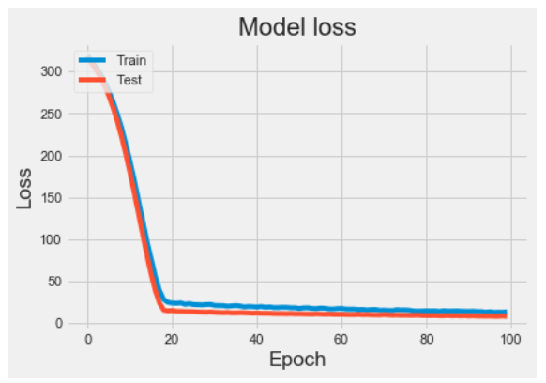
Multi-Layer Perceptron
Accuracy were abysmal
Lowest loss seen was 4.02
A lot of hyperparameter tunning
Attempts with all data
Attempts with subsets of important features
Attempts with and without transformations

Slide 20
Lasso & Ridge Regression
Lasso → Drives weights to zero but does not eliminate them
Ridge → Will drive weights to zero (eliminates features)
Alpha Parameter → Regularization parameter
Cross Validation → Splits training and test data into subsets
Used to reduce overfitting

Slide 21

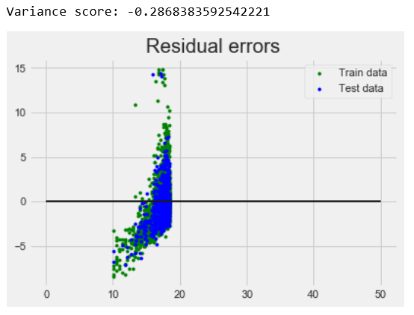
Lasso Regression

Slide 22
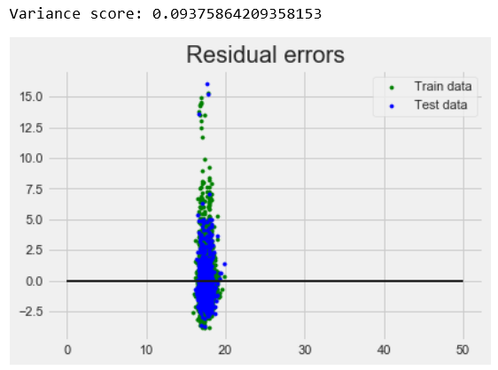
Ridge Regression w/ Cross Validation

Slide 23
Lessons Learned & Considerations
Algorithms often predict certain subsets of your data better
Breaking the data into geographical regions may be worth while
Stacking and ensembled models should be considered
Try making the target variable categorical
The large varchar columns held out could contain useful information

