Slide 1
NPI DATA
By: Greg Houston

Slide 2
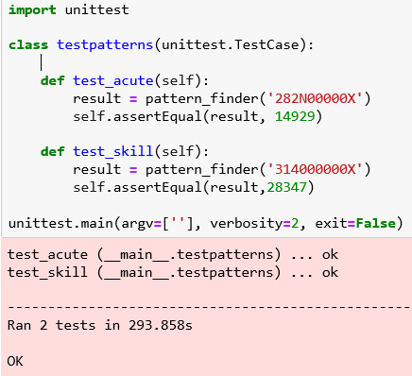
Quality Control Unit testing of vital functions ran after each iteration of development
Iteration 1: Used conditional statements
Iteration 2: Modified to RegEx expressions
Iteration 3: Eliminated RegEx
Modified algorithm to use functions and eliminated RegEx
RegEx caused complexity issues. O(N)

Slide 3
Requirements (First Six)
1. How many Acute hospitals are there?
2. How many Inpatient Rehabilitation Facilities (IRF) are there?
3. How many Long-Term Patient Care Hospitals (LTCH) are there?
4. How many Skilled Nursing Facilities (SNF)?
5. How many Home Health Care Agencies?
6. How many Hospice Care Agencies?
7. What is the percentage of each type of agency vs the total?

Slide 4
Requirements (First Seven)
Acute Hospitals: Acute_Hosp
Inpatient Rehabilitation Facilities: IRF
Long-Term Patient Care Facilities: LTCH
Skilled Nursing Facilities: SNF
Home Health Agencies: HH_Care
Hospice Care: Hospice
Percentages:
Acute_Hosp: 14.5 %
IRF: 0.8%
LTCH: 0.7%
SNF: 37.0%
HH_Care: 40.3%
Hospice: 6.7%
Counts:
Acute_Hosp: 22001
IRF: 1237
LTCH: 1073
SNF: 56002
HH_Care: 60999
Hospice: 10081

Slide 5
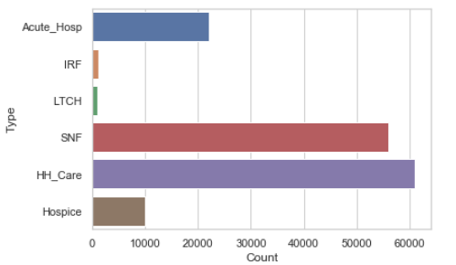
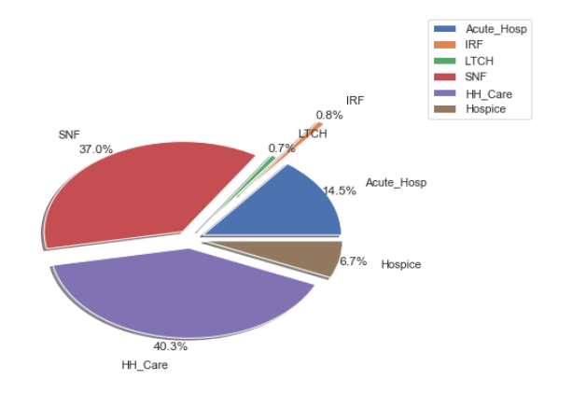
Requirements (First Seven)

Slide 6
Requirements (Number 8)
All agencies:
14374 local education agency
13300 case managment
7189 disabled services
399 home infusion
3748 nursing care
7197 public health
47929 community health
369 pace
2430 voluntary
6534 early intervention
1535 foster care
15334 home support
What other types of agencies are there?

Slide 7
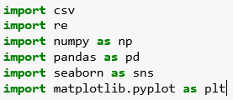
Code Samples
Libraries Used:

Slide 8
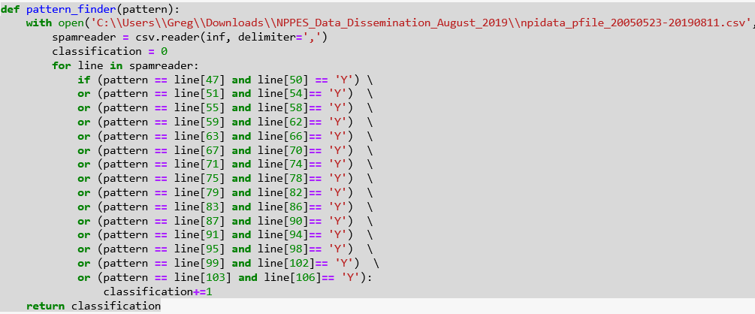
Key Function

Slide 9
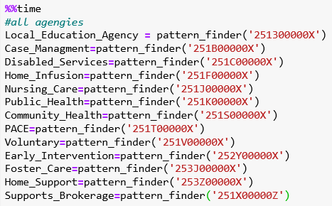
Function Call

Slide 10
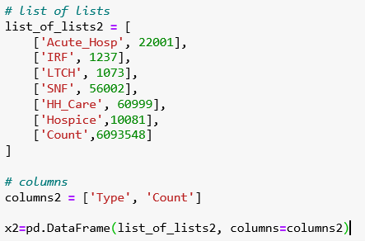
Pandas DataFrame

Slide 11
THE END

