Slide 1


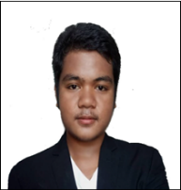
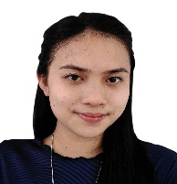
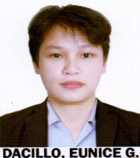
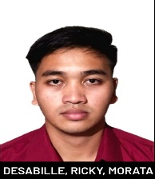
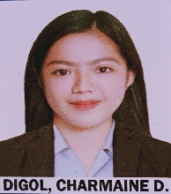
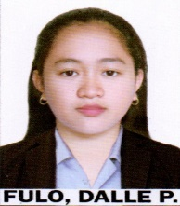
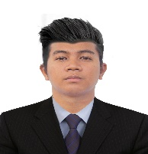
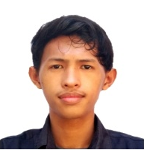
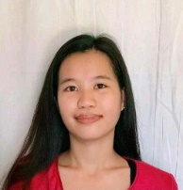
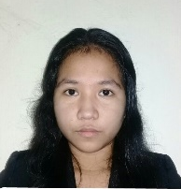
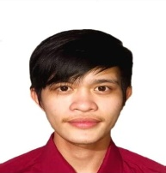
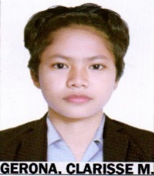
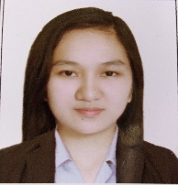
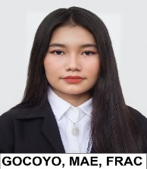
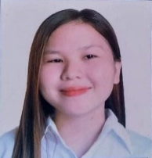
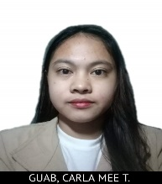
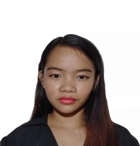
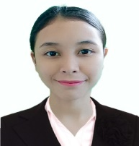
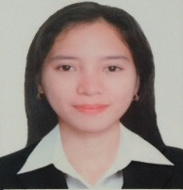
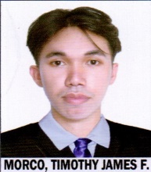
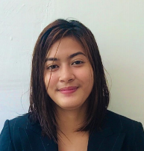
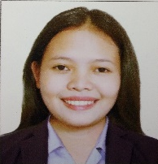
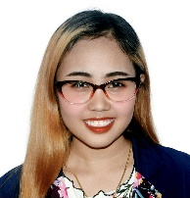

Congratulations
SORSOGON STATE UNIVERSITY
JUNIOR PHILIPPINE INSTITUTE ACCOUNTANTS BULAN CHAPTER
BULAN, SORSOGON
DIPLOMA IN TAXATION examination PASSERS
A$Ñ$ONUEVO,
RIO G.
CONTRERAS, DAPHNE MAE B.
DACILLO,
EUNICE G.
DESSSABILLE,
RICKY M.
DIGOL,
CHARMAINE D.
FULO, DALLE P.
GABAD, JOHN RANIELL P.
GAPUEN, DAN ARVIE F.
GATON, RAJANI G.
GEALONE,
ARVIN C.
GERONA,
CLARISSE, M.
GIPANAO, DONNA MINA G.
GOCOYO, MAE F.
GONZALGO, IRISH DAILE L.
GUAB, CARLA
MEE T.
GARCIA, JIZA J.
GUAB, CARLA
MEE T.
HONA, NIKKI
JANE R.
HONA, NIKKI
JANE R.
LIZANO,
CRISTEL C.
MELITANTE, DARCY JANE R
MORCO, TIMOTHY JAMES F.
RIZALA,
STEPHANIE JOY E.
ROMO,
JAMMELLA G.
TOLENTINO, JONALYN A.
Reviewer: MICHAEL B. BONGALONTA
MICHELLE M. BONGALONTA

