Slide 1
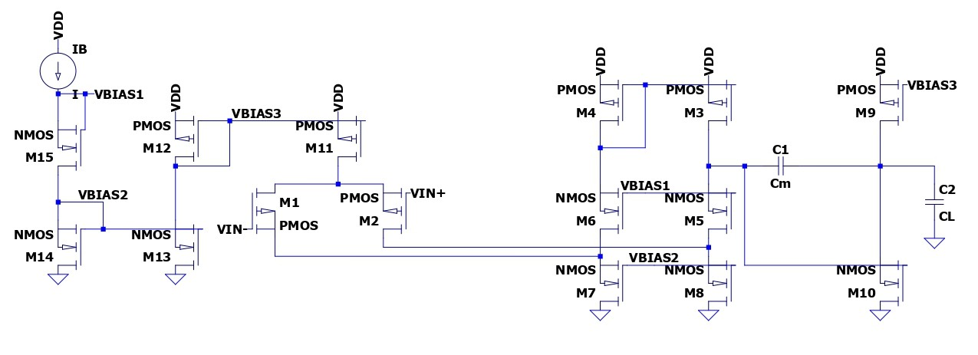
Projet LELEC2650
Querol Kenfack, Robin Warichet

Slide 2
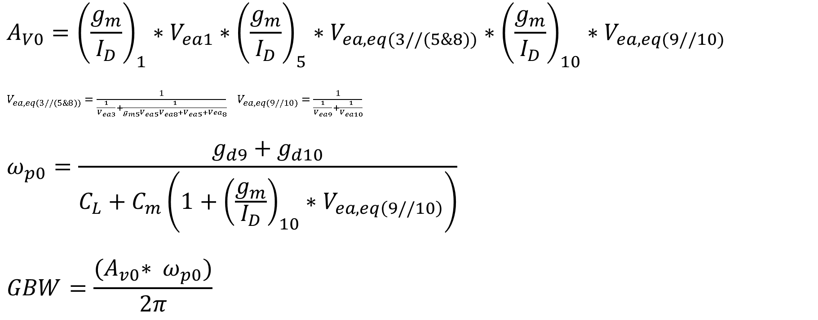
Equations
$$A_{V0}={\left(\frac{g_{m}}{I_{D}}\right)}_{1}∗V_{ea1}∗{\left(\frac{g_{m}}{I_{D}}\right)}_{5}∗V_{ea, eq(3//(5\&8))}∗{\left(\frac{g_{m}}{I_{D}}\right)}_{10}∗V_{ea,eq(9//10)}$$
$V_{ea, eq(3//(5\&8))}=\frac{1}{\frac{1}{V_{ea3}}+\frac{1}{g_{m5}V_{ea5}V_{ea8}+V_{ea5}+{Vea}_{8}}}$ $V_{ea,eq(9//10)}=\frac{1}{\frac{1}{V_{ea9}}+\frac{1}{V_{ea10}}}$
$$ω_{p0}=\frac{g_{d9}+g_{d10}}{C_{L}+C_{m}\left(1+{\left(\frac{g_{m}}{I_{D}}\right)}_{10}∗V_{ea,eq\left(9//10\right)}\right)}$$
$$GBW=\frac{{(A}_{v0}∗ ω_{p0})}{2π}$$

Slide 3
Legend :
Red : known
Blue : unknown
Green : params
(g_{m}/I_{d})_{5,6}
L
V_{ea,l}
5,6
I_{d5,6}
g_{m5,6}
I_{dn5,6}
W_{5,6}
V_{ea5,6}
1,2
I_{dn1,2}
(g_{m}/I_{d})_{1,2}
I_{d1,2}
(W/L)_{1,2}
(W/L)_{5,6}
f_{t}
g_{m1,2}
W_{1,2}
(g_{m}/I_{d})_{3,4}
L
V_{ea,l}
V_{ea1,2}
C_{L}
3,4
I_{d3,4}
g_{m3,4}
I_{dn3,4}
W_{3,4}
V_{ea3,4}
C_{out}
C_{m}
(W/L)_{3,4}
C_{1,2}
L
C_{m}’
(g_{m}/I_{d})_{7,8}
L
V_{ea,l}
V_{ea,l}
7,8
(g_{m}/I_{d})_{9,10}
L
V_{ea,l}
I_{d7,8}
g_{m7,8}
I_{dn7,8}
W_{7,8}
V_{ea7,8}
9,10
(W/L)_{7,8}
I_{d9,10}
g_{m9,10}
I_{dn9,10}
W_{9,10}
V_{ea9,10}
(W/L)_{9,10}

