Slide 1
Mission #1
> Find The Middle

Slide 2
Mission Briefing
Park your ship in the center of the universe
You Need To
Calculate Midpoint from World Width & Height
Issue Multiple Commands
Rotate from your current orientation to the Center
Thrust
Wait
Brake

Slide 3
Issuing Multiple Commands
You need your ship to maintain some state
You can increment a value every call to getNextCommand
This would let you use switch to process a sequence of commands
this.state++;
switch (state) {
case 1:
return new RotateCommand(…);
case 2:
return new ThrustCommand(…);
…
}

Slide 4
Rotate
new RotateCommand(int degrees)
degrees = number of degrees to rotate positive is CCW, negative is CW
Blocking Command
Rotates Ship’s Orientation Only; Doesn’t Directly Effect Movement Direction
Costs 2 Energy Per Second

Slide 5
How Your Ship Processes Commands Two Different Command Types
Blocking
Non-Blocking
Client Issues RotateCommand(30)
Server Processes Command
Server Finishes Command
getNextCommand(env)
Client Issues ThrustCommand(…)
Server Processes Command &
Returns Immediately
getNextCommand(env) Client Issues Another Command
Thrust Processing Still With New Command

Slide 6
Thrust
new ThrustCommand(char dir, double duration, double power)
dir = Thruster to fire ‘B’, ‘F’, ‘L’, ‘R’
duration = Number of Seconds to Fire Thrust
power = 0.0 to 1.0 : % power of Thrust to use
Non-Blocking Command
Finite amount of Thrust i.e. Multiple Commands won’t accelerate ship faster
Costs 3 Energy Per Second

Slide 7
Idle
New IdleCommand(double duration)
duration = number of seconds to wait
Blocking Command
Used to wait before executing another command
Costs no Energy (Your Ship Regains 4 Energy Per Second when doing Nothing Else)

Slide 8
Brake
new BrakeCommand(double power)
power = 0.0 – 1.0 : % of current speed to maintain
Blocking Command
Allows for Slowing Ship Regardless of Direction of Travel
0.2 power would slow to 20% of current speed
Slowing to 0 power while in gravity well can cause problems
Costs 4 Energy Per Second

Slide 9
Getting Information About Your Ship
public ShipCommand getNextCommand(BasicEnvironment env)
BasicEnvironment contains information about your ship in
getShipStatus()
This returns an ObjectStatus; ObjectStatus holds properties of any object you inspect in space.
getPosition() – Gets an Object's Position
getOrientation() – Gets the direction a Ship is facing

Slide 10
Point
The Point Class helps you with positions and angles within Space
getAngleTo can give you the angle between two points from due East
To find the number of degrees to rotate to face a point: From your current position, you can get the angle to that point and subtract your current orientation.

Slide 11
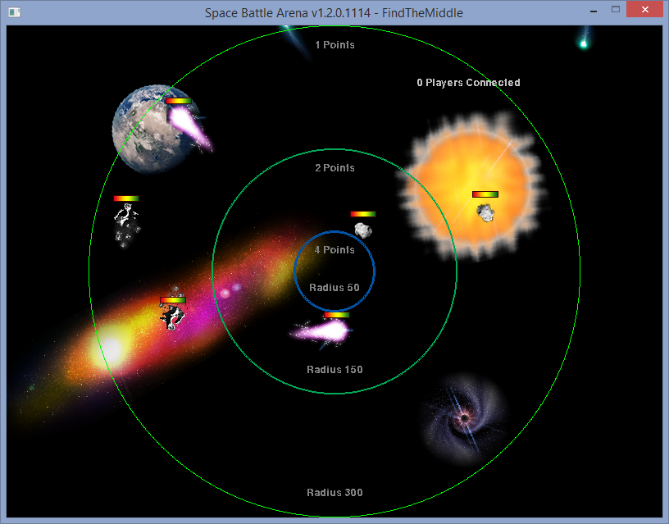
Find The Middle

