Slide 1
Mission 2
> Hungry Hungry Baubles

Slide 2
Mission Briefing
Collect as many baubles as possible in the time allotted
Different Baubles are worth different numbers of points
You Need To
Learn where baubles are located around you
And how much they’re worth
Navigate to them to collect points
Bonus: Avoid other player’s ships

Slide 3
RADAR
new RadarCommand(int level)
new RadarCommand(int level, int target)
level = radar level to initiate
[target] = optional parameter for level 3 to specify a specific radar target
Blocking Command
Radar time based on level selected (higher levels take longer)
Populates Radar Results in the next call to getNextCommand
Costs 6 Energy Per Second

Slide 4
Radar Calls
getNextCommand(env)
Client Issues RadarCommand(5)
Server Processes Command
Server Finishes Command and
Adds RadarResults
getNextCommand(env)
env.getRadar() will be populated

Slide 5
Radar Levels
Level 1 – 0.03 seconds
# of Objects Only
Level 2 – 0.10 seconds
ID# and Positions of Objects Only
Level 3 + Target ID# – 0.10 seconds
All information about the specified Target
Level 4 – 0.15 seconds
ID#, Positions, and Type of Objects Only
Level 5 – 0.40 seconds
All Information about All Objects in Range

Slide 6
Radar Results
Acts as a List<ObjectStatus>
Only exists for the next call to getNextCommand()
You need to save any information you want to remember for the future
Certain Objects may not have information in ObjectStatus methods
This can be because of the type of object
OR the type of radar level requested

Slide 7
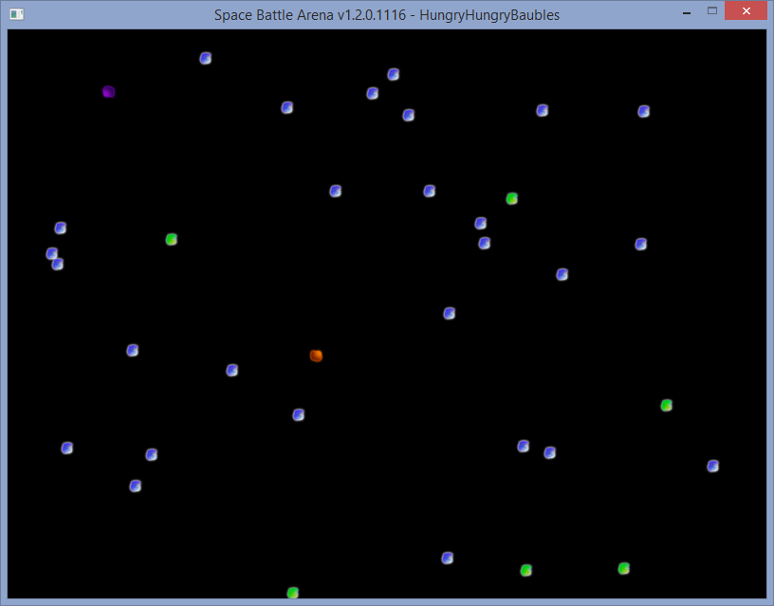
Hungry Hungry Baubles

Slide 8
How to Detect Baubles
Issue Radar Command
Loop over Results
if (env.getRadar() != null) {
for (ObjectStatus object : env.getRadar()) {
// Only care about Baubles with Value Greater Than 1
if (object.getType().equals(“Bauble”) && object.getValue() > 1) {
…
}
}
}

