Slide 1
Diploma Thesis Topic description
Romana Jakob
Supervised by Prof. Margit Pohl and Dr. Gerhard Engelbrecht

Slide 2
Key words
Mobile App Development
Information visualization
Human-centered visualization
Human Computer Interaction
Social computing
Smart Home, Smart Building, Smart Cities
Perhaps Progressive Web App instead of native App

Slide 3
Mobile App
Working title: My CO₂ Footprint
General App accessible for all but with the basic idea of the Aspern Seestadt
Provides information to a user about consumption of
Electricity
Gas
Heating/warmth
…
Gives advice if switching to another energy provider is useful

Slide 4
Self-customizable mobile App
Background: There are different types of users concerning energy consumption:
Some might care about their exact rate of consumption (Green)
Some might want to waste less energy but do not care about their exact rate of consumption (Cozy)
Some only want to know if they are doing ok in general (Lazy)
…and maybe more
App customizes itself due to some questions that appear when first using the App
example question: Vienna has a negative energy balance.
O That‘s great! O I do not care O Awesome! How can I help to improve that even further?

Slide 5
Self-customizable mobile App ctd.
The categorization of the user into the different consumer types might also depend on following factors
Means of transportation used
m² of the flat/house he/she is living in
place of living
Family/Single household
Job

Slide 6
Self-customizable mobile App ctd.
The app changes it‘s appearance then according to the type of the user
A „Green“-user gets a detailed chart with the consumption of all the fields
A „Cozy“-user gets an overall overview of what he/she consumed (not to detailed)
A „Lazy“-user only gets for example a green or red sign, that the rate of consumption is ok or above average
The app might also give advice for the best energy provider e.g. a „Green“-user might get the advice to switch to „Ökostrom“

Slide 7

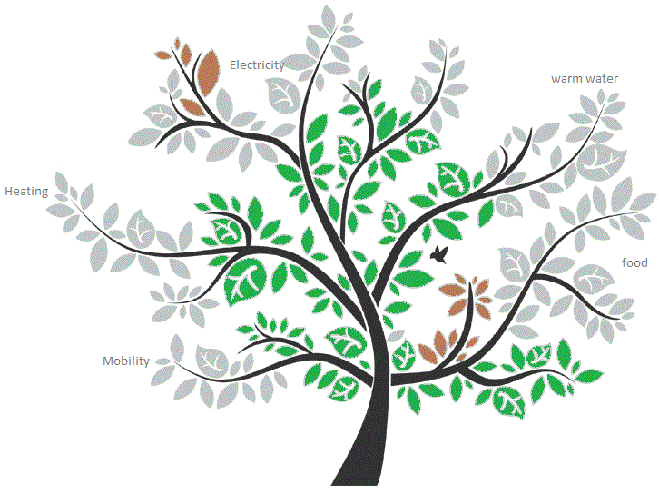
Data Ressource
ASCR
My CO₂ Footprint
Manual user input
Connection to other apps
like
Smart Meter
Wiener Netze
…

Slide 8
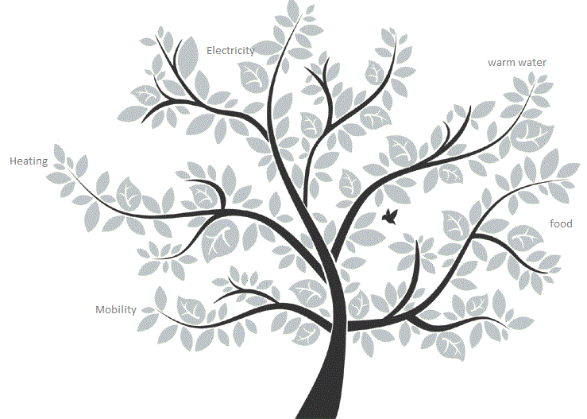
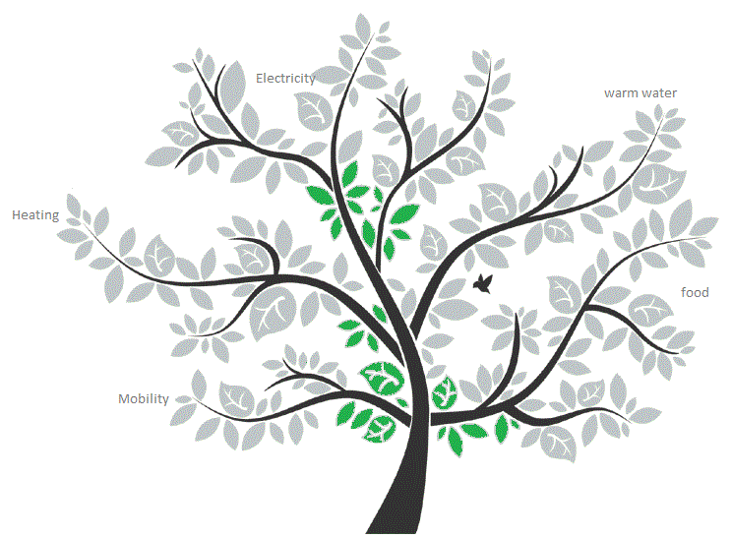
Playful approach
Visualizations to simply show the user the current status of consumption

Slide 9
Supersede Feedback
In order to check the user acceptance and to improve the development circle the Supersede Feedback Mechanism can be applied

Slide 10
Schedule
now – 31.3. -> Abstract
1.4. – 30.4. -> Implementation/Development plan, Architektur, Konzept (~ 3 Chapter)
3.5. Presentation of Proposal and Feedback from Reviews
1.5. – 31.7. -> Entwicklungszeit (~ 1 Chapter)
1.8. – 31.9. -> Implementation description, Validation, Evaluation

Slide 11
Next steps
Define…
research question
problem definition
expected results
Start with proposal

