Slide 1
DAY 3
docker and Kubernetes – Journey

Slide 2
AGENDA
Any query from previous session
SSH connectivity tools
Package manager
Quick reference/cheat sheets
Installation walkthrough
Most used/common commands in Linux
Application pattern – Use Cases
Architecture walkthrough
Docker introduction
Docker Architecture
Docker core components
Docker Networking

Slide 3
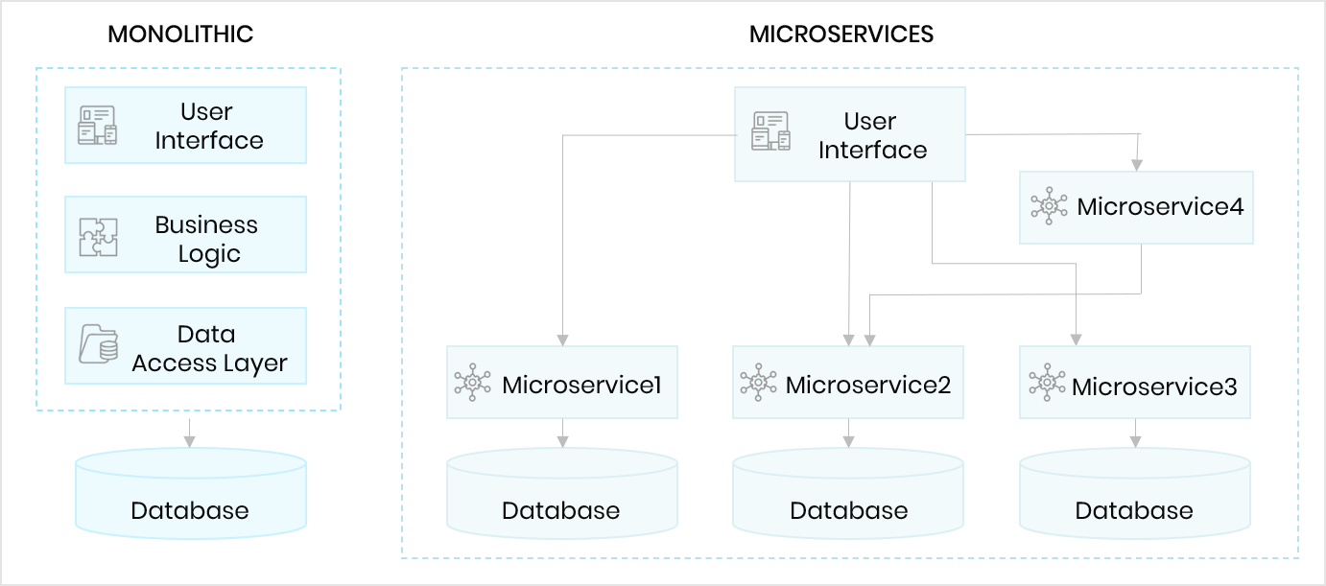
APPLICATION PATTERNS – USE CASES

Slide 4
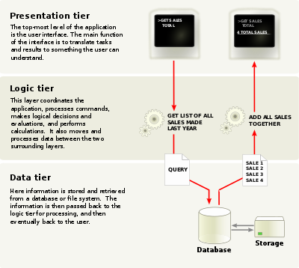
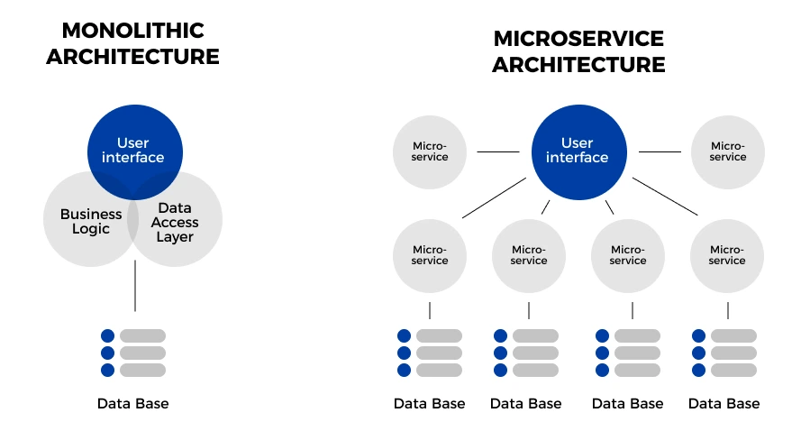
APPLICATION ARCHITECTURE

Slide 5
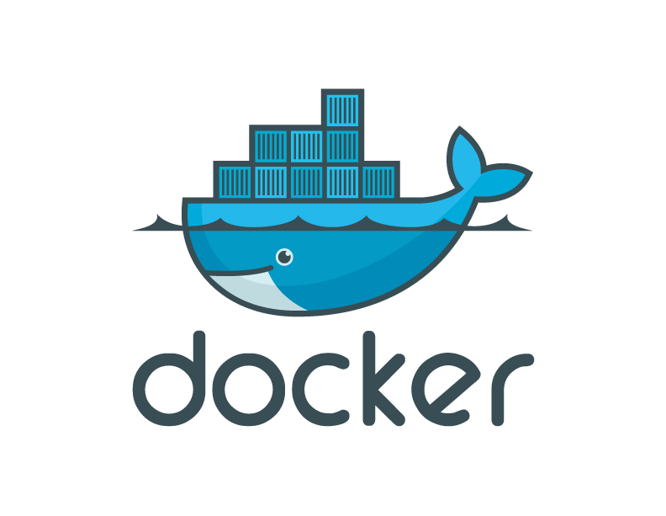
INTRODUCTION TO DOCKER
Docker is “a platform for developers and sysadmins to develop, ship, and run applications”, based on containers.
Docker is an open-source, mainly created in Go and originally on top of libvirt and LXC.
Docker simplifies and standardizes the creation and management of containers.

Slide 6
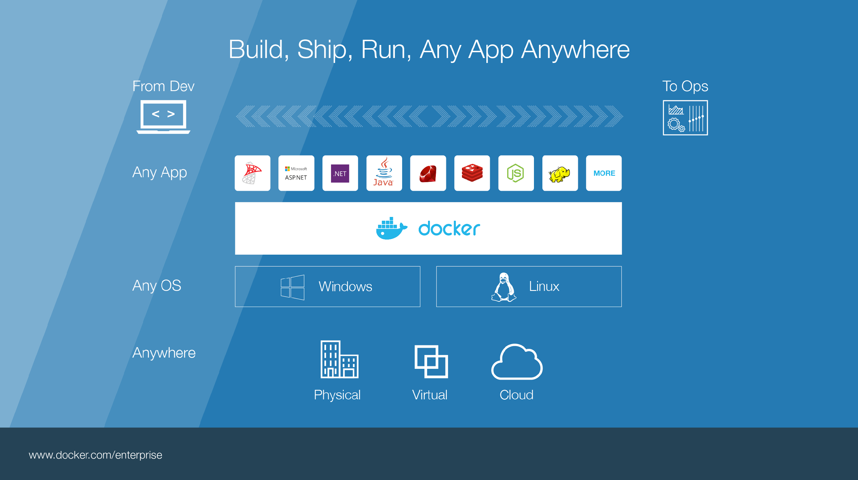

Slide 7
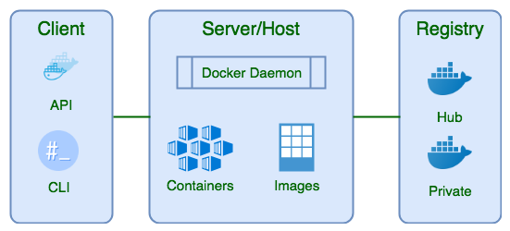
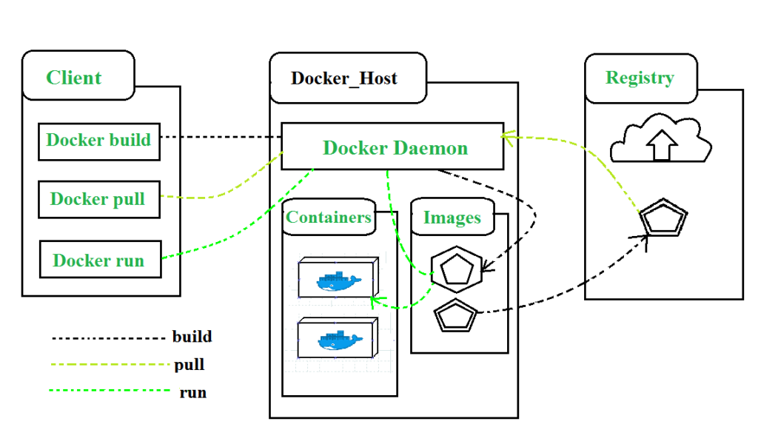
DOCKER - ARCHITECTURE

Slide 8




DOCKER - COMPONENTS
Docker Image
The basis of a Docker container. Represents a full application
Docker Container
The standard unit in which the application service resides and executes
Docker Engine
Creates, ships and runs Docker containers deployable on a physical or virtual, host locally, in a datacenter or cloud service provider
Registry Service (Docker Hub or Docker Trusted Registry)
Cloud or server based storage and distribution service for your images
Notes:
Let’s take a look at what build, ship run means in a little more detail, but before that we need to level set some Docker vocabulary and commands:
Image
The static component that represents a on-running applicatoin
Containers are derived from images
images contain EVERYTHING an application needs to run
Should always be built via a Dockerfile (which we’ll talk about in a bit_
Container
The standard unit in which the application service resides
Package app and dependencies together
Isolated from other containers
One container per app / service
Docker Engine
The program that creates, ships and runs containers
Deployable on any physical or vm host locally, in datacenters or cloud
Communicates with Docker Hub
Registry
The service that store, distributes and manages container images
Receives commands from Docker Client via Engine
Access control with public, private repos

Slide 9
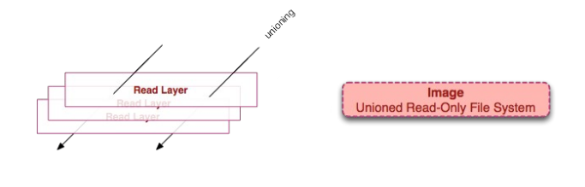
DOCKER IMAGES
Read only template used to create containers
Build by you or other docker users
Stored in the docker hub or you local registry
Every image starts from base image
Include:
Application
Dependencies
Libraries
Binaries
Configuration files

Slide 10
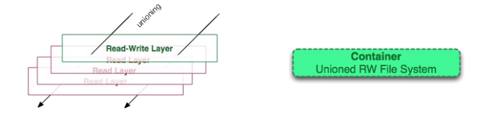
DOCKER CONTAINER
Isolated application platform
Containers everything needed to run you application
Based on one or more images
Docker containers launched from Docker image
When Docker container runs, it adds a read-write layer on top of the image

Slide 11
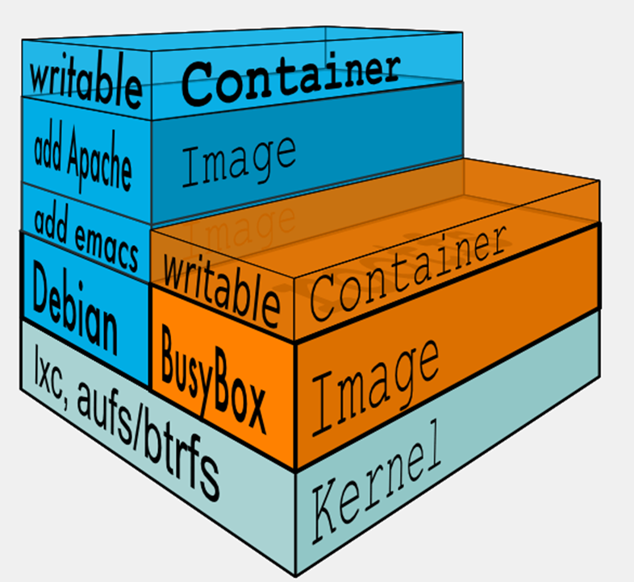
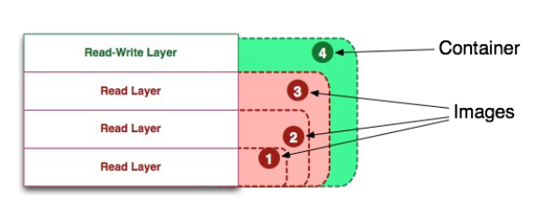
DOCKER IMAGE VS CONTAINER
Docker Image is a class
Docker Container is a instance of class

Slide 12
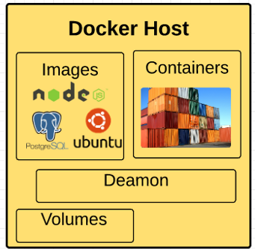
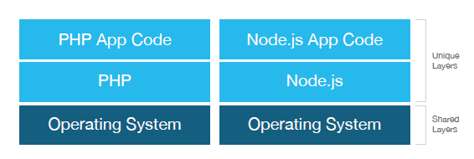
DOCKER IMAGES AND CONTAINERS
Docker will not only share the base image between containers, but it will also share the same layers between different images.

Slide 13

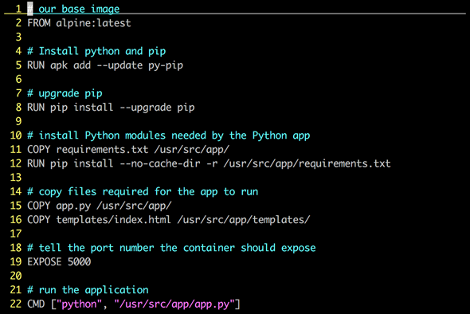
DOCKERFILE
Dockerfile is instructions to build Docker image
How to run commands
Add files or directories
Create environment variables
What process to run when launching container
Result from building Dockerfile is Docker image

Slide 14
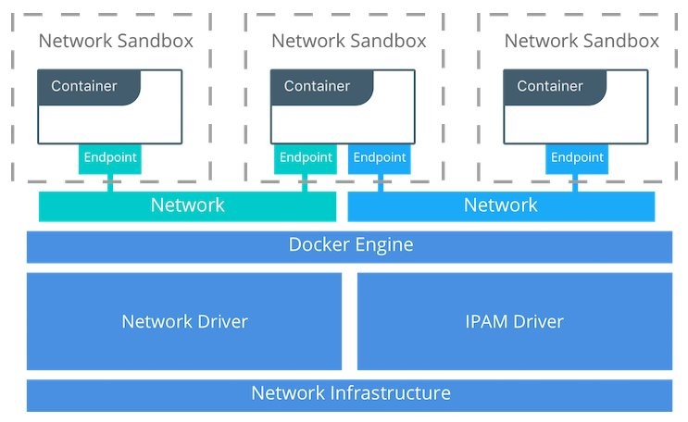
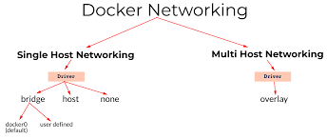
DOCKER NETWORKS
Docker Network Drivers
Bridge N/W: Private default n/w, container linked to internal IP addresses
Host N/W: Public n/w, utilize host IP addresses
None: No external interface, for disabling container n/w
Overlay: For Docker Swarm cluster, internal private n/w to the Docker nodes
Macvlan: For simplified communication b/w containers using MAC address

Slide 15
Artifacts
Linux useful commands
Linux command handbook
/etc/password file details
https://www.cyberciti.biz/faq/understanding-etcpasswd-file-format/
Top 50 Linux commands
Ubuntu package manager cheat sheet
Monolithic vs Microservice - https://www.openlegacy.com/blog/monolithic-application

