Slide 1
DAY 1
docker and Kubernetes – Journey
Background and basics

Slide 2
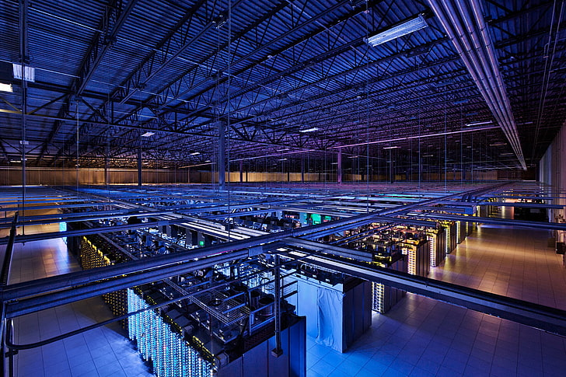
BACKGROUND – BARE METAL SERVER
BARE-METAL-INFRA/SERVERS
Physical hosting device dedicated to single tenant
Setup on-prem or at third party data center location
Exclusively use of computing resources includes:
CPU
RAM
DISK Space
Bandwidth
NEED
High level of processing power
Consistent IOPS
High data privacy/complete control on resources
Costing control

Slide 3
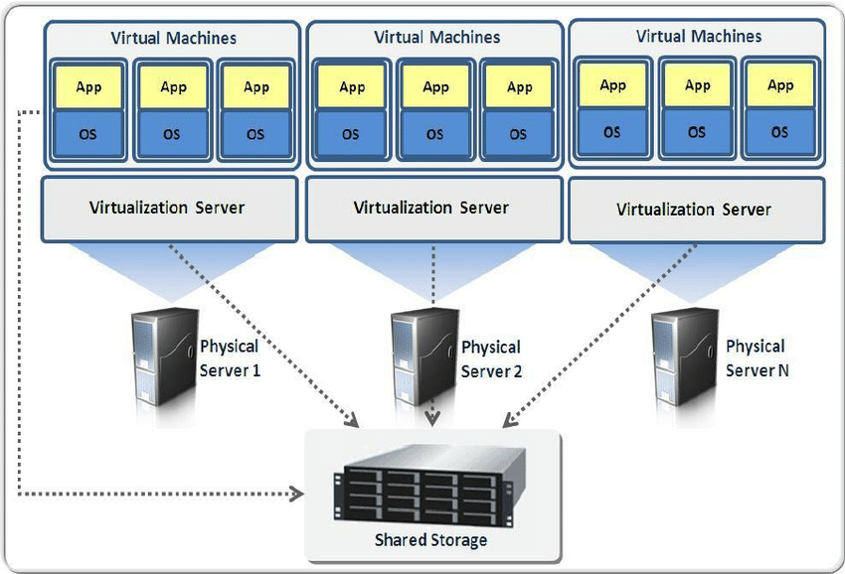
BACKGROUND - VIRTUALIZATION
Virtual
Abstract Layer
Multiple/Guest OS
Shared compute resources
Hypervisor

Slide 4
BACKGROUND - VIRTUALIZATION
Advantages
Lower Cost
Backup/Disaster Recovery
Improved Productivity
Faster Deployments
Environment Sustainability
Better Control
Flexibility
Types of Virtualization
Desktop
Server
Application
Network
Data
Storage

Slide 5
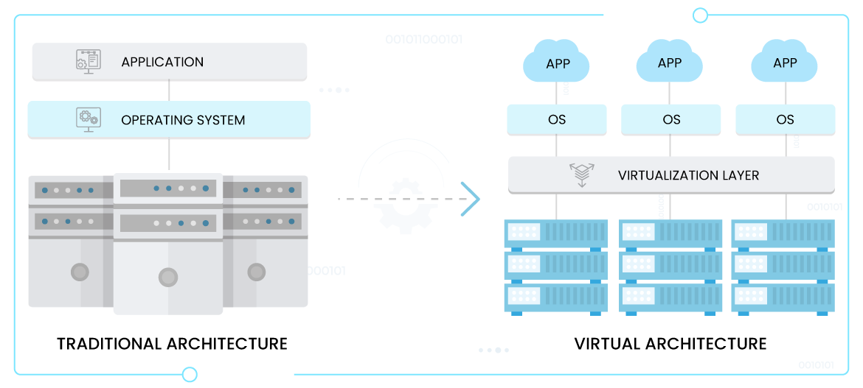
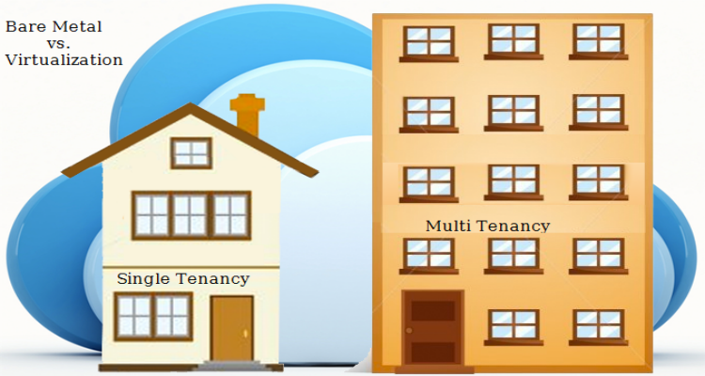
BARE-METAL-SERVER VS VIRTUALIZATION

Slide 6
BARE-METAL-SERVER VS VIRTUALIZATION – KEY POINTERS
POINTERS | BARE METAL SERVER | VIRTUALIZATION (VM SERVER)
Main selling points | Consistent performance and complete data privacy | Near-instant scalability and cost optimization options
Hardware dedication | All server resources (CPU, RAM, memory, bandwidth) belong to a single tenant | Tenants host on the same device and share server resources
Performance capabilities | Consistently high performance | Less consistent performance due to multiple tenants
Customization options | Flexible to choose hardware and software | controlled customization due to the shared resources
Deployment time | Takes time to set up a new server (hours for a rented device, days for an on-prem server) | New deployments are a matter of a few minutes
Hardware maintenance | Complex without managed services | No hardware maintenance
Scalability | Scalability is time consuming | Near-instant, on-demand scalability (both up and down)
Capacity optimization | Limited capacity optimization | Advanced capacity optimization enabled by load balancing
Security | More secure due to single tenancy | Other tenants can cause security and privacy concerns
System recovery | Recovering from a mid-size disaster can take hours or even days | Recovering from a disaster happens in minutes
Server portability | Moving a physical server is a complex and lengthy task | Easily movable
Typical billing methods | A predictable (typically monthly) bill | Charges based on how much resources you use
On-prem expenses | High upfront costs for hardware and space (but no need for licensing purchase) | Smaller hardware costs but pricey VM software licenses

Slide 7
CONTAINERIZATION – NEED/BIRTH
Virtualization - Limitation
Portability
Security concern due to multi tenancy
Scaling challenges
ROI - Costing
Hypervisor – performance issue
Single point of failure – Server Failure
Application Dependency hell

Slide 8
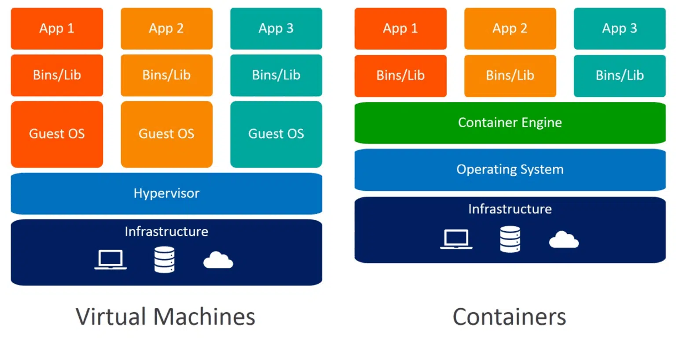
VIRTUALIZATION VS CONTAINERIZATION

Slide 9
VIRTUALIZATION VS CONTAINERIZATION – Key Pointers
POINTERS | VIRTUALIZATION | CONTAINERIZATION
Technology | Single physical machine has multiple tenancy/virtual instances, runs complete OS including kernel | The application developed in a host environment with same OS. Same machine executes flawlessly on multiple environments.
Boot Time | Take more time to spin up virtual instance | Very less, ~2 to 5 seconds
Execution speed | VMs being a virtual copy of the host server on its own operating system, VMs are resource-heavy, hence slower. | Containers are faster
Size | Larger | Smaller
Iimplementation cost | Higher | Lower
Implementation Concept | Hypervisor virtualized the underlined hardware for multiple tenancy | Container virtualize the Operating system by using container runtime. Example – Docker, Kubernetes, etc
Scalability | Scalability is time consuming | Near-instant, on-demand scalability (both up and down)
Portability | Lengthy and time consuming | Small and quick
Persistent Storage | Use virtual Hard Disk (VHD) for local storage of single VM, Shared storage solutions are available, example - SMB | Use persistent disk as persistent volume (PV) and mapping via persistent volume claim (PVC) with container
Load Balancing | Load balancing perform by other running VMs in failover cluster – Active/Passive standby | An orchestrator can automatically start or stop containers on cluster nodes to manage changes in load and availability

Slide 10
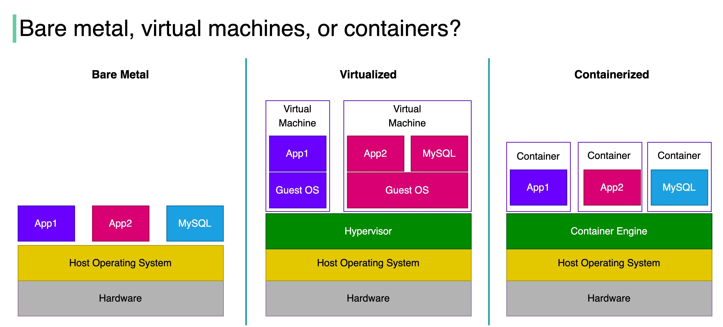
BARE-METAL VS VIRTUALIZATION VS CONTAINERIZATION

Slide 11
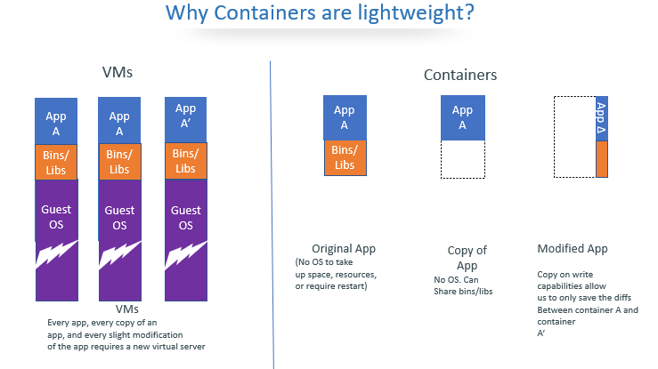
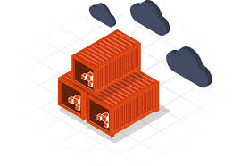
CONTAINERIZATION - BENEFITS
Increased Portability/Reproduce
Improved Scalability
Simple & Fast Deployments
Enhanced Productivity
Better Security
Resource Friendly

Slide 12
FUNDAMENTALS
Operating system basics
Linux understanding
Linux Family
Dependencies
VM/Instance provisioning - ubuntu
Oracle Virtual Box setting

Slide 13
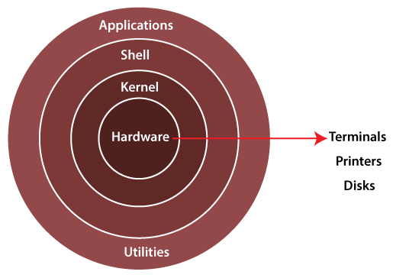
Operating System - Linux
Bootloader – Responsible for managing the boot process of system and starting of Kernel
Kernel – Core of Linux OS, contains different type of modules and coordinate with h/w directly and responsible for all actions
Monolithic Kernel
Micro kernels
Hybrid kernels
System Libraries – These are applied for implementation of OS functionality & don’t need core access to Kernel
System utility programs – Responsible for specialized level and individual activities
Hardware Layer – Consist peripheral devices – CPU, HDD & RAM
Shell – It is the interface between Kernel and end user, it interact with kernel for completion of desired task
Korn shell
Bourne shell
C shell
POSIX shell

Slide 14
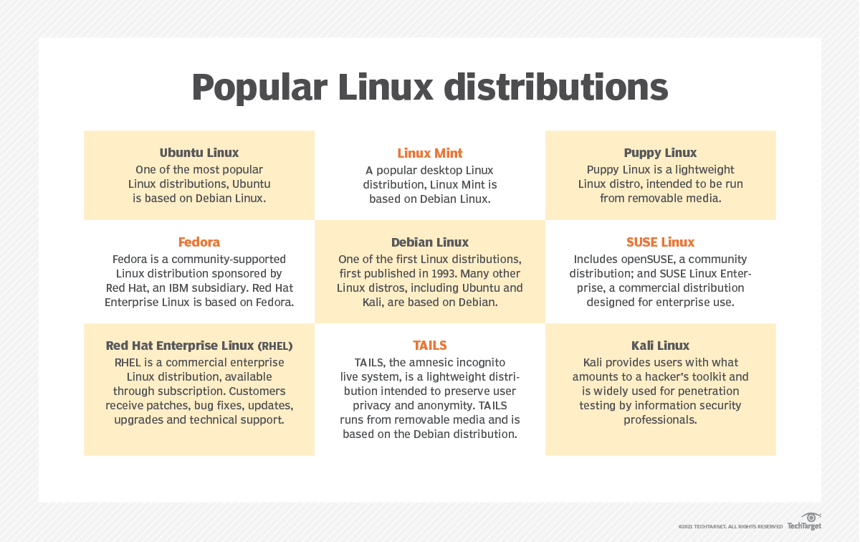
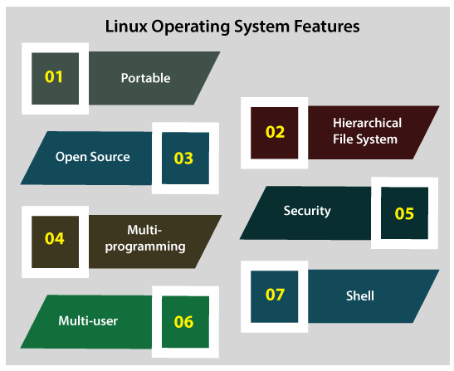
Linux – Distributions & Features

Slide 15
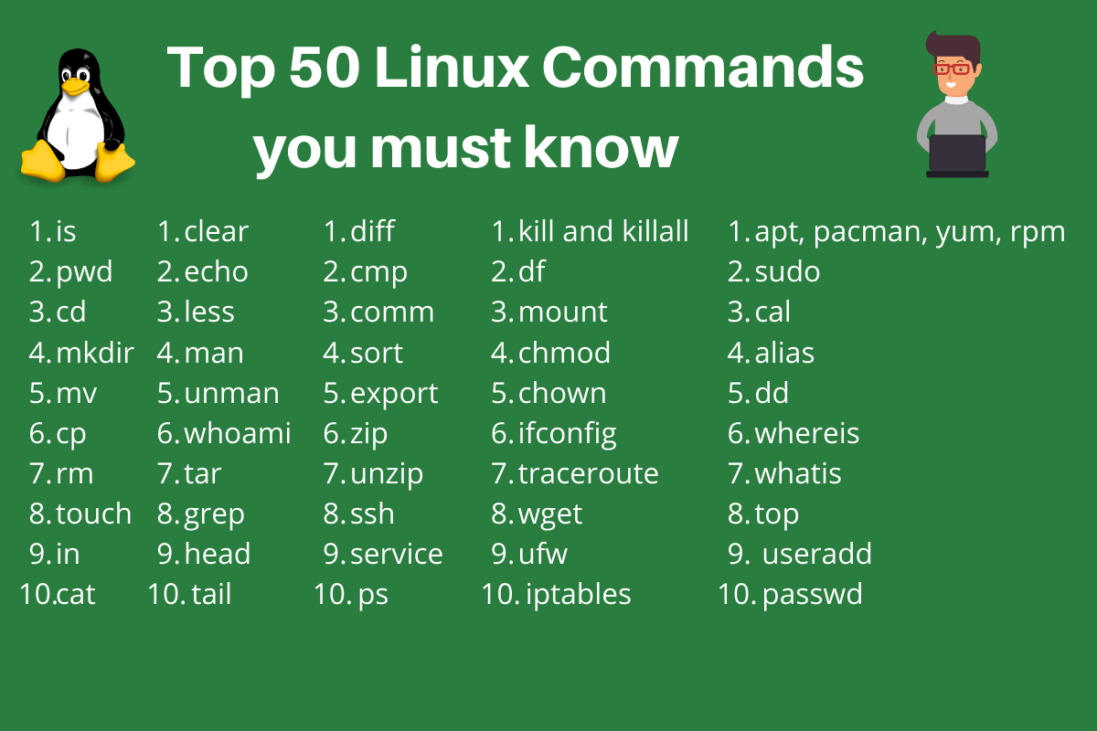
Linux Popular Commands

