Slide 1


ODYSSEE SYSTEMES
ROMAIN COCOGNE ELEC4

Slide 2
SUMMARY
QUICK PRESENTATION
INNER WORKING
QUALITY CONTROL
CONCLUSION

Slide 3
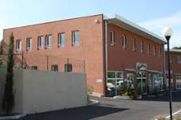




QUICK PRESENTATION
Conception and redistribution of electronic cards
28 employees
Opened since 2001
6 million turnover
Located in Mouans Sartoux
CEO: Pierre Peytoureau

Slide 4
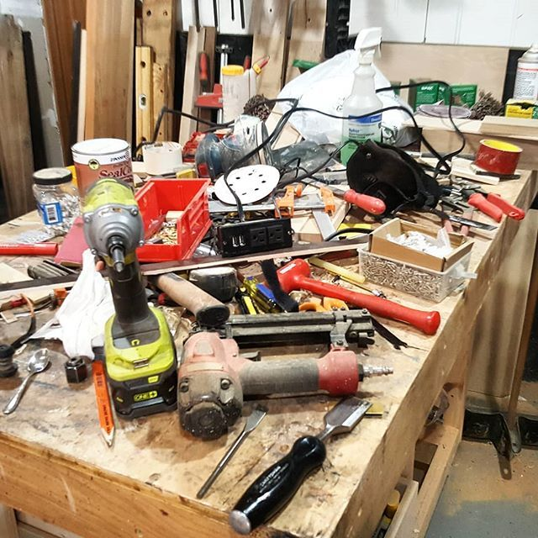

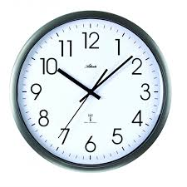

INNER WORKING
Lots of freedom
No requirements for working hours
Dress as you like
Each team is in autonomy
Leads to creativity and productivity
System not perfect

Slide 5
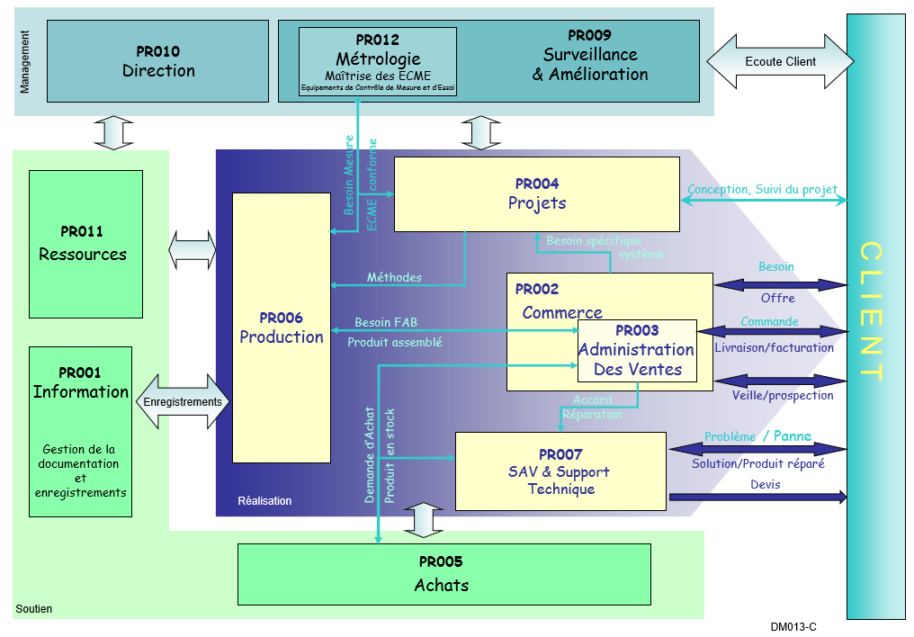
QUALITY CONTROL
ISO 9001 (quality managment)
EN 9100 (aeropsace)
AQAP 2110 (OTAN)
Process workflow
Indicators
Three categories of processes
Maintenance
Management
Development

Slide 6

CONCLUSION
Good environement
Unique atmoshere
Midway between a big company and a small one

