Slide 1


Slide 2
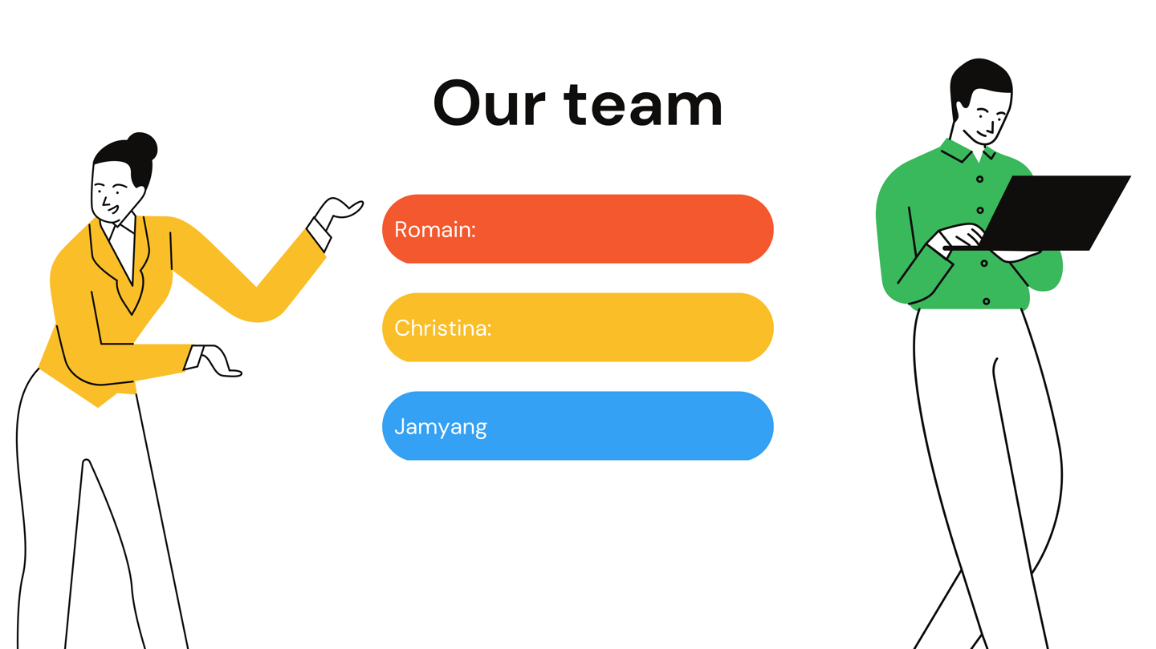
Scraping master
SQL Master
Project Manager

Slide 3

Public Health
World Bank Open Data : (2003 – 2018)
Mortality rate, adult, female (per 1,000 female adults)
Mortality rate, adult, male (per 1,000 male adults)
Current health expenditure (% of GDP)
Domestic general government health expenditure (% of current health expenditure)
External health expenditure (% of current health expenditure)
Out-of-pocket expenditure (% of current health expenditure)
Domestic private health expenditure (% of current health expenditure)

Slide 4
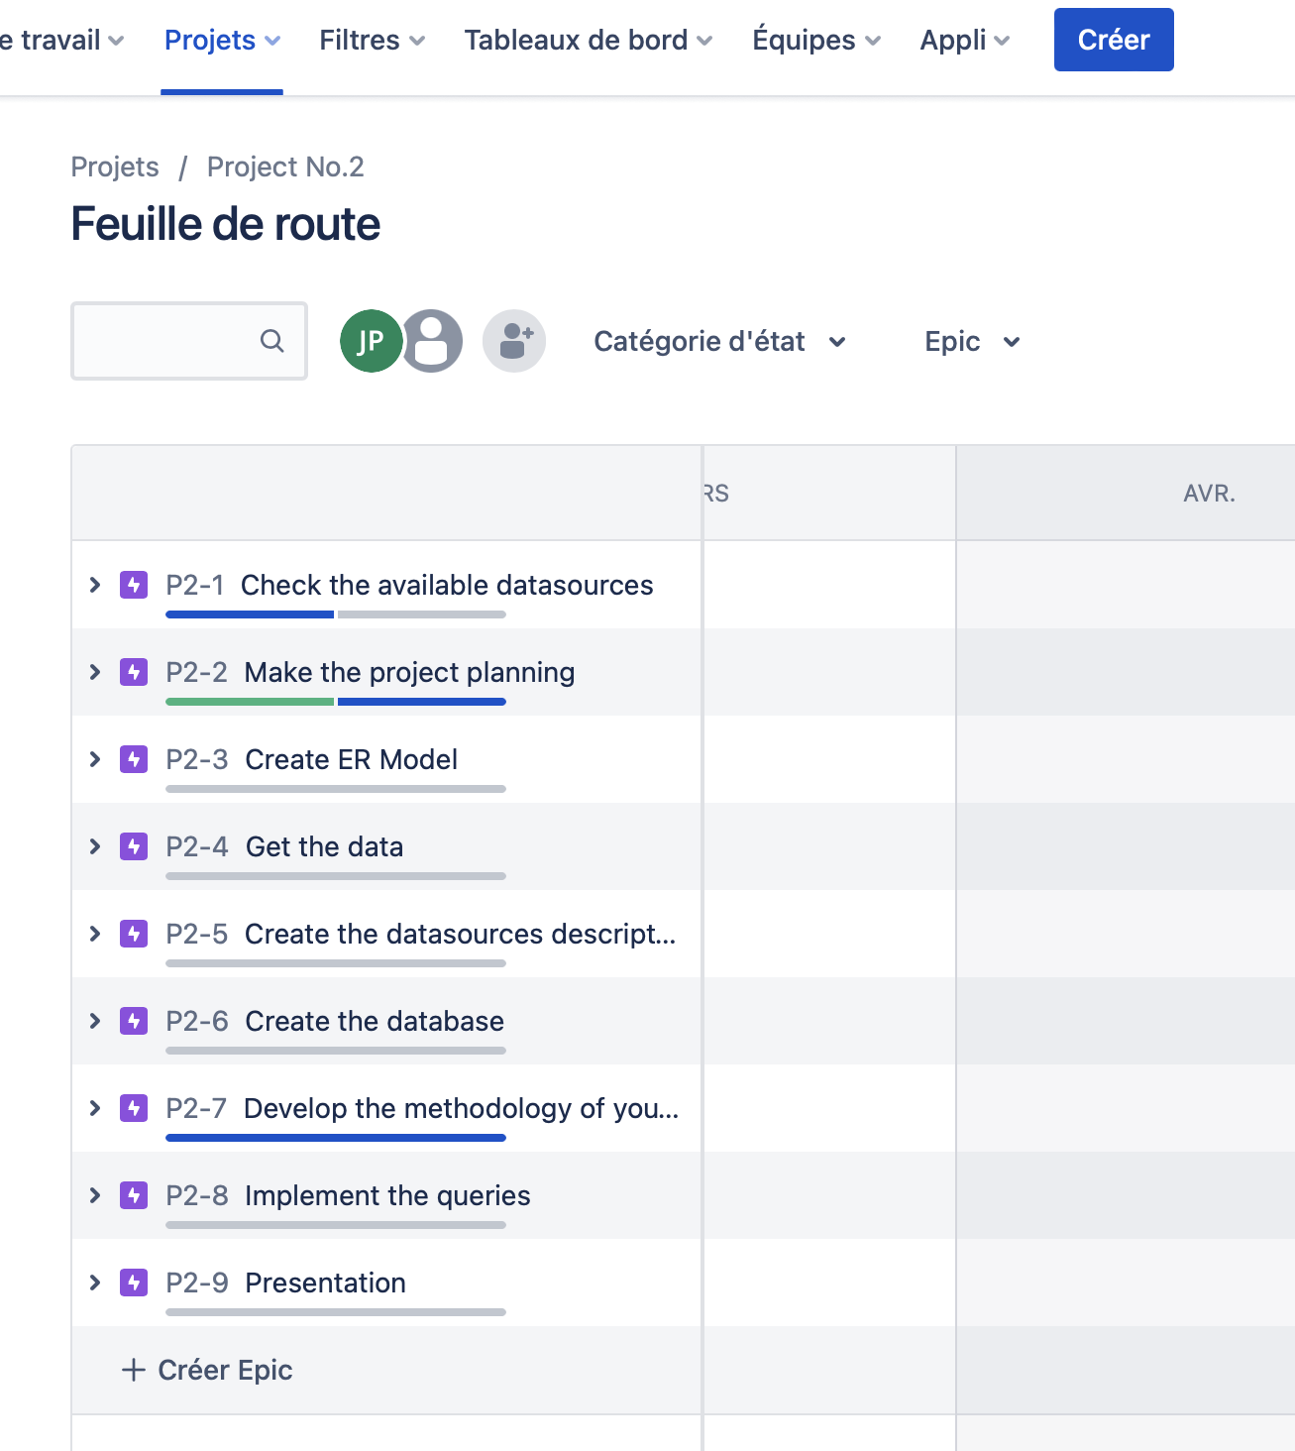
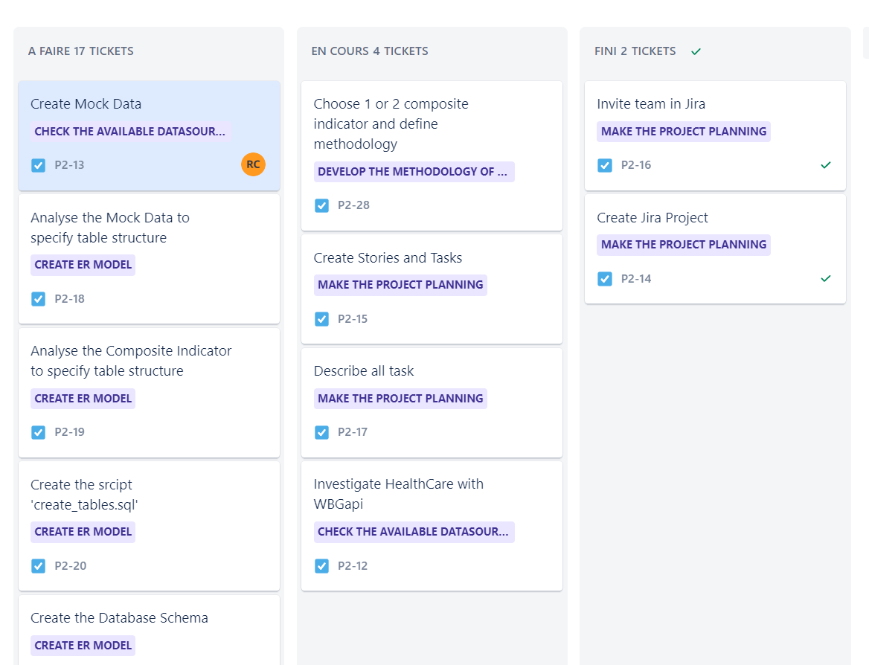
Planning on Jira
Notes:
Description of your Project (Planning, ER, DataBase Schema, Queries, Methodoloy for the composite indicator)

Slide 5

Challenges during the process:
Practice to create Database.
Therefore, the scrap and collect right Datas are fundamental to have relative indicators
Create for relevant Database.

Slide 6

Technical :
API : Framework
Extract Indicators
Management :
Group with different knowledges on Data.
Compromis on work strategy.
Timing:
Less then 24 hours to finish this project.

Slide 7

Data transformation Steps
Python GET API :
wb.data.DataFrame('SH.XPD.CHEX.GD.ZS', wb.region.members('EUU'), time=range(2003,2019))
Create database :
CREATE 1 TABLE countries
Seed Database :
SQLengine.execute(‘INSERT INTO countries(country,name) VALUES ("ABW","Aruba");’)
wb.data.DataFrame([…]).reset_index().rename(columns={'economy':'country’})
.to_sql('health_expenditure_of_gdp', con=SQLengine, if_exists='replace', index = False)
Build Indicator
Pivot : CREATE TEMPORARY TABLE tmp_mortality_female (SELECT country, '2003' as year, IFNULL(YR2003,0)
as value FROM mortality_female
UNION ALL
AVG() : SELECT format(avg(tmp_health_expenditure_of_gdp.value),2) as expenditure_of_gdp FROM

Slide 8
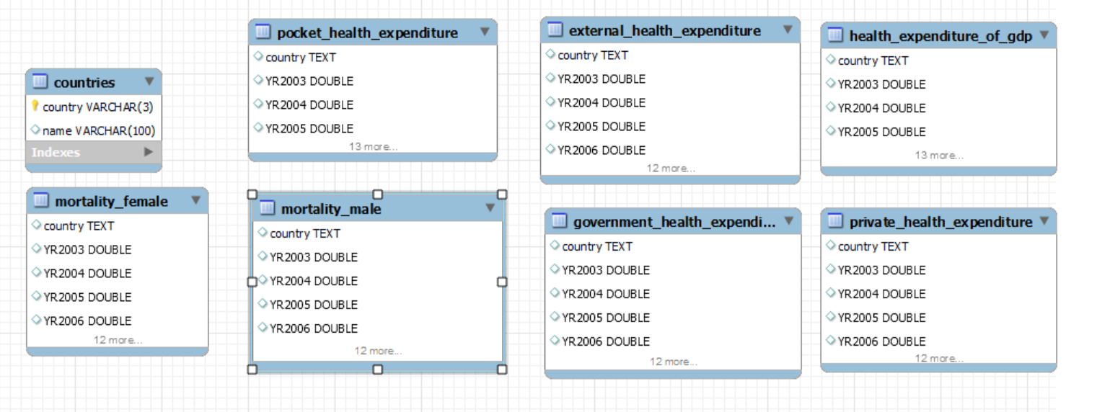
ER (Entity relational) :

Slide 9
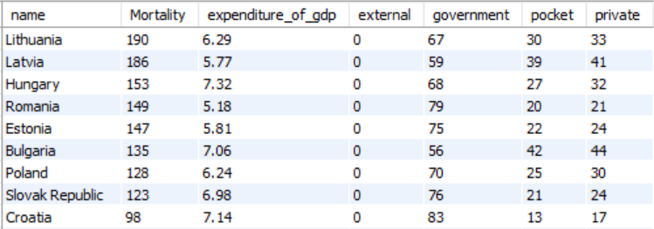
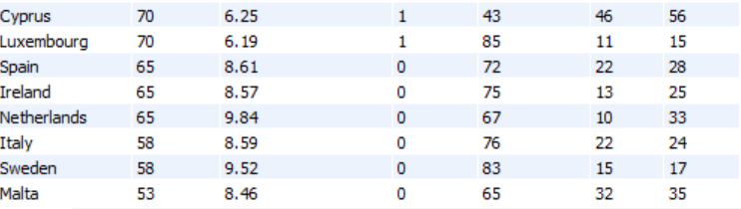
Main results

