Slide 1
What makes a great speech ?
A small understanding of the art of powerful speaking
Romain DUPONT DE POOTER

Slide 2
Outline :
Introduction
Devices and “tricks” used
Style and structure
Conclusion
Romain DUPONT DE POOTER

Slide 3
A few keywords…
Ethos
Logos
Pathos
Political awareness
Critical thinking
Romain DUPONT DE POOTER

Slide 4
Introduction
→ Why understand speeches ?
Shape opinions and inspire actions
Shape opinions and inspire actions
Gain political awareness and critical thinking
Romain DUPONT DE POOTER

Slide 5
Devices
Ethos → Credibility & authority
Logos → Logic & reasoning
Pathos → Emotion & connection
Romain DUPONT DE POOTER

Slide 6
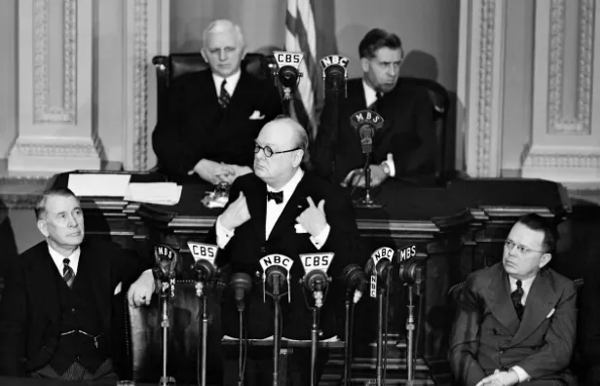
Ethos
Goal : build trust
Show expertise or integrity
Show expertise or integrity
Body language matters !
Churchill’s speech to the US Senate in 1941
Romain DUPONT DE POOTER

Slide 7

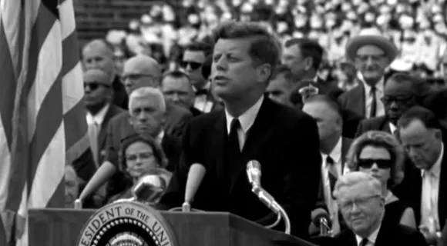
Logos
Goal : Appeal to reason
Fact, data and structure
Problem → cause → solution
JFK speech at Rice University, 1962
Romain DUPONT DE POOTER

Slide 8
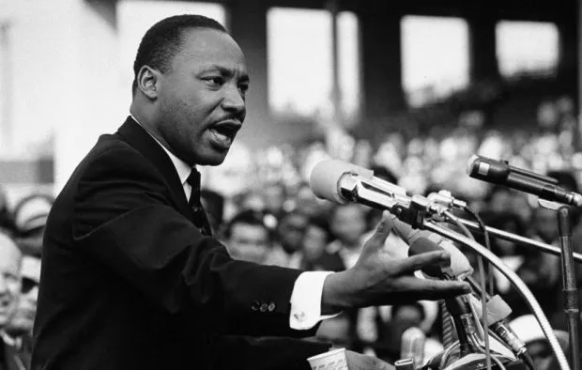
Pathos
Goal : Touching the heart
Storytelling, vivid imagery
Storytelling, vivid imagery
Emotional triggers
“I have a dream […]” MLK, 1963
Romain DUPONT DE POOTER

Slide 9
Style and delivery
Voice : tone, pauses and rythm
Rhetorical devices
Physical presence
Romain DUPONT DE POOTER

Slide 10
Structure
Strong opening
Clear message
Memorable ending
“Ask not what your country can do for you – ask what you can do for your country” JFK, 1961
Romain DUPONT DE POOTER

Slide 11
Conclusion
Mix of reason, emotion and credibility.
Inspire, inform and move people to action.
→ “How did it persuade me ?”
Romain DUPONT DE POOTER

Slide 12
What makes a great speech ?
A small understanding of the art of powerful speaking
Romain DUPONT DE POOTER

