Slide 1

ROAD 3
Mitigating Observed and Unobserved Confounding in Observational Data
Dimitris Bertsimas, Georgios Antonios Margonis,
Vasiliki Stoumpou

Slide 2
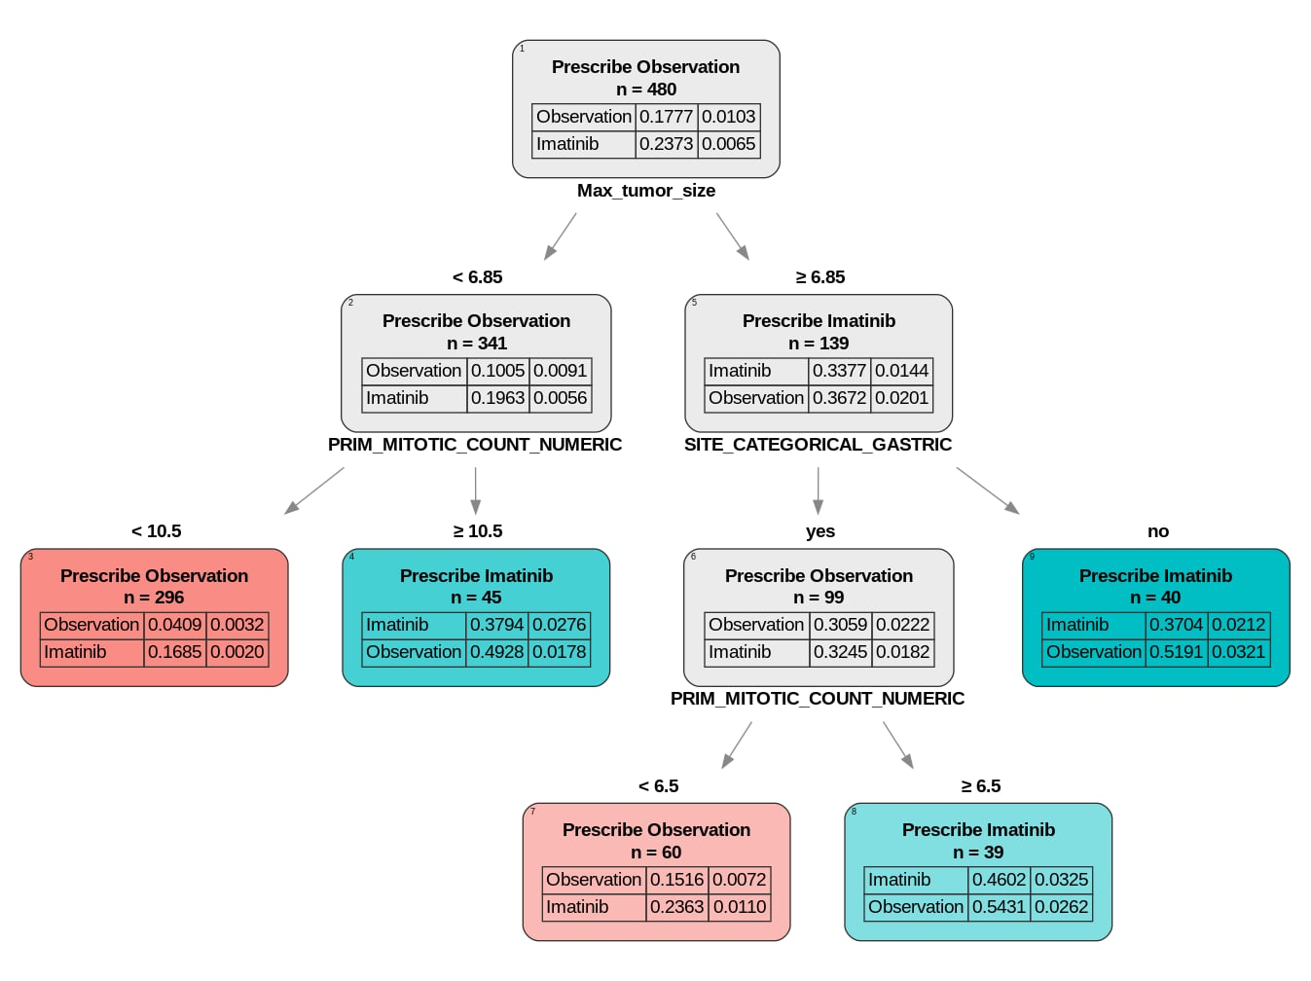
Motivation
GIST
Gastrointestinal Stromal Tumor
Type of cancer in the digestive tract
Usually treated with Imatinib
(blocks enzymes that promote cancer growth)
Imatinib is a highly effective drug
HR = 0.46 < 1
(according to RCT data)
We trained an OPT on observational data…
1

Slide 3





Why?
Randomized Clinical Trial
(RCT)
$$≈$$
2

Slide 4

Why?
Observational data
$$≠$$
Type of confounding | What is it? | Examples | Solutions
Observed | Can be explained by differences in observed features | Age, Size of the tumor, Sex etc. | Covariate adjustment Propensity matching Propensity weighting…
Unobserved | Due to factors that we cannot explain | Mutations | Assume and validate that it doesn’t exist
3

Slide 5


Are ROAD 1 and ROAD 2 enough?
ROAD 1
ROAD 2
Observed confounding
by introducing prognostic matching
Uses the tools introduced in ROAD 1 to emulate a clinical trial
Unobserved confounding
in datasets where we know how effective the treatment is
Improves precision medicine prospects
Cannot generalize to cohorts where the treatment effect is unknown
Cannot generalize to cohorts where a target trial is not available
Question: How do we estimate the treatment effect (and perform precision medicine) with observational data without any other information on the treatment when both observed and unobserved confounding are present?
4
Notes:
If you were to ask a data scientists in the 1990s or early 2000s (or whatever they were called back then) about the models they could use, you would likely get a short list of well understood techniques – linear regression, decision trees, support vector machines. Ask that same question of data scientists today, and you would get a massive list of established and bespoke techniques – every possible variant of linear regression and additive models, decision trees, boosted trees, random forests, neural networks, large language models, and beyond! The field has evolved to the point where practitioners are often overwhelmed by the scale of modeling choices available to them freely, in open-source packages, which are ready to run in minutes. There are now many models available that satisfy the requirements for almost every niche topic and application. Among the trove of options, data scientists must select a model that best suits their needs, which often comes down to three key factors – performance, efficiency, and interpretability. In this lecture, we will focus on selecting the best model based on performance, but we will also discuss how the methods discussed here can help us weigh factors such as efficiency and interpretability.

Slide 6
Proposed Solution
Our main contribution!
5

Slide 7
Taking a step back: What is one way to think about unobserved confounding?
6

Slide 8


Taking a step back: What is one way to think about unobserved confounding?
John
7

Slide 9
Taking a step back: What is one way to think about unobserved confounding?
John’s nearest neighbors with a good outcome in the treated cohort are Mary, Peter and Tom
Similar age
Got the treatment for approximately the same time-period
Their tumor is located in the same area
John
8

Slide 10

Taking a step back: What is one way to think about unobserved confounding?
But John had a recurrence, and Mary, Peter and Tom didn’t
There must be a hidden factor that differentiated John from the rest
We are calculating this unobserved feature for John: $U_{John}$
John
9

Slide 11
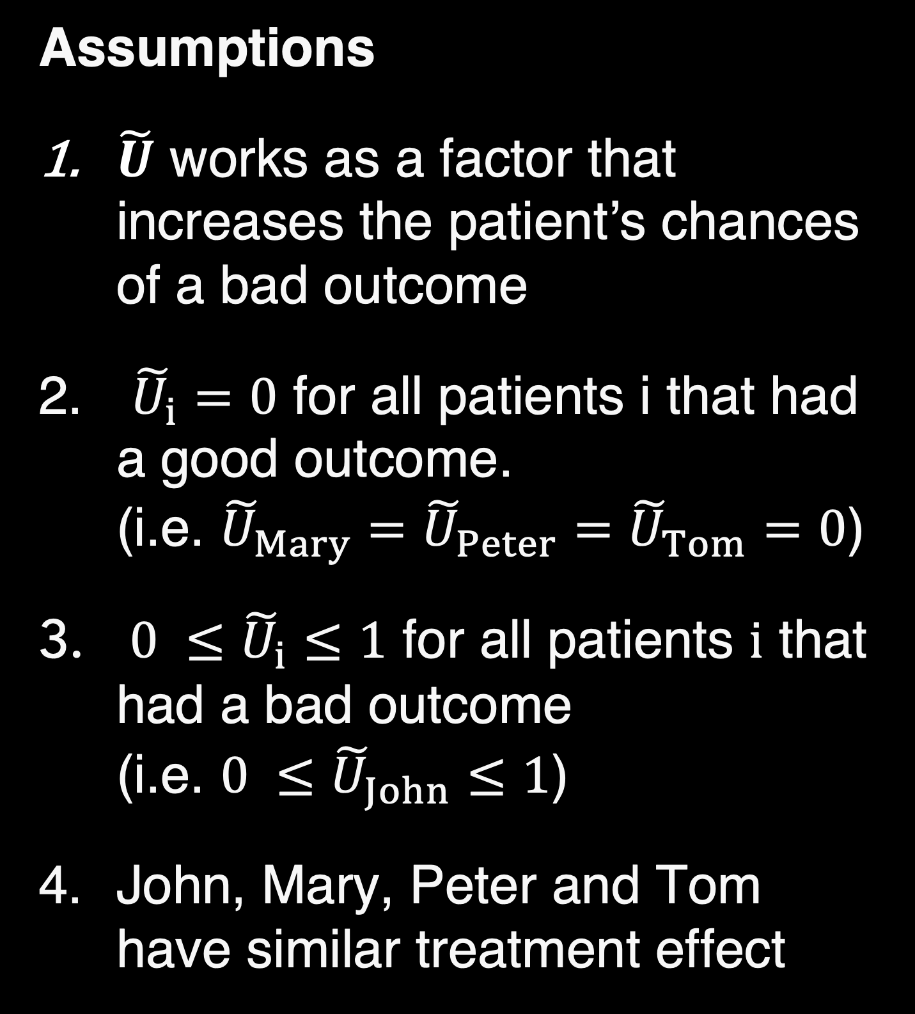
Calculating U
Assumptions
$\tilde{U}$ works as a factor that increases the patient’s chances of a bad outcome
${\tilde{U}}_{i}=0$ for all patients i that had a good outcome. (i.e. ${\tilde{U}}_{Mary}={\tilde{U}}_{Peter}={\tilde{U}}_{Tom}=0$)
${0 ≤\tilde{U}}_{i}≤1$ for all patients $i$ that had a bad outcome (i.e. ${0 ≤\tilde{U}}_{John}≤1$)
John, Mary, Peter and Tom have similar treatment effect
John
10

Slide 12
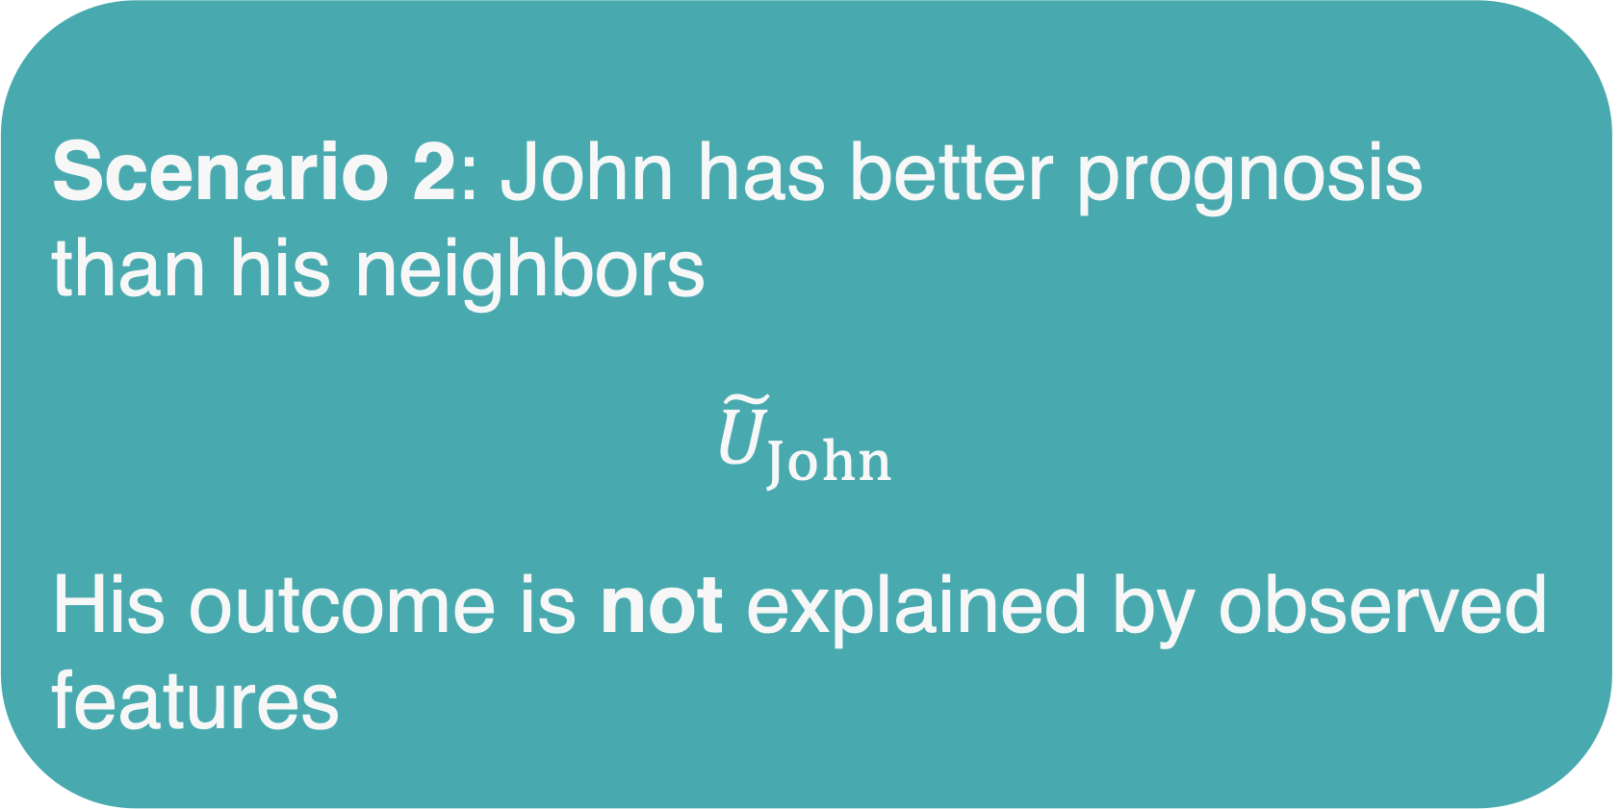
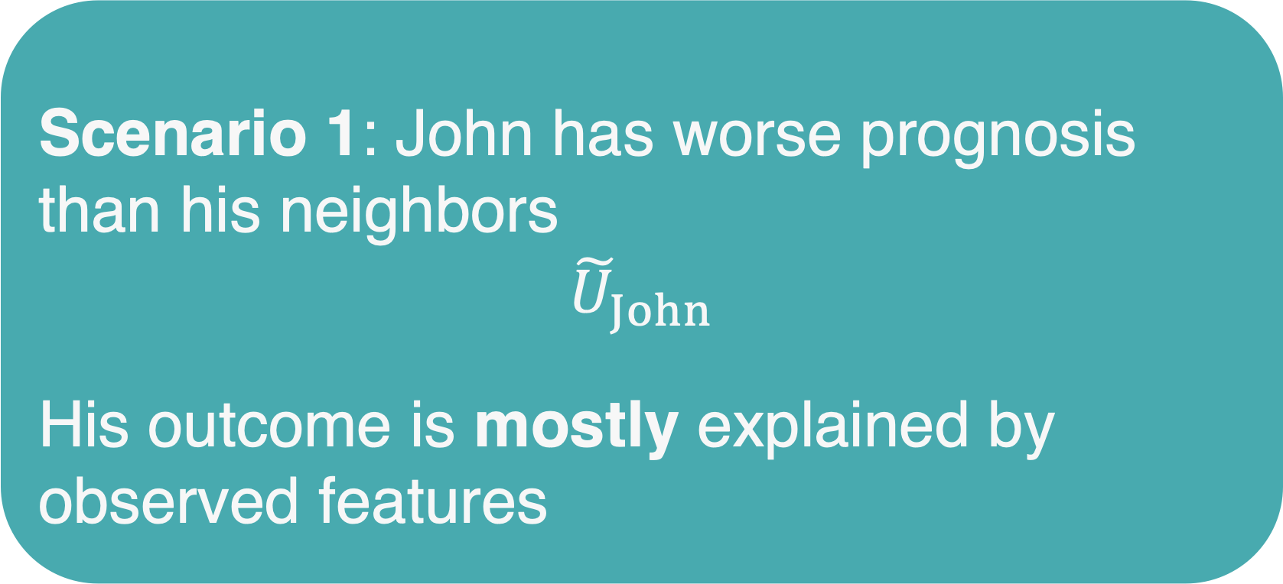
Calculating U
Scenario 1: John has worse prognosis than his neighbors
$${\tilde{U}}_{John}$$
His outcome is mostly explained by observed features
Scenario 2: John has better prognosis than his neighbors
${\tilde{U}}_{John}$
His outcome is not explained by observed features
John
11

Slide 13
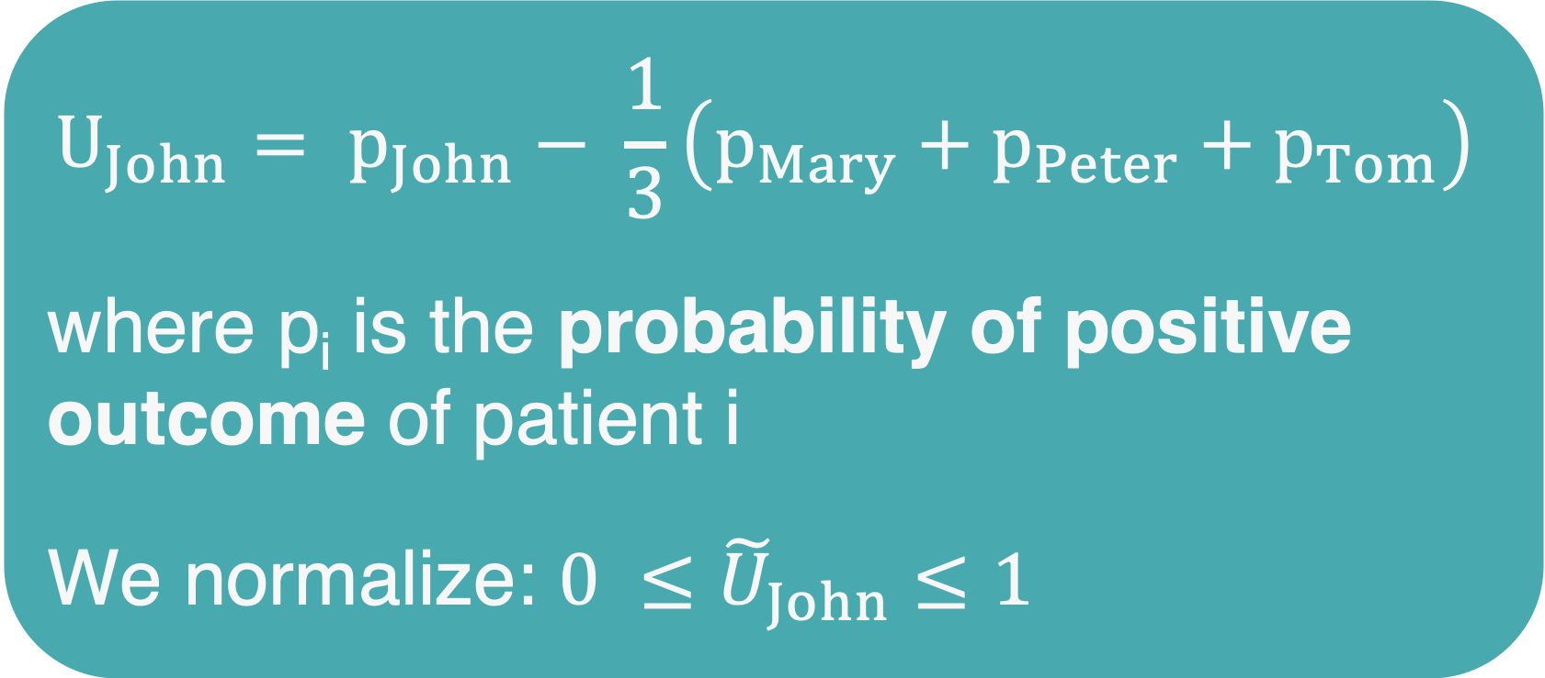
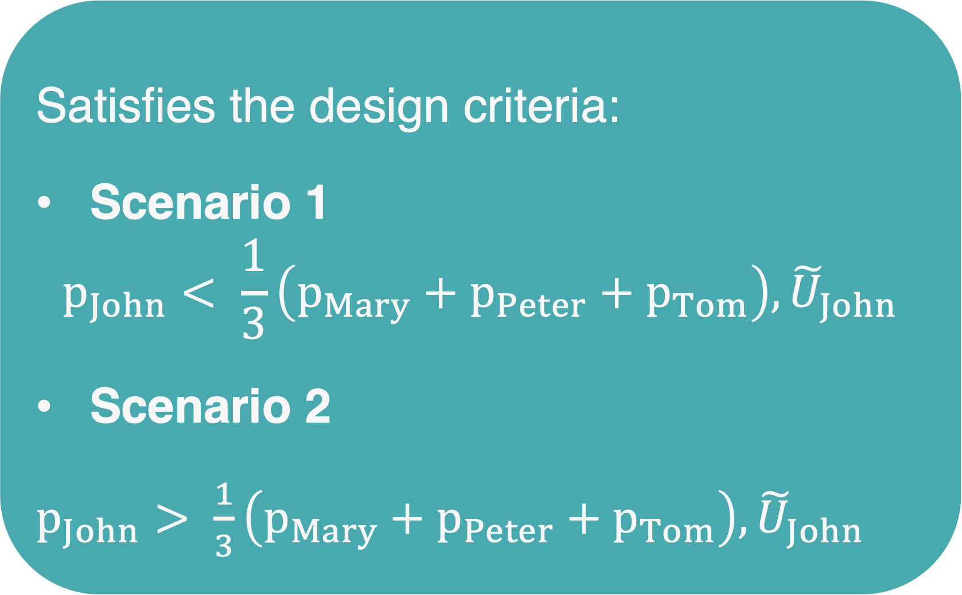
Calculating U
$$U_{John}= p_{John}− \frac{1}{3}\left(p_{Mary}+p_{Peter}+p_{Tom}\right)$$
where p_{i} is the probability of positive outcome of patient i
We normalize: ${0 ≤\tilde{U}}_{John}≤1$
Satisfies the design criteria:
Scenario 1
$$p_{John}< \frac{1}{3}\left(p_{Mary}+p_{Peter}+p_{Tom}\right),{\tilde{U}}_{John}$$
Scenario 2
$p_{John}> \frac{1}{3}\left(p_{Mary}+p_{Peter}+p_{Tom}\right),{\tilde{U}}_{John}$
John
12

Slide 14
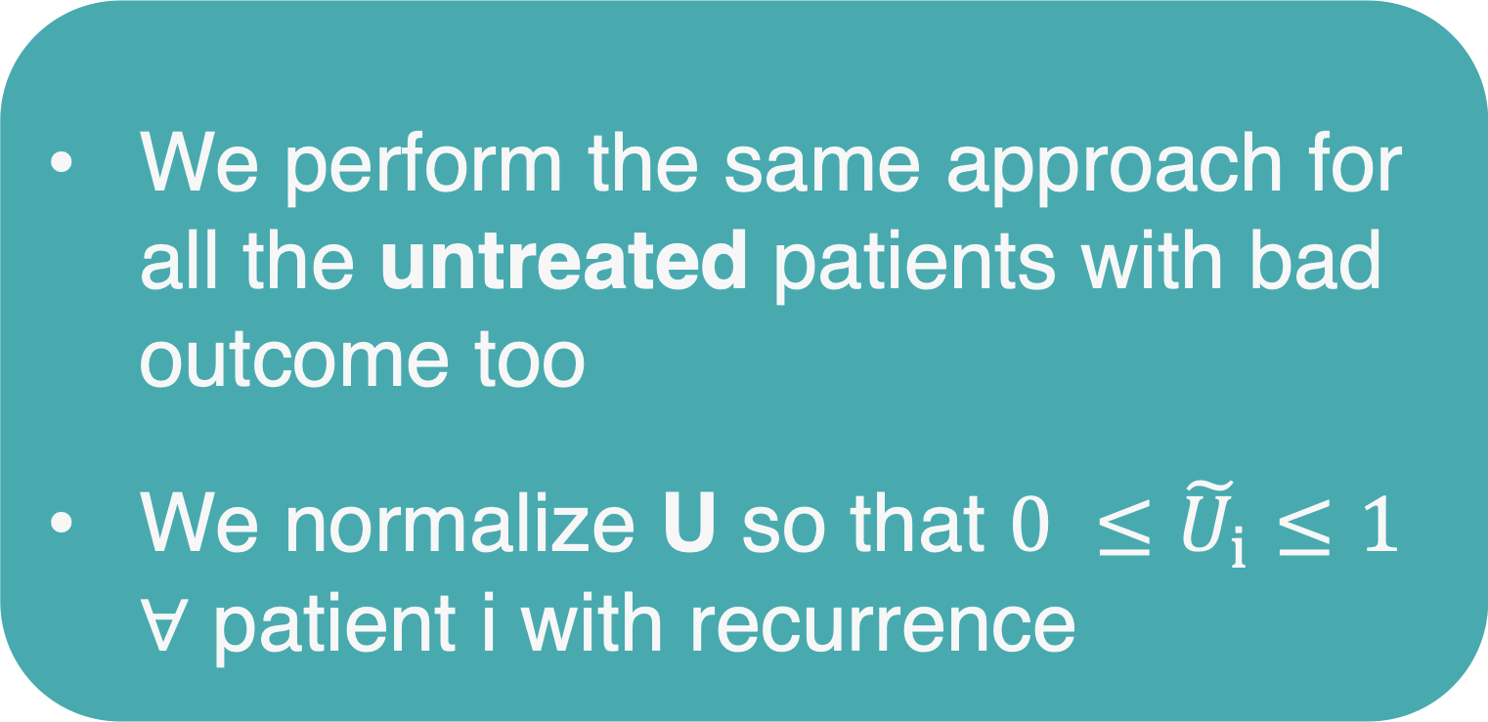
Calculating U
We perform the same approach for all the untreated patients with bad outcome too
We normalize U so that ${0 ≤\tilde{U}}_{i}≤1$ ∀ patient i with recurrence
Main design choices
which prognostic model to use
# neighbors considered
Henry
13

Slide 15
Recap
14

Slide 16
Results on observational data
Goal: We want to estimate the hazard ratio and compare it to the ground truth, as calculated by clinical trials for the same treatments
15

Slide 17
Results on artificially confounded RCT data
Artificial confounding is added by randomly resampling patients with bad outcome and adding them to the dataset
16

Slide 18
Main contributions
Introducing a way to quantify the unobserved prognostic factors (hidden information that affects the final outcomes)
Proposing a matching + weighting approach (building on ROAD 1) that aims to create a balanced cohort for accurate treatment effect estimation and personalized medicine
Strong results compared to traditional techniques that ignore unobserved confounding
17

