Slide 1
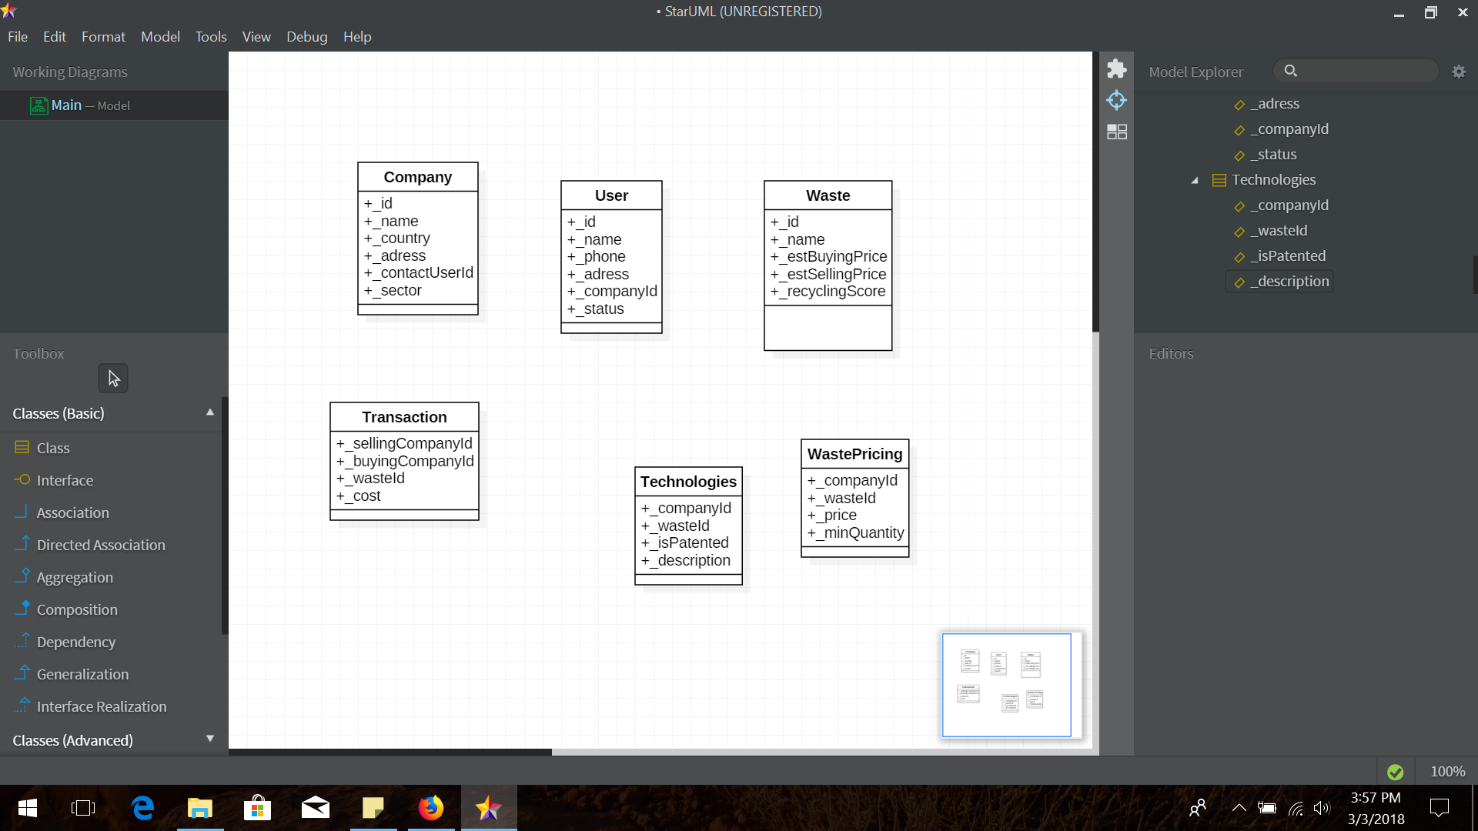
For recommendation purposes, the company will have localization attributes and a sector.

Slide 2
This class store all user contact information, company.
The status will distinguish several users category for personalized content/access

Slide 3
Record an estimated buying and selling prices for quoting & information purpose.
The recycling scores will help prioritize solutions by their environmental impact

Slide 4
Record any transaction between two companies

Slide 5
For information purpose, record a technology that treats a specific waste.
Also records if this is patented or associated with a specific company

Slide 6
Records pricing by company and a minimum quantity to trade if applicable

