Slide 1




Category Theory: You already know it
Romain Berthon @romaintrm
Emilien Pecoul @ouarzy

Slide 2
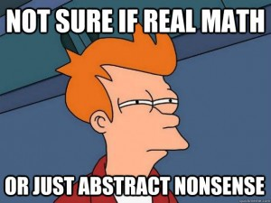
Disclaimer
We’re not mathematicians
Just curious programmers

Slide 3
Question?
www.slido.com

Slide 4
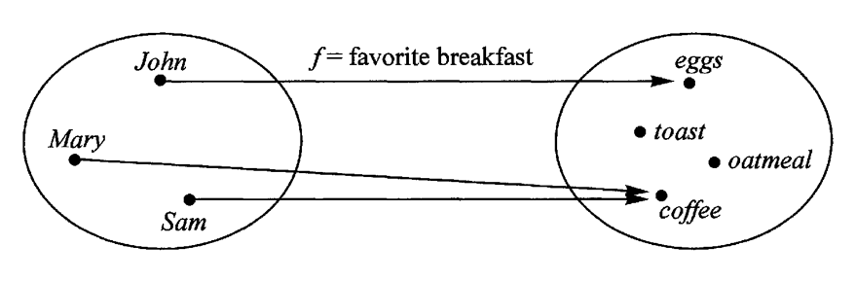
Why Category Theory ?
Common abstract language
Behaviors analysis instead of object analysis
It’s all about structure

Slide 5
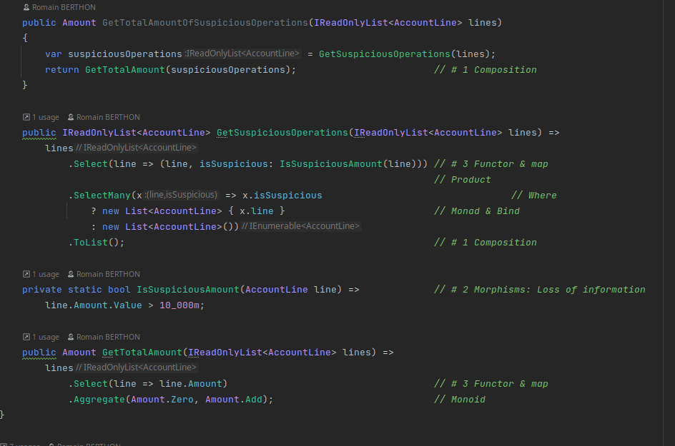
Code review

Slide 6
What’s Category Theory ?
id
f
id
a
g
g o f
c
id
A bunch of morphisms, they start and finish with an object
Identity: (a->a)
Composition: (a ->b) -> (b->c) = (a->c)

Slide 7
What’s Category Theory ?
h
id
f o g
id
id
g
g o h
f
c
id
Identity law: (id o f ) = (f o id ) = f
Associative law: (f o g ) o h = f o (g o h)

Slide 8
Essence of Category Theory ?
Composition
Identity
Abstraction
(Functional)
Programmers know it!

Slide 9
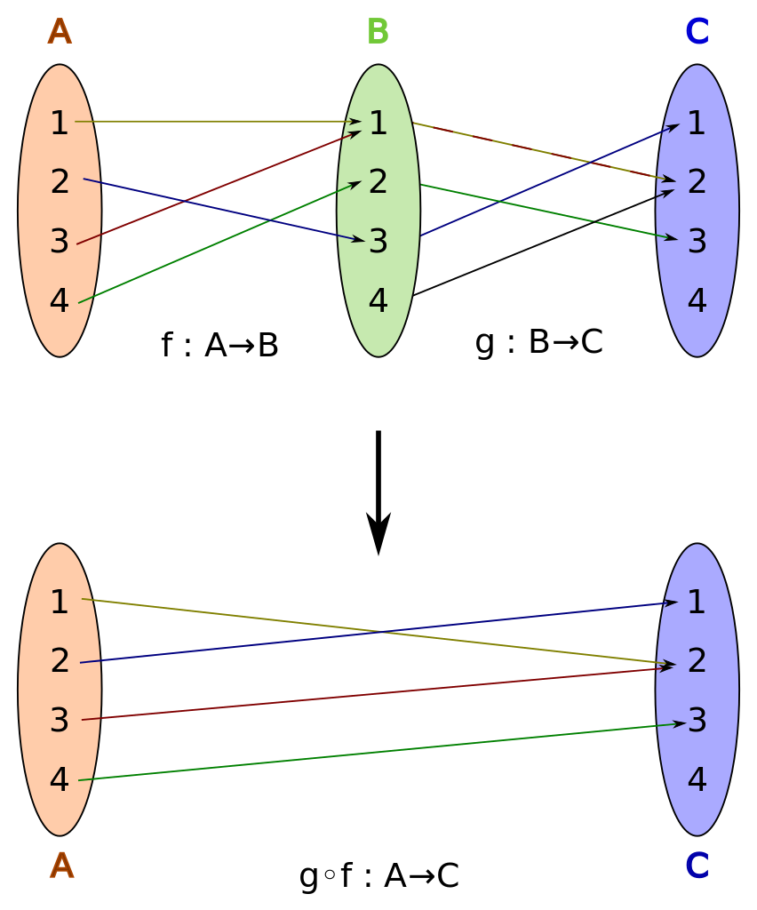
Composition

Slide 10
Composition
Fundamental in functional programming:
The result of each function is the argument of the next - The result of the last one is the result of the whole
App
X
Y
Use Case
Use Case
Service
Service
Service
Function
Function
Function
Function

Slide 11
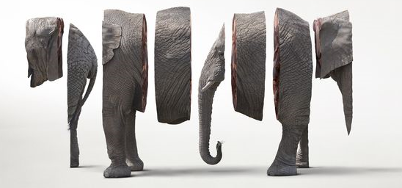
Composition
Chunk big problems into smaller ones
Requires no side effect

Slide 12
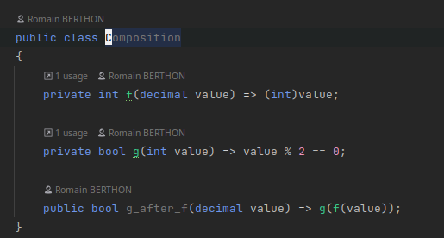
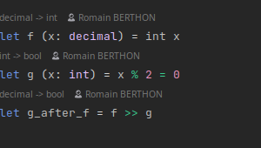
Example ?

Slide 13

Composition
Composition allows to solve big problems with little composed solutions
We need composition because reality is too hard to deal with

Slide 14
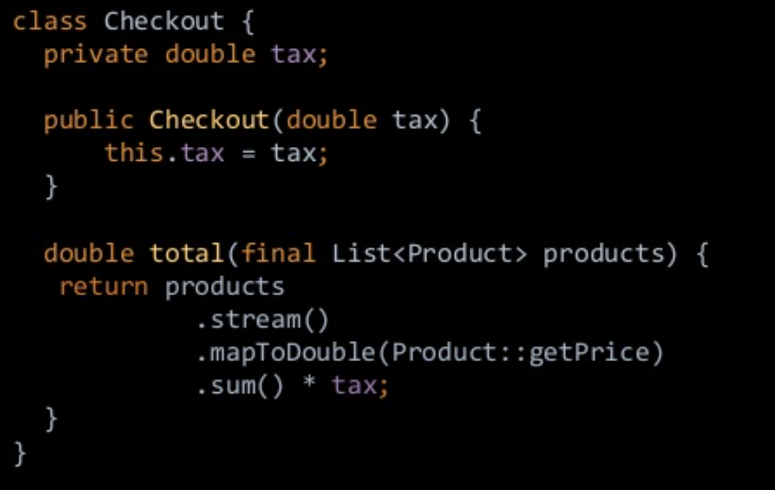
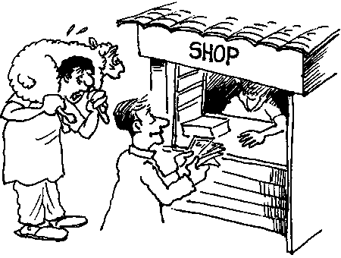
Abstraction
How do we build software ?
Reality
Software Model
Code
Product
Money
Person
Seller
Buyer

Slide 15
Abstraction
How do we abstract stuff ?
Domain
IsEven
CoDomain
Positive Integers 1 2 3 4 …
Bool
True
False

Slide 16
Example ?
Loosing data
Decimal
Int
Bool

Slide 17
Abstraction
Abstracting is hiding (loosing) useless details in order to apply common rules
We need abstraction because reality is too hard to deal with

Slide 18


Identity

Slide 19
Identity
f
id
id
Identity law: (id o f ) = (f o id ) = f

Slide 20
Identity
f
id
id
g
Identity law: (id o f ) = (f o id ) = f
g o f = Id_{Left}
f o g = Id_{Right}

Slide 21

Identity
Does (string,int) = (int,string) ?
Isomorphic
(string, int)
f
(int, string)
g o f
f o g
g
g o f = Id_{Left}
f o g = Id_{Right}

Slide 22
Example ?
Not loosing data
f
Binary
Bool
g
f o g = IdRight
g o f = IdLeft
Model
BDD

Slide 23
Identity
Identity is important to define an object in a given context
We need identity because reality is too hard to deal with

Slide 24

You already know it!

Slide 25
Monoids
g
id
f
A category with only one object => Compose! => Structure containing only monoids are monoids !

Slide 26
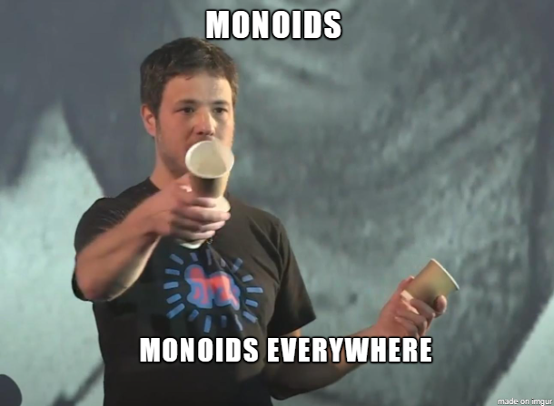
Monoids
https://youtu.be/J9UwWo2qifg

Slide 27
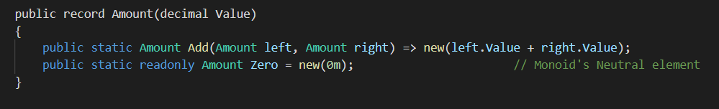
Example ?

Slide 28

Break

Slide 29
Category you already know
B
A
F
G
G o F
C
Category of category (cat)

Slide 30
You know category in code
List<T> + map
A functor is a container with a map preserving structure
isEven
Map(isEven)
bool
List<T>
List<bool>
int
List<int>

Slide 31

Example ?
List<T>.map(isEven)
int
bool
isEven
Select in LINQ = map

Slide 32
Category you already know
G
F
α
β
β o α
H
Category of functors

Slide 33
You know category in code
List<T> -> Maybe<T>
A natural transformation is a generic function between two functors
List<T>
Map(isEven)
List<bool>
isEven
List<int>
bool
MaybeHead
int
Map(isEven)
Maybe<T>
Maybe<bool>
Maybe<int>

Slide 34

Example ?
List<T>
Maybe<T>
MaybeHead

Slide 35
Endofunctor
F
g
id
f
A functor that map a category to itself Endofunctors are interesting because they do a good job of representing structures inside categories that work for any object

Slide 36
Endofunctor
Map(List<T>)
List<int>
List<List<int>>
An endofunctor can apply to itself
"All the Functors we are dealing with in functional programming are Endofunctors" - https://blog.softwaremill.com/monoid-in-the-category-of-endofunctors-b85bab43587b

Slide 37
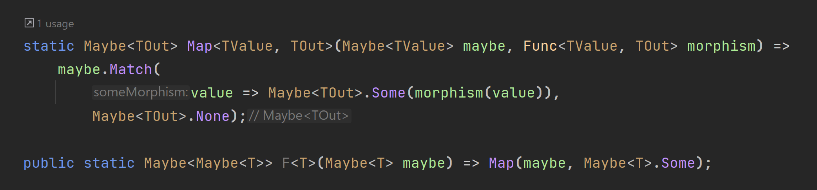
Example ?
Map(Maybe<T>)
Maybe<T>
Maybe<Maybe<T>>

Slide 38
How can I come back ?
Select(List<T>)
List<T>
List<List<T>>
SelectMany(List<List<T>>)
Map(Maybe<T>)
Maybe<T>
Maybe<Maybe<T>>
Join(Maybe<Maybe<T>>)

Slide 39

Monads
A monad is a monoid in the category of endofunctors

Slide 40
Example ?
How to compose function with side effects ? => By encapsulation in a monad!

Slide 41

No Silver bullet
Mathematical abstraction are « easy to build »
Abstraction from real world will be harder to build.

Slide 42
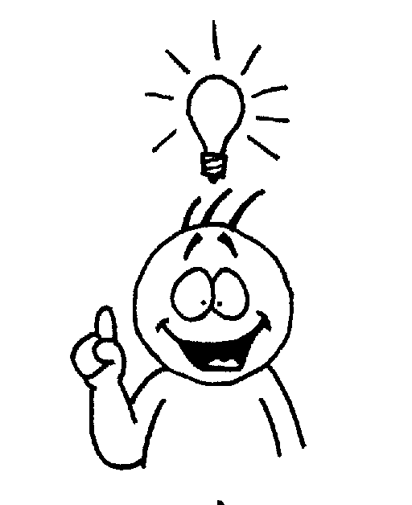
Conclusion
Category theory is not mandatory to code…
..But it could help to find clever solution to complex programming problems.
[Category theory] does not itself solve hard problems […] It puts the hard problems in clear relief and makes their solution possible.
—The Last Mathematician (Hilbert Gottingen)

Slide 43
Thanks

Slide 44
You know category in math
Product
A^{C} * B^{C =} (A * B)^{C}
(C ->A , C ->B) = C -> (A,B)
c
f
g
<f,g>
a
(a,b)
b
first
second

Slide 45
You know category in math
Co Product
(A + B) * C = A * C + B * C
(A|B , C) = (A,C) | (B,C)
ind
inr
a
a|b
b
[f,g]
g
f
c

Slide 46
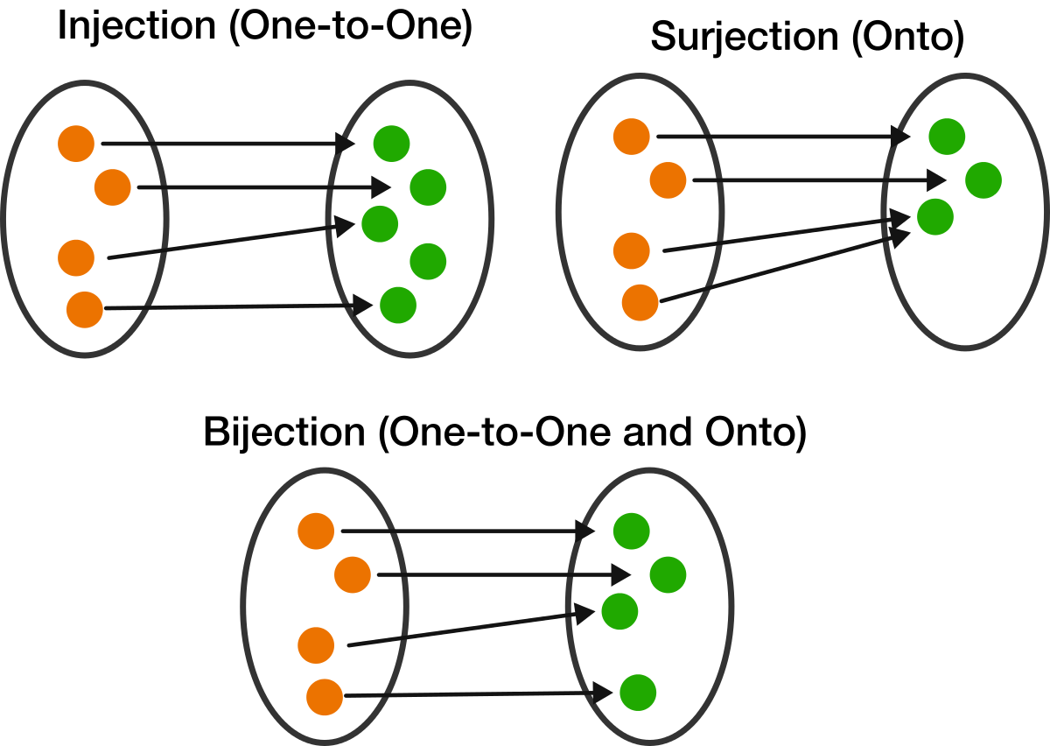
Surjective/Bijective

Slide 47
Category you already know
<=
<=
2
<=
1
<=
<=
3
<=
Ordered set

Slide 48
Category you already know
extends
Person
Seller
extends
extends
Object
Class hierarchy

