Slide 1




Category Theory: You already know it
Romain Berthon @romaintrm
Emilien Pecoul @ouarzy

Slide 2
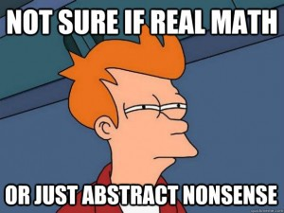
Disclaimer
We’re not mathematicians
Just curious programmers

Slide 3
Question?
www.slido.com
#223494
Q&A www.slido.com #223494

Slide 4
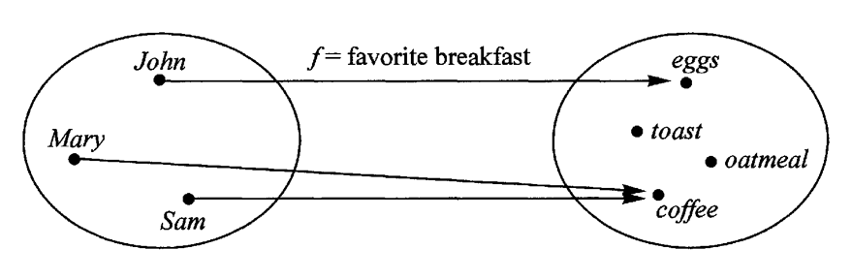
Why Category Theory ?
Common abstract language
Behaviors analysis instead of object analysis
It’s all about structure
Q&A www.slido.com #223494

Slide 5
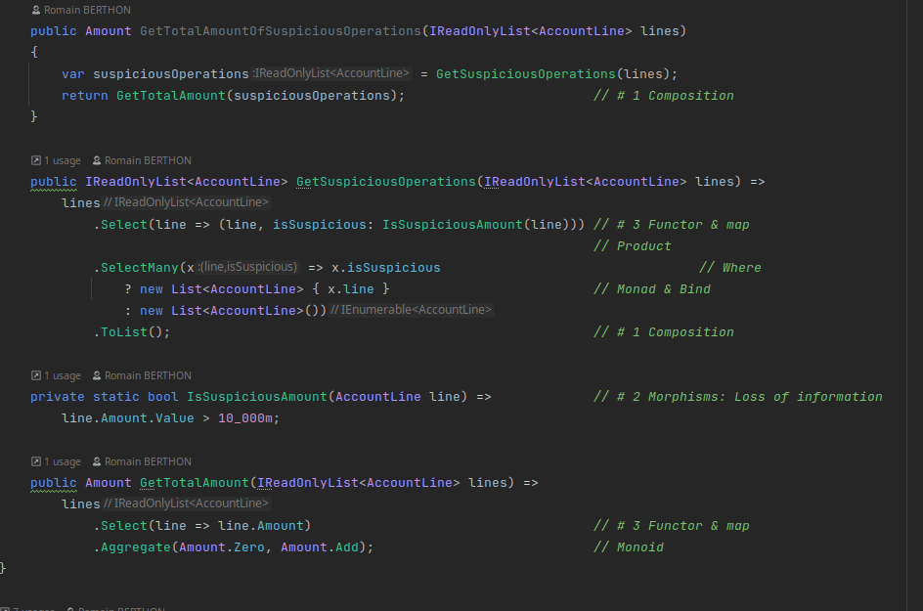
Code review
Q&A www.slido.com #223494

Slide 6
What’s Category Theory ?
id
f
id
a
g
g o f
c
id
A bunch of morphisms, they start and finish with an object
Identity: (a->a)
Composition: (a ->b) -> (b->c) = (a->c)
Q&A www.slido.com #223494

Slide 7
What’s Category Theory ?
h
id
f o g
id
id
g
g o h
f
c
id
Identity law: (id o f ) = (f o id ) = f
Associative law: (f o g ) o h = f o (g o h)
Q&A www.slido.com #223494

Slide 8
Essence of Category Theory ?
Composition
Identity
Abstraction
(Functional)
Programmers know it!
Q&A www.slido.com #223494

Slide 9
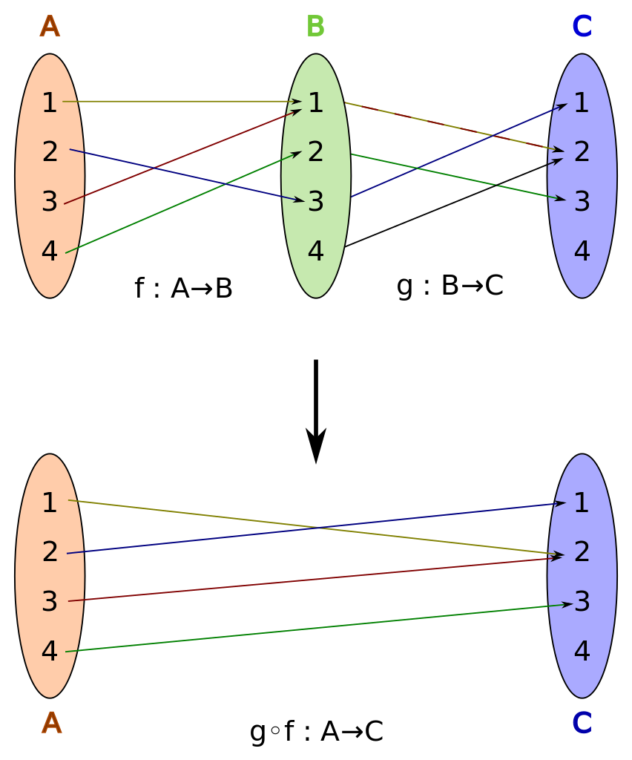
Composition
Q&A www.slido.com #223494

Slide 10
Composition
Fundamental in functional programming:
The result of each function is the argument of the next - The result of the last one is the result of the whole
App
X
Y
Use Case
Use Case
Service
Service
Service
Function
Function
Function
Function
Q&A www.slido.com #223494

Slide 11
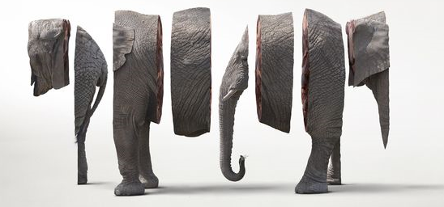
Composition
Chunk big problems into smaller ones
Requires no side effect
Q&A www.slido.com #223494

Slide 12
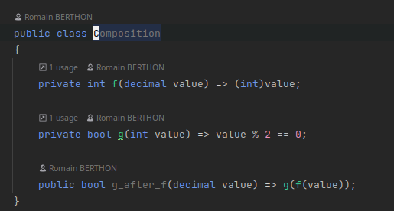
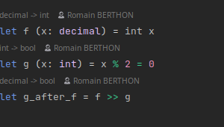
Example ?
Q&A www.slido.com #223494

Slide 13

Composition
Composition allows to solve big problems with little composed solutions
We need composition because reality is too hard to deal with
Q&A www.slido.com #223494

Slide 14
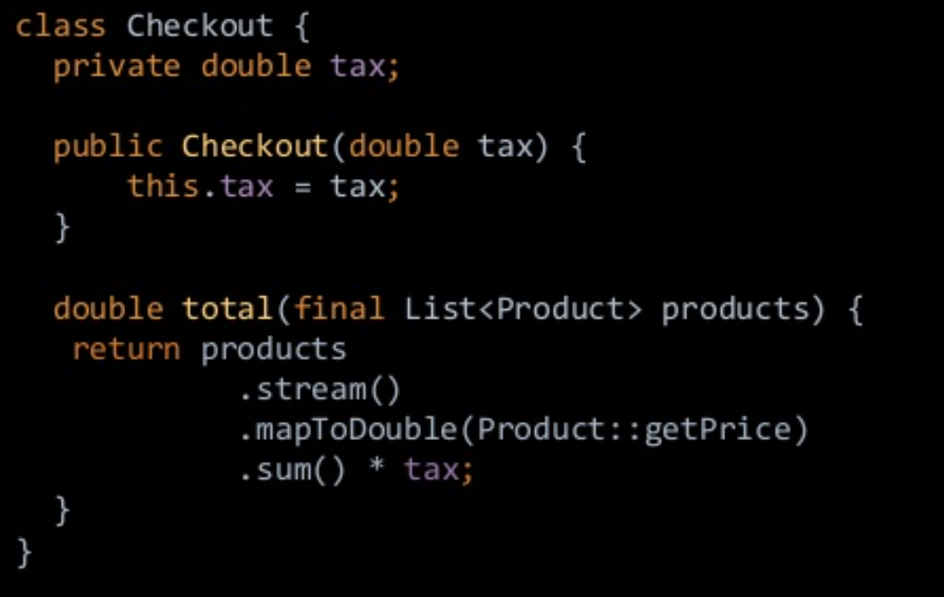
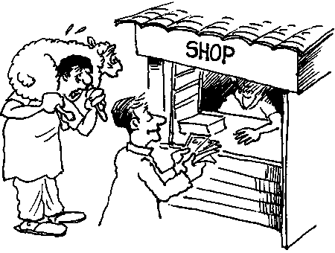
Abstraction
How do we build software ?
Reality
Software Model
Code
Product
Money
Person
Seller
Buyer
Q&A www.slido.com #223494

Slide 15
Abstraction
How do we abstract stuff ?
Domain
IsEven
CoDomain
Positive Integers 1 2 3 4 …
Bool
True
False
Q&A www.slido.com #223494

Slide 16
Example ?
Loosing data
Decimal
Int
Bool
Q&A www.slido.com #223494

Slide 17
Abstraction
Abstracting is hiding (loosing) useless details in order to apply common rules
We need abstraction because reality is too hard to deal with
Q&A www.slido.com #223494

Slide 18


Identity
Q&A www.slido.com #223494

Slide 19
Identity
f
id
id
Identity law: (id o f ) = (f o id ) = f
Q&A www.slido.com #223494

Slide 20
Identity
f
id
id
g
Identity law: (id o f ) = (f o id ) = f
g o f = Id_{Left}
f o g = Id_{Right}
Q&A www.slido.com #223494

Slide 21

Identity
Does (string,int) = (int,string) ?
Isomorphic
(string, int)
f
(int, string)
g o f
f o g
g
g o f = Id_{Left}
f o g = Id_{Right}
Q&A www.slido.com #223494

Slide 22
Example ?
Not loosing data
f
Binary
Bool
g
f o g = IdRight
g o f = IdLeft
Model
BDD
Q&A www.slido.com #223494

Slide 23
Identity
Identity is important to define an object in a given context
We need identity because reality is too hard to deal with
Q&A www.slido.com #223494

Slide 24

You already know it!
Q&A www.slido.com #223494

Slide 25
Monoids
g
id
f
A category with only one object => Compose! Associative ! => Structure containing only monoids are monoids !
Q&A www.slido.com #223494

Slide 26
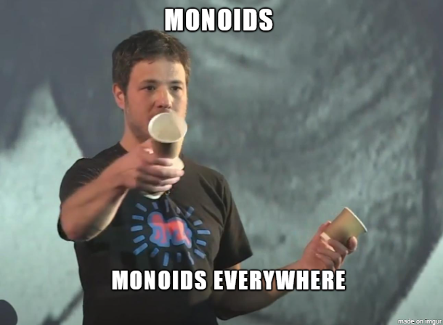
Monoids
https://youtu.be/J9UwWo2qifg

Slide 27
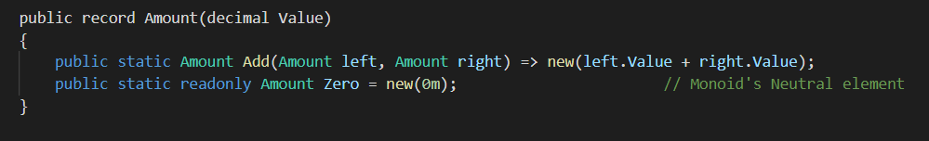
Example ?
Q&A www.slido.com #223494

Slide 28

Break
Q&A www.slido.com #223494

Slide 29
Category you already know
B
A
F
G
G o F
C
Category of category (cat)
Q&A www.slido.com #223494

Slide 30
You know category in code
List<T> + map
A functor is a container with a map preserving structure
isEven
Map(isEven)
bool
List<T>
List<bool>
int
List<int>
Q&A www.slido.com #223494

Slide 31

Example ?
List<T>.map(isEven)
int
bool
isEven
Select in LINQ = map
Q&A www.slido.com #223494

Slide 32
Category you already know
G
F
α
β
β o α
H
Category of functors
Q&A www.slido.com #223494

Slide 33
You know category in code
List<T> -> Maybe<T>
A natural transformation is a generic function between two functors
List<T>
Map(isEven)
List<bool>
isEven
List<int>
bool
MaybeHead
int
Map(isEven)
Maybe<T>
Maybe<bool>
Maybe<int>
Q&A www.slido.com #223494

Slide 34

Example ?
List<T>
Maybe<T>
MaybeHead
Q&A www.slido.com #223494

Slide 35
Endofunctor
F
g
id
f
A functor that map a category to itself Endofunctors are interesting because they do a good job of representing structures inside categories that work for any object
Q&A www.slido.com #223494

Slide 36
Endofunctor
Map(List<T>)
List<int>
List<List<int>>
An endofunctor can apply to itself
"All the Functors we are dealing with in functional programming are Endofunctors" - https://blog.softwaremill.com/monoid-in-the-category-of-endofunctors-b85bab43587b
Q&A www.slido.com #223494

Slide 37
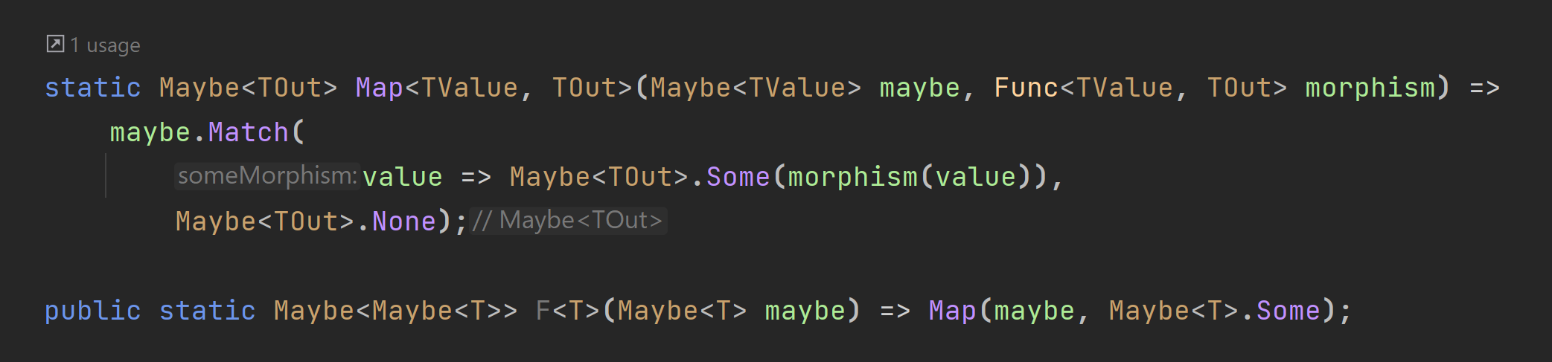
Example ?
Map(Maybe<T>)
Maybe<T>
Maybe<Maybe<T>>
Q&A www.slido.com #223494

Slide 38
How can I come back ?
Select(List<T>)
List<T>
List<List<T>>
SelectMany(List<List<T>>)
Map(Maybe<T>)
Maybe<T>
Maybe<Maybe<T>>
Join(Maybe<Maybe<T>>)
Q&A www.slido.com #223494

Slide 39

Monads
A monad is a monoid in the category of endofunctors
Q&A www.slido.com #223494

Slide 40
Example ?
How to compose function with side effects ? => By encapsulation in a monad!
Q&A www.slido.com #223494

Slide 41

No Silver bullet
Mathematical abstraction are « easy to build »
Abstraction from real world will be harder to build.
Q&A www.slido.com #223494

Slide 42

Conclusion
Category theory is not mandatory to code…
..But it could help to find clever solution to complex programming problems.
[Category theory] does not itself solve hard problems […] It puts the hard problems in clear relief and makes their solution possible.
—The Last Mathematician (Hilbert Gottingen)
Q&A www.slido.com #223494

Slide 43
Thanks

Slide 44
References
Category Theory for beginners (Ken Scambler)
Category Theory for programmers (Bartosz Milewski)
Philip Wadler ’s Blog: http://homepages.inf.ed.ac.uk/wadler/
Robb Seaton’s Blog: http://rs.io/why-category-theory-matters/
Category Theory for the working mathematicians (MacLane, Saunders)
History
1940s: Einlenberg and MacLane formalize Category Theory
1958: Monads discovered by Godement
1990: Moggi, Wadler apply monads to functional programming

Slide 45
You know category in math
Product
A^{C} * B^{C =} (A * B)^{C}
(C ->A , C ->B) = C -> (A,B)
c
f
g
<f,g>
a
(a,b)
b
first
second
Q&A www.slido.com #223494

Slide 46
You know category in math
Co Product
(A + B) * C = A * C + B * C
(A|B , C) = (A,C) | (B,C)
ind
inr
a
a|b
b
[f,g]
g
f
c
Q&A www.slido.com #223494

Slide 47
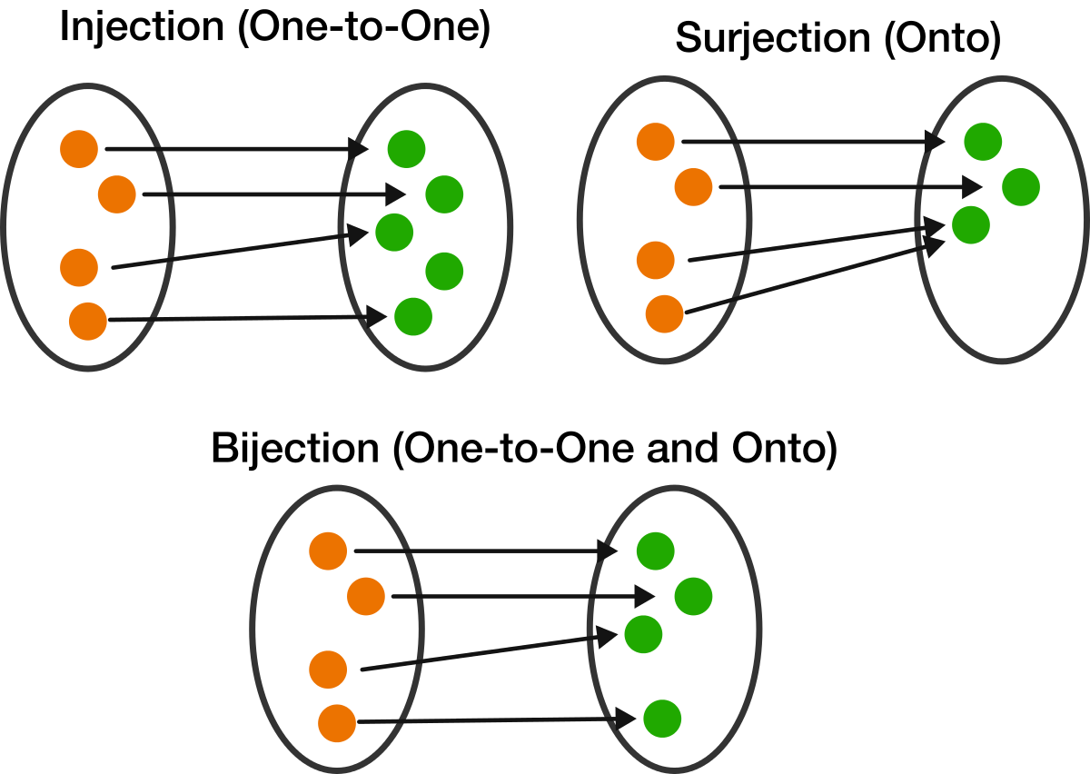
Surjective/Bijective
Q&A www.slido.com #223494

Slide 48
Category you already know
<=
<=
2
<=
1
<=
<=
3
<=
Ordered set

Slide 49
Category you already know
extends
Person
Seller
extends
extends
Object
Class hierarchy

