Slide 1

Capstone And Professional Practices
Analyzing Trust And Ethical Concerns of AI in Healthcare Systems
Presented by:
SAMEEN NOOR (2023-BCS-077)
ROMAISA (2023-BCS-073)
ALMAS SHAFQAT (2023-BCS-016)

Slide 2

TABLE OF CONTENT
Introduction & Background
Problem Statement
Survey Analysis & Findings
Ethical Analysis
Legal & Regulatory Issues
Recommendations & Solutions
Conclusion
Personal Reflection
Q&A

Slide 3

Introduction & Background
Artificial Intelligence in Healthcare is being used for:
Disease diagnosis
Medical imaging
Patient monitoring
Treatment recommendations
Healthcare data management
Why This Topic?
Healthcare decisions directly affect human life.
AI systems create ethical and trust-related concerns.
Public trust is necessary for AI adoption.

Slide 4
Objectives
Analyze public trust in use of AI in healthcare systems
Identify major ethical concerns
Apply IEEE/ACM/BCS ethical principles
Suggest safer AI solutions to build the public trust
“Although AI improves efficiency, people still fear privacy risks, wrong diagnosis, and lack of transparency.”

Slide 5
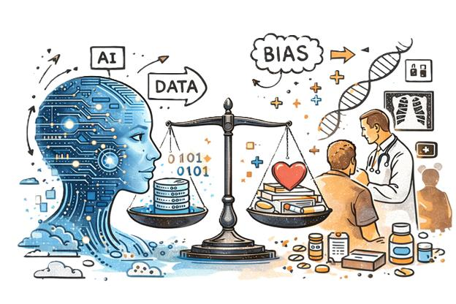
Problem Statement
Main Problems Identified:
Lack of transparency in AI decisions
Incorrect diagnosis risks
Bias in healthcare algorithms
Privacy and cybersecurity concerns
Accountability issues
Overdependence on AI systems
Real-World Example
During COVID-19, some AI systems produced biased or inaccurate predictions due to incomplete training data.

Slide 6

Stakeholders Involved
Patients
Doctors & Nurses
Hospitals
AI Developers
Government Authorities
Society
“Healthcare AI is not only a technical issue — it is also an ethical and social responsibility.”

Slide 7
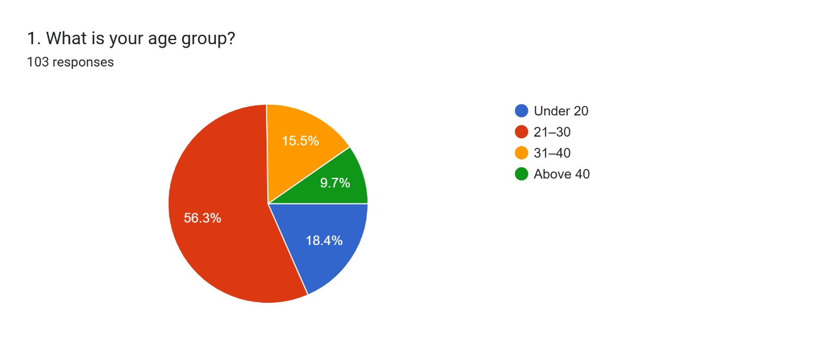
Demographics of Survey
Majority of participants (56.3% or approx. 58 people) are aged 21-30. This indicates a young, tech-aware demographic.

Slide 8
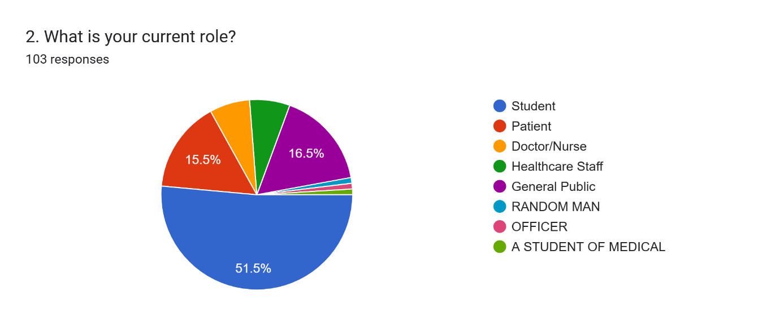
Over half (51.5%) are students, followed by healthcare staff (16.5%) and patients (15.5%)

Slide 9
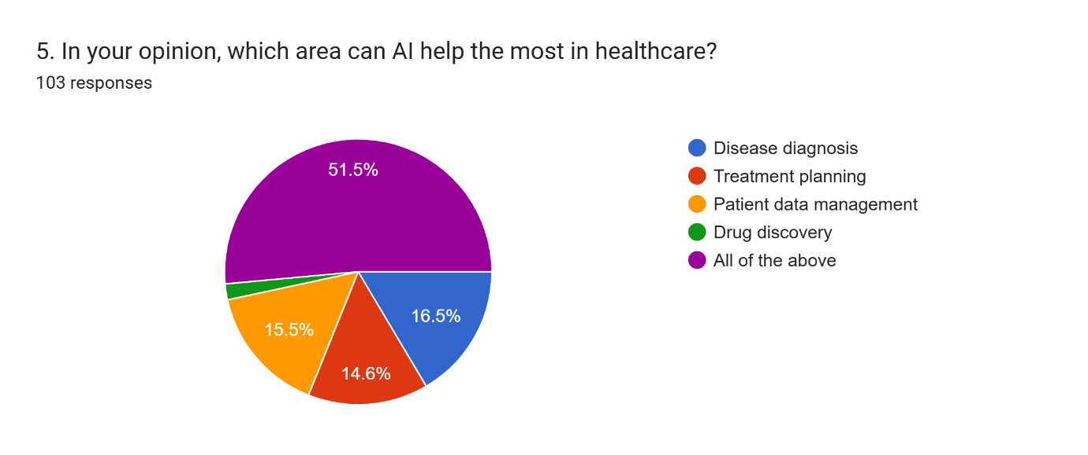
Public Perception on AI Capabilities in Healthcare
51.5% (53 respondents) believe AI helps most across all major areas (Diagnosis, Treatment, & Data Management)

Slide 10
Key Analysis / Findings
Trust, Transparency & Privacy Analysis
Trust in AI Systems:
Most participants “mostly trust” AI
Very few completely trust AI without doctors
Transparency Concerns:
Participants want AI systems to explain decisions clearly
Lack of transparency reduces trust

Slide 11
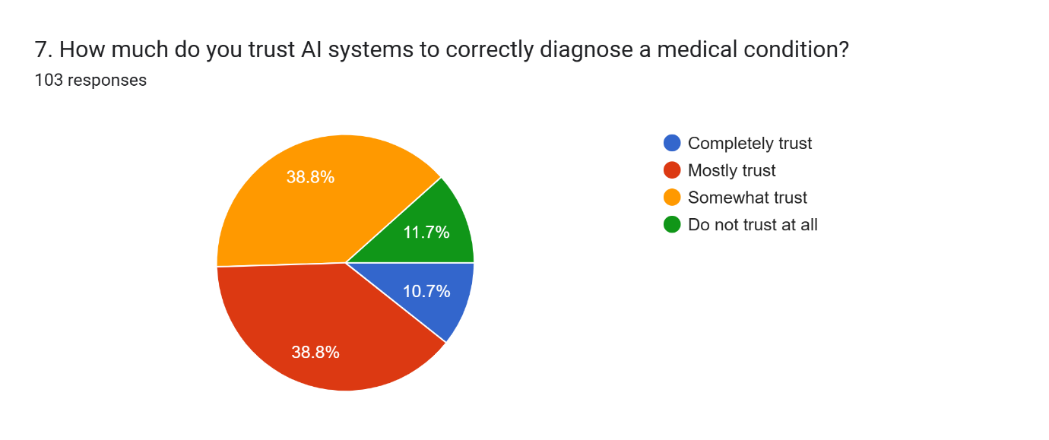
Trust is conditional: 38.8% “Mostly trust” it, while another 38.8% only “Somewhat trust

Slide 12
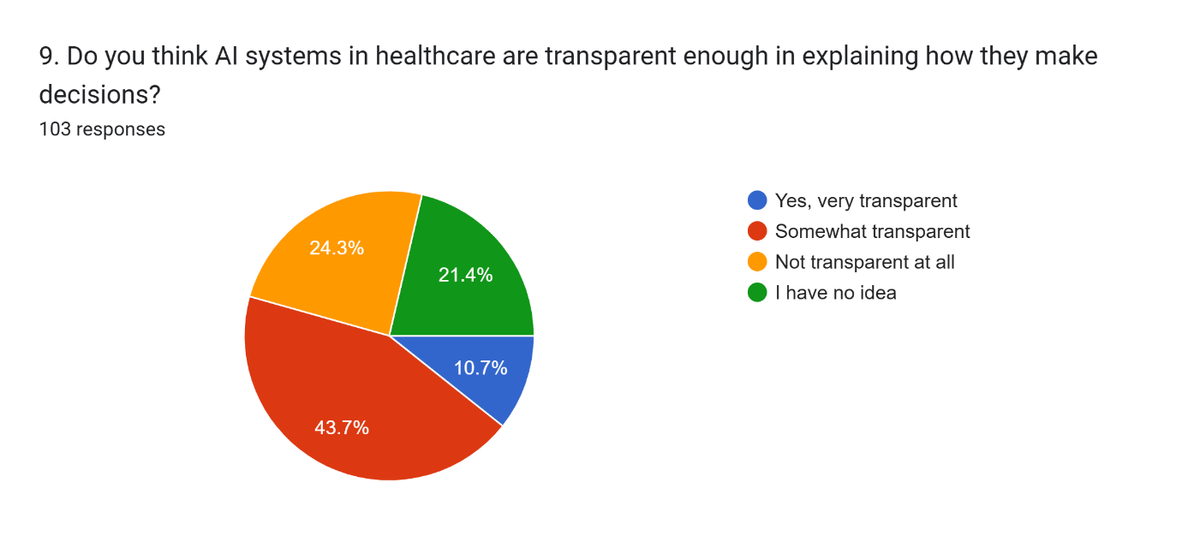
Only 10.7% find AI "Very Transparent." Most feel it is only "Somewhat Transparent" (43.7%).

Slide 13

Key Analysis/Findings
Privacy & Security Concerns:
Participants were worried about:
Data misuse
Security risks
Wrong diagnosis
Privacy breaches
“People support AI benefits, but they still want human supervision and stronger security.”

Slide 14
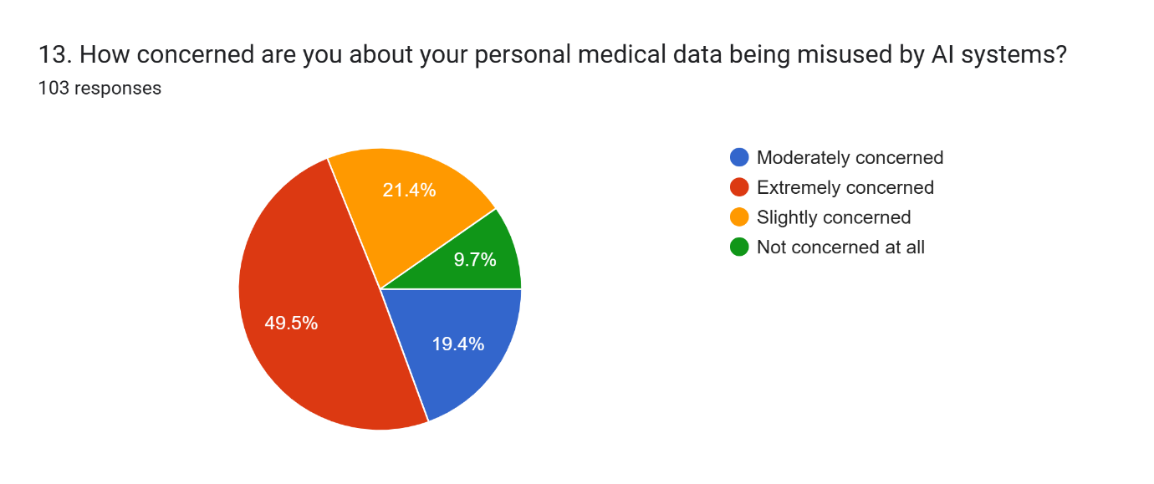
A massive 49.5% (51 respondents) of the participants expressed that they are Extremely Concerned about their personal medical data being misused by AI systems.

Slide 15
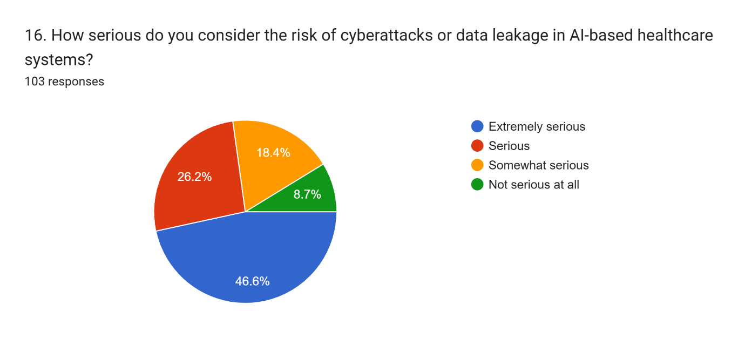
46.6% (48 people) believe the risk of cyberattacks in AI healthcare is Extremely Serious.

Slide 16
Key Findings & Analysis
Accountability & Building Trust
Responsibility for AI Errors
Survey responses showed mixed opinions:
Doctors
Hospitals
AI developers
Government authorities
Building Trust in AI
Participants recommended:
Regular AI testing
Better transparency
Human supervision
Government regulation
Strong cybersecurity
“Trust in AI depends more on ethics and transparency than technology itself.”

Slide 17
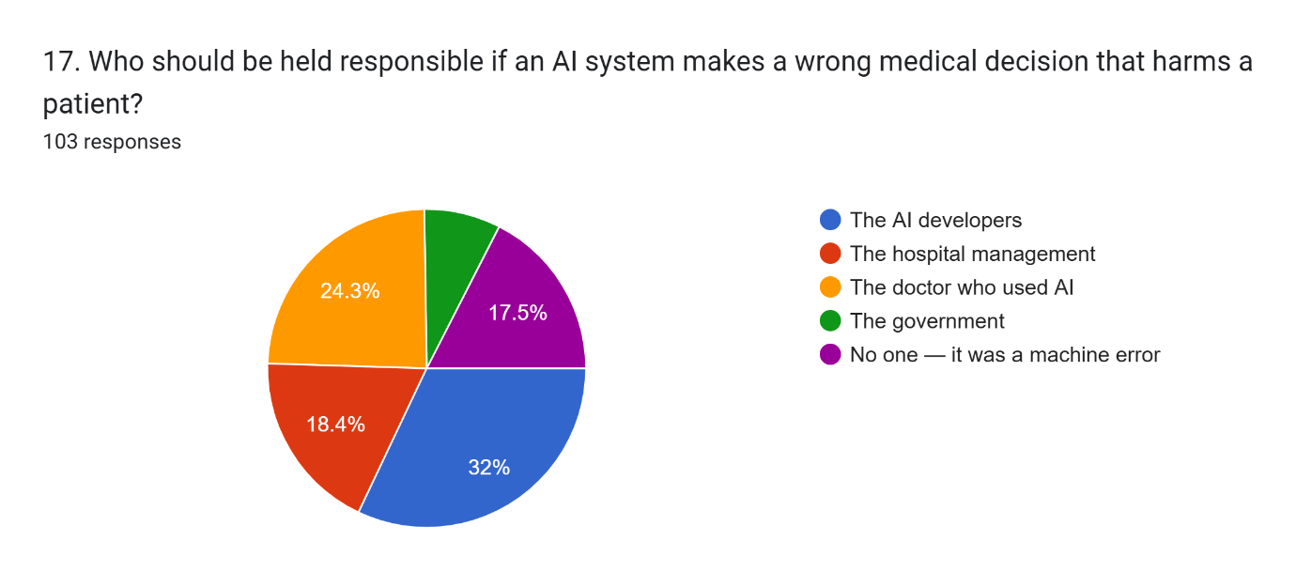
Survey responses show split accountability:
32% blame AI Developers.
24.3% blame the Doctor.
18.4% blame the Hospital.

Slide 18
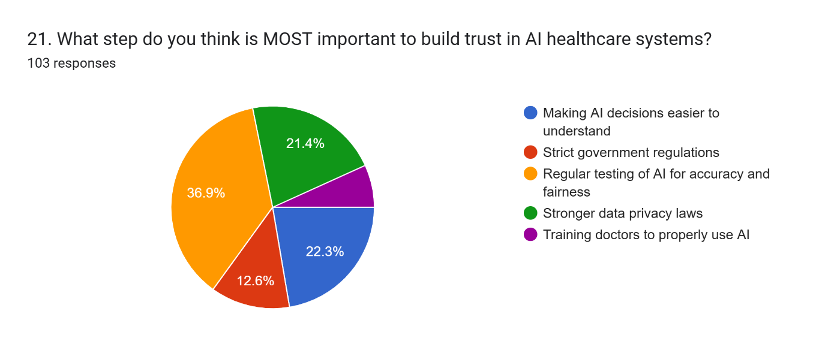
Participants voted for:
36.9% - Regular testing for accuracy.
22.3% - Making decisions easier to understand.

Slide 19
Key Analysis & Findings
Survey Area | Main Finding
Trust in AI | Most participants trust AI only with doctor supervision
Privacy Concerns | Many respondents are worried about misuse of patient data
Transparency | Participants want AI systems to explain decisions clearly
AI-Based Treatment | Most people prefer human confirmation before treatment
Responsibility for Errors | Opinions were divided between doctors, hospitals, and developers
Building Trust | Regular testing and monitoring were considered very important
Trust & Reliability | Respondents believed reliable and accurate AI systems increase public confidence
Professional Responsibility | Participants believed doctors, developers, and hospitals should ensure ethical AI usage

Slide 20
Ethical Analysis
Major Ethical Dilemmas
Patient Privacy: AI systems collect sensitive healthcare data.
Incorrect Diagnosis: Wrong AI decisions can harm patients.
Bias & Discrimination: Biased datasets may produce unfair healthcare outcomes.
Lack of Transparency: Patients may not understand AI decisions.
Overdependence on AI: Too much automation may reduce human judgment.
“Healthcare AI must protect human welfare, not only improve efficiency.”
“Ethics should be integrated into AI systems from the beginning.”

Slide 21
Ethical Issue | Mapping with IEEE / ACM / BCS Codes | Stakeholder Impact
Patient Privacy & Safety | ACM: Respect Privacy, IEEE: Protect Public Welfare | Patients may lose trust in healthcare organizations.
Incorrect Diagnosis | ACM: Avoid Harm, IEEE: Accept Responsibility | Patients can face serious health risks.
Bias and Discrimination | ACM: Be Fair and Avoid Discrimination | Certain groups may receive unequal healthcare services.
Lack of Transparency | IEEE: Be Honest and Transparent | Patients and doctors may not trust AI decisions.
Overdependence on AI | BCS: Protect Public Interest | Quality of patient care may decrease.
Trust & Reliability | ACM: Maintain Trust, IEEE: Ensure System Reliability | Patients and healthcare professionals may hesitate to use AI systems.
Professional Responsibility | IEEE: Accept Responsibility, BCS: Professional Competence and Integrity | Healthcare organizations may face legal action and loss of professional credibility.
“Without ethical standards, AI systems may prioritize efficiency over patient safety.”

Slide 22
Ethical Mapping (Standards)
Ethical Issue | Code (IEEE/ACM/BCS) | Survey Insight
Privacy | ACM: Respect Privacy | 49.5% are extremely concerned about misuse.
Non-Maleficence | IEEE: Protect Welfare | 46.6% see cybersecurity as a critical threat.
Transparency | IEEE: Be Honest | Only 10.7% see systems as "Very Transparent."
Responsibility | BCS: Professional Integrity | Users hold Developers (32%) accountable for errors.

Slide 23

Legal & Societal Issues
PECA (Pakistan Electronic Crimes Act)
Protection against cybercrime
Punishment for data misuse
GDPR
Data privacy
User consent
Transparency
Accountability
Intellectual Property Rights (IPR)
Protection of AI software
Protection of healthcare algorithms

Slide 24
Risks and Compliance Challenges
Major Risks
Data breaches
Biased recommendations
Unsafe AI systems
Weak cybersecurity
Loss of public trust
Compliance Gaps
Technology is growing faster than laws
Limited AI regulations in healthcare
Lack of accountability frameworks
“Advanced technology without ethical control can become dangerous.”

Slide 25
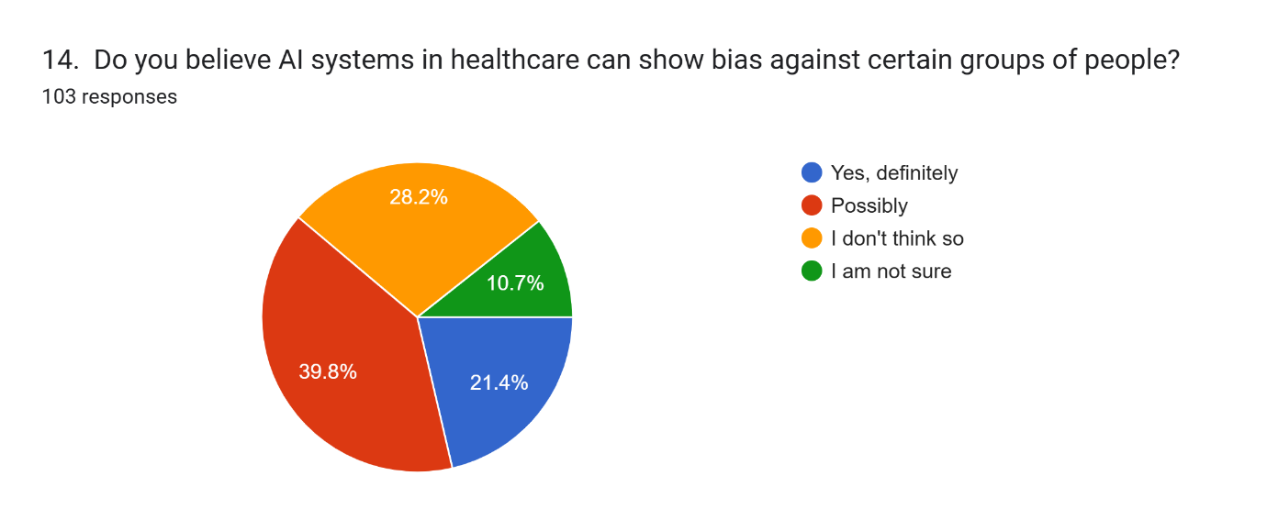
A significant 43.7% (45 respondents) believe that AI systems in healthcare can show bias against certain groups of people, while 34% (35 respondents) are unsure (Maybe).

Slide 26
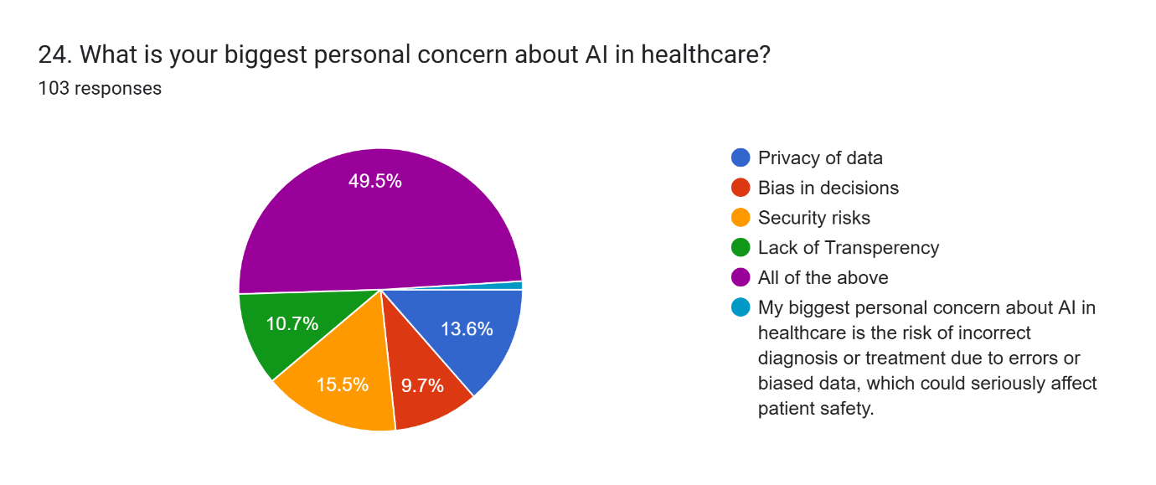
Synthesis of Major Personal Concerns
Nearly half of the participants (49.5% / 51 respondents) identified "All of the Above" (Privacy, Bias, Security, and Transparency) as their biggest collective concern.

Slide 27
Recommendations / Solution
Technical Solutions
Explainable AI systems
Regular AI testing
Strong cybersecurity
Bias detection systems
Legal Solutions
Government regulation
AI certification standards
Accountability policies
“AI should support healthcare professionals, not replace them.”
Ethical Solutions
Human supervision
Ethical AI training
Fair datasets

Slide 28
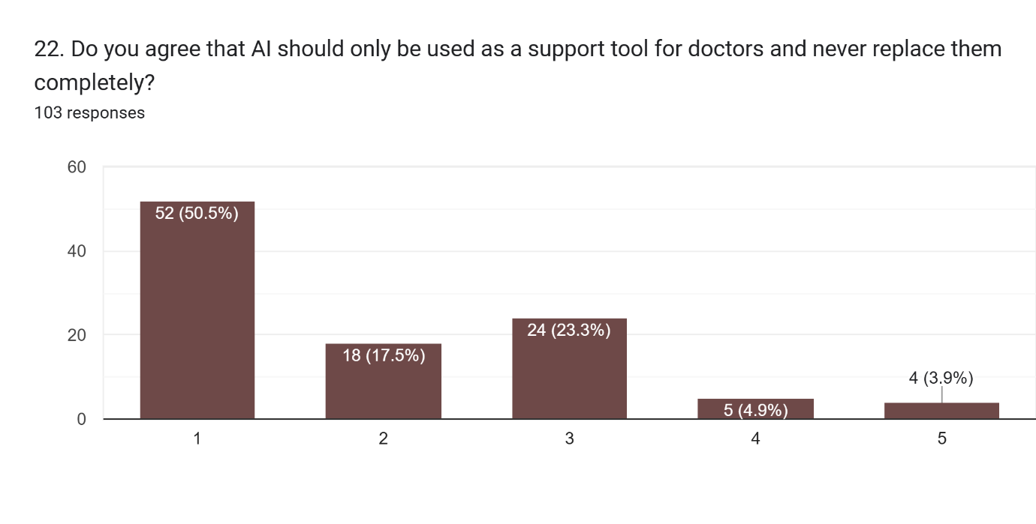
50.5% (52 participants) Strongly Agree that AI should only be a support tool and never replace doctors completely.

Slide 29
Implementation Plan
Step | Action | Responsible Stakeholder
1 | Develop ethical AI policies | Government & Hospitals
2 | Implement cybersecurity systems | IT Teams
3 | Conduct fairness and safety testing | AI Developers
4 | Train healthcare professionals | Hospitals & Universities
5 | Monitor AI performance regularly | Regulatory Authorities

Slide 30
Implementation Plan
Outcomes
Better patient trust
Improved healthcare safety
Reduced bias
Stronger compliance
Strong Presentation Line
“Responsible AI requires balance between innovation, ethics, and human welfare.”

Slide 31
Conclusion & Key Takeaways
Conclusion
AI can improve healthcare efficiency.
Trust and ethics remain major concerns.
Human supervision is still necessary.
Transparency and privacy are critical.
Key Takeaway
Responsible AI development is necessary for safe and trusted healthcare systems.
“Technology should serve humanity, not replace human responsibility.”

Slide 32
Personal Reflection & Learning
Skills Gained
Research skills
Survey analysis
Ethical reasoning
Communication skills
Critical thinking
Challenges Faced
Connecting ethics with technology
Understanding legal issues
Analyzing public trust concerns
Workplace Readiness
This project improved our understanding of professional responsibility and responsible technology development and taught us that successful technology must also be ethical and trustworthy.

Slide 33
References
Survey Link:
https://docs.google.com/forms/d/e/1FAIpQLSeo1Zu8iaUNzXONG6b9iKxKDkNgkmtrC1k5jq4HDH6zmEVLwg/viewform?usp=publish-editor
ACM Code of Ethics
IEEE Code of Ethics
BCS Code of Conduct
Sara Baase — A Gift of Fire
Deborah Johnson — Computer Ethics
WHO Reports on AI in Healthcare
GDPR Documentation
PECA Documentation

Slide 34
Thank You
“The future of healthcare depends not only on intelligent systems, but also on ethical and trustworthy systems.”

