Slide 1

羅馬
ROMA
Where the world's roads meet
A new color direction — presentation

Slide 2

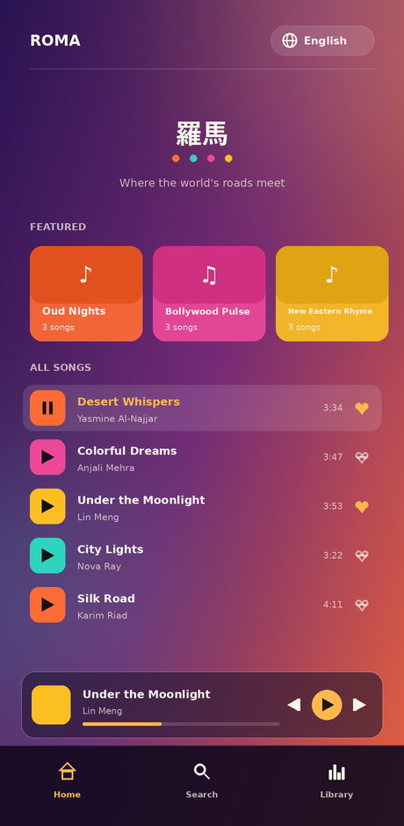
A warmer, more inviting palette
The interface moved from a neutral dark theme to a sunset gradient with four vivid culture accents. The goal: a first impression that feels energetic and welcoming — pulling listeners in — while keeping text and controls easy to read.
Energy at first glance
A gradient background and warm gold accent feel alive, not clinical.
One color per culture
Arabic, English, Hindi and Chinese each keep a distinct, vivid identity mark.
Contrast preserved
Cream text and translucent surfaces stay legible over the gradient.

Slide 3
Palette
One accent for interaction, four culture marks, one background gradient.
Accent
Arabic
English
Hindi
Chinese
#FFB84D
#FF6B35
#2DD4BF
#EC4899
#FBBF24
Background gradient
linear-gradient(165deg, #2A1454 → #7A2C7A → #E8623C)

Slide 4
Home screen
Featured playlists
Four culture-rooted playlists, each with its own accent color and cover.
Full track list
Play, pause and like controls with a clear active-track highlight.
Persistent mini player
Progress bar and transport controls stay pinned above navigation.
Bottom navigation
Home, Search and Library — the active tab always reads in the accent gold.

Slide 5
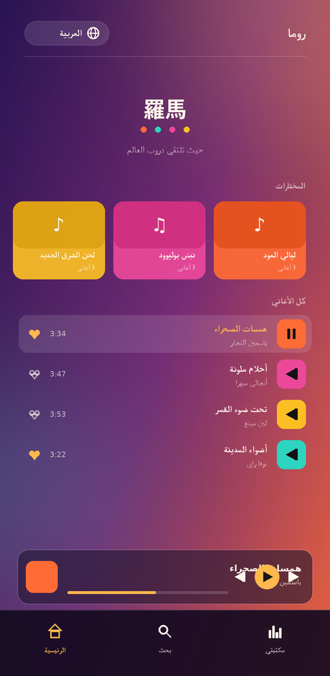
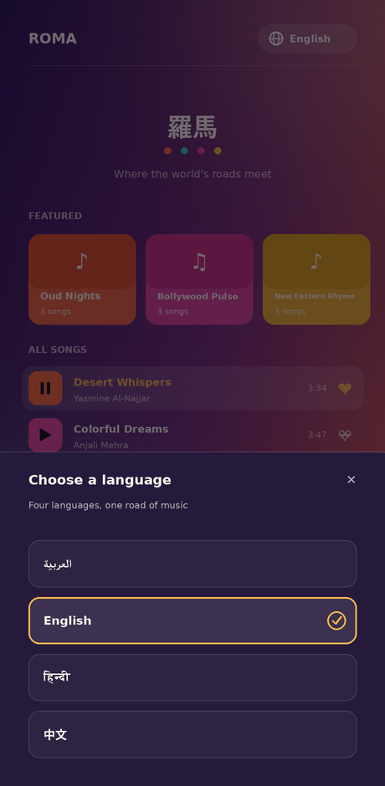
Built for four languages, not translated after the fact
Arabic mirrors the entire layout — header, cards, track rows and navigation — rather than just flipping the text. One tap on the globe button opens every language by its native name.
Arabic — right-to-left layout
Language switcher

Slide 6
Ready for the next step
Full project source, mock API and translations are ready in the roma-app package.

