Slide 1


Wine quality dataset
Predict the quality of wine

Slide 2


ANTICIPATE THE QUALITY OF WINE
This datasets is related to red variants of the Portuguese "Vinho Verde" wine.
The dataset describes the amount of various chemicals present in wine and their effect on it's quality.
Task is to predict the quality of wine using the given data.

Slide 3

Solution
1
2
3
DATA
FEATURE ENGINEERING
EXPLORATORY DATA ANALYSIS
4
5
DATA PREPROCESSING
MODEL

Slide 4
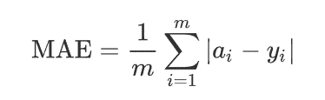
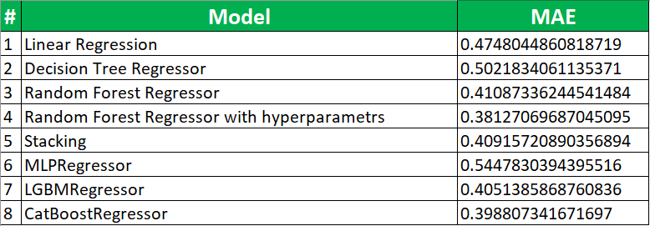
Metrics

Slide 5
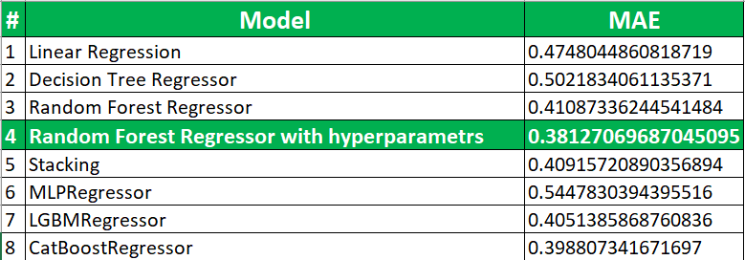
Conclusion

