Slide 1
Temperature Nowcasting
1‑hour graph‑based forecasting with GCN over New York State

Slide 2
Introduction
Create a reproducible graph-based nowcasting model that predicts the next hour of weather for a fixed set of cities in New York State. Each city is treated as a graph node. To attach observations to a node, we map the city’s latitude/longitude to its nearest meteorological station and use that station’s hourly measurements as the city’s input signal. Edges connect geographically close cities (k-nearest neighbours), allowing the model to propagate information across locations that influence one another (e.g., fronts moving from Syracuse toward Utica/Rome).
The task is node-level prediction: for every city and at every inference step, the model forecasts 1 hour ahead the key surface variables needed for quick operational decisions—air temperature, wind speed, relative humidity, and snowfall rate. We focus on a one-hour horizon because it maximally benefits from the most recent observations while keeping physical dynamics locally coherent; this makes GCNs effective, as they aggregate each city’s recent time window with its neighbours' context.
Training uses historical hourly data; at run time the system fetches live observations for the same cities, builds the latest window, and outputs the next-hour predictions for every node. The goal is not to beat large forecasting systems, but to deliver a clear, interpretable, and fast baseline that demonstrates how spatial graph structure + recent history can produce useful city-level nowcasts.

Slide 3
Cities as Nodes
Predictions are produced per city. Below is the working set used in examples and outputs.
The pattern is “City Name, State (longitude, latitude)”. The “lon” and “lat” for the list below were taken from the nearest stations from each city.
Utica, NY (43.1009, -75.2327), Rome, NY (43.2128, -75.4557), Newport, NY (43.1906, -75.0179), Herkimer, NY (43.0256, -74.9854), Oneida, NY (43.0810, -75.6524), Syracuse, NY (43.0500, -76.1500), Cicero, NY (43.1758, -76.1142), Auburn, NY (42.9320, -76.5672), Cortland, NY (42.6012, -76.1805), Oneida, NY (43.0810, -75.6524), Albany, NY (42.6526, -73.7562), Troy, NY (42.7300, -73.6700), Schenectady, NY (42.8100, -73.9400), Saratoga Springs, NY (43.0830, -73.7840), Hudson, NY (42.2529, -73.7910), Buffalo, NY (42.8864, -78.8784), Niagara Falls, NY (43.0962, -79.0377), Lockport, NY (43.1706, -78.6903), Hamburg, NY (42.7159, -78.8295), Batavia, NY (42.9981, -78.1875), Rochester, NY (43.1610, -77.6109), Greece, NY (43.2098, -77.6931), Henrietta, NY (43.0364, -77.6120), Canandaigua, NY (42.8861, -77.2817), Batavia, NY (42.9981, -78.1875), Binghamton, NY (42.0987, -75.9180), Johnson City, NY (42.1156, -75.9588), Endicott, NY (42.0984, -76.0494), Owego, NY (42.1034, -76.2622), Norwich, NY (42.5312, -75.5235), New York City, NY (40.7143, -74.0060), Yonkers, NY (40.9312, -73.8987), New Rochelle, NY (40.9115, -73.7824), White Plains, NY (41.0340, -73.7629), Hempstead, NY (40.7062, -73.6187), Ithaca, NY (42.4440, -76.5019), Cortland, NY (42.6012, -76.1805), Dryden, NY (42.4909, -76.2972), Trumansburg, NY (42.5377, -76.6560), Watkins Glen, NY (42.3806, -76.8733), Watertown, NY (43.9748, -75.9108), Sackets Harbor, NY (43.9464, -76.1178), Adams, NY (43.8092, -76.0241), Carthage, NY (43.9781, -75.6094), Lowville, NY (43.7867, -75.4919), Binghamton, NY (42.0987, -75.9180), Johnson City, NY (42.1156, -75.9588), Endicott, NY (42.1018, -76.0528), Owego, NY (42.1044, -76.2633), Norwich, NY (42.5319, -75.5217)

Slide 4

Methodology and workflow
We represent New York State as a weighted k-nearest-neighbors graph where each node is a city and edges connect geographically close cities. Using great-circle distances between city coordinates, we compute a weight matrix $W$(higher weight = closer cities) and then build the normalized adjacency $\hat{A}$ by adding self-loops and normalizing by node degrees. This matrix is precomputed once from the chosen city list and graph settings (e.g., $k$, distance kernel) and saved as A_hat.npy. The file stores the full $N×N$ matrix used by the GCN to mix each city’s signal with its neighbors at every forward pass.
For each city, the input window is the last $L$hourly observations (air temperature, wind speed, relative humidity, snowfall rate) taken from the city’s nearest weather station. A small temporal CNN compresses that $L×\text{features}$ history into a fixed-size vector. This is all combined into a summary with the trainable embedding of the city to form the current node state. A two-layer GCN then propagates information across the graph using $\hat{A}$, and a final linear head produces the 1-hour-ahead node-level forecast (temperature, wind speed, humidity, snowfall rate).

Slide 5
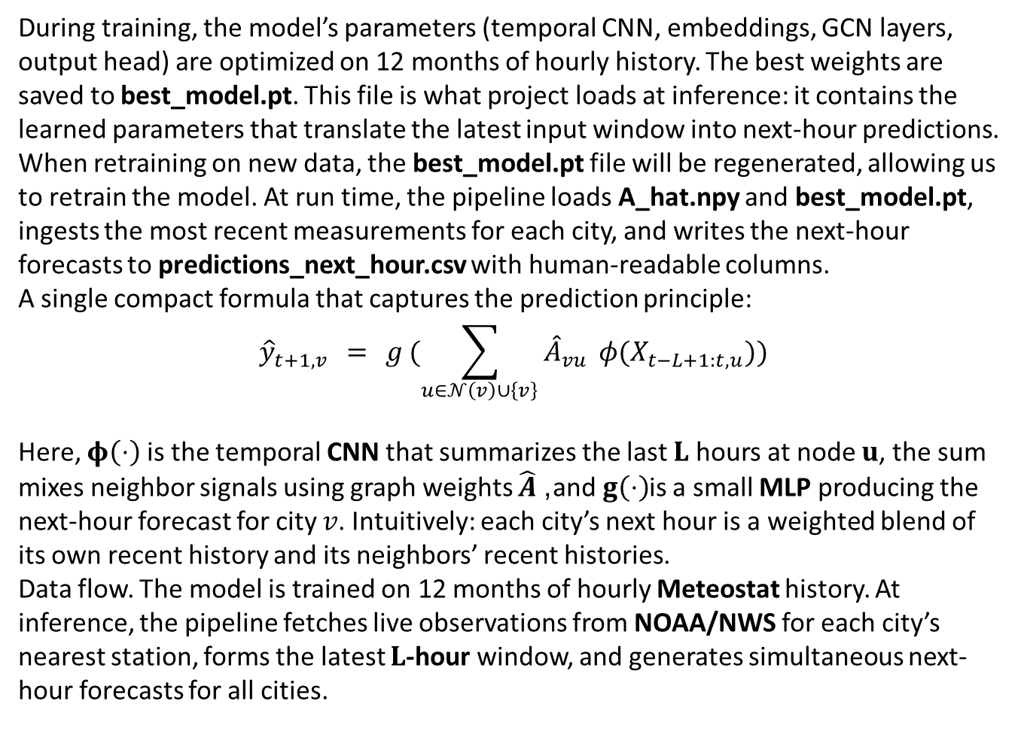
During training, the model’s parameters (temporal CNN, embeddings, GCN layers, output head) are optimized on 12 months of hourly history. The best weights are saved to best_model.pt. This file is what project loads at inference: it contains the learned parameters that translate the latest input window into next-hour predictions. When retraining on new data, the best_model.pt file will be regenerated, allowing us to retrain the model. At run time, the pipeline loads A_hat.npy and best_model.pt, ingests the most recent measurements for each city, and writes the next-hour forecasts to predictions_next_hour.csv with human-readable columns.
A single compact formula that captures the prediction principle:
$${\hat{y}}_{t+1,v} = g (\sum_{u∈𝒩\left(v\right)∪\left\{v\right\}}{{\hat{A}}_{vu}} φ(X_{t−L+1:t,u}))$$
Here, $φ\left(⋅\right)$ is the temporal CNN that summarizes the last $L$ hours at node $u$, the sum mixes neighbor signals using graph weights $\hat{A}$, and $g\left(⋅\right)$is a small MLP producing the next-hour forecast for city $v$. Intuitively: each city’s next hour is a weighted blend of its own recent history and its neighbors’ recent histories.
Data flow. The model is trained on 12 months of hourly Meteostat history. At inference, the pipeline fetches live observations from NOAA/NWS for each city’s nearest station, forms the latest $L$-hour window, and generates simultaneous next-hour forecasts for all cities.

Slide 6
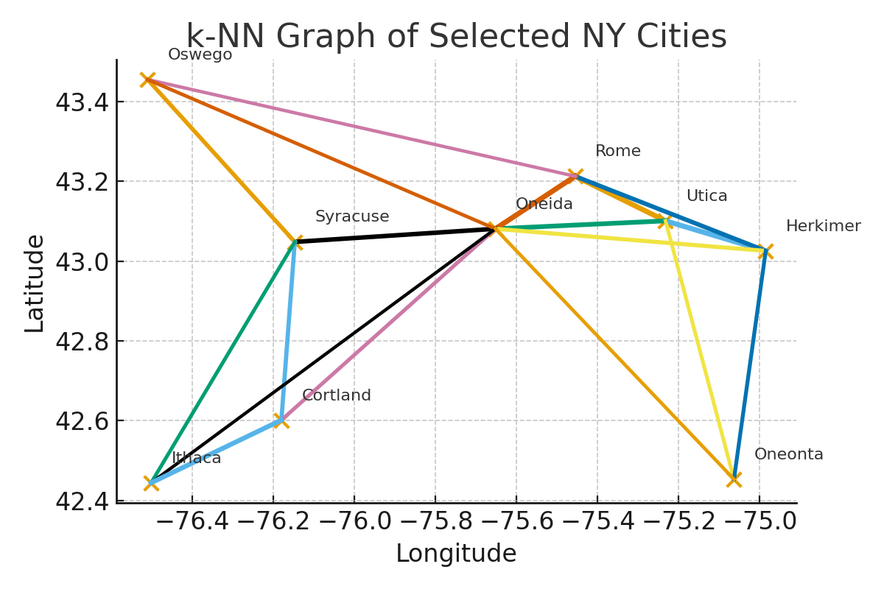
Output:
Predictions are written to “predictions_next_hour.csv” with columns (temperature in °F, wind in m/s, humidity in %, snowfall in mm/h).
• This k-NN graph represents several cities as nodes from our list, their actual locations,
and the connections between them.

Slide 7
Data Source
The model was trained on 12 months of hourly historical weather from Meteostat (accessed via RapidAPI) for the selected New York State cities. For each city, the nearest observation station was identified by latitude/longitude, and its hourly measurements were aggregated into a node time series. At inference time, the pipeline pulls live observations from NOAA / National Weather Service (NWS) to build the most recent window and produce the next-hour forecast.
Historical (training) data — Meteostat (via RapidAPI).
The endpoints for station’s data, typically:
GET /point/hourly?lat={lat}&lon={lon}&start={YYYY-MM-DD}&end={YYYY-MM-DD}&tz=UTC&units=metric&model=true
GET /stations/nearby?lat={lat}&lon={lon}&radius=...&limit=1
Meteostat via RapidAPI. Sign-up is straightforward and not covered here.

Slide 8
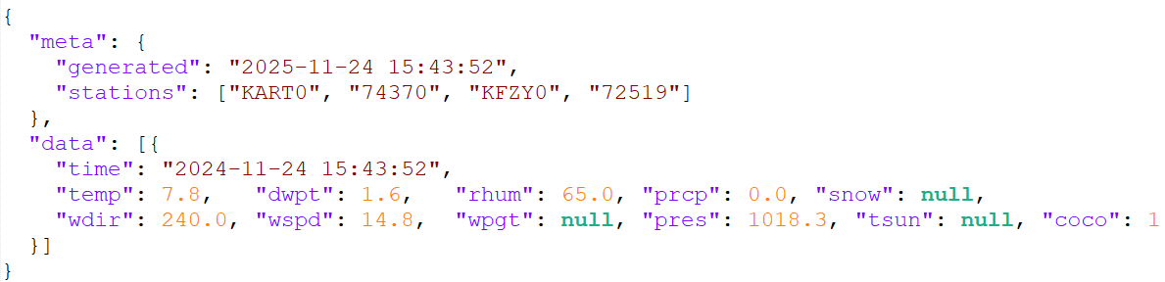
Live (inference) data — NOAA / NWS.
GET /points/{lat},{lon} → gives the responsible grid and the list of nearby stations
GET /stations/{STATION_ID}/observations/latest → returns the latest observation used to close the input window
Example Meteostat JSON (hourly history).
(The sample below shows the structure JSON data for training.)

Slide 9
Fields for which the data would be predicted (per node, hourly):
temp — air temperature, °C (converted to °F).
wspd — wind speed, km/h (converted to m/s).
rhum — relative humidity, %.
snow — snowfall proxy, mm (treated as mm/h rate when available).
The “predictions_next_hour.csv” report contains node-level next-hour predictions with human-readable columns.
Output columns in CSV file:
Node Name — city name (graph node).
Future Date — New York local time, rounded to the hour, +1 hour
Air temperature (F) — predicted next-hour temperature in °F
Wind Speed (m/s) — predicted next-hour wind speed (m/s)
Humidity (%) — predicted next-hour relative humidity
Snowfall (mm/h) — predicted next-hour snowfall rate

Slide 10
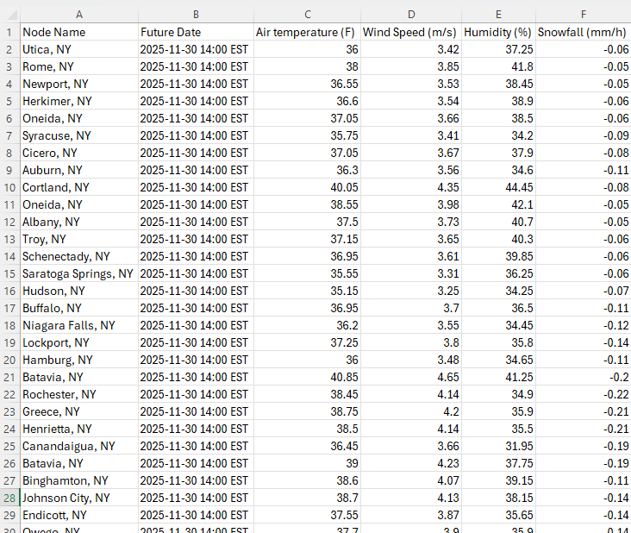
Sample Output (CSV)

Slide 11
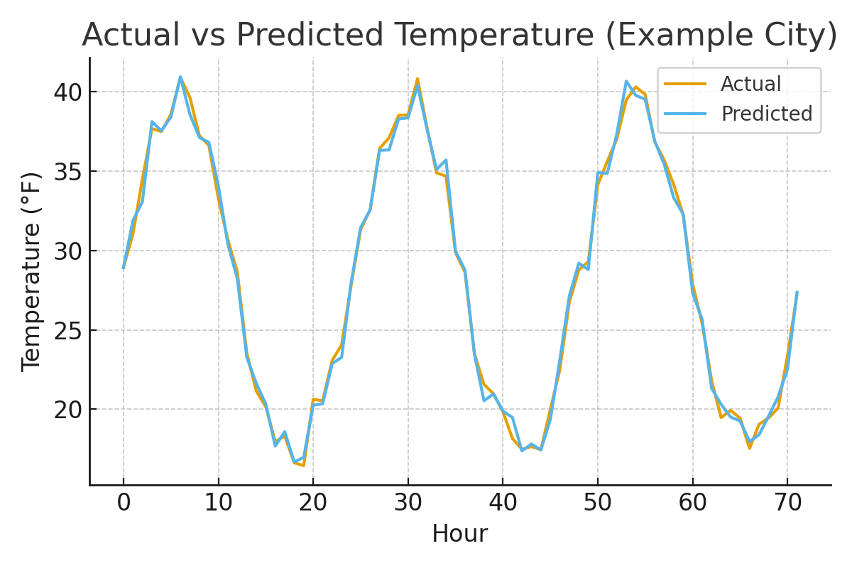
Conclusion and results
Actual vs Predicted temperature for a sample city (small residual error).

