Slide 1
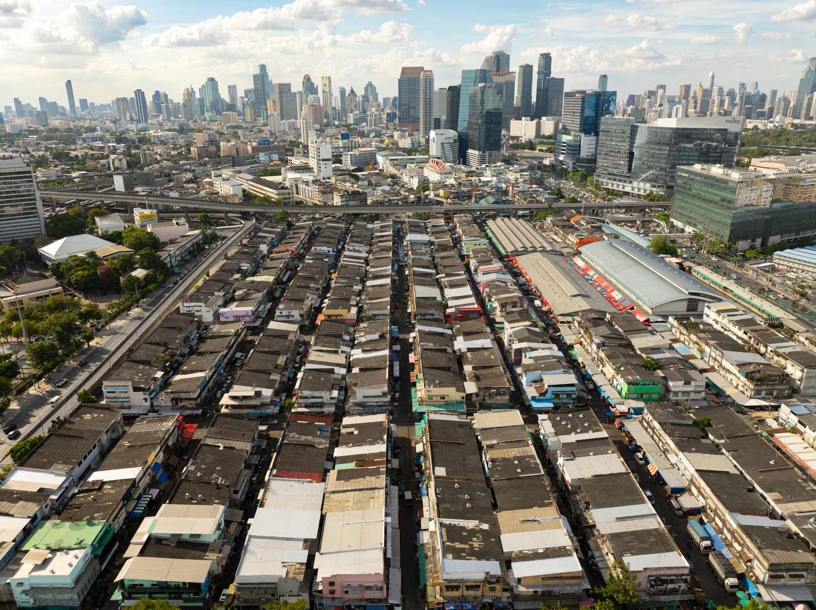
GISTDA GEOHACKATHON 2026
Pixels 2 Metro Policy
A Geospatial Analysis Framework and Methodological Toolkit for Revealing Hidden Challenges in Bangkok’s Informal Settlements
Community records + building evidence + Satellite image
Khlong Toei, Bangkok / Photograph: Unequal Scenes
Notes:
SLIDE 1 | 0:00–0:25
Where should Bangkok send its next field team? That is the decision behind Pixels to Metro Policy. Community records and building data describe the same city in different ways. We bring them together so a planning team can see where the evidence disagrees and decide what needs checking on the ground.
SOURCE: EN slides 1, 12–13; Final_v3 slide 9. Cover photograph: Unequal Scenes, Bangkok, https://unequalscenes.com/bangkok ; 1920 × 1438 source https://unequalscenes.com/img/bangkok/bangkok-01-1920-689fcb0a.jpg . Photo retained with attribution; no open licence asserted.
Q&A / EVIDENCE LIMITS:

Slide 2
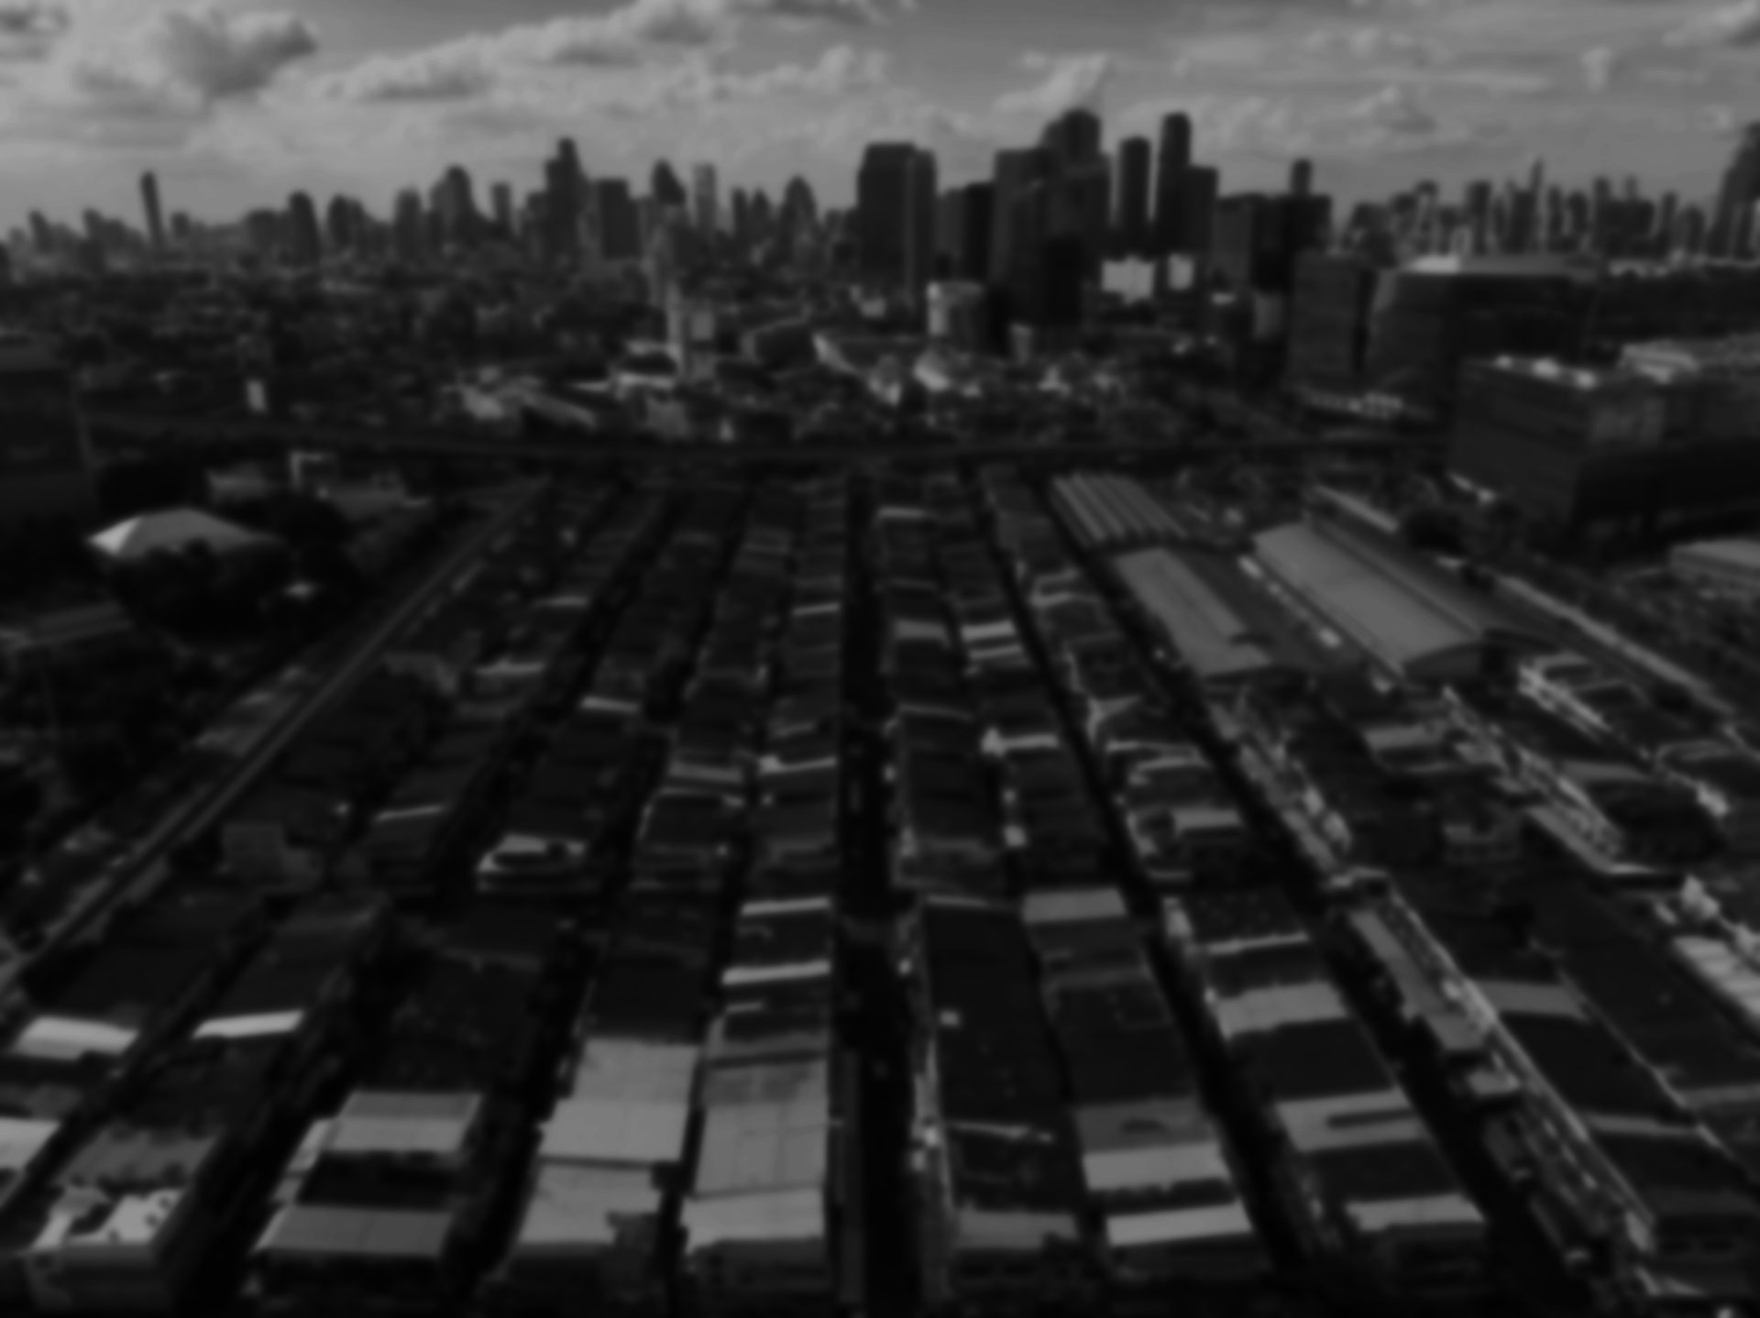
.
Main message
Data used on local level of metropolitan planning and management often is outdated, fragmented and biased
– real challenge for modern local urban governance. Metropolises change every day.
Pixels2MetroPolicy
Identify
analyze
Understand
Communicate
Act
Interactive tool for metropolitan planning and management
- identifies slum and sensitive neighborhoods with slum-like risks.
- aggregates everyday data from statistic sources and social media, scores risks and makes ranking of problems in identified neighboorhoods.
- proposes range of policy toolkits (from the World’s case studies) to be applied by decision of metropolitan governance body
PIXELS TO METRO POLICY / GEOHACKATHON 2026
02
Notes:
SLIDE 2 | 0:25–1:00
The first reason to investigate is a mismatch between public records. In the supplied spatial comparison, 1,135 of 1,588 National Housing Authority low-income community points fall outside every Bangkok community polygon. These are already recorded places. Different dates, definitions or boundary geometry may explain the difference. But a planner needs to see that disagreement before relying on either layer alone. Our starting point is reconciliation: making an incomplete picture visible and traceable.
SOURCE: EN slide 4; Final_v3 slide 2.
Q&A / EVIDENCE LIMITS: NHA points: 1,135 outside + 325 inside congested + 128 inside other = 1,588. BMA polygon snapshot has 1,993 features, distinct from live register 1,994. No claim that 1,135 are unregistered slums.

Slide 3
The city’s housing records do not line up
NHA low-income locations and BMA community boundaries describe different sets of places.
71%
of NHA points fall outside
BMA community polygons
Planning use
Reconcile source dates and boundaries
before treating a record gap as a new settlement.
1,588 NHA points compared
A cross-register mismatch. Different dates, definitions and boundaries can explain the gap.
PIXELS TO METRO POLICY / GEOHACKATHON 2026
02
Notes:
SLIDE 2 | 0:25–1:00
The first reason to investigate is a mismatch between public records. In the supplied spatial comparison, 1,135 of 1,588 National Housing Authority low-income community points fall outside every Bangkok community polygon. These are already recorded places. Different dates, definitions or boundary geometry may explain the difference. But a planner needs to see that disagreement before relying on either layer alone. Our starting point is reconciliation: making an incomplete picture visible and traceable.
SOURCE: EN slide 4; Final_v3 slide 2.
Q&A / EVIDENCE LIMITS: NHA points: 1,135 outside + 325 inside congested + 128 inside other = 1,588. BMA polygon snapshot has 1,993 features, distinct from live register 1,994. No claim that 1,135 are unregistered slums.

Slide 4
Community boundaries, housing projects and risk
The layers connect settlement geography with housing programmes and assessed fire risk.
PIXELS TO METRO POLICY / GEOHACKATHON 2026
03
Notes:
SLIDE 3 | 1:00–1:35
This map connects community boundaries with housing programmes and assessed fire risk. Orange polygons show 626 registered congested communities. Blue points locate 177 Baan Mankong projects. Red markers identify six communities assessed at high or critical fire risk. These are different evidence layers: a project point is not a project boundary, and an assessed risk is not a recorded fire. Together they help a planning team frame location-specific questions for the next field visit.
SOURCE: EN slides 2–3 and 12; HTML Baan Mankong coordinates; BMA FeatureServer/14 boundary layer downloaded 16 Oct 2026. Fire assessments 2568.
Q&A / EVIDENCE LIMITS: Toolkit capabilities and counts are reported by source deck. No live demo or performance benchmark was independently rerun for this presentation. Map overlays 1,993 official community polygons, including 626 congested, with 177 project locations from HTML. Project points are not project boundaries. Red markers show risk assessments, not actual fire incidents. Layer dates differ. Boundary source: https://cpudgiapp.bangkok.go.th/arcgis/rest/services/Community/Service_Community/FeatureServer/14

Slide 5
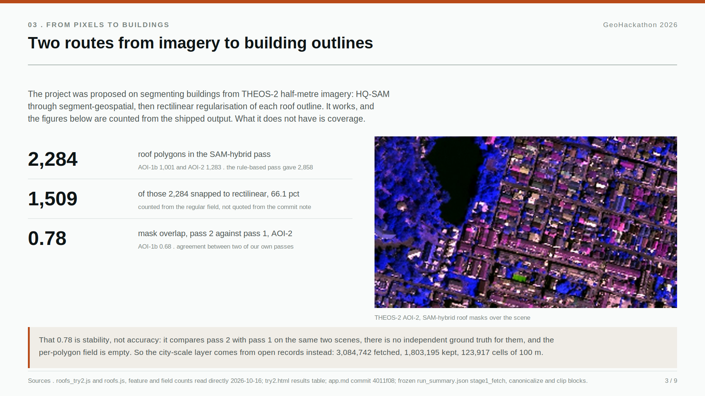
Citywide screening produces a review queue
Local satellite segmentation and the citywide building model use separate inputs and serve different scales.
SEPARATE CITYWIDE PIPELINE
1.80M footprints
Open building records clipped to the study area
123,917 grid cells
Building patterns summarized at 100 m resolution
244 review areas
Clusters retained after register and distance filters
THEOS-2 roof extraction
Output supports a survey queue; validation is pending.
2,284 polygons across two scenes
PIXELS TO METRO POLICY / GEOHACKATHON 2026
04
Notes:
SLIDE 4 | 1:35–2:15
We tested two scales. A local THEOS-2 experiment extracted 2,284 roof polygons across two scenes. The citywide run uses a separate open building dataset: 1.8 million footprints across the study boundary. It summarizes building patterns into roughly 124,000 hundred-metre cells, then applies model and spatial filters. The frozen output is 244 candidate areas. That turns a citywide search into a finite review queue. The imagery experiment and the citywide screening use different inputs, so we report them separately.
SOURCE: EN slides 5–6; Final_v3 slides 3–4.
Q&A / EVIDENCE LIMITS: Exact footprints 1,803,195. Screening reported 4,372 cells, reconstruction 4,361. After register mask 2,926 cells. Cluster and NHA distance filters produce 244. Six generating scripts were absent from the supplied archives per Final_v3, so do not claim full reproducibility. THEOS-2 overlap measures internal stability, not external accuracy.

Slide 6
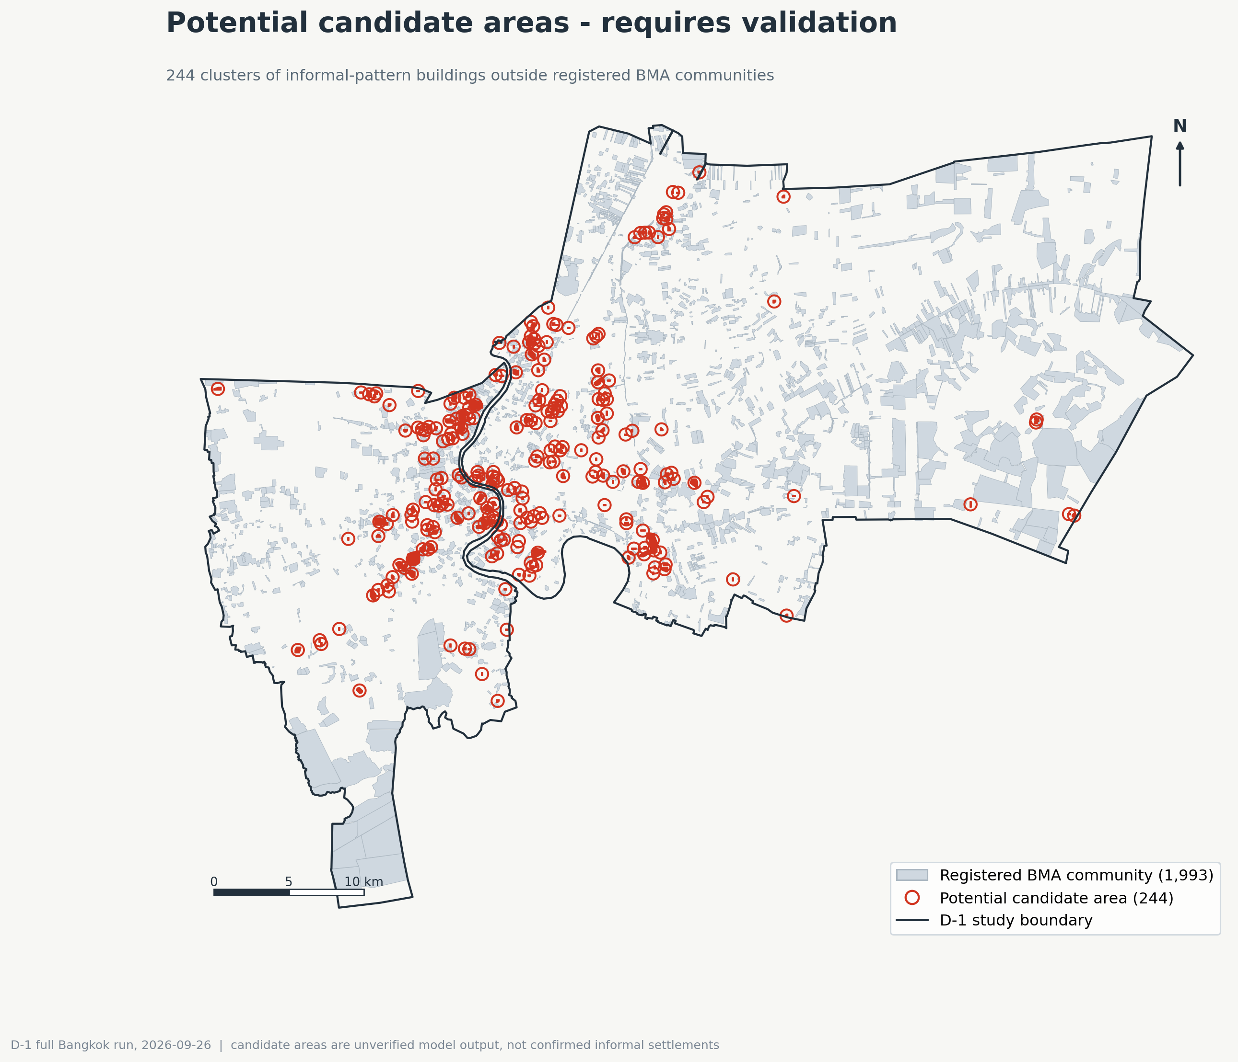
244 areas to check, with boundaries to reconcile
The final polygon check separates areas with no register overlap from areas needing boundary review.
154 areas: inspect evidence beyond the register
90 areas: reconcile overlapping boundaries
Use together with existing registered communities.
Unranked screening output. Zero independently confirmed settlements.
PIXELS TO METRO POLICY / GEOHACKATHON 2026
05
Notes:
SLIDE 5 | 2:15–2:50
Here is the candidate map. A check of the final candidate polygons shows that 154 have no overlap with registered community polygons, while 90 overlap at least one. Those 90 need boundary reconciliation. This distinction matters because a filter applied to analysis cells does not by itself establish the status of a final area. All 244 remain unranked screening outputs. We have independently confirmed zero settlements. The map gives the next investigation a defined geography and an explicit uncertainty.
SOURCE: EN slide 8; candidate map from EN slide 8.
Q&A / EVIDENCE LIMITS: Original figure subtitle says candidates outside registered communities. Cropped title/subtitle and replaced with the final polygon audit: 154 no overlap and 90 any overlap, including 55 congested. Map markers locate candidates, not hazard or priority levels.

Slide 7
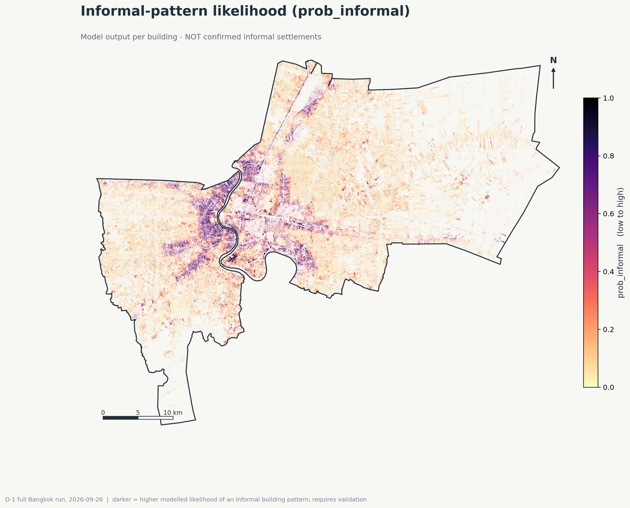
The audit changed what we could claim
Scores show resemblance to patterns in the training labels. Independent evidence must establish local conditions.
Spatial validation limits classification; a corrected join changes how buildings count inside communities.
MODEL PERFORMANCE
Darker areas indicate a higher
modelled building-pattern score.
Spatial AUC 0.733
Below the gate for classification
*The map does not establish
poverty, tenure or legality.
AUC measures discrimination across held-out districts.
Registration-derived labels do not establish settlement status.
A counting correction, not newly detected buildings. Independent settlement validation remains open.
PIXELS TO METRO POLICY / GEOHACKATHON 2026
06
Notes:
SLIDE 6 | 2:50–3:35
We also tested the limits of the evidence. The model achieved a spatial cross-validation AUC of 0.733, below our pre-set 0.80 gate. It is not ready to classify settlement status. Separately, an audit found that 46 registered communities appeared to contain zero buildings because the original method counted grid-cell centres. Counting intersecting building footprints instead produced 1,688 buildings in those same communities. We corrected the interpretation. Nothing new appeared on the ground. This is why the counting rule and the model limits belong beside the map.
SOURCE: EN slides 7 and 10; Final_v3 slides 5 and 7.
Q&A / EVIDENCE LIMITS: AUC exact .7327 from 5 district folds. Registration-derived labels measure resemblance to register patterns, not poverty, tenure or legal status. 46 communities hold 5,227 recorded households and 16,769 residents. The correction is attribution, not detection gain. Screening minimum resolution around 1–2 ha.

Slide 8
SEA evidence: fire risk by community
Assessment year 2568: 2 critical and 4 high-risk communities. Three are in Wang Thong Lang.
N ↑
1. Nom Klao
Wang Thong Lang / Critical
2. San Chao A Niao
Khlong San / Critical
6
3. Rim Khlong Phra Khanong
1
Khlong Toei / High
4
4. Rim Khlong Lat Phrao
Wang Thong Lang / High
2
5. Mi Suwan Phatthana
3
Bang Khae / High
5
6. Surao Don Sakae
5 km
Wang Thong Lang / High
Grey points: community locations. Coloured districts contain the six assessed communities.
PIXELS TO METRO POLICY / GEOHACKATHON 2026
09
Notes:
BACKUP ONLY. Outside the five-minute pitch. Source: HTML fire-risk assessments 2568 and community locations 2567. Six high/critical communities, three in Wang Thong Lang. These are risk classifications, not confirmed fire incidents. Thai community names retained for accurate identification.

Slide 9
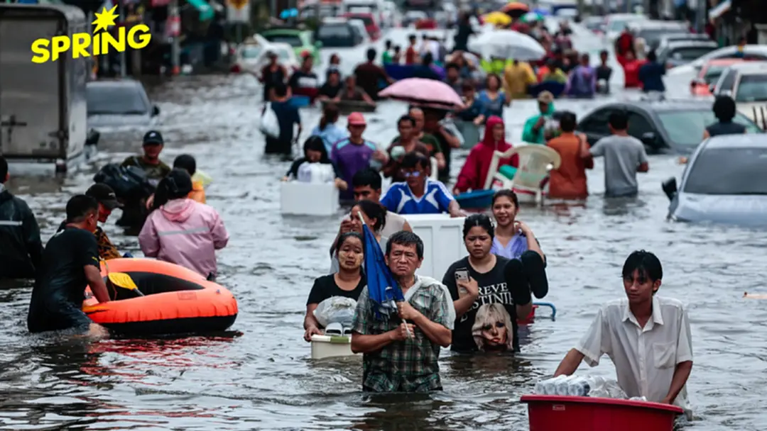
SEA evidence: communities outside flood walls
More than 11 registered informal communities, 320 households and about 1,070 people outside the flood walls.
N ↑
01
Ratchapha Thapthim Ruam Chai
02
Thewarat Kunchon
1
03
Tha Wang
04
Mata Nuson
05
Behind Charoen Krung Hospital
3
06
Soi Wat In Ban Chong
11
07
Wat Bang Khlo Nok
08
Rice Mill, Rama III Road
09
Wat Dusit Nimit Mai
10
End of Soi Charoen Krung 29/2
4
8
11
Chang Nak–Saphan Yao
6
Six coordinate matches in the available file. Five locations remain unmatched or unconfirmed.
5 km
PIXELS TO METRO POLICY / GEOHACKATHON 2026
10
Notes:
BACKUP ONLY. Outside the five-minute pitch. Source: HTML and supplied notes, November 2568. Eleven communities, 320 households, about 1,070 people. Only six names matched to coordinates in the available file. Unmatched does not mean the city lacks coordinates. Thai names retained.

Slide 10
SEA evidence: household burdens
Limited income and shared utility meters can compound household vulnerability.
MONTHLY INCOME PER PERSON
ELECTRICITY COST PER UNIT
Baht per person per month
Bang Na case: about 3.4 times
Historical source figures and one shared-meter case. Different populations and reference periods.
PIXELS TO METRO POLICY / GEOHACKATHON 2026
11
Notes:
BACKUP ONLY. EN slide 2 and user-supplied HTML excerpts. Income 1,964 vs national poverty line 2,762 baht/person/month. Electricity shared-meter case 12 vs approximate typical household 3.5 baht/unit. The 3.4 ratio belongs to electricity, not water. No assertion these are current tariffs or citywide averages. Periods in the compiled sources differ.

Slide 11
Density dominates the morphology diagnostics
0.98
Eighteen descriptors, measured across 40 frames holding 28,950 buildings, with 10 frames judged
consistent against 20 inconsistent by one reviewer. Direction only, no interval.
Building count and inside density
Separation, |AUC - 0.5| x 2
0 means no separation
Spearman rank correlation, n = 40 frames
Surrounding-ring density
0.69
1
2
3
4
5
6
7
8
9
Distance to canal, median
0.60
1 buildings
0.98
0.66
-0.68
Model mean probability
M
0.56
Nearest-neighbour distance
0.54
2 density in
0.98
0.68
-0.69
Model high-score share
M
0.54
3 density ring
0.66
0.68
Orientation concentration
0.50
Rectangularity, median
A
0.47
4 spacing
-0.68
-0.69
-0.53
Density inside the frame
0.44
Building count
0.43
5 orientation
Building area, median
0.40
0.88
Building elongation
A
0.39
6 rectangularity
Edge gap between buildings
0.25
7 canal distance
Share of touching buildings
0.16
Model probability and
high-score share
Variability of building size
0.12
8 model prob
0.88
Spacing regularity
0.11
Orientation entropy
0.10
9 model share
-0.53
0.88
Inside-to-outside ratio
0.09
Share aligned within 10 deg
0.03
Nine of the eighteen descriptors exist at frame level; the other nine are published only as summary rows. No missing values. Correlation is not predictive importance, not separation, and not causation.
higher in consistent frames
lower in consistent frames
M = the model’s own output. A = known artefact of the footprint source.
Building count and density inside the frame correlate at 0.98, and both track the surrounding ring. Four of the five leading
separators are density at different radii, and the fifth is a model input. None of them establishes settlement status.
Sources . morphology_diagnostic_table.csv, 18 rows, separation verified for every row; group_membership.csv, 40 frames x 9 descriptors, no missing values; phase5_results.json strata.
PIXELS TO METRO POLICY / GEOHACKATHON 2026
13
Notes:
BACKUP ONLY. Source: Final_v3 slide 6. Eighteen separation values transcribed from source figure. Selected correlations reproduced: buildings versus density .98; model probability versus model high-score share .88. Full original correlation matrix has additional cells without numerical labels and is not reconstructed. Forty frames, one reviewer, exploratory evidence only.

Slide 12
The evidence continues in our web app
Explore Bangkok community data
01 Choose a district
03 Read the local evidence
Locate communities in the area you want to examine.
Connect the map with community information
and the social and infrastructure analysis.
02 Compare map layers
OPEN THE WEB APP
View community boundaries, SEA analysis, Segmentation analysis, Overlay mapping analysis
PIXELS TO METRO POLICY / GEOHACKATHON 2026
08
Notes:
SLIDE 8 | 4:20–5:00
The next step is to explore the evidence in the web app we built. I will open the Bangkok community map, choose one district and compare the available layers. We can locate registered community boundaries, see Baan Mankong locations and examine the available flood context. Then we connect those locations with the page’s community information and social analysis. This turns the presentation into an explorable evidence resource. Let’s open the app and look at one district together.
SOURCE: User-confirmed demo target: bangkok-slums-standalone_1.html.
Q&A / EVIDENCE LIMITS: DEMO HANDOFF: Open the HTML before presenting. At this slide switch to its browser tab, select a district, toggle the relevant available map layers and inspect community information. Local PPTX hyperlink points to the sibling HTML file. Keep both files together. Map tiles and remote GIS layers may require internet. This HTML demo is the community evidence resource, not a claim that the 244 model candidate layer is implemented in this file. Five-minute narration ends at the handoff.

Slide 13
GEOHACKATHON 2026
Thank you
Pixels2MetroPolicy
Roman Pomazan
Pruethicheth Lert-Udompruksa
Olga Panina
Khlong Toei, Bangkok / Photograph: Unequal Scenes
Notes:
SLIDE 1 | 0:00–0:25
Where should Bangkok send its next field team? That is the decision behind Pixels to Metro Policy. Community records and building data describe the same city in different ways. We bring them together so a planning team can see where the evidence disagrees and decide what needs checking on the ground.
SOURCE: EN slides 1, 12–13; Final_v3 slide 9. Cover photograph: Unequal Scenes, Bangkok, https://unequalscenes.com/bangkok ; 1920 × 1438 source https://unequalscenes.com/img/bangkok/bangkok-01-1920-689fcb0a.jpg . Photo retained with attribution; no open licence asserted.
Q&A / EVIDENCE LIMITS:

Slide 14
The next milestone is independent validation
Matched controls test whether the screening adds information beyond density alone.
300 review units
Dated imagery ≤ 1 metre
Three independent reviewers
Stop if agreement
kappa < 0.40
120 flagged + 120 density-matched unflagged + 60 registered areas. Zero reviewed so far.
PIXELS TO METRO POLICY / GEOHACKATHON 2026
07
Notes:
SLIDE 7 | 3:35–4:20
Our next milestone is an independent test with 300 review units: 120 flagged areas, 120 matched controls and 60 registered areas. That comparison tests whether screening adds useful information beyond density alone. Before review begins, we need imagery at one metre or better with visible capture dates, and three reviewers who did not build the model. Review has not started. The design includes a stopping rule if reviewer agreement falls below kappa 0.40. Any policy use also needs community and socioeconomic evidence beyond what imagery can show.
SOURCE: EN slide 11; Final_v3 slide 8.
Q&A / EVIDENCE LIMITS: 300 planned units, zero reviewed. Required imagery and independent reviewers not secured in supplied source. Kappa threshold is a stop rule, not sufficient proof of model accuracy.

