Slide 1
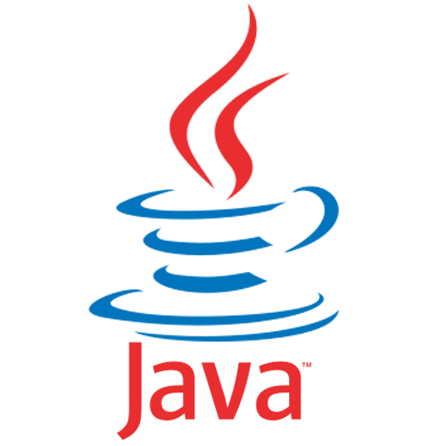
Introduction of Java
By Er. Suman Bhandari

Slide 2
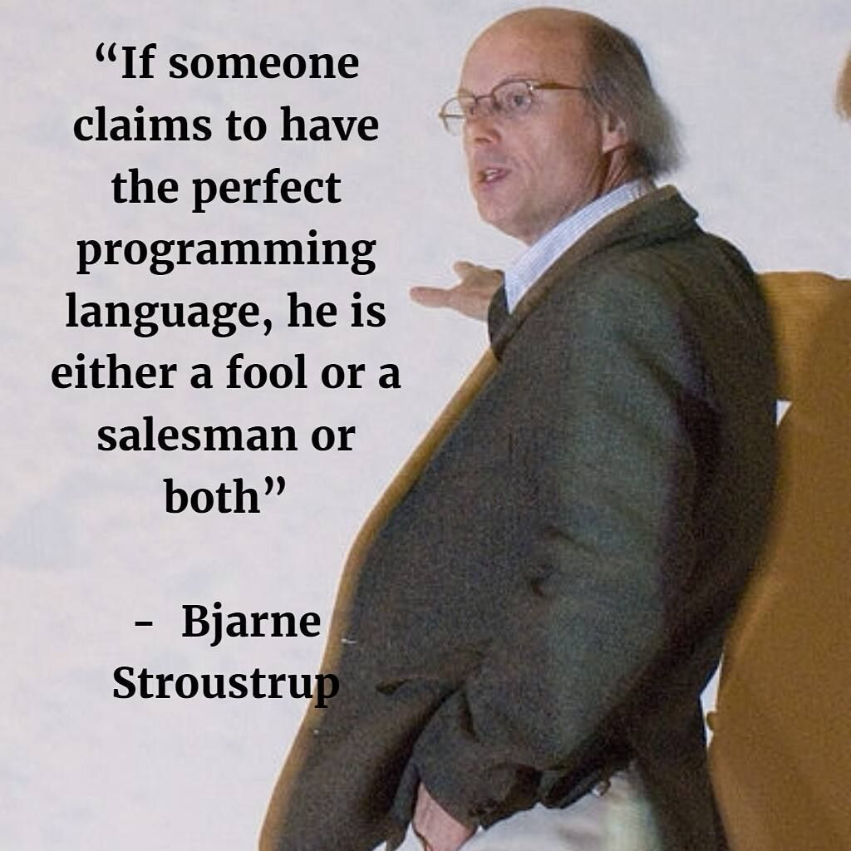
What is programming Language?
Stroustrup (Danish computer scientist) [1994] says that a programming languages is:
a tool for instructing machines
a means of communicating between programmers
a vehicle for expressing high-level designs
a notation for algorithms
a way of expressing relationships between concepts
a tool for experimentation
a means for controlling computerized devices
Programming languages are notations, used for specifying, organizing, and reasoning about computations.

Slide 3
Different Programming Paradigm
Imperative - C
Functional - LISP
Object Oriented - C++, smalltalk, Java, simula
Logic - Proglog

Slide 4
Content
What is Java ?
Where is Java used ?
History of Java
Features of Java
Disadvantage of Java
Java Development Kit (JDK)
Java Compiler
Java Virtual Machine (JVM)
Java Program-Development phase
Portability of Java
Simple Java Program
Java Development Tools
What is Object Oriented Programming

Slide 5
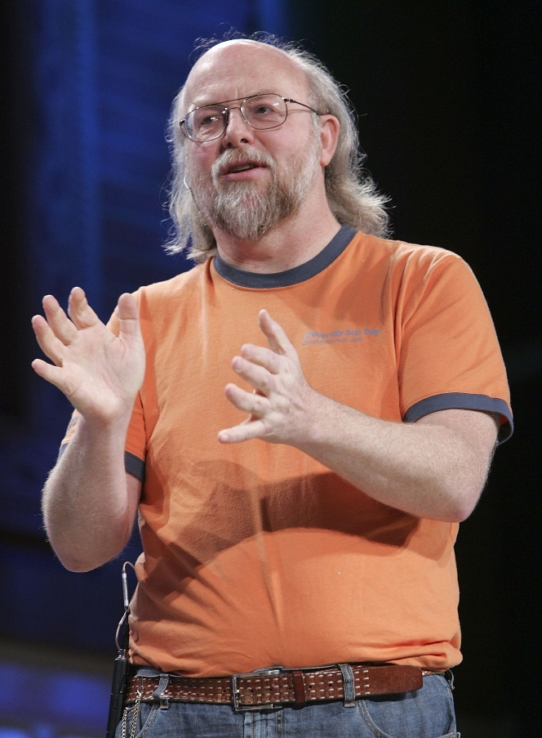
What is Java ?
Java is relatively high-level language, class-based and Object-oriented Programming Language.
Java was developed by James Gosling at Sun Microsystems.
Java is a first programming language which provide the concept of writing programs that can be executed using the web.
James Arthur Gosling, often referred to as "Dr. Java", OC is a Canadian computer scientist, best known as the founder and lead designer behind the Java programming language.

Slide 6
Where Is Java Used ?
3 Billion devices run java.
There are many devices where Java is currently used.
Java is full-featured and general-purpose programming language that is capable for developing a robust mission-critical application for:
Desktop Applications - Media player, Antiviruses etc.
Servers
Mobile Devices
Web Applications
Enterprise Application – Banking Application, Business Application
Embedded System
Games
Robotics
Java running on the desktop is called Application
Java running on the Internet is called Applets
Java running on the server-side is called Servlet

Slide 7

James Gosling
James Gosling is generally credited as the inventor of the Java programming language
He was the first designer of Java and implemented its original compiler and virtual machine
He is also known as the Father of Java.

Slide 8
Brief History of Java
In 1990, Sun Microsystems began an internal project known as the Green Project to work on a new technology.
In 1992, the Green Project was spun off and its interest directed toward building highly interactive devices for the cable TV industry.
In 1994, the focus of the original team was re-targeted, this time to the use of Internet technology. A small web browser called HotJava was written.
Oak was renamed to Java after learning that Oak had already been trademarked.

Slide 9
In 1995, Java was first publicly released.
In 1996, Java Development Kit (JDK) 1.0 was released.
In 2002, JDK 1.4 (codename Merlin) was released, the most widely used version.
In 2004, JDK 5.0 (codename Tiger) was released, the latest version.
There are the JDK version list and its release date.

Slide 10
Version Name | Code Name | Release Date
JDK 1.0 | Oak | January 1996
JDK 1.1 | (none) | February 1997
J2SE 1.2 | Playground | December 1998
J2SE 1.3 | Kestrel | May 2000
J2SE 1.4 | Merlin | February 2002
J2SE 5.0 | Tiger | September 2004
JDK 6 | Mustang | December 2006
JDK 7 | Dolphin | July 2011
JDK 8 |  | March 2014
JDK 9 |  | September, 21st 2017
JDK 10 |  | March, 20th 2018
JDK 11 |  | September, 25th 2018
JDK 12 |  | March, 19th 2019
JDK 13 |  | September, 10th 2019
JDK 14 |  | March, 17th 2020
JDK 15 |  | September, 15th 2020
JDK 16 |  | March, 16th 2021

Slide 11
Features of Java
Java is Simple.
Java is Object Oriented
Java is Distributed
Java is Architecture Neutral
Java is Robust
Java is Interpreted and Compiled
Java is Secure
Java is Portable
Java is Multi-Threaded
Java Is Dynamic

Slide 12
Features of Java
Java is Simple
Java is Object Oriented
Java is Distributed
Java is Architecture Neutral
Java is Robust
Java is Interpreted
Java is Secure
Java is Portable
Java is Multi-Threaded
Java Is Dynamic
Java is partially modeled on C++, but greatly simplified and improved. Some people refer to Java as "C++--" because it is like C++ but with more functionality and fewer negative aspects.

Slide 13
Features of Java
Java is Simple
Java is Object Oriented
Java is Distributed
Java is Architecture Neutral
Java is Robust
Java is Interpreted
Java is Secure
Java is Portable
Java is Multi-Threaded
Java Is Dynamic
Java was designed from the start to be object-oriented. Object- oriented programming (OOP) is a popular programming approach that is replacing traditional procedural programming techniques.
Object-oriented programming provides great flexibility, modularity, clarity, and reusability through encapsulation, inheritance, and polymorphism.

Slide 14
Features of Java
Java is Simple
Java is Object Oriented
Java is Distributed
Java is Architecture Neutral
Java is Robust
Java is Interpreted
Java is Secure
Java is Portable
Java is Multi-Threaded
Java Is Dynamic
Distributed computing involves several computers working together on a network.
Java is designed to make distributed computing easy. Since networking capability is inherently integrated into Java, writing network programs is like sending and receiving data to and from a file.

Slide 15
Features of Java
Java is Simple
Java is Object Oriented
Java is Distributed
Java is Architecture Neutral
Java is Robust
Java is Interpreted
Java is Secure
Java is Portable
Java is Multi-Threaded
Java Is Dynamic
Write once, run anywhere With a Java Virtual Machine (JVM), you can write one program that will run on any platform.

Slide 16
Features of Java
Java is Simple
Java is Object Oriented
Java is Distributed
Java is Architecture Neutral
Java is Robust
Java is Interpreted
Java is Secure
Java is Portable
Java is Multi-Threaded
Java Is Dynamic
Java compilers can detect many problems that would first show up at execution time in other languages.
Java has a runtime exception-handling feature to provide programming support for robustness.

Slide 17
Features of Java
Java is Simple
Java is Object Oriented
Java is Distributed
Java is Architecture Neutral
Java is Robust
Java is Interpreted
Java is Secure
Java is Portable
Java is Multi-Threaded
Java Is Dynamic
You need an interpreter to run Java programs. The programs are compiled into the Java Virtual Machine code called bytecode.
The bytecode is machine-independent and can run on any machine that has a Java interpreter, which is part of the Java Virtual Machine (JVM).

Slide 18
Features of Java
Java is Simple
Java is Object Oriented
Java is Distributed
Java is Architecture Neutral
Java is Robust
Java is Interpreted
Java is Secure
Java is Portable
Java is Multi-Threaded
Java Is Dynamic
Java implements several security mechanisms to protect your system against harm caused by stray programs.

Slide 19
Features of Java
Java is Simple
Java is Object Oriented
Java is Distributed
Java is Architecture Neutral
Java is Robust
Java is Interpreted
Java is Secure
Java is Portable
Java is Multi-Threaded
Java Is Dynamic
Because Java is architecture neutral, Java programs are portable.
They can be run on any platform without being recompiled.

Slide 20
Features of Java
Java is Simple
Java is Object Oriented
Java is Distributed
Java is Architecture Neutral
Java is Robust
Java is Interpreted
Java is Secure
Java is Portable
Java is Multi-Threaded
Java Is Dynamic
Multithread programming is smoothly integrated in Java, where as in other languages you have to call procedures specific to the operating system to enable multithreading.

Slide 21
Features of Java
Java is Simple
Java is Object Oriented
Java is Distributed
Java is Architecture Neutral
Java is Robust
Java is Interpreted
Java is Secure
Java is Portable
Java is Multi-Threaded
Java Is Dynamic
Java was designed to adapt to an evolving environment. New code can be loaded on the fly without recompilation.
There is no need for developers to create, and for users to install, major new software versions.
New features can be incorporated transparently as needed.

Slide 22
Disadvantages of Java
Slower than compiled language such as C
an experiment in 1999 showed that Java was 3 or 4 times slower than C or C++
Since Java Programs run on top of JVM, it consumes more memory.

Slide 23
Java Platform Edition
A Java Platform is the set of APIs, class libraries, and other programs used in developing Java programs for specific applications.
There are 3 Java Platform Editions
Java 2 Platform, Standard Edition (J2SE)
Core Java Platform targeting applications running on workstations
Java 2 Platform, Enterprise Edition (J2EE)
Component-based approach to developing distributed, multi-tier enterprise applications
Java 2 Platform, Micro Edition (J2ME)
Targeted at small, stand-alone or connectable consumer and embedded devices

Slide 24
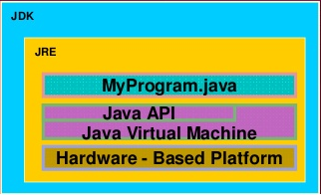
Java Development Kit (JDK)
Java Development Kit (JDK)
Is a set of Java tools for developing Java programs
Consists of Java API, Java Compiler, and JVM
Java Application Programming Interface (API)
Is prewritten code, organized into packages of similar topics
Java Virtual Machine (JVM) is an execution engine that runs compiled Java byte code.

Slide 25
Java Compiler (Byte Code)
The Java compiler translates Java programs into byte‐code.
Byte-code creates and store on disk as .class file
Byte-code verifier verify the validation and check whether it violate java’s security or not.
Once compiled to byte‐code, a Java program can be used on any computer, making it very portable machine.

Slide 26
Java Virtual Machine (JVM)
Java Virtual Machine is the like usual computer which translate high level language into machine language.
Just like that Java virtual machine also translate Bytecode into machine language.
JVM are available for many hardware and software Platform.

Slide 27
Java Program Development Phase
Java programs normally undergo four phases
Edit
Programmer writes program (and stores program on disk)
Compile
Compiler creates byte-codes from program (.class)
Load
Class loader stores byte-codes in memory
Execute
Interpreter: translates byte-codes into machine language

Slide 28
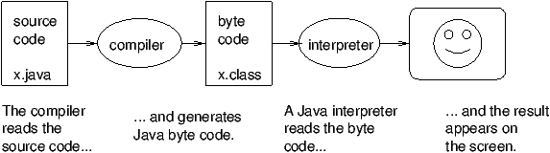
Cont…

Slide 29
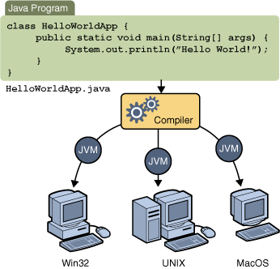
Portability of Java
Portable means that a program may be written on one type of computer and then run on a wide variety of computers, with little or no modification.
Java byte code runs on the JVM and not on any particular CPU; therefore, compiled programs are highly portable.
JVMs exist on many platforms:
Windows
Mac
Linux

Slide 30
A Simple Java Program
//This program prints Welcome to Java!
class Welcome {
public static void main(String[] args) {
System.out.println("Welcome to Java!");
}
}

Slide 31
Class definition: This line uses the keyword class to declare that a new class is being defined.
class Welcome
Main Method: In Java programming language, every application must contain a main method whose signature is:
public static void main(String[] args)
public: So that JVM can execute the method from anywhere.
static: Main method is to be called without object. The modifiers public and static can be written in either order.
void: The main method doesn't return anything.
main(): Name configured in the JVM.
String[]: The main method accepts a single argument: an array of elements of type String.
The next line of code is shown here. Notice that it occurs inside main( )
System.out.println("Hello, World");
Output is actually accomplished by the built-in println( ) method. System is a predefined class that provides access to the system, and out is the variable of type output stream that is connected to the console.
Comments: They can either be multi-line or single line comments.
/* This is multiline comment*/
// This single line comment

Slide 32
Java Development Tools
A software that provides an integrated development environment (IDE) for rapidly developing Java programs.
Java development tools on the market:
NetBeans by Sun (open source)
IntelliJ IDEA by Jetbrains
Eclipse by IBM (open source)
Other useful tools:
TextPad Editor
Visual Studio Code
Jedit

Slide 33
What is Object Oriented Programming?
A language in which everything represent in the form of Object is called Object Oriented Programming Language.
It not only makes the program less complex but also makes the software reuse feasible and possible.
All object-oriented programming languages provide mechanisms that help you implement the object- oriented model.
Principles of OOP:
Encapsulation
Inheritance
Polymorphism
Abstraction

Slide 34
Procedure Oriented Vs Object Oriented
S.N | Procedural Oriented Programming | Object Oriented Programming
1 | In procedural programming, program is divided into small parts called functions. | In object oriented programming, program is divided into small parts called objects.
2 | Procedural programming follows top down approach. | Object oriented programming follows bottom up approach.
3 | There is no access specifier in procedural programming. | Object oriented programming have access specifiers like private, public, protected etc.
4 | Adding new data and function is not easy. | Adding new data and function is easy.
5 | Procedural programming does not have any proper way for hiding data so it is less secure. | Object oriented programming provides data hiding so it is more secure.
6 | In procedural programming, overloading is not possible. | Overloading is possible in object oriented programming.
7 | In procedural programming, function is more important than data. | In object oriented programming, data is more important than function.
8 | Procedural programming is based on unreal world. | Object oriented programming is based on real world.
9 | Examples: C, FORTRAN, Pascal, Basic etc. | Examples: C++, Java, Python, C# etc.

Slide 35
Handling Common Errors:
When executing Java code, different errors can occur: coding errors made by the programmer, errors due to wrong input, or other unforeseeable things.
When an error occurs, Java will normally stop and generate an error message. The technical term for this is: Java will throw an exception (throw an error).

Slide 36
Java try and catch
The try statement allows you to define a block of code to be tested for errors while it is being executed.
The catch Statement allows you to define a block of code to be executed, if an error occurs in the try block.
The try and catch keywords come in pairs.

Slide 37
Syntax

Slide 38
Example of Simple error Handling:

Slide 39
Assignment
What is object oriented programming? Differentiate between procedural vs object oriented programming. What is error handling?
Next Class
What are the Data Types in Java?

