Slide 1
Chapter-10
Holding Collection Of Data

Slide 2
Collections in Java
Arrays
Has special language support
Iterators
Iterator
Collections (also called containers)
Collection
Set
HashSet
TreeSet
List
ArrayList
LinkedList
Map
HashMap
TreeMap

Slide 3
Array
Arrays are fixed in size that is once we create an array we can not increased or decreased based on our requirement.
With respect to memory Arrays are not recommended to use.
With respect to performance Arrays are recommended to use.
Arrays can hold only homogeneous data types elements.
There is no underlying data structure for arrays and hence radiate method support is not available.
Arrays can hold both object and primitive.

Slide 4
Array
Most efficient way to hold references to objects.
data index
Car | Car |  | Car |  |  | Car
0 1 2 3 4 5 6 7
Advantages
An array know the type it holds, i.e., compile-time type checking. An array know its size, i.e., ask for the length.
An array can hold primitive types directly.
■
■
Disadvantages
An array can only hold one type of objects (including primitives).
Arrays are fixed size.

Slide 5
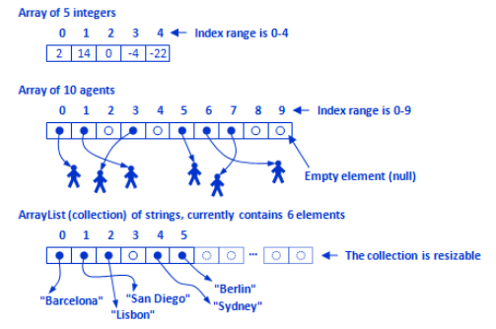
Array Example
Helper class java.util.Arrays
Search and sort: binarySearch(), sort()
Comparison: Instantiation: Conversion:
equals() fill() asList()
(many overloaded) (many overloaded)
■
■

Slide 6
Overview of Collection
Collection are growable in nature that is based on our requirement. We can increase or decrease of size.
With respect to memory collection are recommended to use.
With respect to performance collection are not recommended to use.
Collection can hold both homogeneous and and heterogeneous elements.
Every collection class is implemented based on some std data structure and hence for every requirement readymade method support is available being a performance. we can use these method directly and We are not responsible to implement these methods.
Collection can hold only object types but primitive.

Slide 7
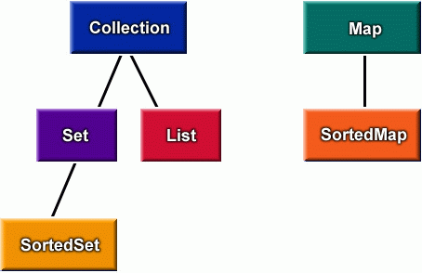
Collection Interfaces
Collections are primarily defined through a set of interfaces.
Supported by a set of classes that implement the interfaces
Interfaces are used of flexibility reasons
Programs that uses an interface is not tightened to a specific implementation of a collection.
It is easy to change or replace the underlying collection class with another (more efficient) class that implements the same interface.
■

Slide 8
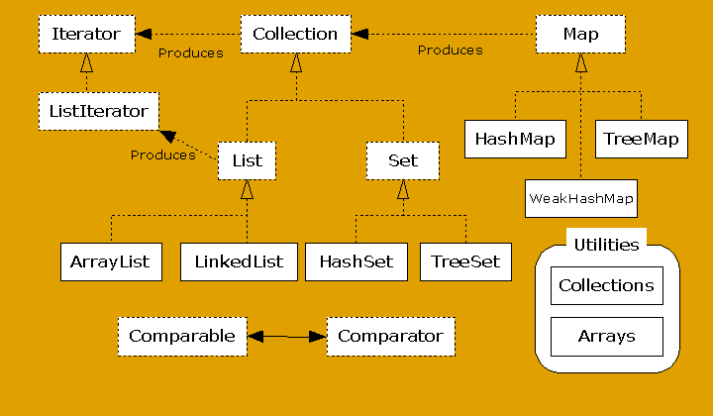
Collection Interfaces and Classes

Slide 9
The Iterator Interface
It allows us to traverse the collection, access the data element and remove the data elements of the collection.
java.util package has public interface Iterator and contains three methods:
boolean hasNext(): It returns true if Iterator has more element to iterate.
Object next(): It returns the next element in the collection until the hasNext()method return true. This method throws ‘NoSuchElementException’ if there is no next element.
void remove(): It removes the current element in the collection. This method throws ‘IllegalStateException’ if this function is called before next( ) is invoked.

Slide 10
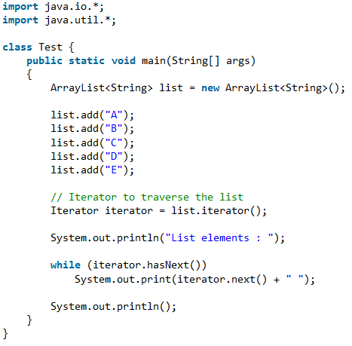
Iterator Interface Example
Output
List elements :
A B C D E

Slide 11
Set Interface
A Set is a Collection that cannot contain duplicate elements. It models the mathematical set abstraction.
The Set interface contains only methods inherited from Collection and adds the restriction that duplicate elements are prohibited.
Set also adds a stronger contract on the behavior of the equals and hashCode operations, allowing Set instances to be compared meaningfully even if their implementation types differ.
The methods declared by Set are summarized in the following table −

Slide 12
Sr.No. | Method & Description
1 | add( ) Adds an object to the collection.
2 | clear( ) Removes all objects from the collection.
3 | contains( ) Returns true if a specified object is an element within the collection.
4 | isEmpty( ) Returns true if the collection has no elements.
5 | iterator( ) Returns an Iterator object for the collection, which may be used to retrieve an object.
6 | remove( ) Removes a specified object from the collection.
7 | size( ) Returns the number of elements in the collection.

Slide 13
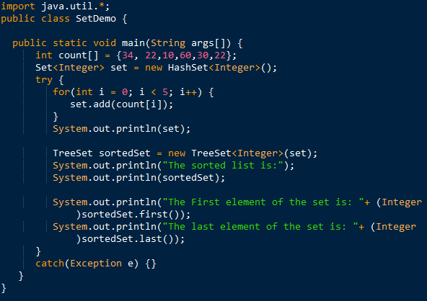
Example

Slide 14

Output

Slide 15
Set Idioms
set1 ∪ set2
set1.addAll(set2)
set1 ∩ set2
set1.retainAll(set2)
set1 − set2
set1.removeAll(set2)

Slide 16
Hash Set and Tree Set Classes
HashSet and TreeSet implement the interface Set.
HashSet
Implemented using a hash table.
No ordering of elements.
add, remove, and contains methods constant time complexity
O(c).
■
■
TreeSet
Implemented using a tree structure. Guarantees ordering of elements.
add, remove, and contains methods logarithmic time complexity
O(log (n)), where n is the number of elements in the set.
■
■

Slide 17
HashSet, Example
// [Source: java.sun.com] import java.util.*; public class FindDups {
public static void main(String args[]){ Set s = new HashSet();
for (int i = 0; i < args.length; i++){
if (!s.add(args[i])) System.out.println("Duplicate detected: " +
args[i]);
}
System.out.println(s.size() +
" distinct words detected: " + s);
}
}

Slide 18
The List Interface
The List interface corresponds to an order group of elements. Duplicates are allowed.
Extensions compared to the Collection interface
Access to elements via indexes, like arrays
add (int, Object), get(int), remove(int), set(int, Object) (note set = replace bad name for the method)
Search for elements
◆
■
indexOf(Object), lastIndexOf(Object)
Specialized Iterator, call ListIterator
Extraction of sublist
■
■
subList(int fromIndex, int toIndex)

Slide 19
The List Interface, cont.
Further requirements compared to the Collection Interface
add(Object)adds at the end of the list.
remove(Object)removes at the start of the list.
list1.equals(list2)the ordering of the elements is taken into consideration.
Extra requirements to the method hashCode.
list1.equals(list2) implies that
list1.hashCode()==list2.hashCode()

Slide 20
The List Interface, cont.
public interface List extends Collection {
// Positional Access Object get(int index);
Object set(int index, Object element); // Optional
void add(int index, Object element); Object remove(int index);
// Optional
// Optional
abstract boolean addAll(int index, Collection c);
// Optional
// Search
int indexOf(Object o); int lastIndexOf(Object o);
// Iteration
ListIterator listIterator(); ListIterator listIterator(int index);
// Range-view
List subList(int from, int to);
}

Slide 21
ArrayList and LinkedList Classes
The classes ArrayList and LinkedList implement the
List interface.
ArrayList is an array based implementation where elements can be accessed directly via the get and set methods.
Default choice for simple sequence.
LinkedList is based on a double linked list
Gives better performance on add and remove compared to
ArrayList.
Gives poorer performance on get and set methods compared to
ArrayList.
■

Slide 22
ArrayList, Example
// [Source: java.sun.com]
import java.util.*;
public class Shuffle {
public static void main(String args[]) {
List l = new ArrayList();
for (int i = 0; i < args.length; i++) l.add(args[i]);
Collections.shuffle(l, new Random()); System.out.println(l);
}
}

Slide 23
LinkedList, Example
import java.util.*;
public class MyStack {
private LinkedList list = new LinkedList();
public void push(Object o){
list.addFirst(o);
}
public Object top(){
return list.getFirst();
}
public Object pop(){
return list.removeFirst();
}
public static void main(String args[]) {
Car myCar;
MyStack s = new MyStack();
s.push (new Car());
myCar = (Car)s.pop();
}
}

Slide 24
Map Interface in Java
The java.util.Map interface represents a mapping between a key and a value. The Map interface is not a subtype of the Collection interface. Therefore it behaves a bit different from the rest of the collection types.
Characteristics of the Map Interface are:
A Map cannot contain duplicate keys and each key can map to at most one value. Some implementations allow null key and null value like the HashMap and LinkedHashMap, but some do not like the TreeMap.
The order of a map depends on specific implementations, e.g TreeMap and LinkedHashMap have predictable order, while HashMap does not.
There are two interfaces for implementing Map in java: Map and SortedMap, and three classes: HashMap, TreeMap and LinkedHashMap.

Slide 25
Why and When to use Maps?
Maps are perfect to use for key-value association mapping such as dictionaries. The maps are used to perform lookups by keys or when someone wants to retrieve and update elements by keys.
Some examples are:
A map of error codes and their descriptions.
A map of zip codes and cities.
A map of managers and employees. Each manager (key) is associated with a list of employees (value) he manages.
A map of classes and students. Each class (key) is associated with a list of students (value).

Slide 26
Methods in Map Interface:
public Object put(Object key, Object value): This method is used to insert an entry in this map.
public void putAll(Map map): This method is used to insert the specified map in this map.
public Object remove(Object key): This method is used to delete an entry for the specified key.
public Object get(Object key): This method is used to return the value for the specified key.
public boolean containsKey(Object key): This method is used to search the specified key from this map.
public Set keySet(): This method is used to return the Set view containing all the keys.
public Set entrySet(): This method is used to return the Set view containing all the keys and values.

Slide 27
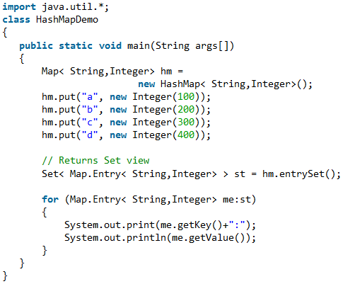
Example:
Output
a:100
b:200
c:300
d:400

Slide 28
HashMap and TreeMap Classes
The HashMap and HashTree classes implement the Map
interface.
HashMap
The implementation is based on a hash table.
No ordering on (key, value) pairs.
TreeMap
The implementation is based on red-black tree structure.
(key, value) pairs are ordered on the key.

Slide 29
HashMap, Example
import java.util.*;
public class Freq {
private static final Integer ONE = new Integer(1); public static void main(String args[]) {
Map m = new HashMap();
// Initialize frequency table from command line for (int i=0; i < args.length; i++) {
Integer freq = (Integer) m.get(args[i]); m.put(args[i], (freq==null ? ONE :
new Integer(freq.intValue() + 1)));
}
System.out.println(m.size()+
" distinct words detected:"); System.out.println(m);
}
}

Slide 30
Static Methods on Collections
Search and sort: binarySearch(), sort()
Reorganization: reverse(), shuffle()
Wrappings: unModifiableCollection, synchonizedCollection

Slide 31
Collection Advantages and Disadvantages
Advantages
Can hold different types of objects.
Resizable
Disadvantages
Must cast to correct type
Cannot do compile-time type checking.

Slide 32
The End

